Slide 1
TI II: Computer Architecture
Introduction
Single Processor Systems
Historical Background
Classification / Taxonomy
Architectural Overview
Examples
The Layered Computer Model
Notes:
In diesem Kapitel werden die folgenden Themen behandelt:
Von Neumann-Architektur
History of Computers
History of Microprocessors
What is Computer Architecture
Classification of Computers
Performance assessment of computer systems
A six-level computer

Slide 2
Contents
Organizational
  Organizational Information
  Course overview
Introduction
  Single Processor Systems
  Historical overview
  Six-level computer architecture
Data representation and Computer arithmetic
  Data and number representation
  Basic arithmetic
Microarchitecture
  Microprocessor architecture
  Microprogramming
  Pipelining
  Very Long Instruction Word
Instruction Set Architecture
  CISC vs. RISC
  Data types, Addressing, Instructions
  Assembler
Memories
  Hierarchy, Types
  Physical & Virtual Memory
  Segmentation & Paging
  Caches
Computer Systems
  Interconnects
  Components, Peripherals
  Classical PCs
  Parallel Systems, Clusters, Multiprocessors

Slide 3
Single Processor Systems

Slide 4
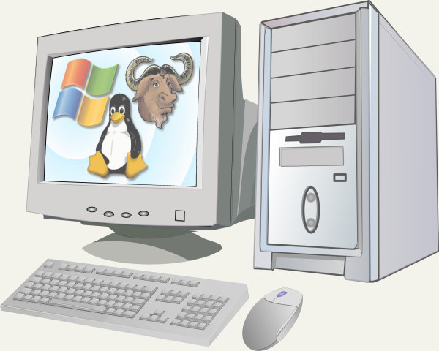
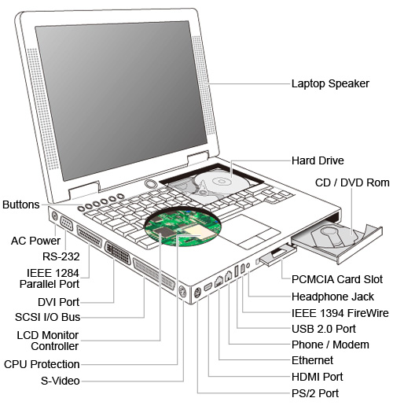
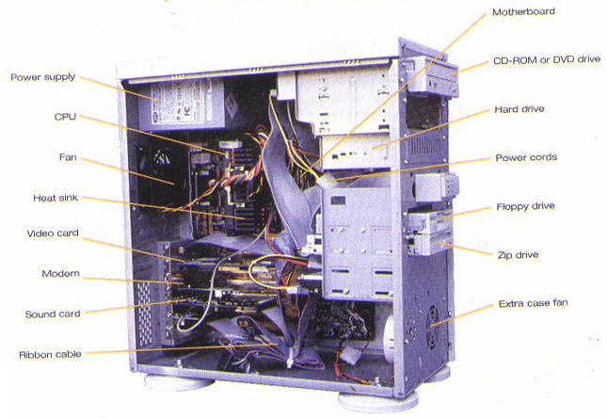
Computer System – the old days …

Slide 5
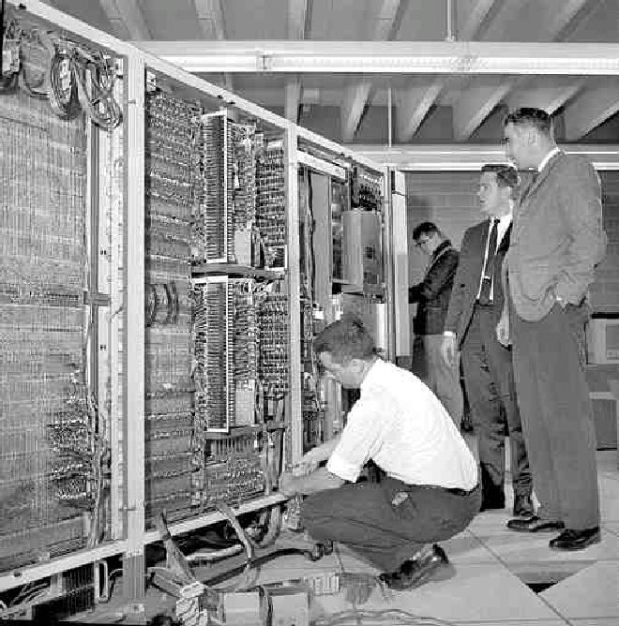
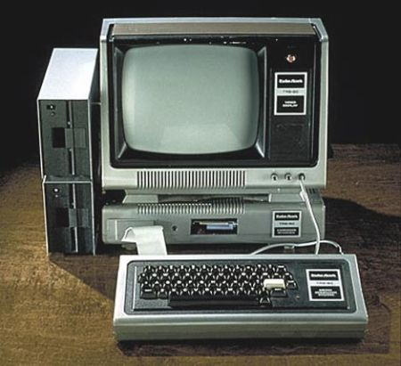
Computer System – very old days

Slide 6
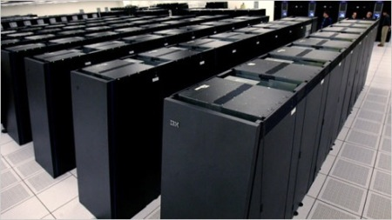
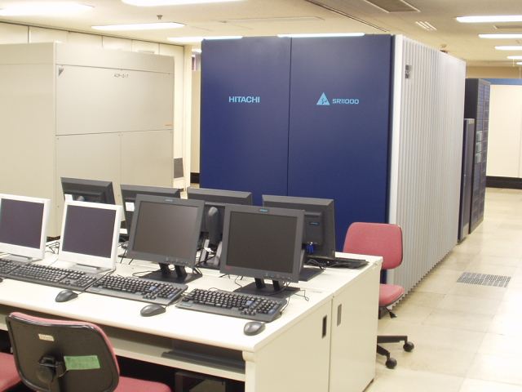
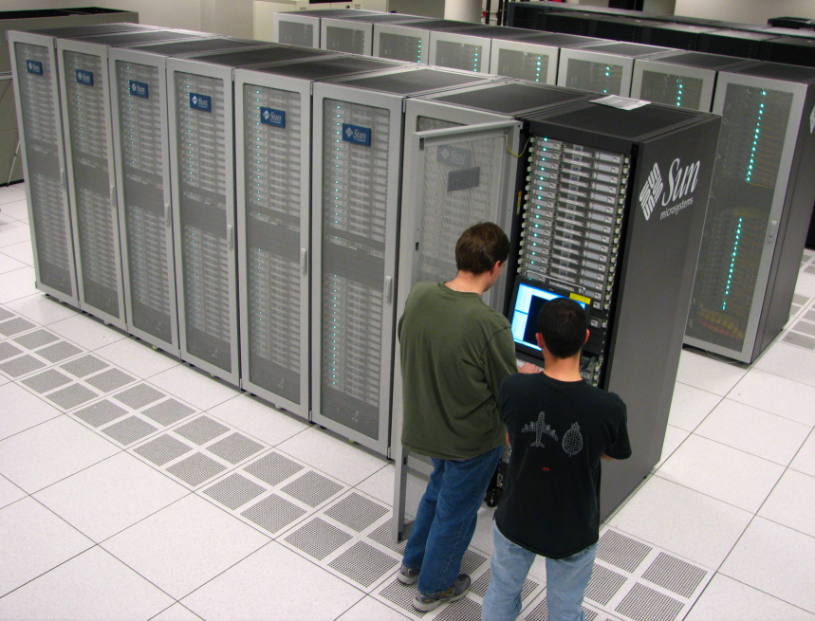
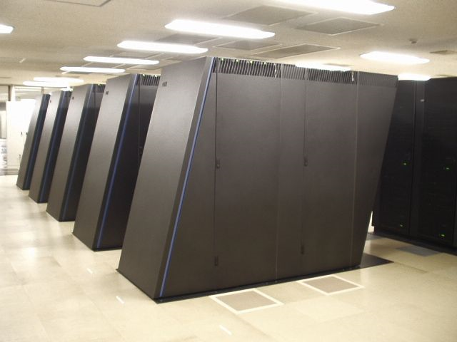
Computer System – not much to see

Slide 7
Classical architecture of microcomputers
Monitor
Bus

Slide 8
Classical idea of a modular computer system

Slide 9
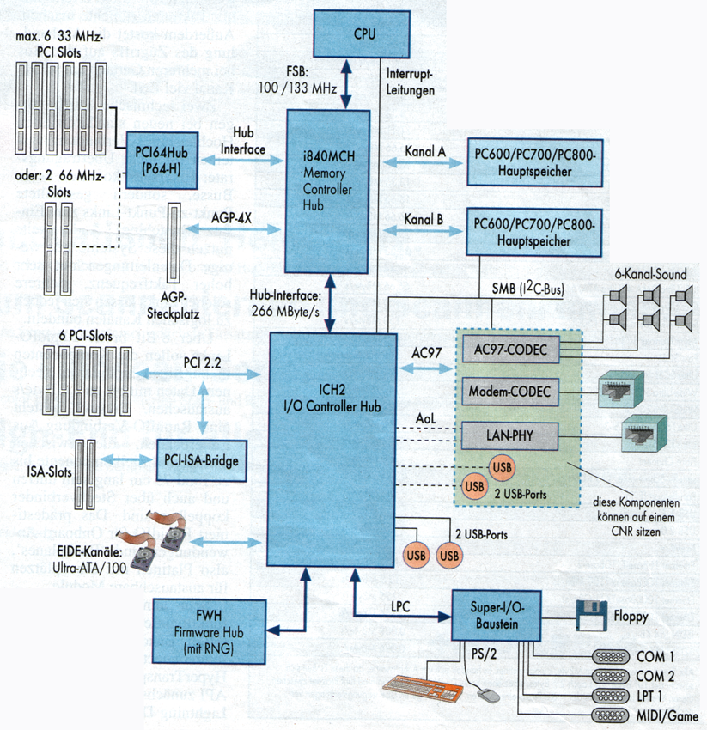
A complete classical single processor system
Notes:
Der übliche Chipsatz teilt sich in die North- und die South-Bridge auf. Eine physikalische Trennung in zwei Bausteine ist jedoch nicht unbedingt notwenig.
Die North-Bridge(Host) werden die Datenströme zwischen Prozessor, Cache und Arbeitsspeicher geregelt. In modernen Systemen ist dort auch der AGP angeschlossen. An die Host-Bridge ist die PCI-to-ISA-Bridge angeschlossen. Dazwischen liegt der PCI-Bus mit 3 bis 5 Steckplätzen. Die South-Bridge kümmert sich um die Schnittstellen, die an den Chipsatz angeschlossen sind, und im Computersystem zu Verfügung stehen. Dazu gehört EIDE und USB, sowie die Serielle und die Parallele Schnittstelle. Je nach Ausführung sind der Keyboard-Controller und die Echtzeituhr integriert.

Slide 10
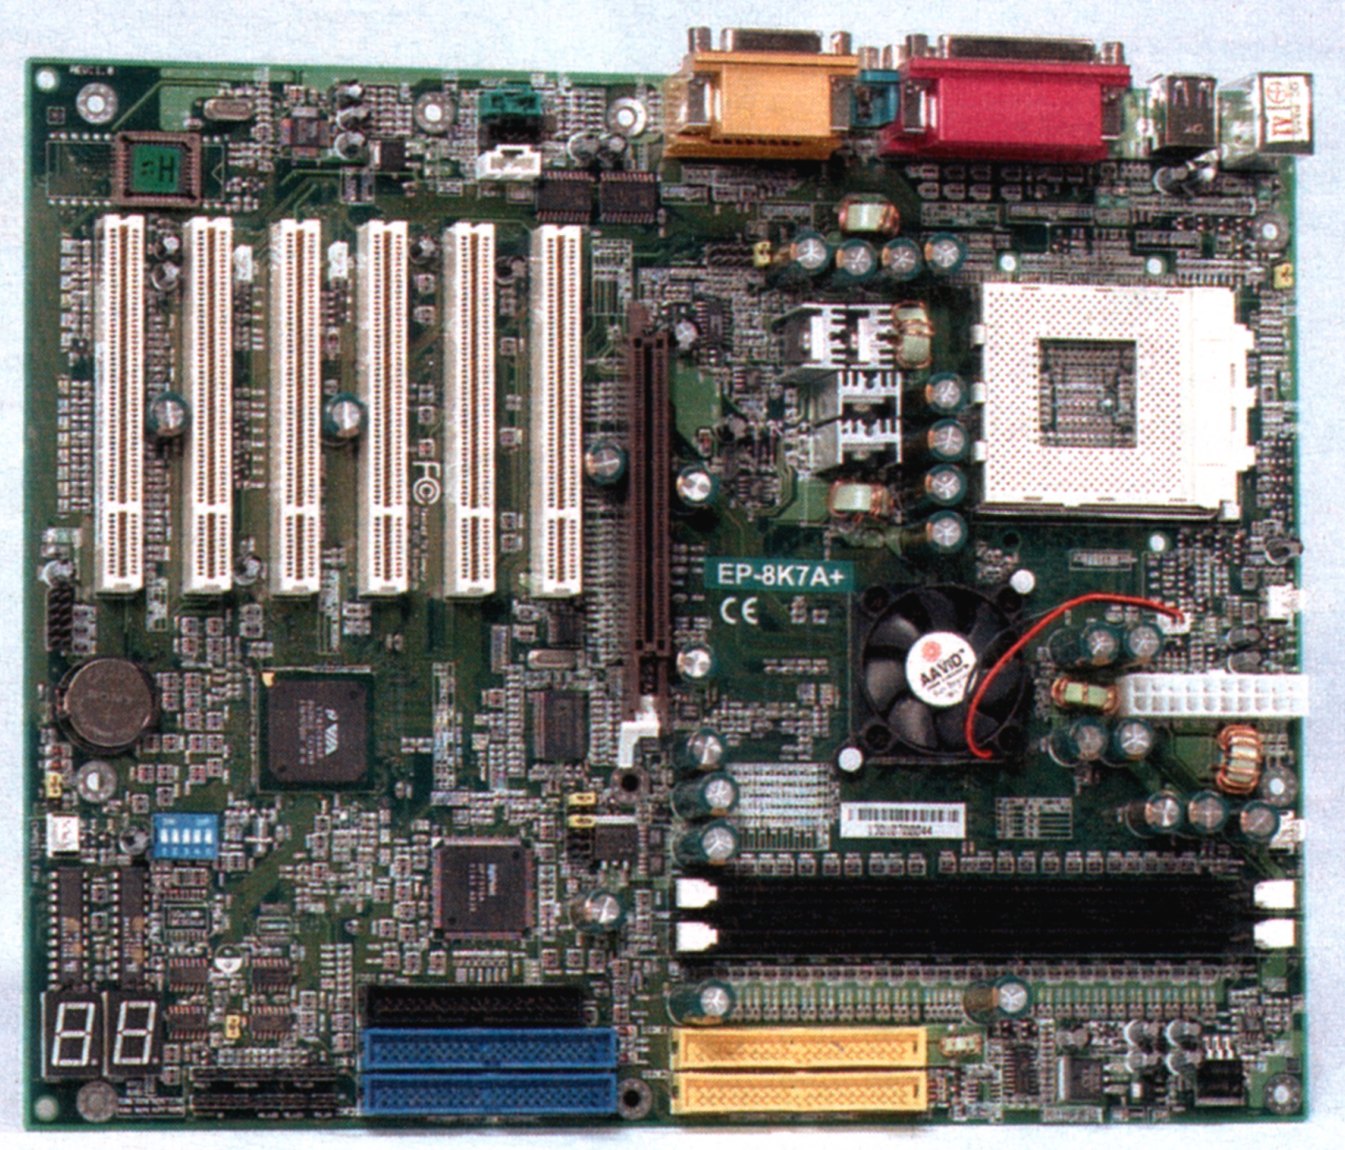
A complete classical single processor system
I/O connectors (USB, serial, parallel)
PCI slots
CPU socket
AGP slot
Power supply
Memory sockets
EIDE connector (disk, CD, DVD)
Notes:
Das Motherboard ist sozusagen der Grundbaustein, der zu einem Computer gehört. Es sorgt dafür, daß alle anderen Komponenten zusammenarbeiten können. Die entscheidenden Bauteile eines Computers befinden sich auf dieser Platine. Diese Schaltzentrale im Computer bestimmt über System-Leistung, Erweiterbarkeit und Zukunftsicherheit. Die meisten Motherboards sind auf eine Prozessor-Klasse zugeschnitten. Die Verwendbarkeit eines Prozessors hängt deshalb vom Motherboard bzw. vom Prozessorsockel/-steckplatz auf dem Motherboard ab.
Auf dem Motherboard sind folgende Systemkomponenten zu finden:
Steckplatz für den Prozessor
Bus-System
Steckplätze für Speichermodule
Steckplätze für die Bussysteme(z.B. ISA, PCI, AGP)
Cache
Bios-Rom
Echtzeituhr
Eingabe-/Ausgabe-Schnittstellen(seriell, parallel, USB, Firewire)
EIDE- oder SCSI-Controller
DMA-Controller
Interrupt-Controller
Floppy-Controller
Tastatur-Prozessor
Stromversorgung für den Prozessor
Aufgrund der immer höher werdenden Integrationsdichte, kann die eine oder andere Komponente noch onboard dazu kommen.
In Zukunft werden vor allem viele Schnittstellen-Bausteine und Multimedia-Erweiterungen ihren Platz auf dem Motherboard finden.

Slide 11
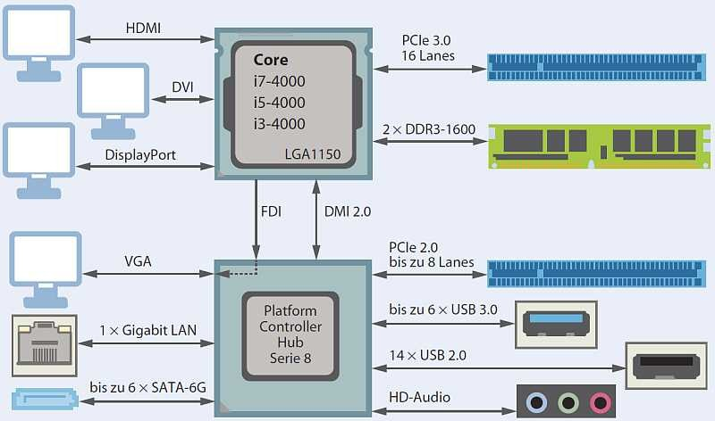
PC Architecture 2014
www.heise.de

Slide 12
Simple single processor system
Central
processing unit (CPU)
Control
unit
Ar
ithmetic
logical unit
(ALU)
I/O de
vices
Registers
Main
Disk
Printer
…
…
memory
Bus
Do we still have this today? Think of, e.g., mobile phone with main CPU, radio modem, graphics accelerator, GPS, WLAN, … later more about this!

Slide 13
The von Neumann Architecture

Slide 14
The von Neumann architecture
Processor
The von Neumann architecture forms the basis of many hardware architectures presented in this course.
The architecture comprises the following main components
  Central processing unit
    Control unit
    ALU / Operating unit
  Memory
  Input/Output units
  Interconnection
Control unit
Operating unit
Connection
I/O system
Main memory

Slide 15
The von Neumann architecture
Central control of the computer
A computer consists of several functional units (central processing unit, memory, input/output unit, connection)
The computer is not tailored to a single problem but a general purpose machine. In order to solve a problem a program is stored in the memory (“program controlled universal computer”) – yes, today this sounds so simple…
IMPORTANT
  Instructions (the program) and data (input and output values) are stored in the same memory.
  The memory consists of memory cells with a fixed length, each cell can be addressed individually.
Memory
Address | 0 | 1 | 2 |  |  |  |  |  |  | 2^{n}-1

Slide 16
The von Neumann architecture
Processor, central unit (CPU: "central processing unit")
  Controls the flow and execution of all instructions
Control unit
  Interprets the CPU instructions
  Generates all control commands for other components
Arithmetic Logical Unit (ALU)
  Executes all instructions (I/O and memory instructions with the help of these units)
Input/Output system
  Interface to the outside world
  Input and output of program and data
Memory
  Storage of data and program as sequence of bits
Interconnection

Slide 17
Principle of Operation of a Computer
The von Neumann Architecture

Slide 18
Principle of Operation of a Computer
At any time the CPU executes only a single instruction. This instruction can only manipulate a single operand.
  Traditionally, this is called SISD (Single Instruction Single Data).
Code and data are stored in the same memory without any distinction. There are no memory protection mechanisms – programs can destroy each other, programs can access arbitrary data.
Memory is unstructured and is addressed linearly. Interpretation of memory content depends on the context of the current program only.
Two phase principle of instruction processing:
  During the interpretation phase the content of a memory cell is fetched based on a program counter. This content is then interpreted as an instruction (note: this is a pure interpretation!).
  During the execution phase the content of a memory cell is fetched based on the address contained in the instruction. This content is then interpreted as data.
The instruction flow follows a strict sequential order.

Slide 19
Principle of Operation of a Computer Instruction Execution
public class Interpreter
{
static int PC; // Program counter holds the address of the next instruction
static int AC; // Register for doing arithmetic, accumulator
static int instruction; // Current instruction
static int instructionType; // Type of the current instruction, i.e. what to do
static int dataLocation; // Address of the data for the instruction
static int data; // Holds the operand
static boolean runBit = true; // Bit used to halt the computer
public static void interpreter(int memory[], int startingAddress)
{
PC = startingAddress; // Initialize the program
while( runBit ) {
instruction = memory[PC]; // Fetch next instruction
PC = PC + 1; // Increment PC
instructionType = getInstructionType(instruction); // Determine instruction
dataLocation = findData(instruction, instructionType); // Locate data
if( dataLocation >= 0 ) // No operand if -1
data = memory[dataLocation]; // Fetch data
execute(instructionType, data); // Execute instruction
}
}
}

Slide 20
Principle of Operation of a Computer Instruction Execution
Example: interpreter(memory, 256);
Byte sequence: 80 0 5 80 1 7 20 2 0 1
Bit sequence: 01010000 00000000 00000101
01010000 00000001 00000111
00010100 00000010 00000000 00000001
Assembler representation (MMIX Style)
LDB $0,5
LDB $1,7
ADD $2,$0,$1
High-level programming language representation
Z = X + Y
memory[256] = 80 memory[257] = 0 memory[258] = 5 memory[259] = 80 memory[260] = 1 | memory[261] = 7 memory[262] = 20 memory[263] = 2 memory[264] = 0 memory[265] = 1

Slide 21
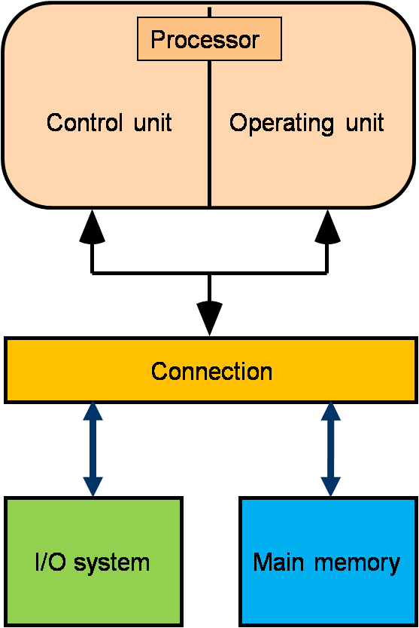
Pros and Cons of the von Neumann architecture
Advantages
  Principle of minimal hardware requirements
  Principle of minimal memory requirements
Disadvantages
  The main interconnection (memory ↔ CPU)
  is the central bottleneck: the “von Neumann bottleneck”
  Programs have to take into account the sequential data flow across the von Neumann bottleneck
  → Influences on higher programming languages (“intellectual bottleneck”)
  Low structuring of data (a long sequence of bits…)
  The instruction determines the operand type
  No memory protection

Slide 22
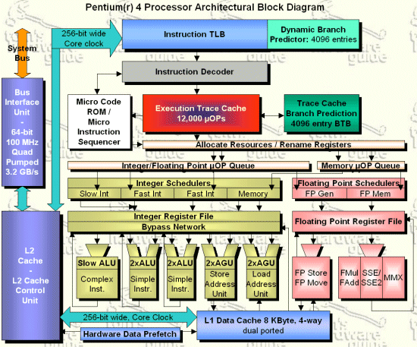
Look around:
Not everything is von Neumann!
Basic “von Neumann-architecture”: data and program are stored in the same memory
Typical for the PC architecture…
  well, depends on your viewpoint…

Slide 23
Harvard Architecture
Classical definition of the Harvard architecture
  Separation of data and program memory
Most processors with microarchitecture
  von Neumann from the outside
  Harvard from the inside
  Reason
    Different time scales and locality when caching data and instructions

Slide 24
High-level comparison
general purpose
memory
CPU
von Neumann
program
memory
CPU
data
memory
Harvard

Slide 25
Micro Computers

Slide 26
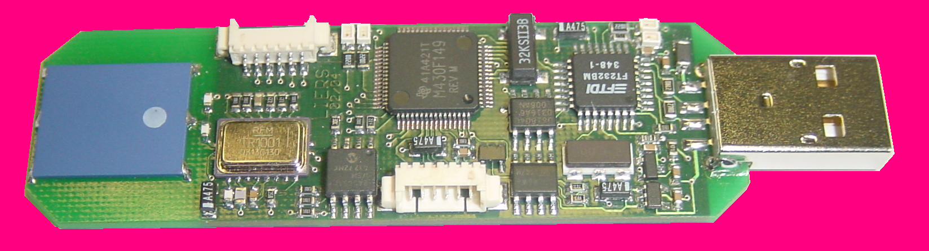
Special purpose micro processors
micro processors for special applications exist next to universal microprocessors (standard-micro-processs):
  Micro controller
  Signal processors
  Coprocessors
Quartz (Clock) for
Processor, 32kHz
FTDI
SerialUSB
Processor
MSP 430
FTDI
JTAG
To program another scatter node
CPU
MSP 430
Antenna
Transceiver
Quartz for FTDI
EEPROM for FTDI
Transceiver
TR1001 868MHz
19200 bit/s
64 kByte
Flash memory
JTAG Programming Interface

Slide 27
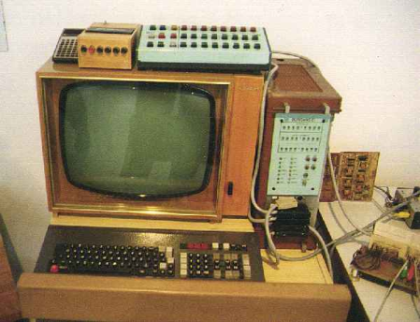
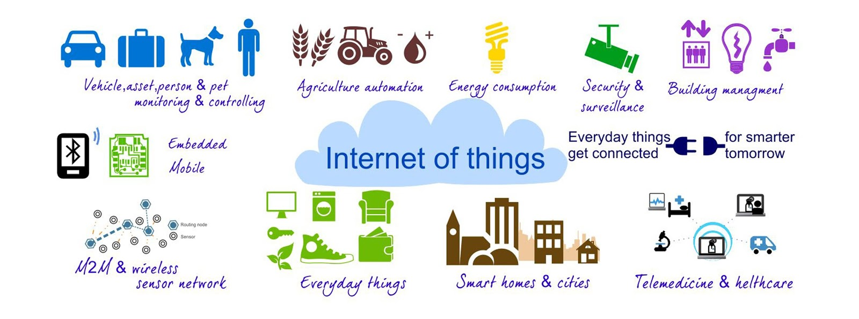
Definition of a Micro computer system
Micro processor system:
  Digital system, using a micro processor as central control and/or arithmetic unit
Micro computer:
  includes a micro processor that communicates with memory, controllers
  and interfaces for external devices using the system bus.
Special cases of microcomputers:
  Single-chip microcomputer
    All components of the microcomputer are located on one chip.
  Single-circuit microcomputer (dt. Ein-Platinen-Mikrocomputer)
    All components of the microcomputer are on one circuit board.
Microcomputer system:
  Microcomputer with connected external devices
  Can be small – think of the Internet of Things!
Notes:
Circuit board = Platine
Chip = Schaltkreis
External devices = Peripheriegeraete

Slide 28
Basic concept of a micro computer
The IBM PC is a modified von Neumann architecture and was introduced by IBM fall 1981.
The interconnection structure was realized by a bus.
  The bus connects the CPU with the main memory, several controllers and the input/output system.
Address bus
Data bus
CPU
Main
Controllers
Input/
memory
output
Control bus

Slide 29
Interconnection
The bus comprises the
  data bus
  address bus
  control bus
The bus is controlled by a bus controller and uses a buffer for data and addresses to communicate with the CPU.
The CPU fetches each instruction sequentially from the main memory.
The controllers are accessed with an I/O mapped model
  The internal registers of a controller are accessed with special I/O instructions using port addresses.

Slide 30
Components of a Computer
Hardware: all mechanical and electronic components
Software: all programms running on the computer
Firmware: micro-programs stored in ROM, somewhere in-between SW and HW
Research: Where to place a function – software or hardware?
Hardware and Software are logically equivalent!
Software
input
output
Firmware
Hardware

Slide 31
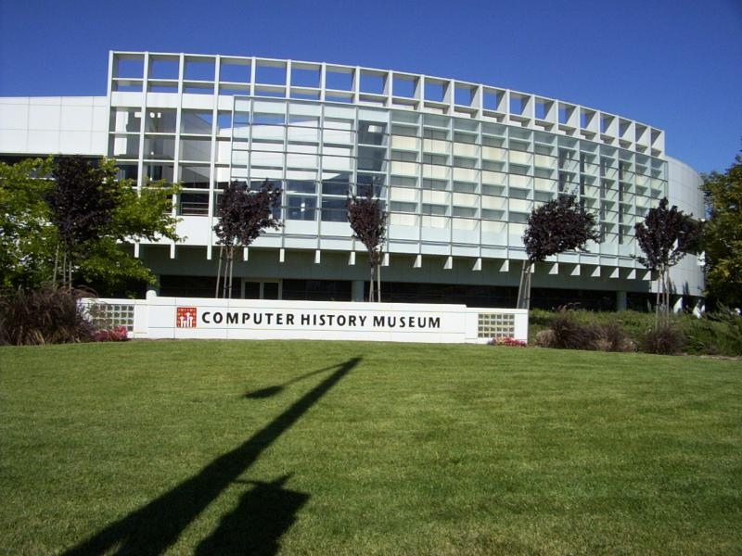
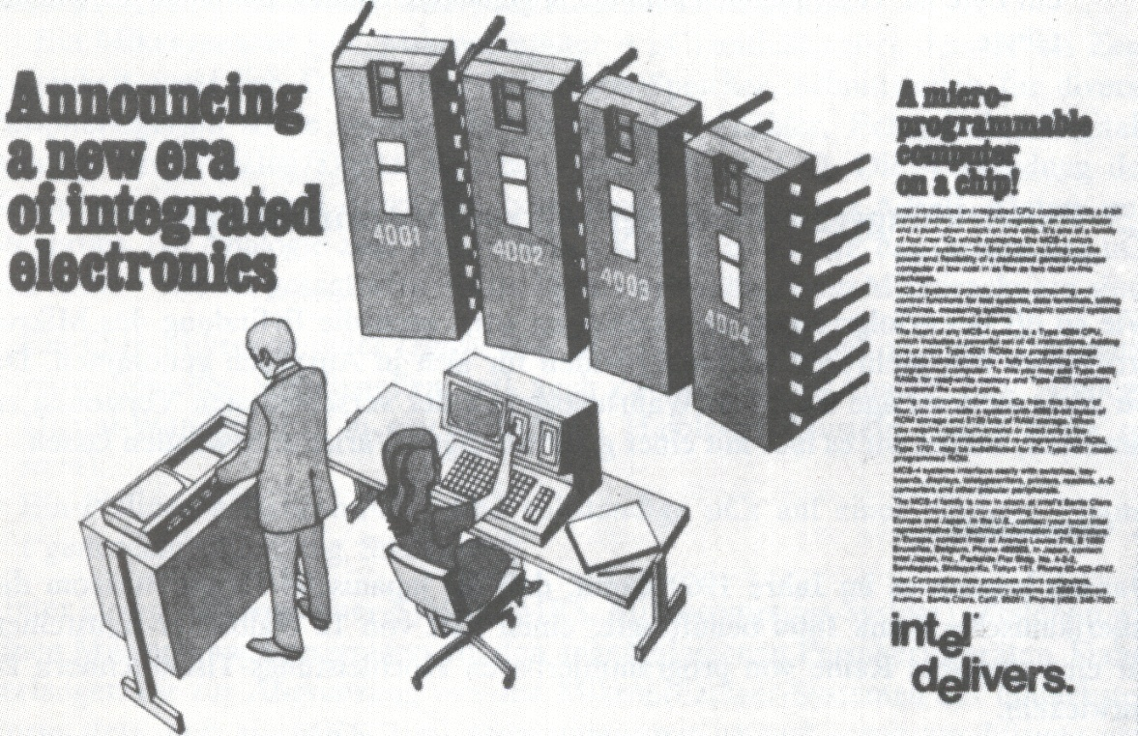
History of Computers
See for example:
http://www.computerhistory.org/
http://en.wikipedia.org/wiki/History_of_computing_hardware
„Computer history museum“ by Dzou - en.wikipedia / CC BY-SA 3.0

Slide 32
Performance of Processors

Slide 33
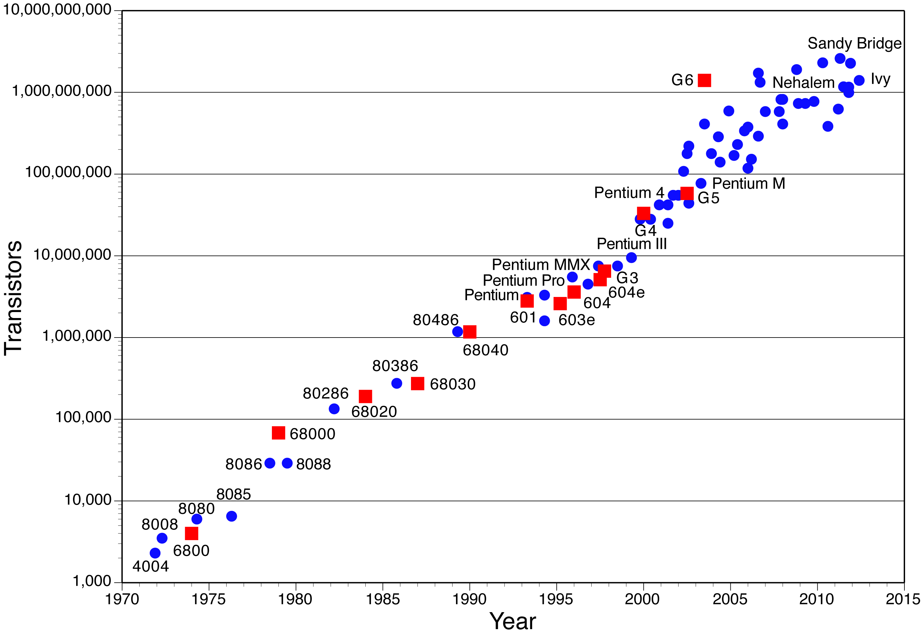
Anwendung vom Mooreschen Gesetz auf CPU-Chips
www.overclock.net
„Alle 18 Monate verdoppelt sich die verfügbare Rechenleistung“

Slide 34
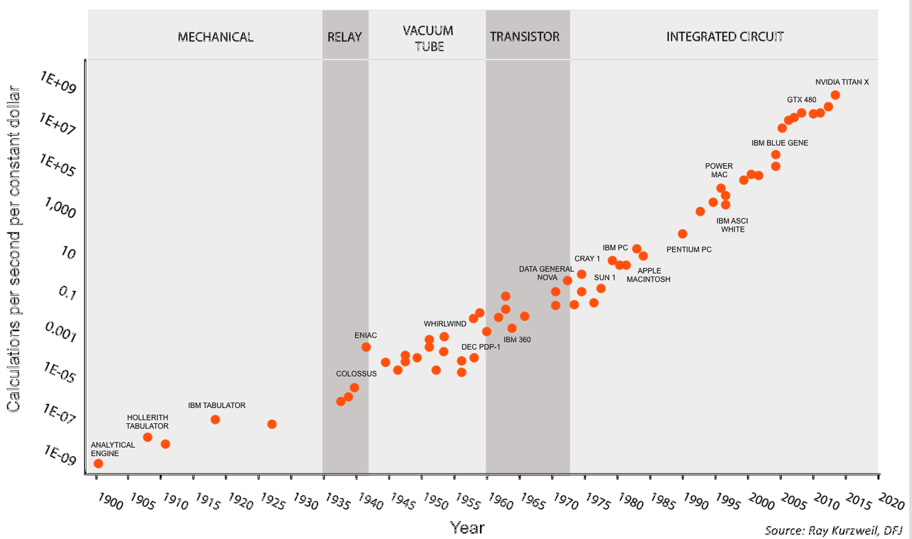
120 Years of Moore‘s Law

Slide 35
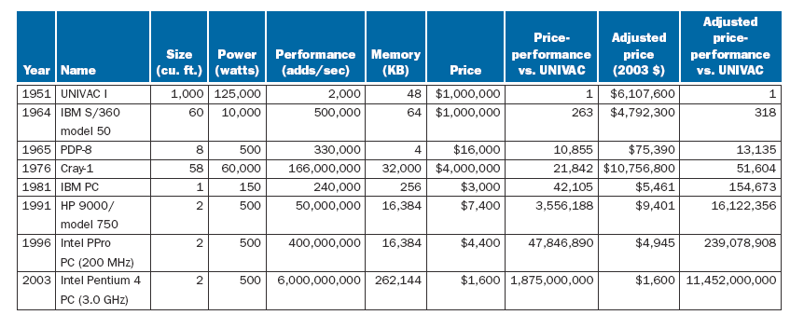
Performance increase, price decrease
Source: Patterson, Hennessy,
Computer Organization and Design

Slide 36
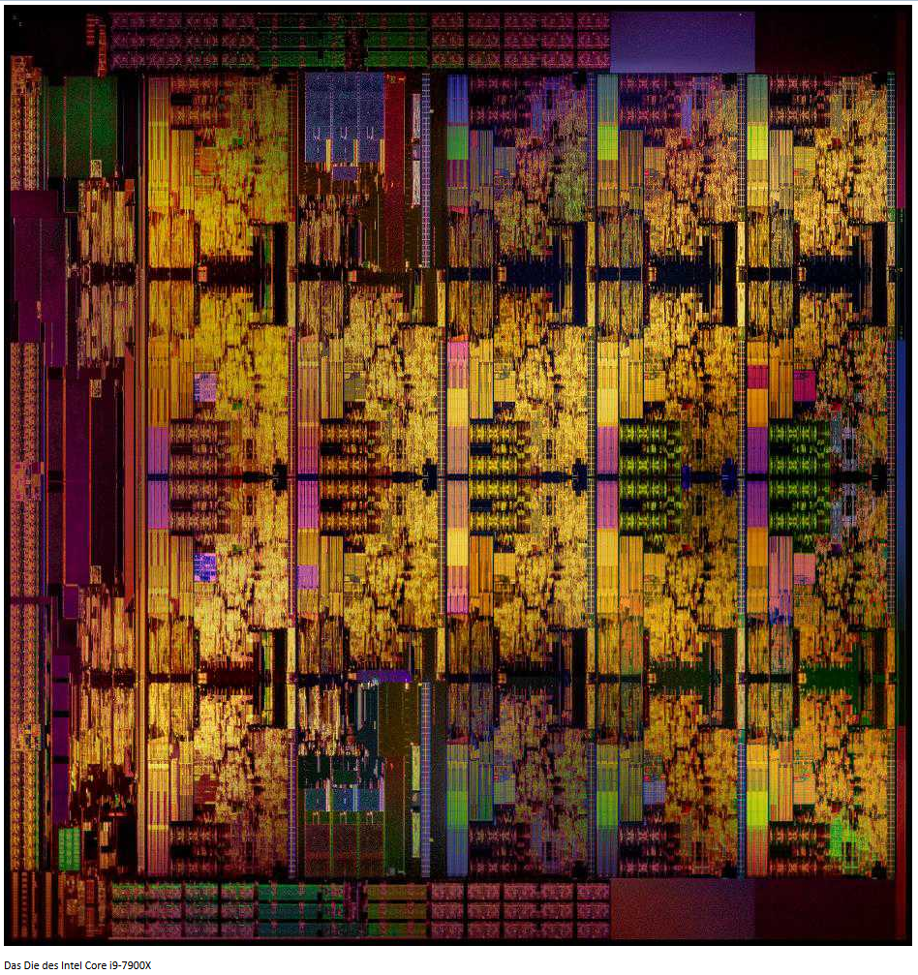
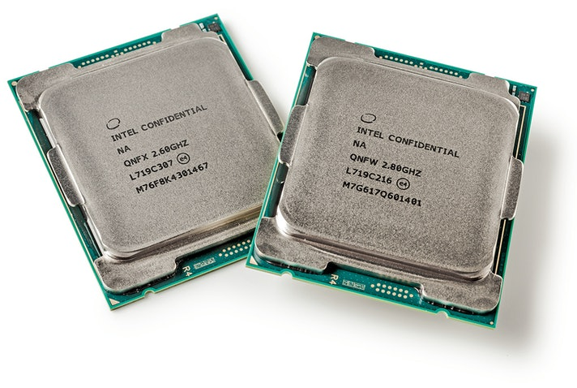
Example Processor: Intel Core i9
Up to 18 cores
Up to $2000
Up to 1.3 Tflop/s dual precision
Up to 165 W TDP

Slide 37
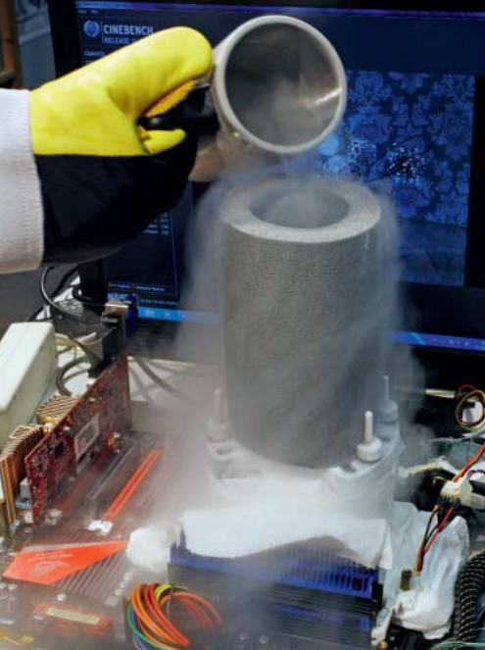
Overclocking of i9-7980XE
→ 1000 W!
Limits?
Useful?
How to go even faster?

Slide 38
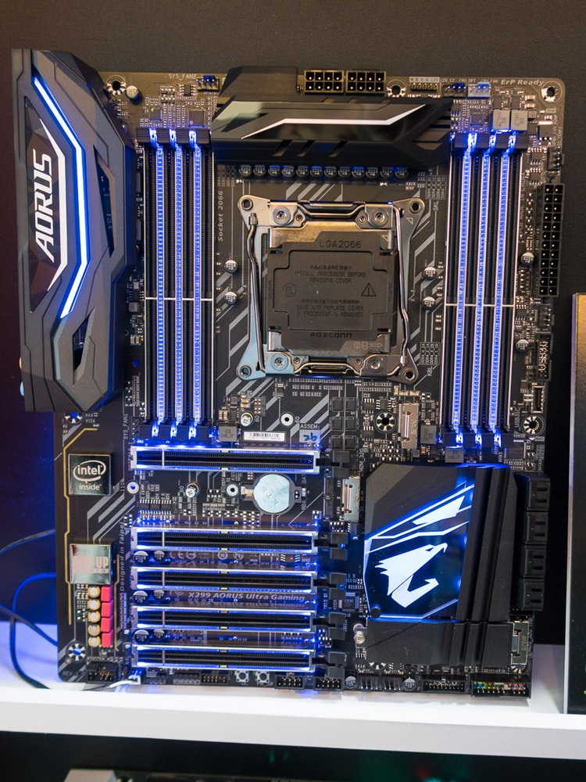
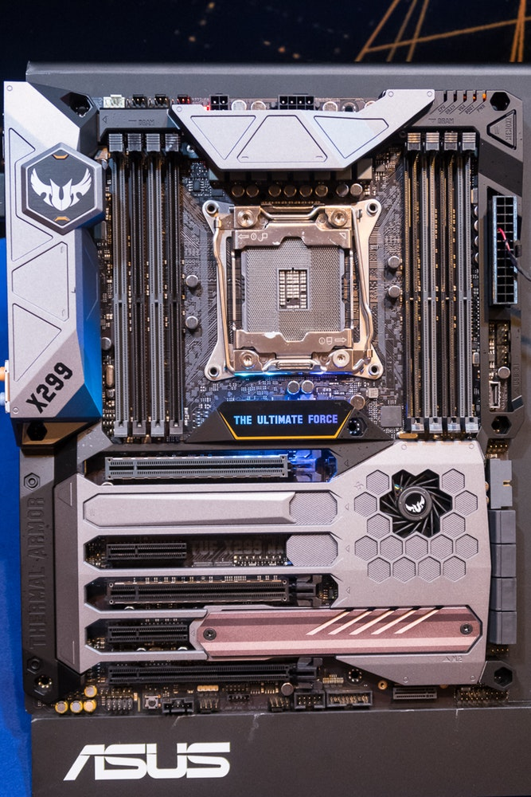
Current Mainboards

Slide 39
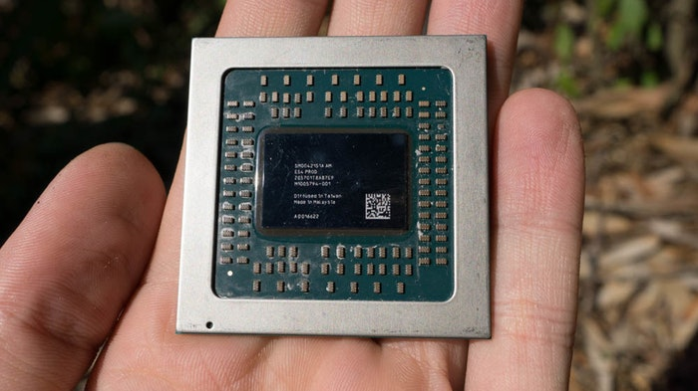
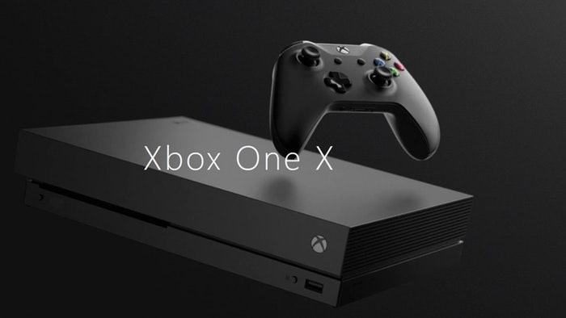
Yet another Example: High Performance for 500€

Slide 40
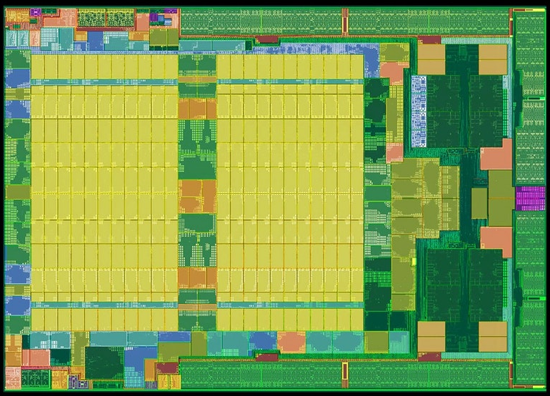
Physical Layout

Slide 41
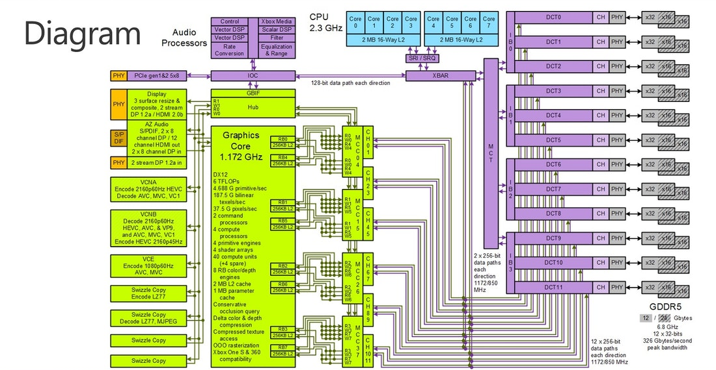
Internal Structure

Slide 42
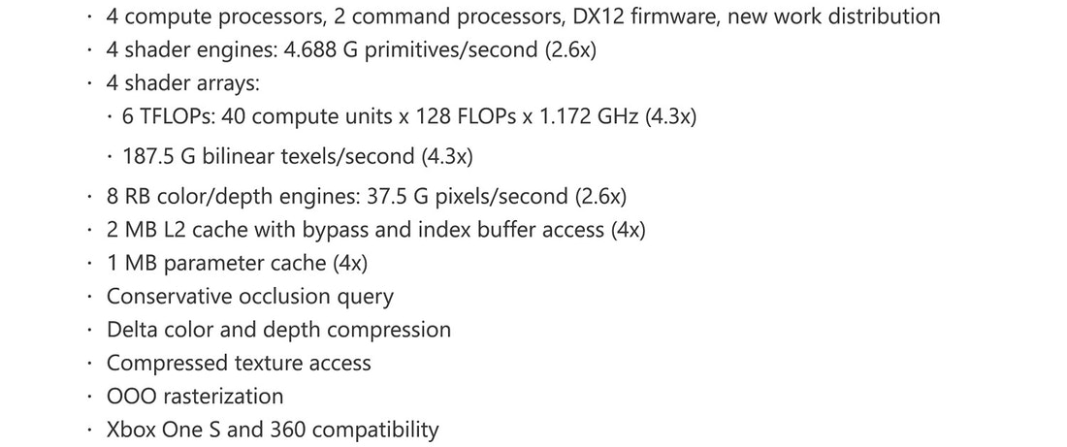
High Graphics Performance

Slide 43
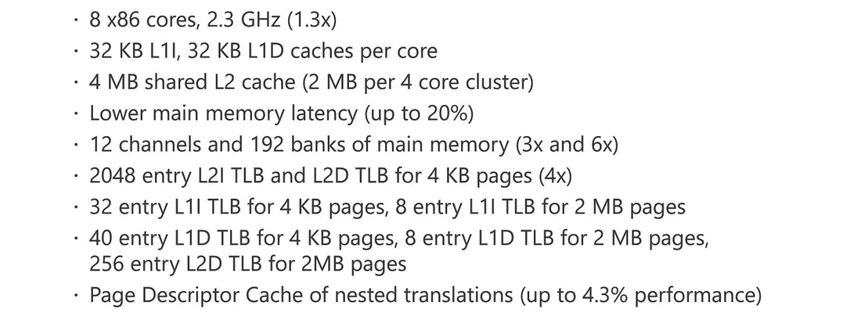
Many Cores, a lot of Caching

Slide 44
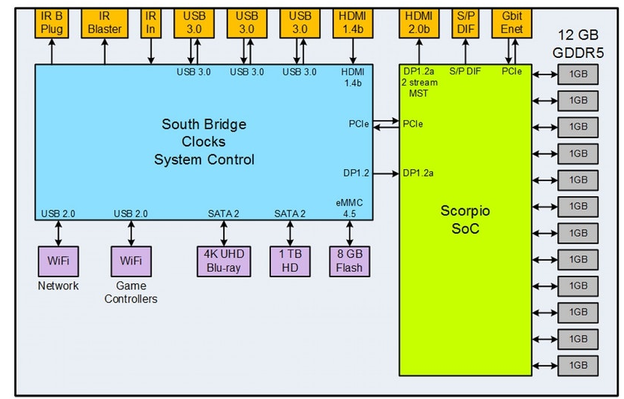
Many Interfaces
Totally confused? At the end of the course you will understand the basic principles even
behind these state-of-the art systems!

Slide 45
What is Computer Architecture?

Slide 46
What is Computer Architecture?
Different opinions exist
  Hardware structure, components, interfaces
  Basic operation principle, applications
  Only external view
  Internal and external view
  …
Computer architecture is NOT (only) standard PC architecture!
  The vast majority of computers are embedded systems, specialized solutions
  One size does NOT fit it all
    Should be: Computer Architectures

Slide 47
Amdahl, Blaauw and Brooks 1967
“Computer architecture is defined as the attributes and behavior of a computer as seen by a machine-language programmer. This definition includes the instruction set, instruction formats, operation codes, addressing modes, and all registers and memory locations that may be directly manipulated by a machine language programmer.
Implementation is defined as the actual hardware structure, logic design, and data path organization of a particular embodiment of the architecture.“

Slide 48
Another view: processor architecture
The processor architecture (Instruction Set Architecture) comprises the description of attributes and functions of a system as seen from a machine language programmer’s point of view.
The specification of the processor architecture comprises:
  instruction set
  instruction formats
  addressing modes
  interrupt handling
  logical address space
  Register/memory model (as far as a programmer can access it)
The processor architecture does not describe details of the implementation or hardware – all internal operations and components are explicitly excluded.

Slide 49
From the architects of the DEC Alpha microprocessor 1992
„Thus, the architecture is a document that describes the behavior of all possible implementations; an implementation is typically a single computer chip.
The architecture and software written to the architecture are intended to last several decades, while individual implementations will have much shorter lifetimes.
The architecture must therefore carefully describe the behavior that a machine-language programmer sees, but must not describe the means by which a particular implementation achieves that behavior.“

Slide 50
Processor micro architecture
An implementation (micro architecture) describes the hardware structure, all data paths, the internal logic etc. of a certain realization of the processor architecture, thus a real microprocessor.
The micro architecture defines:
  Number and stages of pipelines
  Usage of super scalar technology
  Number of internal functional units (ALUs)
  Organization of cache memory
The definition of a processor architecture (ISA, instruction set architecture) enables the use of programs independent of a certain internal implementation of a microprocessor.
All microprocessors following the same processor architecture specification are called “binary compatible” (i.e., the same binaries run on them).

Slide 51
Classification of Computers

Slide 52
Classification of Computers: Levels of and techniques for parallelism
How to classify those many different systems, different architectures?
  By hardware? Changes too fast…
  By software? Can run on many systems…
  By size? Price? ???
  Here: by parallelism supported
A parallel program can be seen as a partially ordered set of instructions. The order is given by the dependencies among the instructions. Independent instructions can be executed in parallel.
Levels of parallelism: within a program/a set of programs
Techniques for parallelism: implemented in hardware

Slide 53
Classification of Computers: 5 levels of parallelism
Program level
Process level (or task level)
  Tasks (heavy weighted processes, coarse-grained tasks)
Block level
  Threads, Light-Weighted Processes
Instruction level
  Basic instructions (of the chosen language, of the instruction set)
Sub-operation level
  Basic instructions of a language/an instruction set can be divided into sub-operations/micro operations by a compiler/the processor (e.g., Pentium 4 uses micro instructions internally)

Slide 54
Level of parallelism and granularity
The granularity depends on the relation of computation effort over communication or synchronization effort
Typically, program, process, and thread level are considered as large grained parallelism
Thus, instruction and sub-operation level may support
fine grained parallelism
Sometimes, the block or thread level is considered as medium grained

Slide 55
Techniques of parallelism vs. levels of parallelism
Sub-operation level
Techniques
Program level
Instruction level
Process level
Block level
Loosely coupled computers
Hyper- and Meta-computer
X
X
Workstation-Cluster
X
X
Coupled multi processor systems
Message coupled
X
X
Memory coupled (SMP)
X
X
X
Memory coupled (DSM)
X
X
X
Large grained data flow principle
X
X
Processor internal structures
Instruction pipelining
X
Super scalar
X
VLIW
X
Overlapping I/O and CPU
X
Fine grained data flow principle
X
SIMD and microarchitectures
Vector and field computers
X
Micro architectures
X

Slide 56
Performance assessment of computer systems

Slide 57
Performance assessment of computer systems
Needed for:
  Selection of a new computer system
  Tuning of an existing system
  Design of new computer systems
Methods for performance assessment
  Evaluation of hardware parameters
  Run-time measurements of existing programs
  Monitoring during operation of real computer systems
  Model theoretic approaches

Slide 58
Methods for performance assessment
Performance parameters
  Hypothetical maximum performance
  MIPS or MOPS (Millions of Instructions/Operations per Second)
  MFLOPS (Millions of Floating Point Operations per Second, today Tera FLOPS, TFLOPS ~10¹²)
  MLIPS (Millions of Logical Inferences per Second)
Mixes
  Theoretical mix of operations
Benchmark programs
  Number crunching, office applications, …
Monitors / measurement during operation
  Hardware monitor
  Software monitor
Model theoretic approaches
  Analytical methods
  Software simulation

Slide 59
Mixes
Calculation of an assumed average run-time based on the durations of n operations according to the formula:
T average duration
n number of distinct operations
t_{i} duration of operation i
p_{i} relative weight of operation i (i.e., relative number of appearances)
The following must hold:

Slide 60
Benchmark programs
Sieve of Erathostenes, Ackermann function
Whetstone (1970, typ. Fortran, lots of floating point arithmetic)
Dhrystone (begin of 80s, 53% assignments, 32% control statements, 15% function/procedure calls)
Savage-Benchmark (mathematical standard functions)
Basic Linear Algebra Subprograms (BLAS), core of the LINPACK/LAPACK (Linear Algebra Package) software package
Lawrence Livermore Loops (for vectorizing compilers)
SPEC-Benchmark Suite

Slide 61
SPEC benchmarks
SPEC Standard Performance Evaluation Corporation
  since 1989, many vendors, general purpose applications, focuses on calculation speed and throughput (www.spec.org)
Many benchmark suites exist:
  SPEC CPU2006, CPU2017 (Integer, Floating point)
  SPEC MPI2007, OMP2012, ACCEL (High Performance Computing)
  SPEC jvm2008, jms2007, jEnterprise2010, jbb2015 (Java Client/Server)
  SPEC VIRT_SC 2013 (virtualized servers)
  SPEC Cloud_IaaS 2016
  …
“[…] SPEC is once again seeking to encourage those outside of SPEC to assist us in locating applications that could be used in the next CPU-intensive benchmark suite, currently planned to be SPEC CPU2004.” (http://www.spec.org/cpu2004/ , March 2004)

Slide 62
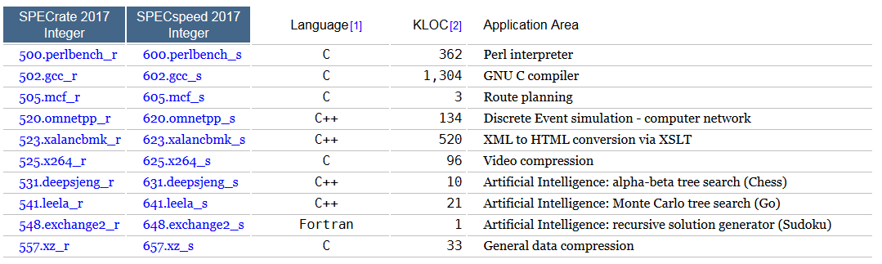
Integer Component of SPEC CPU2017

Slide 63
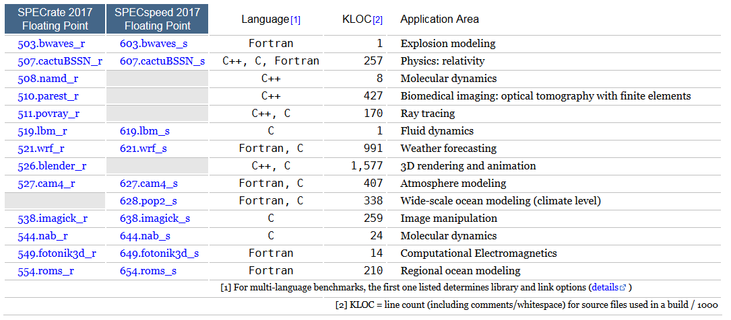
Floating Point Component of SPEC CPU2017
See https://www.spec.org/cpu2017/results/cpu2017.html for results

Slide 64
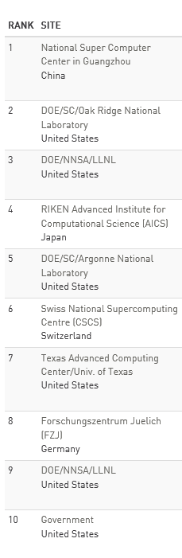
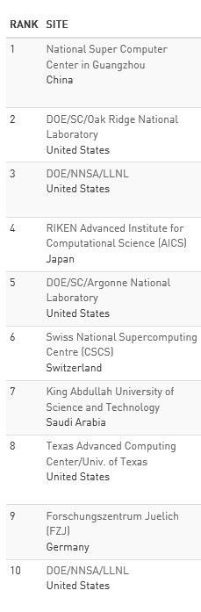
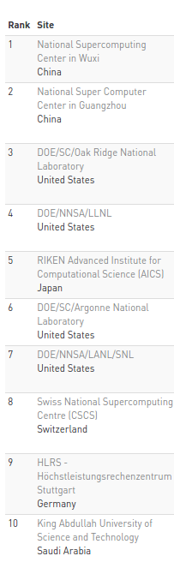
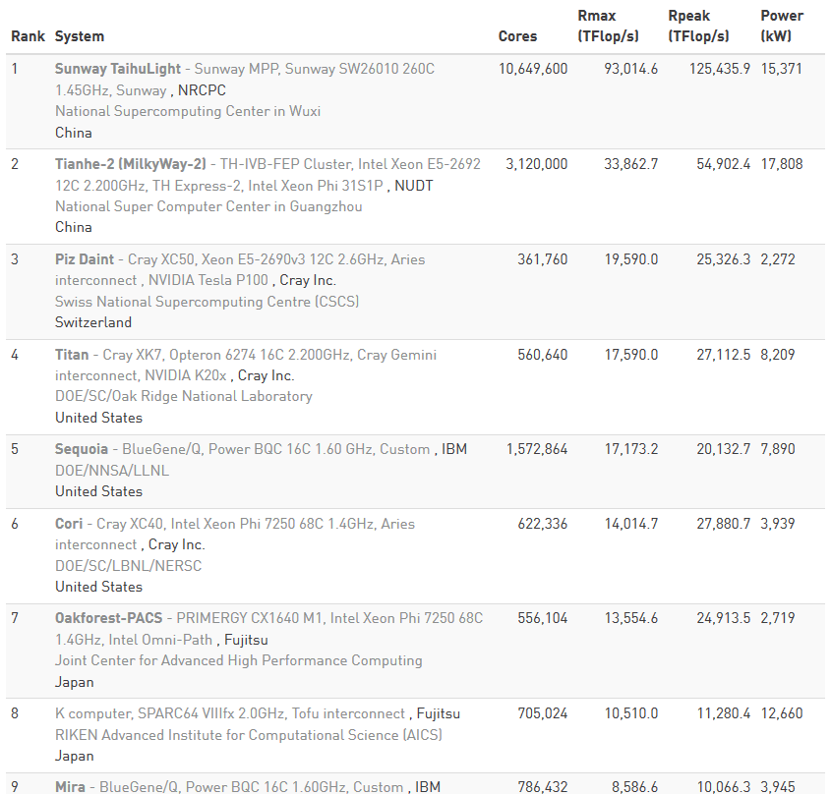
www.top500.org
Nov. 2014
Juni 2015
August 2016
Juni 2017

Slide 65
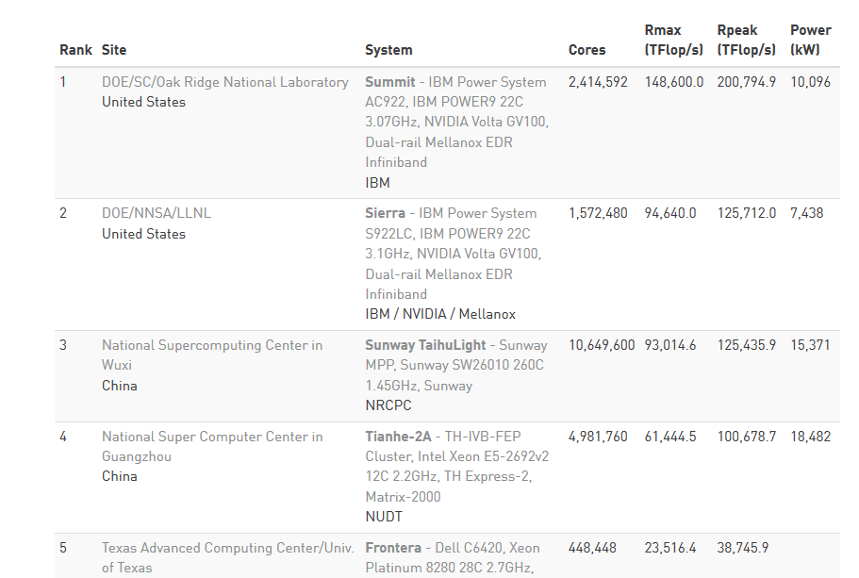
www.top500.org – June 2019

Slide 66
Model theoretic approaches
Analytical methods
  deterministic queuing models (parameter: fixed values)
  stochastic queuing models (parameter: average values)
  operational queuing models (parameter: measured values)
Software simulations
  deterministic simulation
  stochastic simulation
  simulation based on traces

Slide 67
The Layered Computer Model

Slide 68
A Six-level Computer
Level 5
Problem-oriented language level
Translation (Compiler)
Level 4
Assembly language level
Translation (Assembler)
Level 3
Operating system machine level
Partial interpretation (operating system)
Level 2
ISA (Instruction Set Architecture) level
Interpretation (microprogram) or direct execution
Level 1
Microarchitecture level
Hardware
Level 0
Digital logic level

Slide 69
A Six-level Computer – Examples
Level 5
Problem-oriented language level
Java, C#, C++, C, Haskell, Cobol, Swift…
Translation (Compiler)
javac, gcc,
.NET
Level 4
Assembly language level
Java Byte Code, MSIL/CIL
Translation (Assembler)
JVM, CLR;
JIT/Interpreter
Level 3
Operating system machine level
Unix, Windows, iOS
Partial interpretation (operating system)
JVM, CLR;
JIT/Interpreter
Level 2
ISA (Instruction Set Architecture) level
x64, x86, PPC, ARM, …
Interpretation (microprogram) or direct execution
microprogram/
none
Level 1
Microarchitecture level
Netburst, ISSE, ASX, <none>, …
Hardware
hardware
Level 0
Digital logic level
Core i9-7980XE, ARM9, Ryzen, …

Slide 70
Summary
Classical computer architecture
  von Neumann
  Harvard
Universal & special purpose computers
µComputer
Milestones of computer development
A definition of computer architecture
Classification of computers
Performance assessment
Layered computer model

