Slide 1
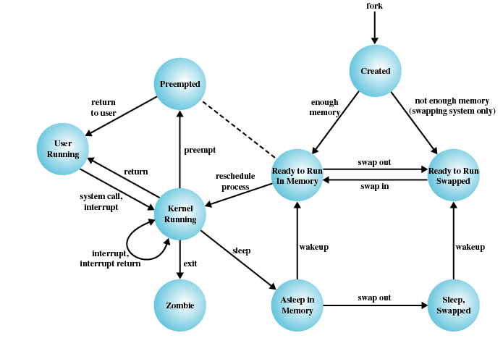
TI III: Operating Systems & Computer Networks
Booting, Services, and Security
Prof. Dr.-Ing. Jochen Schiller
Computer Systems & Telematics
Freie Universität Berlin, Germany

Slide 2
Content
Introduction and Motivation
Subsystems, Interrupts and System Calls
Processes
Memory
Scheduling
I/O and File System
Booting, Services, and Security

Slide 3
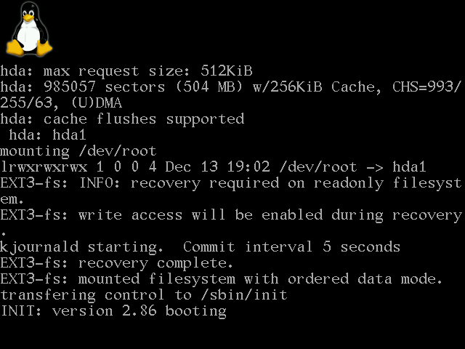
Boot Process Overview
Process of starting an operating system
  “Bootstrapping” – simple system is used to start more complex system
Goals:
  Hardware detection and setup
  Operating system loading and initialization

Slide 4
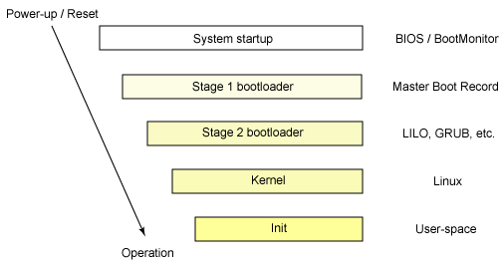
Boot Process Overview
Multi-stage process (early stages without OS involvement)
  System startup
    Simple hardware initialization performed by BIOS
  Stage 1 bootloader
    Continue initialization
    Load state 2 bootloader
  Stage 2 bootloader
    Continue initialization
    Load kernel image
  Kernel
    Continue initialization
    Start first process “init”
  Init
    Start system services, including login shell
Only limited resources available at each state

Slide 5
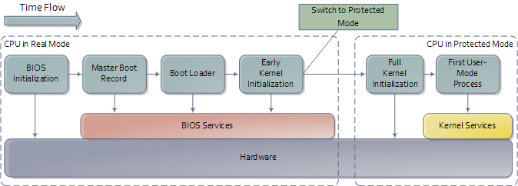
Boot Process Overview
http://duartes.org/gustavo/blog/post/how-computers-boot-up

Slide 6
Booting – System Startup (with classical BIOS)
Power supply switched on ➙ Power supply performs self-test
  Sends Power Good signal to CPU if OK
CPU Timer chip receives Power Good signal
  Stops sending reset signals to CPU
CPU executes ROM BIOS code at 0xFFFF0000
BIOS performs basic hardware test
  Beeps on errors
BIOS checks for adapters with own ROM BIOS
  Initializes video adapter
BIOS runs Power On Self Test (POST)
  No memory check, if “warm-start”
  Error messages on non-fatal errors
  Abort and beep code on fatal error
BIOS reads system configuration from CMOS
  Defines in which order to check drives for operating system
BIOS examines first sector of bootable medium
  Loads Master Boot Record (MBR)

Slide 7
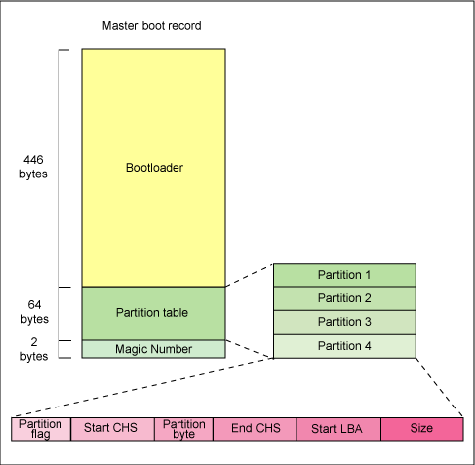
Booting – Stage 1/2 Bootloader
BIOS transfers control to bootloader
  Windows: NTLDR
  Linux: Linux Loader (LILO) or GRand Unified Bootloader (GRUB)
May offer choices for OS or system parameters to user
Boot loader works in stages
  Work around size limitations (only 446 bytes available in MBR)
  Incrementally add support for loading larger binaries from anywhere on disk
  Commonly two, sometimes three stages (“stage 1.5”)
Last stage of bootloader is powerful enough to load kernel image
Chain loading allows bootloader to pass control to other bootloaders, e.g. GRUB to NTLDR

Slide 8

UEFI/EFI
Today, UEFI (Unified Extensible Firmware Interface) and the predecessor EFI (Extensible Firmware Interface) describe the interface between firmware, components of a computer, and the operating system
Includes Secure Boot
  allows booting of signed bootloaders only
  Typically, shim needed for Linux as many mainboard manufacturers only deliver MS signatures
Allows the selection of drivers, exclusion of software components of the OS
Additional capabilities for diagnostics (networking, hardware etc.)
Alternatives: Open Firmware (PowerPC, SPARC), coreboot
(legacy BIOS not supported any longer)

Slide 9
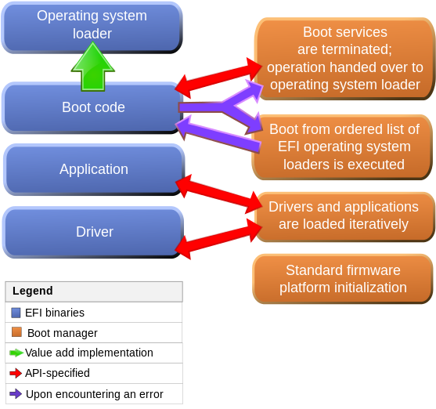
EFI specification
Digital Rights Management
Remote maintenance using own network stack
  security?
Preboot execution environment
Graphics adapter support
Sandbox mode
Support for HD > 2 TB for booting
CC-BY-SA-2.5, Msikma on en.wikipedia

Slide 10
Booting – Kernel
Bootloader passes control to kernel
Detect/initialize hardware
  CPU, e.g. on x86, switch from real (8086) to protected mode
    Enables support for memory > 1MB, virtual memory, process isolation
    Possibly start-up additional CPUs in multi-processor systems
  System buses and memory (“north bridge”)
  Peripheral buses and devices (“south bridge”)
  May require loading of additional device drivers from disk
    Problem: Ordering of steps in initialization procedure non-trivial
    Workaround: Append file system containing drivers to kernel image, use bootloader to load most important drivers into RAM
Start kernel subsystems
  Allocate/initialize core data structures, e.g., process queues, page tables, ...
Setup environment for user processes
  Mount root file system
  Start scheduler, enable multi-tasking
Start first user-space process, e.g. /sbin/init in Unix systems

Slide 11
Booting – Init (Unix SysV Init)
SysV Init starts system services according to runlevels:
Typical runlevels:
  Runlevel 0: Halt
  Runlevel 1: Single-user mode
  Runlevel 2: Not used (user-definable)
  Runlevel 3: Full multi-user mode
  Runlevel 4: Not used (user-definable)
  Runlevel 5: Full multi-user mode (GUI login screen)
  Runlevel 6: Reboot
Vendor-specific variations
Typical system services:
  System logging daemon
  Remote Procedure Call (RPC) server
  Print spooler
  Mail Transfer Agent (MTA)
  SNMP daemon
  SSH server
  Login shell
  X Windows System (GUI)
Also performs more complex initialization, e.g. networking

Slide 12
Questions & Tasks
  Do all computers perform booting? Think of different application scenarios.
  Check the booting process of your computer. Depending on the different platforms you might need to press certain keys during the initialization to see all steps.
  Why do we sometimes need several stages of booting?
  Check the story behind UEFI and its implications when it comes to secure boot!

Slide 13

UNIX Daemons
System services on UNIX-derived systems
Typically started at boot time
Process that runs in background
  Disassociate from console (if any)
  Fork a child on start-up, then exit
    init adopts the child
  Set working directory to root directory
  Close open file descriptors (if any)
  Set stdin, stdout, and stderr to logfile, console, or /dev/null
May store PID in known file for future interaction

Slide 14
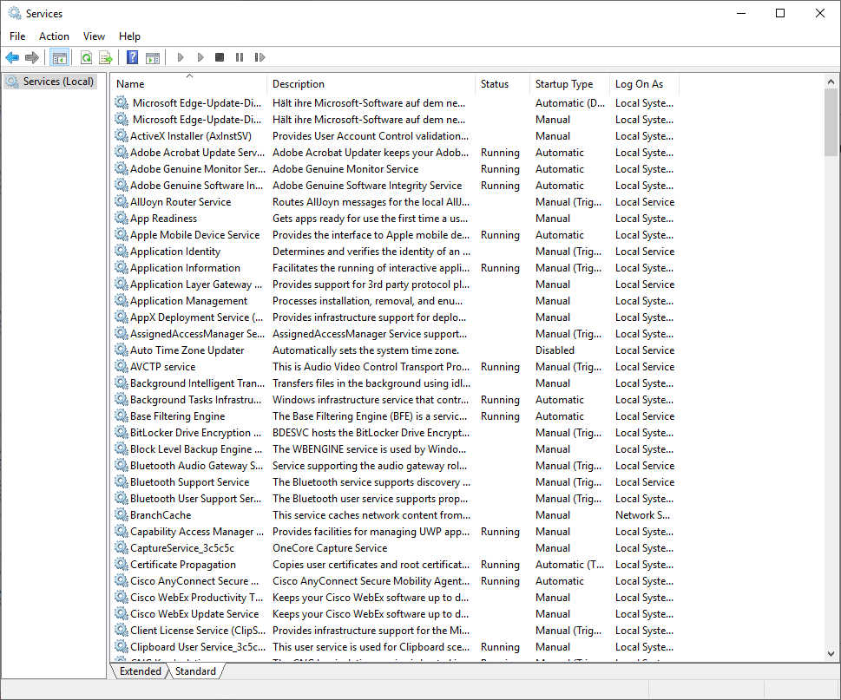
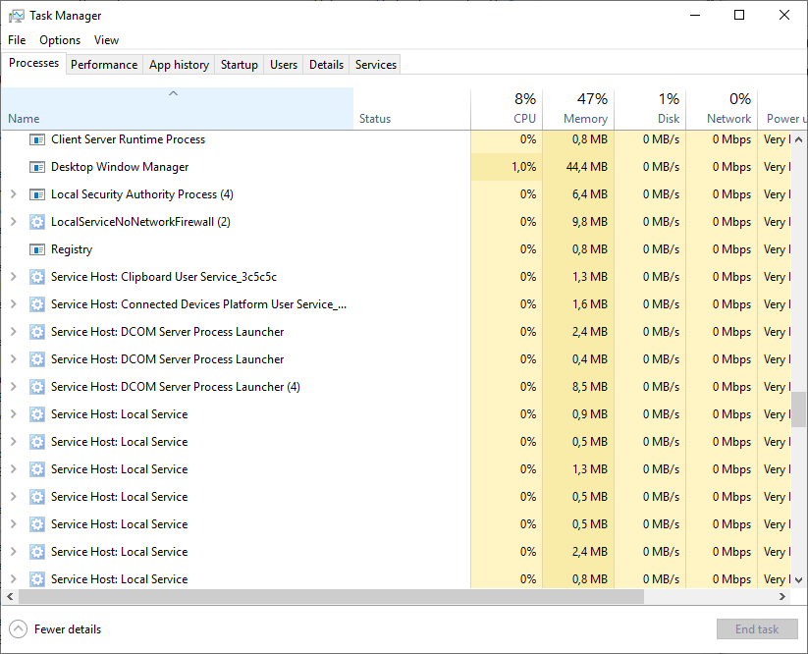
Windows offers services

Slide 15
System Services Example: crond
Periodically runs commands, referred to as “cron jobs”
Commands are configured in /etc/crontab:
# /etc/crontab: system-wide crontab
# Unlike any other crontab you don't have to run the `crontab'
# command to install the new version when you edit this file.
# This file also has a username field, that none of the other crontabs do.
SHELL=/bin/sh
PATH=/usr/local/sbin:/usr/local/bin:/sbin:/bin:/usr/sbin:/usr/bin
MAILTO=staff-simpel2@inf.fu-berlin.de
# m h dom mon dow user command
25 6 * * * root test -e /usr/sbin/anacron || run-parts --report /etc/cron.daily
47 6 * * 7 root test -e /usr/sbin/anacron || run-parts --report /etc/cron.weekly
52 6 1 * * root test -e /usr/sbin/anacron || run-parts --report /etc/cron.monthly
#
#tos: der cron job sollte nicht root-mail zuspammen..
0 4 * * * root /etc/simpel/delayed_update >/dev/null 2>&1
#
# vielleich hilft das gegen eingefrorene maeuse, vv 17.6.02
#0 7 * * * root /etc/init.d/gpm restart > /dev/null 2>&1
Notes:
Example:
# Minute Hour Day of Month Month Day of Week Command
# (0-59) (0-23) (1-31) (1-12 or Jan-Dec) (0-6 or Sun-Sat)
0 2 12 * 0,6 /usr/bin/find

Slide 16
System Services Example: syslogd
Daemon for local and/or remote message logging
Uses Syslog protocol (RFC 3164) to receive messages via UDP or TCP on port 514
Writes messages to /var/log/syslog:
Separate daemon klogd to log kernel messages
Nov 28 01:31:59 vaio syslogd 1.4.1#18: restart.
Nov 28 01:31:59 vaio anacron[4603]: Job `cron.daily' terminated (mailing output)
Nov 28 01:32:00 vaio anacron[4603]: Normal exit (1 job run)
Nov 28 01:36:50 vaio kernel: usb 1-1.1: new high speed USB device using ehci_hcd and address 7
Nov 28 01:36:50 vaio kernel: usb 1-1.1: configuration #1 chosen from 1 choice
Nov 28 01:36:50 vaio kernel: usb-storage: device found at 7
Nov 28 01:36:50 vaio kernel: usb-storage: waiting for device to settle before scanning
Nov 28 01:36:55 vaio kernel: Vendor: WDC WD16 Model: 00BB-22GUC0 Rev: 0811
Nov 28 01:36:55 vaio kernel: Type: Direct-Access ANSI SCSI revision: 00
Nov 28 01:36:55 vaio kernel: usb-storage: device scan complete
Nov 28 01:36:55 vaio kernel: SCSI device sda: 312581808 512-byte hdwr sectors (160042 MB)
Nov 28 01:36:55 vaio kernel: sda: test WP failed, assume Write Enabled
Nov 28 01:36:55 vaio kernel: sda: assuming drive cache: write through
Nov 28 01:36:55 vaio kernel: sda: sda1
Nov 28 01:36:55 vaio kernel: sd 0:0:0:0: Attached scsi disk sda
Nov 28 01:37:03 vaio hald: mounted /dev/sda1 on behalf of uid 1000
Nov 28 01:55:40 vaio hald: unmounted /dev/sda1 from '/media/TREKSTOR-1' on behalf of uid 1000
Nov 28 01:56:23 vaio kernel: UDF-fs: No VRS found
Nov 28 01:56:23 vaio kernel: Unable to identify CD-ROM format.

Slide 17
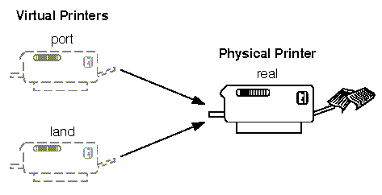
System Services Example: lpd
Provides printer spooling
Manages (multiple) queues for each connected printer
Controls/schedules print jobs of (multiple) users
Virtual printers may transparently provide different options to real printer
  Preprocessing, filtering of documents

Slide 18
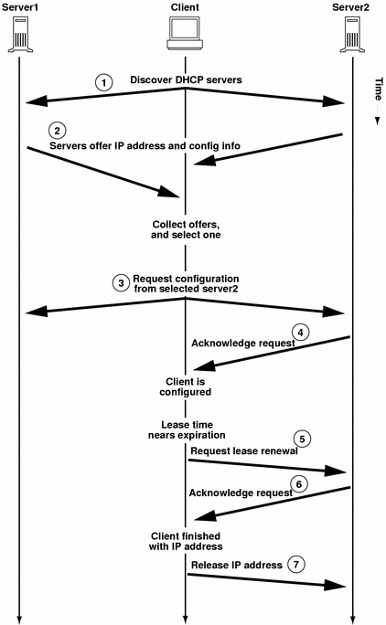
System Services Example: dhcpd
Dynamic Host Configuration Protocol (DHCP, RFC 2131)
Acts as server that manages network information (e.g. IP addresses) for local network
Clients request configuration information at boot time, i.e. upon configuring network interfaces
Effectively provides system service for remote computers

Slide 19
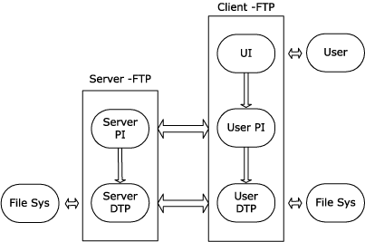
System Services Example: ftpd
File Transfer Protocol (FTP, RFC 959)
Allows remote access to data stored on local file system
  Separate connections for commands and data

Slide 20
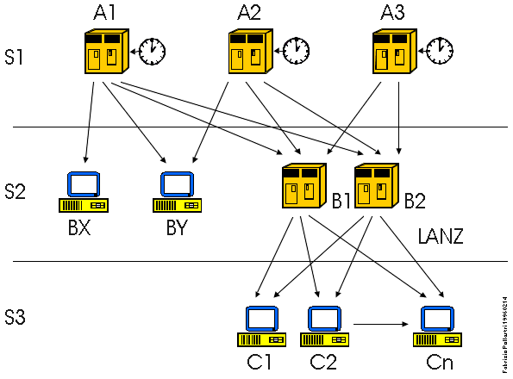
System Services Example: ntpd
Network Time Protocol (NTP, RFC 1305)
Synchronizes time of local computer with time servers / other computers
Example: time.fu-berlin.de

Slide 21
System Services Example: getty
getty:
Opens TTY (terminal typewriter) port and prompts for username (“login:”)
Upon entry of valid user name, start /bin/login process
login:
Authenticate user by querying for password
  Limited number of retries
Set user and group ID and environment variables as specified in /etc/passwd
  Effectively drop administrator (“root”) privileges
Start shell, e.g. /bin/bash
Boot process complete, user logged in, start working!

Slide 22
Questions & Tasks
  Check the running deamons in your UNIX system – or services if you run Windows. There are quite many … The operating systems sometimes offer nice tools to view these deamons/services.

Slide 23
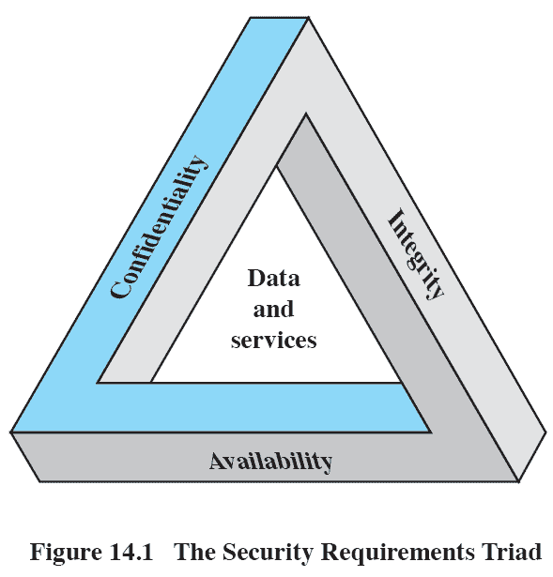
CIA Triad: Security Objectives
Confidentiality
  a loss of confidentiality is the unauthorized disclosure of information
Integrity
  a loss of integrity is the unauthorized modification or destruction of information
Availability
  a loss of availability is the disruption of access to or use of information or an information system
Notes:
These three concepts form what is often referred to as the CIA triad ( Figure 14.1 ).
The three concepts embody the fundamental security objectives for both data and
for information and computing services. For example, the NIST standard FIPS 199
( Standards for Security Categorization of Federal Information and Information Systems )
lists confidentiality, integrity, and availability as the three security objectives for information
and for information systems. FIPS PUB 199 provides a useful characterization
of these three objectives in terms of requirements and the definition of a loss of security
in each category:
• Confidentiality: Preserving authorized restrictions on information access
and disclosure, including means for protecting personal privacy and proprietary
information. A loss of confidentiality is the unauthorized disclosure of
information.
• Integrity: Guarding against improper information modification or destruction,
including ensuring information nonrepudiation and authenticity. A loss of
integrity is the unauthorized modification or destruction of information.
• Availability: Ensuring timely and reliable access to and use of information.
A loss of availability is the disruption of access to or use of information or an
information system.

Slide 24
Additional Concepts
Authenticity
The property of being genuine and being able to be verified and trusted; confidence in the validity of a transmission, a message, or message originator
Verifying that users are who they say they are and that each input arriving at the system came from a trusted source
Accountability
The security goal that generates the requirement for actions of an entity to be traced uniquely to that entity
We must be able to trace a security breach to a responsible party
Systems must keep records of their activities to permit later forensic analysis to trace security breaches or to aid in transaction disputes

Slide 25
Passive Attacks
Learn/use information from system but do not affect
  Eavesdropping and monitoring
Goal: Obtain information
Difficult to detect, since no alteration of data
  Emphasis is on prevention rather than detection
  Encryption for prevention
Types
release of message contents
traffic analysis
Notes:
Network security attacks can be classified
as passive attacks and active attacks . A passive attack attempts to learn or make
use of information from the system but does not affect system resources. An active
attack attempts to alter system resources or affect their operation.
Passive attacks are in the nature of eavesdropping on, or monitoring of, transmissions.
The goal of the attacker is to obtain information that is being transmitted.
Two types of passive attacks are release of message contents and traffic analysis.
The concept of release of message contents , is easily understood. A telephone
conversation, an electronic mail message, and a transferred file may contain sensitive
or confidential information. We would like to prevent an opponent from learning the
contents of these transmissions.
Traffic analysis is a more subtle form of passive attack. Suppose that we had a
way of masking the contents of messages or other information traffic so that opponents,
even if they captured the message, could not extract the information from
the message. The common technique for masking contents is encryption. If we had
encryption protection in place, an opponent might still be able to observe the pattern
of these messages. The opponent could determine the location and identity of
communicating hosts and could observe the frequency and length of messages being
exchanged. This information might be useful in guessing the nature of the communication
that was taking place.
Passive attacks are very difficult to detect because they do not involve any
alteration of the data. Typically, the message traffic is sent and received in an apparently
normal fashion, and neither the sender nor the receiver is aware that a third
party has read the messages or observed the traffic pattern. However, it is feasible
to prevent the success of these attacks, usually by means of encryption. Thus, the
emphasis in dealing with passive attacks is on prevention rather than detection.

Slide 26
Active Attacks
Modify data or create false data
Four categories:
Replay
  first capture data / second retransmit
Masquerade
  pretend to be a different entity
Modification of messages
  alter some portion of a message / delay or reorder message
Denial of service
  prevent normal use of communications facilities
  disrupt entire network by disabling the network or by overloading it
Notes:
Active attacks involve some modification of the data stream or the creation
of a false stream and can be subdivided into four categories: replay, masquerade,
modification of messages, and denial of service.
Replay involves the passive capture of a data unit and its subsequent retransmission
to produce an unauthorized effect.
A masquerade takes place when one entity pretends to be a different entity. A
masquerade attack usually includes one of the other forms of active attack. For example,
authentication sequences can be captured and replayed after a valid authentication
sequence has taken place, thus enabling an authorized entity with few privileges
to obtain extra privileges by impersonating an entity that has those privileges.
Modification of messages simply means that some portion of a legitimate
message is altered, or that messages are delayed or reordered, to produce an
unauthorized effect. For example, a message stating, “Allow John Smith to read confidential
file accounts ” is modified to say, “Allow Fred Brown to read confidential
file accounts .”
The denial of service prevents or inhibits the normal use or management of
communications facilities. This attack may have a specific target; for example, an
entity may suppress all messages directed to a particular destination (e.g., the security
audit service). Another form of service denial is the disruption of an entire network,
either by disabling the network or by overloading it with messages so as to degrade
performance.
Active attacks present the opposite characteristics of passive attacks. Whereas
passive attacks are difficult to detect, measures are available to prevent their success.
On the other hand, it is quite difficult to prevent active attacks absolutely,
because to do so would require physical protection of all communications facilities
and paths at all times. Instead, the goal is to detect them and to recover from any
disruption or delays caused by them. Because the detection has a deterrent effect, it
may also contribute to prevention.

Slide 27
Authentication – Password Creation
Library function crypt() encrypts user’s password by adding some randomness (“salt”)
  Cryptographic hash function
  Based on Data Encryption Standard (DES) algorithm
Limited key space, brute-force attacks feasible

Slide 28
Authentication – Password Verification
Performed by login parameterized with user name (ID)

Slide 29
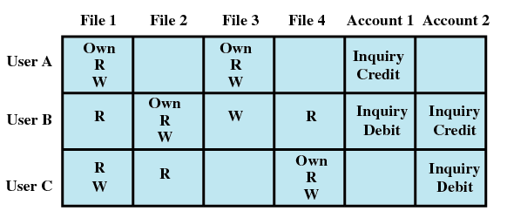
Access Control – Permission Bits
Bit vector per object (e.g. file, directory) encodes:
  Entities (users): Owner, group, other
  Access rights: Read, write, execute (“change into” for directories)
  Example: rwxr-x---
    Owner may read, write and execute
    Owning group may read and execute
    Others aren’t allowed to do anything
  Special bits for advanced features, e.g. SUID big – execute as owner
  Subtle semantics: Changing name of a file requires write access to containing directory
More advanced: Access matrix

Slide 30
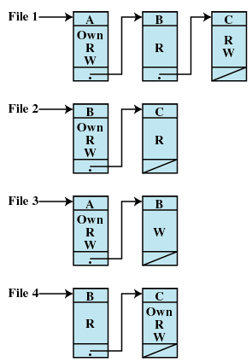
Access Control – Access Control Lists
Permissions bits at times not flexible enough
Access matrix has scalability issues, is sparsely populated
Access Control Lists (ACLs):
Variable number of bit vectors in linked list
  Slight access overhead
One per required entity
Need additional semantics
  What to do if access granted to group but not to specific user?

Slide 31
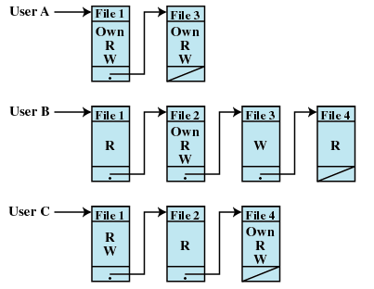
Access Control – Capabilities
Assign set of capabilities to each entity
Example:
  File access (rarely used)
System capabilities:
  Traditional:
    Administrator (root): Can do everything
    User: Can do nothing
  With capabilities:
    Fine grained control
    E.g. access to specific
    system calls, kernel subsystems

Slide 32
Attack Vector – Directory Traversal
Trick “weak” program to access protected/internal file
  Exploits insufficient checking/sanitization of user-supplied file name
Example:
  Documents for student homepages are stored in
  /web/page.mi.fu-berlin.de/web-home/user_name/
    E.g. http://page.mi.fu-berlin.de/~userA/index.html is located at /web/page.mi.fu-berlin.de/web-home/userA/index.html
  What happens if an attackers queries the web server for
  http://page.mi.fu-berlin.de/../../../../etc/passwd?
Defenses:
  Scan input for illegal character sequences
    “../” in this examples, but this may be masked as “%2E%2E%2F” (ASCII encoded)
  Canonization, i.e. convert input into a canonical form
    Depends on type of input, absolute path (without “../”) for path names
  Limit access of web server process to file system

Slide 33
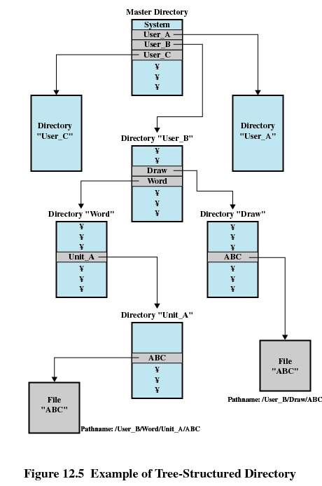
Countermeasures – Limited Access
System support of limiting view of entire system for specific process
chroot system call changes root of file system as perceived by process
  Process is caught in “chroot jail”, cannot break out
Good precaution for processes that
  are self-contained
  deal with untrusted input

Slide 34
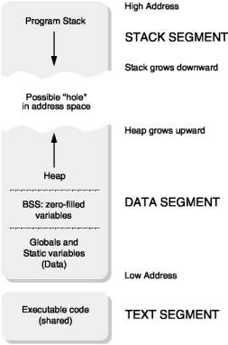
Attack Vector – Buffer Overflow
Overwrite flow control information of a process to gain control of the process
  Works for processes that process external data without proper bounds checking
User-space process address space layout:
  Stack for function calls, parameters, local variables
  Heap for dynamically managed memory, e.g. with malloc(), ...

Slide 35
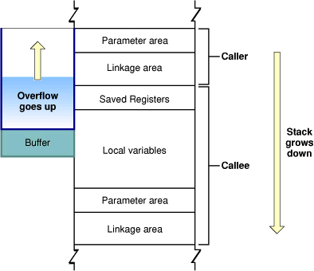
Attack Vector – Buffer Overflow
Exploit weak bounds checking in buffer operations
Example:
  Allocate fixed size buffer
  Copy untrusted data to buffer using strcpy() (instead of strncpy())
  May overwrite control information in stack frame in order to change program flow
Heap-based variants exist
Defense: Use safe versions of library routines, i.e. know how much memory you have

Slide 36
Attack Vector – Buffer Overflow
Example:
#include <stdio.h>
int main()
{
char str1[4];
char str2[4];
gets(str2);
printf("str1=%s, str2=%s\n", str1, str2);
}

Slide 37
Questions & Tasks
  Check /etc/passwd on a Unix system and in this context “shadow passwords” – why are they needed?
  Encryption helps in many ways against active and passive attacks. But what about denial of service?

Slide 38
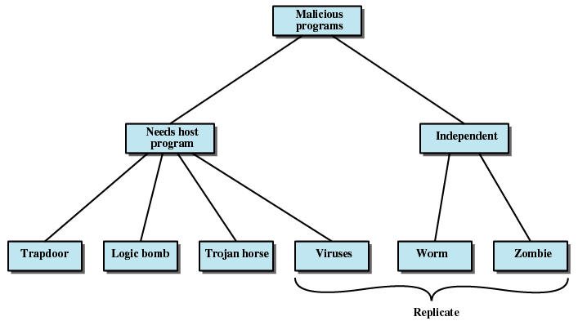
Classification of Threats
Classification by dependency on environment
  Related to propagation method, and thus potential targets

Slide 39
Trapdoor/Backdoor
A secret entry point into a program that allows someone to gain access without going through the usual security access procedures
A maintenance hook is a backdoor that programmers use to debug and test programs
Become threats when unscrupulous programmers use them to gain unauthorized access
It is difficult to implement operating system controls for backdoors
Notes:
A backdoor , also known as a trapdoor , is a secret entry point into a program
that allows someone who is aware of the backdoor to gain access without going
through the usual security access procedures. Programmers have used backdoors
legitimately for many years to debug and test programs; such a backdoor is called
a maintenance hook . This usually is done when the programmer is developing an
application that has an authentication procedure, or a long setup, requiring the user
to enter many different values to run the application. To debug the program, the
developer may wish to gain special privileges or to avoid all the necessary setup and
authentication. The programmer may also want to ensure that there is a method of
activating the program should something be wrong with the authentication procedure
that is being built into the application. The backdoor is code that recognizes
some special sequence of input or is triggered by being run from a certain user ID or
by an unlikely sequence of events.
Backdoors become threats when unscrupulous programmers use them to
gain unauthorized access. The backdoor was the basic idea for the vulnerability
portrayed in the movie War Games . Another example is that during the development
of Multics, penetration tests were conducted by an Air Force “tiger team”
(simulating adversaries). One tactic employed was to send a bogus operating system
update to a site running Multics. The update contained a Trojan horse (described
later) that could be activated by a backdoor and that allowed the tiger team to gain
access. The threat was so well implemented that the Multics developers could not
find it, even after they were informed of its presence [ENGE80].
It is difficult to implement operating system controls for backdoors. Security
measures must focus on the program development and software update activities.

Slide 40
Logic Bomb
One of the oldest types of program threat
Code embedded in some legitimate program that is set to “explode” when certain conditions are met
Once triggered a bomb may alter or delete data or entire files, cause a machine halt, or do some other damage
Notes:
One of the oldest types of program threat, predating viruses and worms, is the logic
bomb. The logic bomb is code embedded in some legitimate program that is set to
“explode” when certain conditions are met. Examples of conditions that can be used
as triggers for a logic bomb are the presence or absence of certain files, a particular
day of the week or date, or a particular user running the application. Once triggered,
a bomb may alter or delete data or entire files, cause a machine halt, or do some
other damage. A striking example of how logic bombs can be employed was the
case of Tim Lloyd, who was convicted of setting a logic bomb that cost his employer,
Omega Engineering, more than $10 million, derailed its corporate growth strategy,
and eventually led to the layoff of 80 workers [GAUD00]. Ultimately, Lloyd was
sentenced to 41 months in prison and ordered to pay $2 million in restitution.

Slide 41
Trojan Horse
Useful, or apparently useful, program or command procedure that contains hidden code that, when invoked, performs some unwanted or harmful function
Trojan horses fit into one of three models:
  continuing to perform the function of the original program and additionally performing a separate malicious activity
  continuing to perform the function of the original program but modifying the function to perform malicious activity or to disguise other malicious activity
  performing a malicious function that completely replaces the function of the original program
Notes:
A Trojan horse is a useful, or apparently useful, program or command procedure
containing hidden code that, when invoked, performs some unwanted or harmful
function.
Trojan horse programs can be used to accomplish functions indirectly that an
unauthorized user could not accomplish directly. For example, to gain access to the
files of another user on a shared system, a user could create a Trojan horse program
that, when executed, changes the invoking user’s file permissions so that the files
are readable by any user. The author could then induce users to run the program by
placing it in a common directory and naming it such that it appears to be a useful
utility program or application. An example is a program that ostensibly produces
a listing of the user’s files in a desirable format. After another user has run the
program, the author of the program can then access the information in the user’s
files. An example of a Trojan horse program that would be difficult to detect is a
compiler that has been modified to insert additional code into certain programs as
they are compiled, such as a system login program [THOM84]. The code creates a
backdoor in the login program that permits the author to log on to the system using
a special password. This Trojan horse can never be discovered by reading the source
code of the login program.
Another common motivation for the Trojan horse is data destruction. The
program appears to be performing a useful function (e.g., a calculator program),
but it may also be quietly deleting the user’s files. For example, a CBS executive
was victimized by a Trojan horse that destroyed all information contained in his
computer’s memory [TIME90]. The Trojan horse was implanted in a graphics routine
offered on an electronic bulletin board system.
Trojan horses fit into one of three models:
• Continuing to perform the function of the original program and additionally
performing a separate malicious activity
• Continuing to perform the function of the original program but modifying the
function to perform malicious activity (e.g., a Trojan horse version of a login
program that collects passwords) or to disguise other malicious activity (e.g., a
Trojan horse version of a process listing program that does not display certain
processes that are malicious)
• Performing a malicious function that completely replaces the function of the
original program

Slide 42
Mobile Code
Programs that can be shipped unchanged to a heterogeneous collection of platforms and execute with identical semantics
Transmitted from a remote system to a local system and then executed on the local system without the user’s explicit instruction
Often acts as a mechanism for a virus, worm, or Trojan horse to be transmitted to the user’s workstation
Takes advantages of vulnerabilities
Popular vehicles for mobile code include Java applets, ActiveX, JavaScript, and VBScript
Notes:
Mobile code refers to programs (e.g., script, macro, or other portable instruction)
that can be shipped unchanged to a heterogeneous collection of platforms and execute
with identical semantics [JANS01]. The term also applies to situations involving
a large homogeneous collection of platforms (e.g., Microsoft Windows).
Mobile code is transmitted from a remote system to a local system and then
executed on the local system without the user’s explicit instruction. Mobile code
often acts as a mechanism for a virus, worm, or Trojan horse to be transmitted
to the user’s workstation. In other cases, mobile code takes advantage of vulnerabilities
to perform its own exploits, such as unauthorized data access or root
compromise. Popular vehicles for mobile code include Java applets, ActiveX,
JavaScript, and VBScript. The most common ways of using mobile code for
malicious operations on local system are cross-site scripting, interactive and
dynamic Web sites, e-mail attachments, and downloads from untrusted sites or
of untrusted software.

Slide 43
Multiple-Threat Malware
Infects in multiple ways
Typically the multipartite virus is capable of infecting multiple types of files
A blended attack uses multiple methods of infection or transmission to maximize the speed of contagion and the severity of the attack
An example of a blended attack is the Nimda attack
Nimda uses four distribution methods
E-mail
Windows shares
Web servers
Web clients
Notes:
Viruses and other malware may operate in multiple ways. The terminology is far
from uniform; this subsection gives a brief introduction to several related concepts
that could be considered multiple-threat malware.
A multipartite virus infects in multiple ways. Typically, the multipartite virus
is capable of infecting multiple types of files, so that virus eradication must deal with
all of the possible sites of infection.
A blended attack uses multiple methods of infection or transmission, to maximize
the speed of contagion and the severity of the attack. Some writers characterize
a blended attack as a package that includes multiple types of malware. An example
of a blended attack is the Nimda attack, erroneously referred to as simply a worm.
Nimda uses four distribution methods:
• E-mail : A user on a vulnerable host opens an infected e-mail attachment;
Nimda looks for e-mail addresses on the host and then sends copies of itself to
those addresses.
Windows shares: Nimda scans hosts for unsecured Windows file shares; it can
then use NetBIOS86 as a transport mechanism to infect files on that host in
the hopes that a user will run an infected file, which will activate Nimda on
that host.
• Web servers: Nimda scans Web servers, looking for known vulnerabilities in
Microsoft IIS. If it finds a vulnerable server, it attempts to transfer a copy of
itself to the server and infect it and its files.
• Web clients: If a vulnerable Web client visits a Web server that has been
infected by Nimda, the client’s workstation will become infected.
Thus, Nimda has worm, virus, and mobile code characteristics. Blended attacks
may also spread through other services, such as instant messaging and peer-to-peer
file sharing.

Slide 44
Viruses
Software that “infects” other programs by modifying them
  carries instructional code to self duplicate
  becomes embedded in a program on a computer
  when the infected computer comes into contact with an uninfected piece of software, a fresh copy of the virus passes into the new program
  infection can be spread by swapping disks from computer to computer or through a network
A computer virus has three parts:
  an infection mechanism
  trigger
  payload
Notes:
A computer virus is a piece of software that can “infect” other programs by modifying
them; the modification includes injecting the original program with a routine to
make copies of the virus program, which can then go on to infect other programs.
Biological viruses are tiny scraps of genetic code—DNA or RNA—that can
take over the machinery of a living cell and trick it into making thousands of flawless
replicas of the original virus. Like its biological counterpart, a computer virus
carries in its instructional code the recipe for making perfect copies of itself. The
typical virus becomes embedded in a program on a computer. Then, whenever the
infected computer comes into contact with an uninfected piece of software, a fresh
copy of the virus passes into the new program. Thus, the infection can be spread
from computer to computer by unsuspecting users who either swap disks or send
programs to one another over a network. In a network environment, the ability
to access applications and system services on other computers provides a perfect
culture for the spread of a virus.
A virus can do anything that other programs do. The
only difference is that it attaches itself to another program and executes secretly
when the host program is run. Once a virus is executing, it can perform any function
that is allowed by the privileges of the current user, such as erasing files and
programs.
A computer virus has three parts [AYCO06]:
• Infection mechanism : The means by which a virus spreads, enabling it to replicate.
The mechanism is also referred to as the infection vector .
• Trigger: The event or condition that determines when the payload is activated
or delivered.
• Payload: What the virus does, besides spreading. The payload may involve
damage or may involve benign but noticeable activity.

Slide 45
Virus Classification
There is no universally agreed upon classification scheme for viruses
Classification by target includes the following categories:
Boot sector infector
  infects a master boot record or boot record and spreads when a system is booted from the disk containing the virus
File infector
  infects files that the operating system or shell consider to be executable
Macro virus
  infects files with macro code that is interpreted by an application
Notes:
There has been a continuous arms race between virus
writers and writers of antivirus software since viruses first appeared. As effective
countermeasures are developed for existing types of viruses, newer types are
developed. There is no simple or universally agreed upon classification scheme
for viruses. In this section, we follow [AYCO06] and classify viruses along two
orthogonal axes: the type of target the virus tries to infect, and the method the
virus uses to conceal itself from detection by users and antivirus software.
A virus classification by target includes the following categories:
• Boot sector infector: Infects a master boot record or boot record and spreads
when a system is booted from the disk containing the virus
• File infector: Infects files that the operating system or shell consider to be
executable
• Macro virus : Infects files with macro code that is interpreted by an application

Slide 46
Concealment Strategy
A virus classification by concealment strategy includes
Encrypted virus
random encryption key encrypts remainder of virus
Stealth virus
hides itself from detection of antivirus software
Polymorphic virus
mutates with every infection
mutation engine is the portion of the virus that is responsible for generating keys and performing encryption/decryption
Metamorphic virus
mutates with every infection
rewrites itself completely after every iteration
Notes:
A virus classification by concealment strategy includes the following categories:
• Encrypted virus: A typical approach is as follows. A portion of the virus
creates a random encryption key and encrypts the remainder of the virus.
The key is stored with the virus. When an infected program is invoked, the
virus uses the stored random key to decrypt the virus. When the virus replicates,
a different random key is selected. Because the bulk of the virus is
encrypted with a different key for each instance, there is no constant bit
pattern to observe.
Stealth virus: A form of virus explicitly designed to hide itself from detection
by antivirus software. Thus, the entire virus, not just a payload is hidden.
• Polymorphic virus: A virus that mutates with every infection, making detection
by the “signature” of the virus impossible.
• Metamorphic virus: As with a polymorphic virus, a metamorphic virus mutates
with every infection. The difference is that a metamorphic virus rewrites itself
completely at each iteration, increasing the difficulty of detection. Metamorphic
viruses may change their behavior as well as their appearance.
One example of a stealth virus was discussed earlier: A virus that uses compression
so that the infected program is exactly the same length as an uninfected
version. Far more sophisticated techniques are possible. For example, a virus can
place intercept logic in disk I/O routines, so that when there is an attempt to read
suspected portions of the disk using these routines, the virus will present back the
original, uninfected program. Thus, stealth is not a term that applies to a virus as
such but, rather, refers to a technique used by a virus to evade detection.
A polymorphic virus creates copies during replication that are functionally
equivalent but have distinctly different bit patterns. As with a stealth virus, the
purpose is to defeat programs that scan for viruses. In this case, the “signature” of
the virus will vary with each copy. To achieve this variation, the virus may randomly
insert superfluous instructions or interchange the order of independent instructions.
A more effective approach is to use encryption. The strategy of the encryption
virus is followed. The portion of the virus that is responsible for generating keys and
performing encryption/decryption is referred to as the mutation engine . The mutation
engine itself is altered with each use.

Slide 47
Macro Viruses
In the mid 1990’s macro viruses became by far the most prevalent type of virus
Macro viruses are particularly threatening because:
  they are platform independent; e.g. many macro viruses infect Microsoft Word documents or other Microsoft Office documents
  they infect documents, not executable portions of code
  they are easily spread; a very common method is by electronic mail
  file system access controls are of limited use in preventing their spread
  Thus: new Office version disable macros by default
Notes:
In the mid-1990s, macro viruses became by far the most prevalent
type of virus. Macro viruses are particularly threatening for a number of reasons:
1. A macro virus is platform independent. Many macro viruses infect Microsoft
Word documents or other Microsoft Office documents. Any hardware platform
and operating system that supports these applications can be infected.
2. Macro viruses infect documents, not executable portions of code. Most of the
information introduced onto a computer system is in the form of a document
rather than a program.
3. Macro viruses are easily spread. A very common method is by electronic mail.
4. Because macro viruses infect user documents rather than system programs, traditional
file system access controls are of limited use in preventing their spread.
Macro viruses take advantage of a feature found in Word and other Office
applications such as Microsoft Excel—namely, the macro. In essence, a macro is an
executable program embedded in a word processing document or other type of file.
Typically, users employ macros to automate repetitive tasks and thereby save keystrokes.
The macro language is usually some form of the Basic programming language.
A user might define a sequence of keystrokes in a macro and set it up so that the
macro is invoked when a function key or special short combination of keys is input.
Successive releases of MS Office products provide increased protection
against macro viruses. For example, Microsoft offers an optional Macro Virus
Protection tool that detects suspicious Word files and alerts the customer to the
potential risk of opening a file with macros. Various antivirus product vendors
have also developed tools to detect and correct macro viruses. As in other types of
viruses, the arms race continues in the field of macro viruses, but they no longer are
the predominant virus threat.

Slide 48
E-Mail Viruses
The first rapidly spreading e-mail viruses made use of a Microsoft Word macro embedded in an attachment
In 1999 a newer, more powerful version of the e-mail virus appeared
  can be activated merely by opening an e-mail that contains the virus rather than opening an attachment
  the virus uses the Visual Basic scripting language supported by the e-mail package
If the recipient opens the attachment the Word macro is activated
the e-mail virus sends itself to everyone on the mailing list in the user’s e-mail package
the virus does local damage on the user’s system
Notes:
A more recent development in malicious software is the e-mail
virus. The first rapidly spreading e-mail viruses, such as Melissa, made use of
a Microsoft Word macro embedded in an attachment. If the recipient opens the
e-mail attachment, the Word macro is activated. Then
1. The e-mail virus sends itself to everyone on the mailing list in the user’s e-mail
package.
2. The virus does local damage on the user’s system.
In 1999, a more powerful version of the e-mail virus appeared. This newer
version can be activated merely by opening an e-mail that contains the virus rather
than opening an attachment. The virus uses the Visual Basic scripting language
supported by the e-mail package.
Thus we see a new generation of malware that arrives via e-mail and uses
e-mail software features to replicate itself across the Internet. The virus propagates
itself as soon as it is activated (either by opening an e-mail attachment or by
opening the e-mail) to all of the e-mail addresses known to the infected host. As a
result, whereas viruses used to take months or years to propagate, they now do so
in hours. This makes it very difficult for antivirus software to respond before much
damage is done. Ultimately, a greater degree of security must be built into Internet
utility and application software on PCs to counter the growing threat.

Slide 49
Worms
A program that can replicate itself and send copies from computer to computer across network connections
Upon arrival the worm may be activated to replicate and propagate again
In addition to propagation the worm usually performs some unwanted function
Actively seeks out more machines to infect and each machine that is infected serves as an automate launching pad for attacks on other machines
Notes:
A worm is a program that can replicate itself and send copies from computer to
computer across network connections. Upon arrival, the worm may be activated to
replicate and propagate again. In addition to propagation, the worm usually performs
some unwanted function. An e-mail virus has some of the characteristics of a worm
because it propagates itself from system to system. However, we can still classify it as a
virus because it uses a document modified to contain viral macro content and requires
human action. A worm actively seeks out more machines to infect and each machine
that is infected serves as an automated launching pad for attacks on other machines.
Network worm programs use network connections to spread from system to
system. Once active within a system, a network worm can behave as a computer
virus or bacteria, or it could implant Trojan horse programs or perform any number
of disruptive or destructive actions.

Slide 50
Worm Propagation
To replicate itself a network worm uses some sort of network vehicle
Electronic mail facility
a worm mails a copy of itself to other systems so that its code is run when the e-mail or an attachment is received or viewed
Remote execution capability
a worm executes a copy of itself on another system either using an explicit remote execution facility or by exploiting a program flaw in a network service to subvert its operations
Remote log-in capability
a worm logs on to a remote system as a user and then uses commands to copy itself from one system to the other
Notes:
To replicate itself, a network worm uses some sort of network vehicle.
Examples include the following:
• Electronic mail facility: A worm mails a copy of itself to other systems, so that
its code is run when the e-mail or an attachment is received or viewed.
• Remote execution capability: A worm executes a copy of itself on another
system, either using an explicit remote execution facility or by exploiting a
program flaw in a network service to subvert its operations (such as buffer
overflow, described in Chapter 7 ).
• Remote login capability: A worm logs on to a remote system as a user and
then uses commands to copy itself from one system to the other, where it then
executes.
The new copy of the worm program is then run on the remote system where, in
addition to any functions that it performs at that system, it continues to spread in
the same fashion.
A network worm exhibits the same characteristics as a computer virus: a
dormant phase, a propagation phase, a triggering phase, and an execution phase.
The propagation phase generally performs the following functions:
1. Search for other systems to infect by examining host tables or similar repositories
of remote system addresses.
2. Establish a connection with a remote system.
3. Copy itself to the remote system and cause the copy to be run.
The network worm may also attempt to determine whether a system has previously
been infected before copying itself to the system. In a multiprogramming
system, it may also disguise its presence by naming itself as a system process or using
some other name that may not be noticed by a system operator.
As with viruses, network worms are difficult to counter.

Slide 51
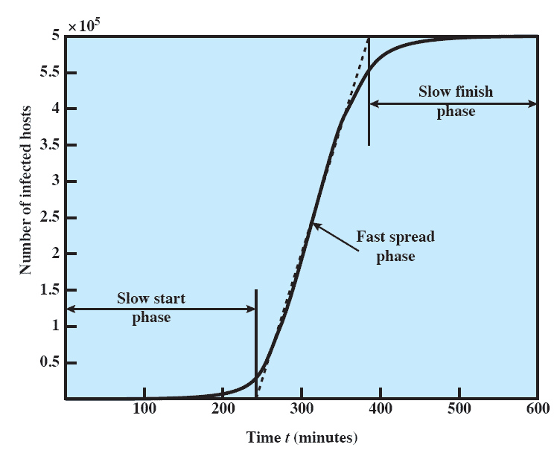
Worm Propagation Model
Notes:
[ZOU05] describes a model for worm propagation
based on an analysis of recent worm attacks. The speed of propagation and the
total number of hosts infected depend on a number of factors, including the mode
of propagation, the vulnerability or vulnerabilities exploited, and the degree of
similarity to preceding attacks. For the latter factor, an attack that is a variation of a
recent previous attack may be countered more effectively than a more novel attack.
Figure 14.5 shows the dynamics for one typical set of parameters. Propagation proceeds
through three phases. In the initial phase, the number of hosts increases exponentially.
To see that this is so, consider a simplified case in which a worm is launched from a
single host and infects two nearby hosts. Each of these hosts infects two more hosts,
and so on. This results in exponential growth. After a time, infecting hosts waste some
time attacking already infected hosts, which reduces the rate of infection. During this
middle phase, growth is approximately linear, but the rate of infection is rapid. When
most vulnerable computers have been infected, the attack enters a slow finish phase
as the worm seeks out those remaining hosts that are difficult to identify.
Clearly, the objective in countering a worm is to catch the worm in its slow
start phase, at a time when few hosts have been infected.

Slide 52
Bots
A program that secretly takes over another Internet-attached computer and then uses that computer to launch attacks that are difficult to trace to the bot’s creator
  also known as a Zombie or drone
Typically planted on hundreds or thousands of computers belonging to unsuspecting third parties
- today millions of “things” used in the context of the Internet of Things, attacks > 1 Tbit/s
Collection of bots acting in a coordinated manner is a botnet
A botnet exhibits three characteristics:
  the bot functionality
  a remote control facility
  a spreading mechanism to propagate the bots and construct the botnet
Notes:
A bot (robot), also known as a zombie or drone, is a program that secretly takes
over another Internet-attached computer and then uses that computer to launch
attacks that are difficult to trace to the bot’s creator. The bot is typically planted on
hundreds or thousands of computers belonging to unsuspecting third parties. The
collection of bots often is capable of acting in a coordinated manner; such a collection
is referred to as a botnet .
A botnet exhibits three characteristics: the bot functionality, a remote control
facility, and a spreading mechanism to propagate the bots and construct the botnet.
We examine each of these characteristics in turn.

Slide 53
Rootkit
Set of programs installed on a system to maintain administrator (or root) access to that system
Root access provides access to all the functions and services of the operating system
The rootkit alters the host’s standard functionality in a malicious and stealthy way
  with root access an attacker has complete control of the system and can add or change programs and files, monitor processes, send and receive network traffic, and get backdoor access on demand
  A rootkit hides by subverting the mechanisms that monitor and report on the processes, files, and registries on a computer
Notes:
A rootkit is a set of programs installed on a system to maintain administrator (or
root) access to that system. Root access provides access to all the functions and
services of the operating system. The rootkit alters the host’s standard functionality
in a malicious and stealthy way. With root access, an attacker has complete control
of the system and can add or change programs and files, monitor processes, send
and receive network traffic, and get backdoor access on demand.
A rootkit can make many changes to a system to hide its existence, making
it difficult for the user to determine that the rootkit is present and to identify
what changes have been made. In essence, a rootkit hides by subverting the
mechanisms that monitor and report on the processes, files, and registries on a
computer.

Slide 54
Exploits
Quite often today’s computers contain several mechanisms and programs defending against malware/viruses etc.
However, malicious code may still be able to take over control by using exploits
Exploit: code that takes advantage of bugs/vulnerabilities of a computer (SW/HW) to cause unintended behavior
Goals: e.g. privilege escalation to execute malicious code, DoS attack
Zero day exploit: cyber attack that occurs on the same day a weakness is discovered

Slide 55
Questions & Tasks
  Backdoors seem to be a bad idea. Why are they still used?
  Why do we have the problems of viruses, exploits, DoS attacks etc. at all? Think of technical reasons but also motivations!

Slide 56
Related System Calls (Linux)
uid_t getuid(void)
int setuid(uid_t uid)
  Gets/sets the user ID
int chroot(const char *path)
  Changes root directory of process to path
  Access to files outside “chroot jail” not possible afterwards
Library functions:
char *crypt(const char *key, const char
*salt)
  Encrypts user’s password key using salt (2 bytes) to add randomness
  Returns encrypted password as 13-character string
    First 2 bytes correspond to salt

Slide 57
Content (1)
Introduction and Motivation
  Tasks
  Services
  Virtual Resources
  Historical Perspective
  Examples
  Tools
Subsystems, Interrupts and System Calls
  System Structure
  Flow of Control
  System Library
  POSIX
Processes
  Definition
  Implementation
  State Model
Memory
  Paging & Segmentation
  Virtual Memory
  Swap Policies
Scheduling
  Types of Scheduling
  Decision Modes
  Process Priorities
  Scheduling Policies
I/O and File System
  Devices
  Buffering and Caching
  Files and Directories
Booting, Services, and Security
  System Startup
  System Services
  Security Issues

Slide 58
Content (2)
Networked Computer & Internet
Host-to-Network
Internetworking
Transport Layer
Applications
Network Security
Example

