Slide 1
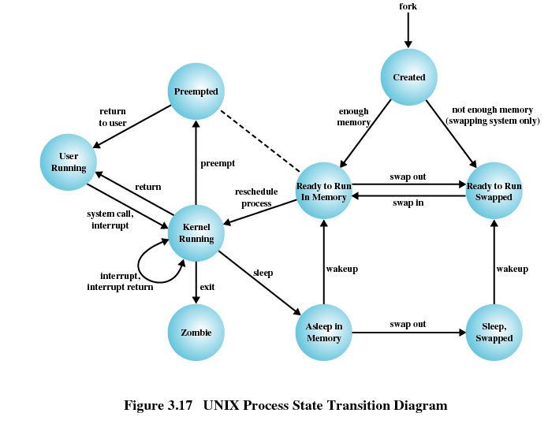
TI III: Operating Systems & Computer Networks
Scheduling
Prof. Dr.-Ing. Jochen Schiller
Computer Systems & Telematics
Freie Universität Berlin, Germany

Slide 2
Content
Introduction and Motivation
Subsystems, Interrupts and System Calls
Processes
Memory
Scheduling
I/O and File System
Booting, Services, and Security

Slide 3
Definition and Goals
Assign processes to be executed by the processor(s)
More general: Assign consumers to resources
  Examples: I/O requests ➔ Device-specific queues
  Memory pages ➔ Primary/secondary memory
Goals:
  Throughput, i.e., effectively use processing time
  Response time / fairness, i.e., interactivity of individual processes
  Processor efficiency, i.e., optimal utilization of CPU (as resource)
Conflicting goals: Maximal throughput means unpredictable response time (and vice versa)

Slide 4
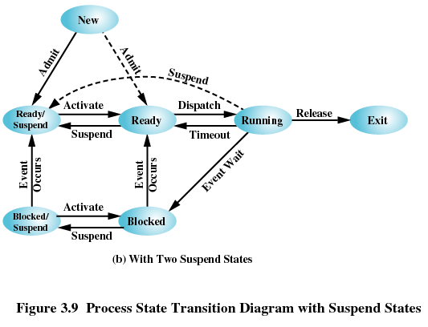
Process States and Scheduling
Scheduling decisions correspond to state transitions in process state graph

Slide 5
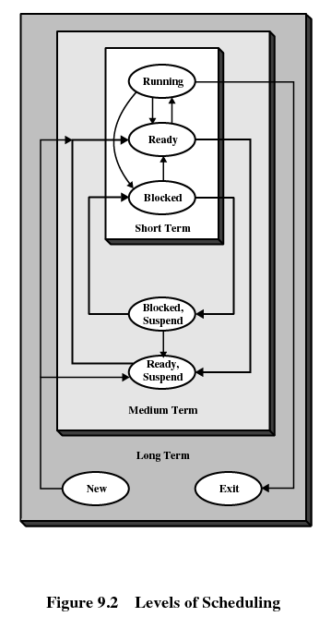
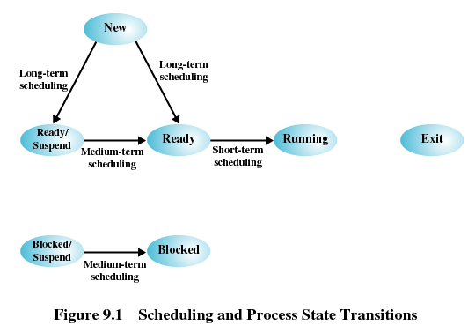
Process States and Scheduling
Scheduling decisions correspond to state transitions in process state graph
  States form hierarchy depending on transition frequency

Slide 6
Types of Scheduling
Long-term scheduling
Whether to add process to running queue and execute it
  Determines which programs are admitted to system for processing, e.g., based on user
  Specifies degree of multiprogramming, i.e., maximal number of processes
  The more processes, the smaller percentage of time each process is executed
How many processes should be allowed?

Slide 7
Types of Scheduling
Medium-term scheduling
Whether to add/remove existing process (that is only partially in primary memory)
  Part of swapping function
  Based on need to dynamically manage degree of multiprogramming (considering available resources)
Should processes be swapped in or out? If so, which ones?

Slide 8
Types of Scheduling
Short-term scheduling
Which one of fully available processes to run
  Known as “dispatcher”
  Executes most frequently
    Overhead / algorithmic complexity matters
  Invoked when event occurs (clock interrupts, I/O interrupts, operating system calls, signals)
Whose turn is it?

Slide 9
Types of Scheduling
I/O scheduling
Which I/O request (of which process) to dispatch to I/O device for handling
Consider state of external device

Slide 10
Short-Term Scheduling Criteria
User-oriented:
  Response time: elapsed time between submission of a request until there is output
  Interactivity: user perceives system as “responsive”
System-oriented (hardware and resources):
  Effective and efficient utilization of processor
Performance-related:
  Quantitative / measurable properties
  Examples: response time, throughput
Non-functional:
  Algorithmic properties
  Examples: predictability, fairness
 | Performance-related | Non-functional
User-oriented | Turnaround time Response time Deadlines | Predictability
System-oriented | Throughput Processor utilization | Fairness Enforcing priorities Balancing resources

Slide 11
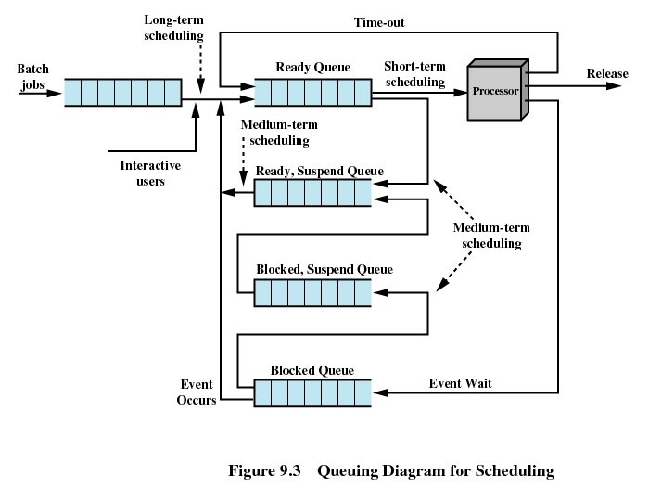
Scheduler Implementation: Queuing

Slide 12
Questions & Tasks
  Compare a TOP500 high-performance compute cluster with a standard PC, an on-board flight stabilization controller and a game console when it comes to scheduling. What are typical long, mid and short term tasks? Where should the focus be in system design in terms of throughput, response time, fairness, efficiency?
  What does a perfect scheduling system need? (OK, it does not exist, but in theory…)

Slide 13
Scheduling Decision Modes
Non-preemptive
  Current process explicitly yields CPU
    Cooperative multitasking, e.g., Windows (<95), Mac OS (<X)
  Once a process is in running state, it will continue until it terminates or blocks itself for I/O
Preemptive
  OS may interrupt current process
    Transparent to process
    Preemptive multitasking, e.g., Windows (≥95), Mac OS X, Unix
  Allows for better scheduling since no process can monopolize CPU

Slide 14
Priorities
Some processes are more important than other processes, i.e., should get more CPU cycles or better responsiveness than others
  Similar for other resources
Scheduling is controlled by per-process priorities
  OS internal vs. user-visible priorities
Scheduler will always choose a process of higher priority over one of lower priority
Lower-priority processes may suffer starvation, i.e. are never scheduled and do not make any progress

Slide 15
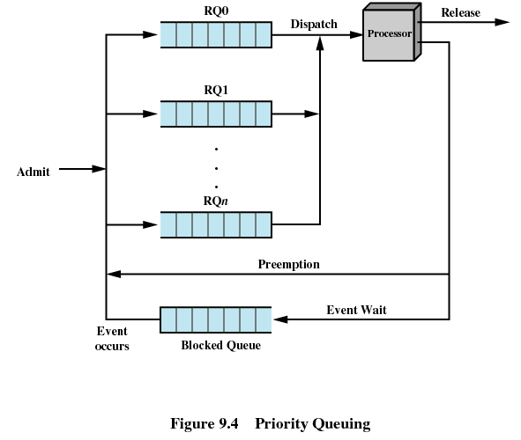
Priority Implementation: Queuing
Have multiple ready queues to represent each level of priority
Move process data between queues according to scheduling algorithm

Slide 16
Priority Inversion and Inheritance
Problem: Priority Inversion
Occurs when circumstances within the system force a higher priority task (here: T₁) to wait for a lower priority task (here: T₂)
Solution: Priority Inheritance
Lower-priority task (here: T₃) inherits priority of any higher priority task (here: T₁) pending on a resource they share

Slide 17
Questions & Tasks
  What are prerequisites for preemptive scheduling? Who preempts and how can this work if a process does not “want” to leave the processor?
  Is preemptive scheduling really transparent to processes?
  What are typical low-priority or high-priority processes, respectively?
  Go through the example for priority inversion/inheritance and try to understand it! Do you find an example in everyday life?

Slide 18
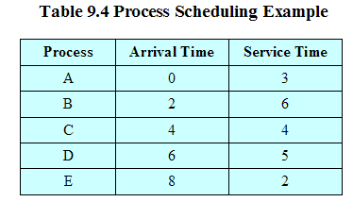
Scheduling Algorithm Classes
Non-preemptive
  First-Come-First-Served (FCFS)
  Shortest Process Next (SPN)
  Highest Response Ratio Next (HRRN)
Preemptive
  Shortest Remaining Time (SRT)
  Round-Robin
  Feedback
Example workload

Slide 19
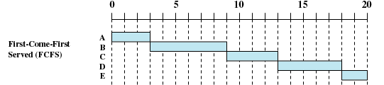
First-Come-First-Served (FCFS)
New process placed at end of Ready queue
When current process ceases to execute, oldest process in the Ready queue is selected
Short process may have to wait a very long time before it can execute
  Poor response time / interactivity
Favors CPU-bound processes
  I/O processes have to wait until CPU-bound process completes, since I/O processes frequently call into OS

Slide 20

Shortest Process Next (SPN)
Process with shortest expected processing time is selected
  OS may abort processes with incorrect time estimates
Short processes jump ahead of longer processes
Improves interactivity (based on assumption that short processes are due to user interaction)
Predictability of longer processes is reduced
Possibility of starvation for longer processes

Slide 21

Highest Response Ratio Next (HRRN)
Choose next process with the highest ratio
Even long process will run eventually
Generally, predictable response times not feasible without preemption
time spent waiting + expected service time
expected service time

Slide 22

Shortest Remaining Time (SRT)
Ready queue is sorted by remaining processing time
  Requires estimate of remaining processing time
New processes may preempt current process upon arrival
  Preemptive version of shortest process next policy
Improved response time of short processes by using preemption
  Limited additional overhead due to process switches upon process creation
But what happens to interactive requests that don’t spawn a new process?

Slide 23

Round-Robin
Each process may use CPU for given amount of time
  Process preemption based on clock interrupt generated at periodic intervals, i.e., time slicing
  Time quantum q as tunable parameter
When interrupt occurs, currently running process is placed in Ready queue, next ready job is selected
Initial support for interactivity
Scheduling overhead (scheduling decision, process switch)
  Tradeoff between interactivity and efficiency, directly tunable by q
Problematic for I/O processes that hardly ever use full quantum

Slide 24
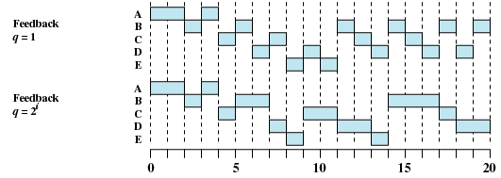
Feedback
Processes start in the queue with highest priority RQ₀ and move to queues with lower priority after each time slice
  Multiple queues with different priorities
For fairness, allow longer time slices q for queues RQ_{i}
Penalize long running processes
No need to know remaining execution time of process

Slide 25
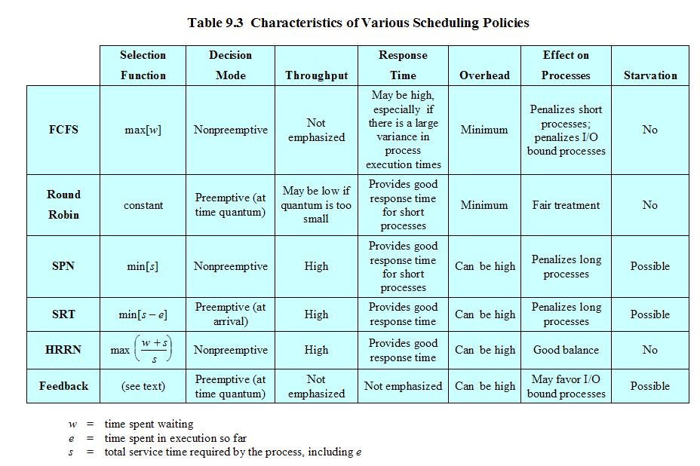
Qualitative Comparison of Policies
w = time spent waiting, e = time spent in execution so far, s = total service time required by process, including e

Slide 26
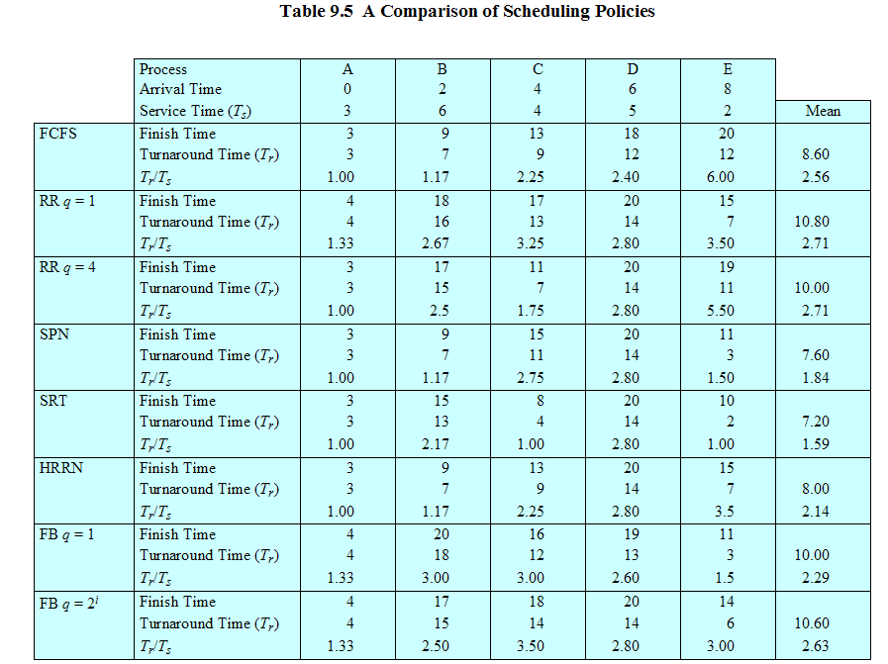
Quantitative Comparison of Policies

Slide 27
Questions & Tasks
  Which scheduler is good for long jobs, gaming console, guaranteed processing time, normal PC, elevator controller, mobile phone? Why? (and remember: it depends …)
  Go through the comparison table and try to understand the figures (e.g. what does T_{r} mean?)! Is there a winner?

Slide 28
Multiprocessor and Real-Time Scheduling

Slide 29
Multiprocessor Scheduling
Assignment of processes to processors
  Permanently assign process to a processor
  Treat processors as a pooled resource and assign process to processors on demand
    Possibly move running process between processors (expensive!)
Architectures
  Global queue: schedule to any available processor
  Master/slave: Key kernel functions always run on a particular processor, master is responsible for scheduling
  Peer: Operating system can execute on any processor, each processor does self-scheduling
Use of multiprogramming on individual processors
Actual dispatching of processes

Slide 30
Real-Time Scheduling
Correctness of system depends
  on logical result of the computation
  AND on time at which the results are produced
Tasks or processes attempt to control or react to events that take place in outside world
Examples:
  Control of laboratory experiments
  Process control in industrial plants
  Robotics
  Air traffic control
  Telecommunications
  Military command and control systems
Real-time applications are not (that much) concerned with speed but with completing tasks

Slide 31
Real-Time Scheduling: Examples

Slide 32
Questions & Tasks
  Do you use real-time operating systems in your everyday life?
  And what about multiprocessor scheduling?
  Why is it expensive to move a process from one processor to another?
  What happens if a process announces a wrong deadline or has an infinite loop in RT-scheduling? What can the OS do?

Slide 33
Examples: Traditional UNIX Scheduling
Multilevel feedback using round robin within each priority queue
If running process does not block or complete within one second, it is preempted
Priorities are recomputed once per second
Base priority (set upon process creation) divides all processes into fixed bands of priority levels

Slide 34
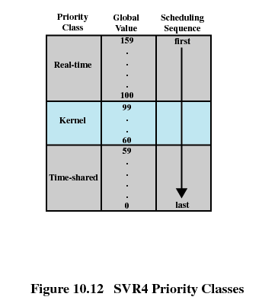
Examples: UNIX SVR4 Scheduling
Preemptable static priority scheduler
Introduces set of 160 priority levels divided into three priority classes
  Highest preference to real-time processes
  Next-highest to kernel-mode processes
  Lowest preference to other user-mode processes
In-kernel preemption points, i.e. long running kernel operations may be preempted
SVR4 Priority Classes:
  Real time (159 – 100)
  Kernel (99 – 60)
  Time-shared (59-0)

Slide 35
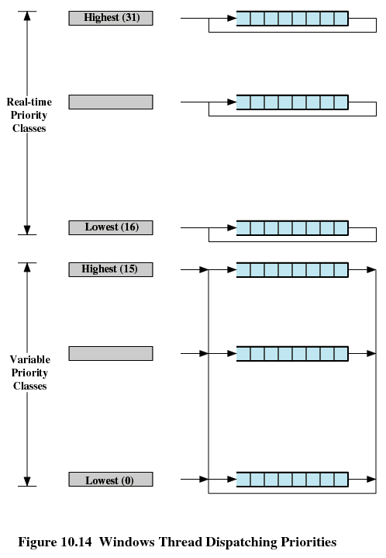
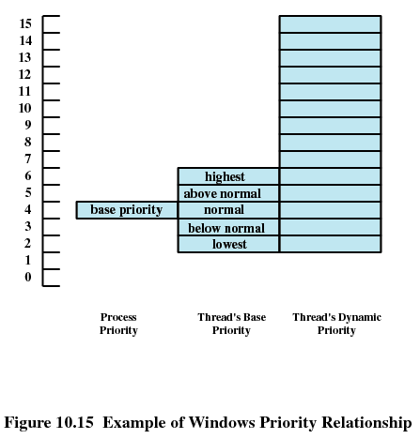
Examples: Windows Scheduling
Priorities organized into two bands or classes
  Real time
  Variable
Priority-driven preemptive scheduler within each class

Slide 36
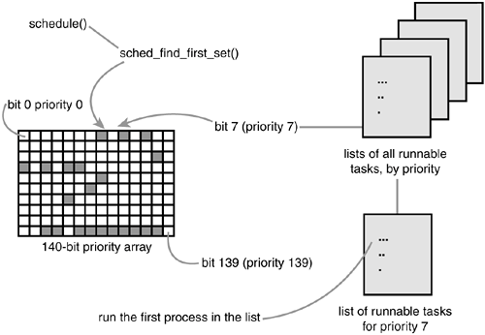
Example: Linux O(1) Scheduling
Scheduling algorithm needs to scale with number of processes
  Variable overhead unacceptable for real-time systems
Linux O(1) scheduler
  Active/expired bit arrays for priorities; one list per priority
  Priority assigned based on
    Static (process) priority
    Heuristics to determine interactivity requirements, e.g. CPU- vs. I/O-bound
  Process timeslice (i.e. runtime in relation to other processes) calculated when process moves from active to expired state
  Switch from active to expired bit array when all processes have used their timeslice
  Scheduling decision in constant time

Slide 37
Related System Calls (Linux)
int sched_yield(void)
  Voluntarily yield processor, e.g. when waiting for input
int getpriority(int which, int who)
int setpriority(int which, int who, int prio)
  Get/set priority of user, group or process (which) with ID who
  Library interface: int nice(int inc)
    Increment how nice you are; only root is allow not to be nice
int sched_get_priority_max(int policy)
int sched_get_priority_min(int policy)
  Returns max/min priority values for given scheduling policy

Slide 38
Related System Calls (Linux, cont.)
int sched_setscheduler(pid_t pid, int policy,
conststruct sched_param *param)
int sched_getscheduler(pid_t pid)
  Controls which scheduling policy to use for a process
  Policies are SCHED_BATCH, SCHED_FIFO, SCHED_RR and SCHED_OTHER
int sched_setparam(pid_t pid, const struct sched_param
*param)
int sched_getparam(pid_t pid, struct sched_param *param)
  Get/set policy specific scheduling parameters
int sched_setaffinity(pid_t pid, unsigned int
cpusetsize, cpu_set_t *mask)
int sched_getaffinity(pid_t pid, unsigned int
cpusetsize, cpu_set_t *mask)
  Controls on which CPU in multi-processor system a process can/should run

Slide 39
Content
Introduction and Motivation
Subsystems, Interrupts and System Calls
Processes
Memory
Scheduling
I/O and File System
Booting, Services, and Security

