Slide 1
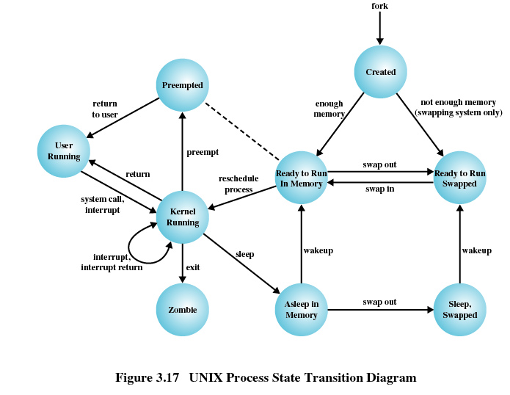
TI III: Operating Systems & Computer Networks Processes
Prof. Dr.-Ing. Jochen Schiller
Computer Systems & Telematics
Freie Universität Berlin, Germany

Slide 2
Content
Introduction and Motivation
Subsystems, Interrupts and System Calls
Processes
Memory
Scheduling
I/O and File System
Booting, Services, and Security

Slide 3
Definitions of a Process
Program in execution
Instance of a program running on a computer
There may be multiple instances of the same program, each as a separate process
Unit characterized by
Execution of a sequence of instructions
Current state
Associated block of memory

Slide 4
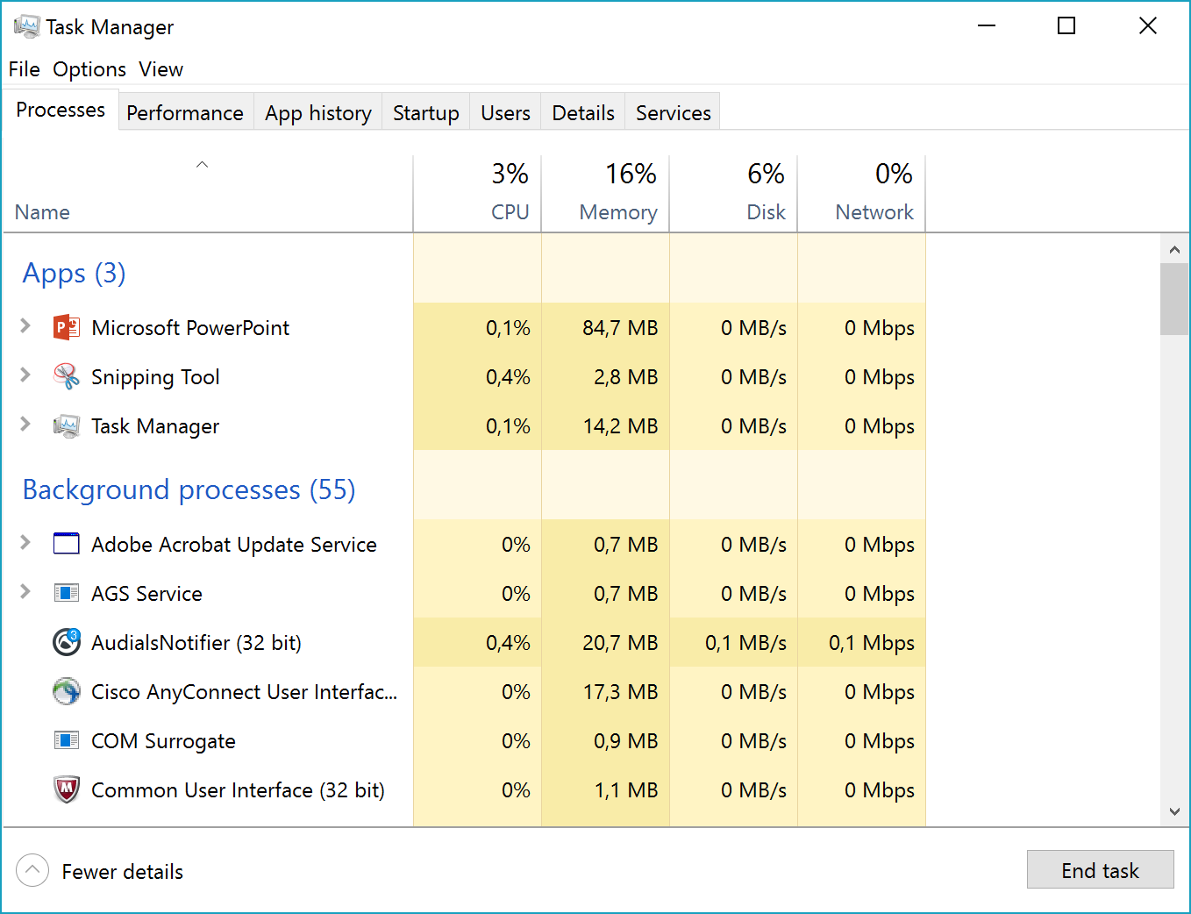
Related Concepts to “Process”
Thread: One (of several) runtime entities that share the same address space
Easy cooperation, requires explicit synchronization
A process may consist of several threads
Application: User-visible entity, one or more processes

Slide 5
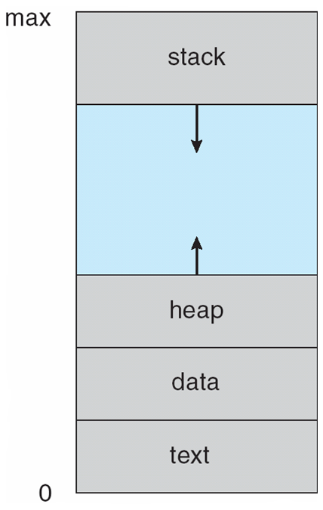
Program vs. Process
Multiple parts
Program code ➙ text section
Current activity ➙ program counter, processor registers
Stack ➙ temporary data
Data section ➙ global variables
Heap ➙ dynamic memory
Program is passive entity, process is active
Program becomes process when executable file loaded into memory
One program can be several processes

Slide 6
Tasks of an OS concerning processes
Interleaved execution (by scheduling) of multiple processes
Maximization of processor utilization
Reduction of response time
Allocation of resources for processes
Consideration of priorities
Avoidance of deadlocks
Support for Inter-Process Communication (IPC)
On-demand user-level process creation
Structuring of applications

Slide 7
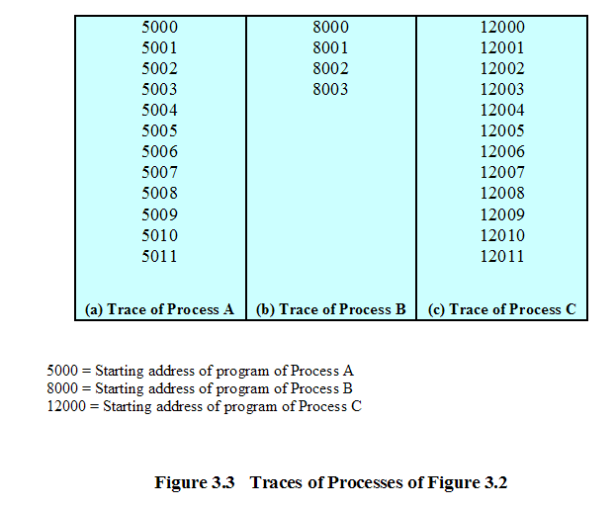
Process execution (Trace)

Slide 8
Process execution (Trace)

Slide 9
Questions & Tasks
Check the number and type of processes and threads running on your computer – surprised?
What are many of the “invisible” processes used for? Who started them?
Why can several instances of the same program running as individual processes make sense?
What could be disadvantages?
Who is responsible for the “interleaved execution” of multiple processes?
But how can this be done if we assume a single processor running a single process that does not want to leave this processor?
Name some criteria for schedulers!

Slide 10
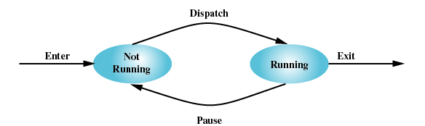
Simple Process Model
Process is in one of two states:
running
not running
How to implement?

Slide 11
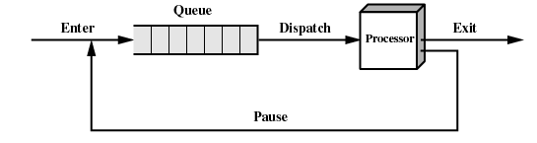
Simple Process Model
Running processes managed in queue:
What information required?

Slide 12
Process Control Block (PCB)
Definition: OS data structure which contains the information needed to manage a process (one PCB per process)
Process identifiers | IDs of process, parent process, and user
CPU state | User-visible registers Control and status registers: Stack pointer (SP) Program counter (PC) Processor status word (PSW)
Control information | Scheduling information: Process state, priority, awaited event Accounting information: Amount of memory used, CPU time elapsed Memory management: Location and access state of all user data I/O management: Devices currently opened (files, sockets)

Slide 13
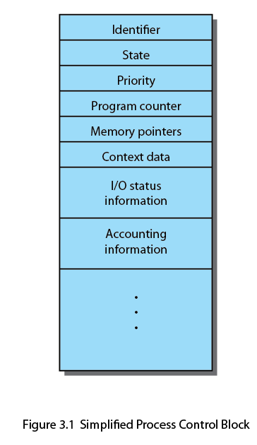
Process Control Block (PCB)

Slide 14
Reasons for Process Creation
Interactive logon
User logs onto a terminal
May create several processes as part of logon procedure (e.g. GUI)
Created by the OS to provide a service
Provide a service to user program in the background (e.g. printer spooling)
Either at boot time or dynamically in response to requests (e.g. HTTP)
Spawned at application start-up
Separation of a program into separate processes for algorithmic purposes
Always spawned by existing process
Operating system creates first process at boot time
Processes are organized in a tree-like structure (`pstree`)

Slide 15
Process Termination
Execution of process is completed
process terminates itself by system call
Other user process terminates the process
Parent process or other authorized processes
OS terminates process for protection reasons
Invalid instruction (process tries to execute data)
Privileged instruction in user mode
Process tries to access memory without permission
I/O-Error
Arithmetic error
Some exceptions can be caught and handled by the process.

Slide 16
Questions & Tasks
What are disadvantages of the simple FIFO-queue in our simple process model?
What could be alternatives?
Start your favorite process monitor, then start programs, use them, terminate them and monitor the list of current processes and threads to get a better understanding of your system!
How can you kill a process that goes crazy?
Can you (as a normal user) kill all processes? Try it and see what happens! PLEASE: Do not do this while running anything important, save all files before you do this …
What is the role of a administrator/root/superuser in this context?

Slide 17
Process Model
Simple model with two states
Problems
Most of the processes will be waiting for IO
Different IO devices
Different priorities
➔ Extend the model

Slide 18
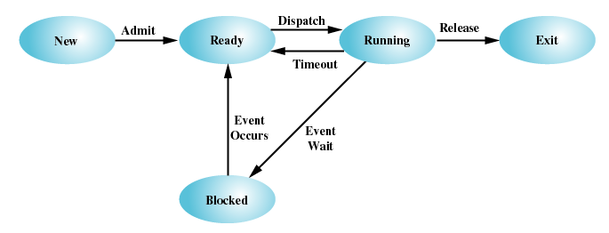
Extended Process Model
Five states including creation, termination, and resource handling:
Running: currently being executed
Ready: ready to run, waiting for execution
Blocked: not ready to run, waiting for external event, e.g., completion of I/O operation
New: newly created process, not yet in running set
Exit: completed/terminated process, removed from running set

Slide 19
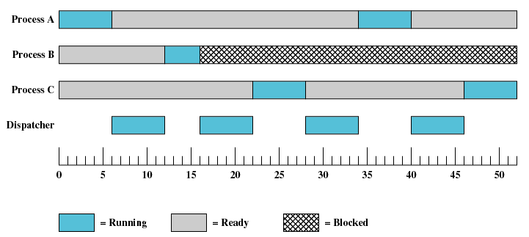
Process States over Time

Slide 20
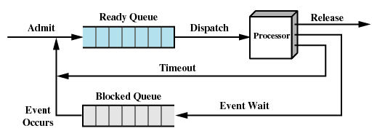
Implementation of Process States
Assign process to different queues based on state of required resources
Two queues:
Ready processes (all resources available)
Blocked processes (at least one resource busy)
But what happens if processes need different resources?

Slide 21
Improved Implementation
Several queues one for each resource / type of resource
More efficient, but fairness issues must be considered
Ready Queue
Release
Admit
Dispatch
Processor
Timeout
Event 1 Queue
Event 1 Wait
Event 1
Occurs
Event 2 Queue
Event 2
Event 2 Wait
Occurs
Event
Queue
n
Event
Wait
Event
n
n
Occurs
(b) Multiple blocked queues

Slide 22
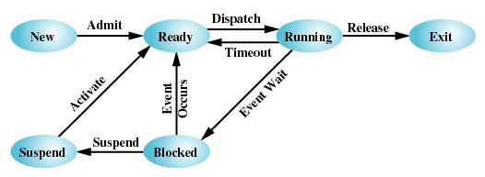
Suspension / Swapping of Processes
Swapping motivated by two observations:
Physical main memory is (was) a scarce resource
Blocked processes may wait for longer periods of time (e.g. during I/O, while waiting for requests, ...)
➔ Swap blocked processes to secondary storage thereby reducing memory usage

Slide 23
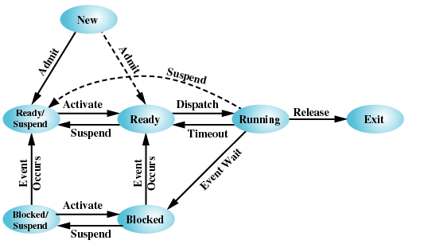
Extended Process State Diagram
Two additional considerations
Blocked/swapped processes may become ready to run when event occurs
Ready and/or running processes may be swapped even without waiting for event

Slide 24
Questions & Tasks
What is a typical state for a typical program you use, such as e.g. text processing, email, chat etc.?
So what is your computer normally doing (unless you are an active gamer…)?
How do interrupts fit into the picture of processes, queues, scheduling?
How and where to implement different priorities?
What does swapping involve? Think of the memory hierarchy!
Can you notice swapping?
Can we swap all processes?

Slide 25
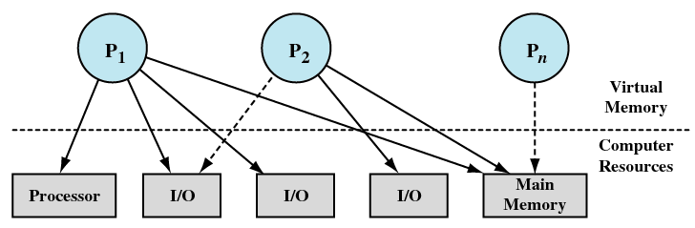
Processes and Resource Allocation
Process state reflects allocated resources:
Running
Blocked
Ready/Suspended
Required resource available
Required resource not available

Slide 26
Global data structures for processes and resources usage
Process tables:
Process Control Block (PCB)
Location of process image in memory
Resources (process-specific view)
Memory tables:
Allocation of primary and secondary memory
Protection attributes of blocks of (shared) memory
Virtual memory management
I/O tables:
Allocation of I/O devices, assignment to processes
State of current operation and corresponding memory region
File tables:
Currently open files
Location on storage media / secondary memory
State and attributes

Slide 27
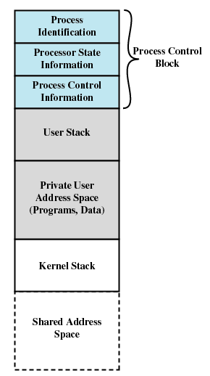
Process Control Table and Image
Process
Memory Tables
Image
Process
Memory
1
Devices
I/O Tables
Files
Processes
File Tables
Primary Process Table
Process 1
Process 2
Process 3
Process
Image
Process
n
Process
n

Slide 28
Kernel / Process Implementations
Separated kernel and processes:
Separate memory and stack for kernel
Kernel is no process
➔ Expensive and unsafe
P
P
P
1
2
n
Kernel
(a) Separate kernel

Slide 29
Kernel / Process Implementations
Execution of system calls as part of user process, but in kernel mode:
Kernel functions use same address space
Same process switches into privileged mode (Ring 0)
➔ Less expensive and quite safe
P
P
P
1
2
n
OS
OS
OS
Func-
Func-
Func-
tions
tions
tions
Process Switching Functions
(b) OS functions execute within user processes

Slide 30
Kernel / Process Implementations
Microkernel:
Collection of system processes that provide OS services
➔ Quite expensive but very safe
P
P
P
OS
OS
1
2
n
1
k
Process Switching Functions
(c) OS functions execute as separate processes

Slide 31
Questions & Tasks
Make sure you understand how to implement tables, references to tables, pointers etc.!
What is “expensive” when it comes to certain kernel/process implementations?
What can be “unsafe”?
Read e.g. https://www.oreilly.com/library/view/understanding-the-linux/0596002130/ch01s06.html to get more insight! (Understanding the Linux Kernel, Daniel P. Bovet, Marco Cesati, O’Reilly)

Slide 32
Example: UNIX – Architecture
Process architecture that executes kernel functions in the context of a user process
Two modes are used: user / kernel mode (Ring 3/Ring 0)
Two types of processes: system / user processes
➔ System processes are implemented as part of kernel to run background services, e.g. swapping
P
P
P
1
2
n
OS
OS
OS
Func-
Func-
Func-
tions
tions
tions
Process Switching Functions

Slide 33
Example: UNIX – Process State Diagram

Slide 34
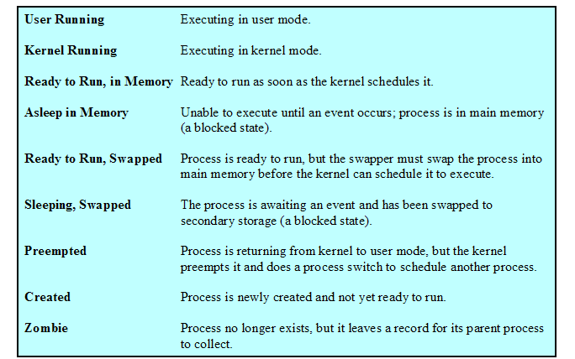
Example: UNIX – Process States

Slide 35
Related System Calls
int execve(const char *filename, char *const argv[], char *const envp[])
Executes program pointed to by filename with arguments argv and environment envp (in the form of key=value)
Effectively replaces the current program with another one
➔ exec() family of library function
pid_t fork(void)
Creates child process that differs from parent only in its PID (process identifier) and PPID (parent process identifier)
Returns 0 for child process and child’s PID for parent process
void _exit(int status)
Terminates calling process; closes open file descriptors; children are adopted by process 1; signals termination to parent
➔ exit() library function
pid_t wait(int *status)
Wait for state change in child of calling process

Slide 36
Programming Example
#include <stdio.h>
#include <stdlib.h>
#include <sys/wait.h>
main()
{
int status;
pid_t pid;
pid = fork();
if(pid == 0) {
printf("Child process running...\n");
// Do something...
printf("Child process done.\n");
exit(123);
}
else if(pid > 0) {
printf("Parent process, waiting for child %d...\n", pid);
pid = wait(&status);
printf("Child process %d terminated, status %d.\n", pid, WEXITSTATUS(status));
exit(EXIT_SUCCESS);
}
else {
printf("fork() failed\n");
exit(EXIT_FAILURE);
}
}

Slide 37
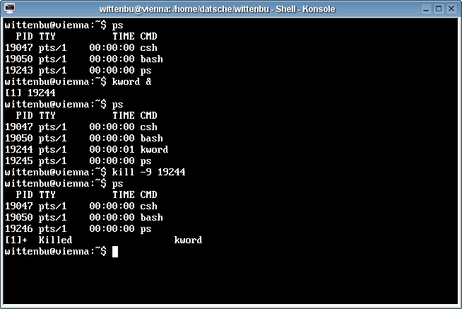
User-Level Process Control

Slide 38
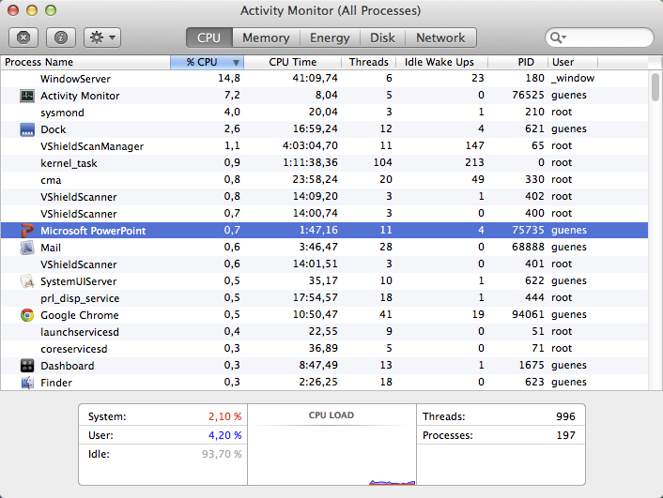
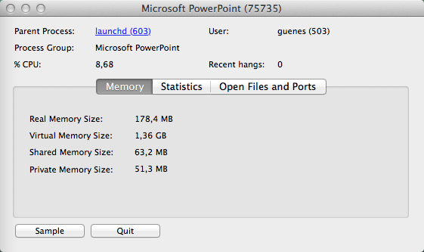
User-Level Process Control

Slide 39
Content
Introduction and Motivation
Subsystems, Interrupts and System Calls
Processes
Memory
Scheduling
I/O and File System
Booting, Services, and Security

