Slide 1

CONTENT of this CHAPTER
  DNS
  HTTP and WWW
  EMAIL
  SNMP

Slide 2
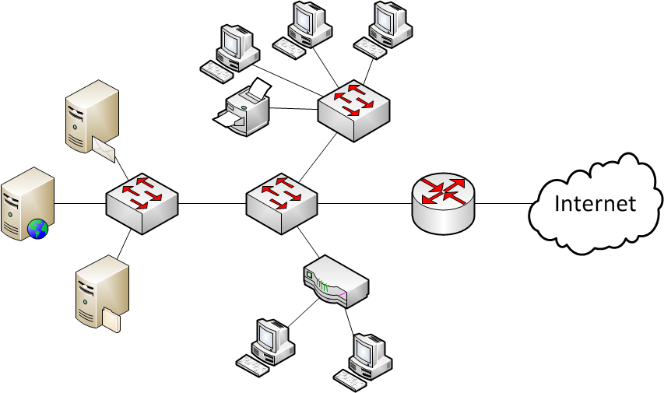
Problems in the Network?
?
?
?
?
?
?
Is it a host problem?
Weird switch behavior?
Misconfigured box? (proxy?)
Is a box out of service?
Some networks are LARGE
Reachability of elements?
We need a management tool!
Notes:
Maybe some animation of failures?
What‘s the goal? Monitor your network.
Let‘s say for example a user complains his internet connection is slow.
Is it because of his computer?
Is it because of a weird behavior of a switch somewhere in the network?
Is another box badly configured?
Is a box out of service?
Need a tool to make remote diagnostics
Need a tool for accounting of network usage
Use statistics and accounting to diagnostic/signal attacks (security). Eg. Trigger on packets/s on an interface raises alarm for DoS
Use statistics and accounting for network planning. Eg. Statistic of usage/load (per day, per week) on some boxes hints at extending/replacing them, or reconfiguration

Slide 3
Management Functionalities Needed
Performance Management
  Measure and analyze network performance to provide good network service
  e.g. measure throughput, response times (RTT), line utilization (load).
Configuration Management
  Monitor or modify configuration settings of hardware or software elements
Accounting Management
  Measure network utilization parameters per user, or per group of users
Fault Management
  Detect, log, notify users, and automatically fix network problems to keep running
Security Management
  Control access to network resources according to local guidelines so that the network cannot be sabotaged (intentionally or unintentionally) and sensitive information cannot be accessed by those without appropriate authorization.
Notes:
Security (control access, intrusion detection system, intrusion prevention system).
Distinguish heavy user from an attack? Sometimes difficult.
All these aspects are vital to network operator‘s business...

Slide 4
Implementing Network Management – Requirements
Goals of network management
  Monitoring of network equipment
  Statistics of network usage
  Remote diagnostics
  Protected and safe networking
  Efficient (inter)networking
  Simple model of network status
  Gather data for network planning
Should be achieved remotely over the existing network!
We need a protocol above IP!
What requires network mgmt.?
Users & authorization
  Authentication and identification
  Addressing
  Roaming profiles and services
Applications & services
  Mail, DNS, …
  IP telephony, broadcasting
Devices & infrastructure
  Routers, switches, server …
  Bandwidth, buffers, policies
Heterogeneous information sources.
System-independent description of the information structure needed.
Notes:
Use statistics and accounting to diagnostic/signal attacks (security). Eg. Trigger on packets/s on an interface raises alarm for DoS
Use statistics and accounting for network planning. Eg. Statistic of usage/load (per day, per week) on some boxes hints at extending/replacing them, or reconfiguration

Slide 5
About SNMP
  Protocol Overview
  Managed Objects
  SNMP Operations
  Abstract Representation of Heterogeneous Data
  Tools

Slide 6
Simple Network Management Protocol (SNMP)
Objectives of SNMP
SNMP allows management of devices and services
Use a simple datagram service
Network management framework with SNMP
Client-Server architecture (but many more servers than clients!)
  Agent: process continuously running on each managed node collecting information about the device it is running on.
  Manager: process running intermittently on a management workstation that requests information about devices on the network.
Proxy agent: process integrating non-SNMP capable systems
Meta description of management information
Notes:
There are several versions of SNMP, but they all use this concept.

Slide 7

Describing and Accessing Management Information
Describing Management Information
SMI: Structure of Management Information
  Rules specifying how the monitored information is structured
  Format used to define objects that the SNMP protocol accesses over the network
MIB: Management Information Base
  Open concept for data storage
  Describes the concrete managed objects
  Standard (see RFCs) and private (proprietary) MIBs
Accessing Management Information
SNMP: Simple Network Management Protocol
  Defines format of messages exchanged by management systems and agents.
  Defines basic operations: Get, GetNext, Set, and Trap
Notes:
Fundamental questions:
How do Agents and Managers talk to each other?
Specified by the SNMP protocol
Specifies packet formats, and basic operations Get, GetNext, Set and Trap (we’ll get to that)
(Omitted: SNMP is based on UDP  connectionless)
How are Monitoring Information structured?
Say you want to ask a router who has a temperature sensor: how warm is it in the room, how warm is your processor?
(integer? OK. But coded on 16bit, 32bit, 64bit? Little Endian, Big Endian?) Need to know the structure/format of this information.
Where is this information located?
MIB: hierarchical structure of managed objects to find your way in an agent’s database.

Slide 8

Different SNMP Versions
1988 SNMPv1 was designed originally as an interim solution (RFC 1157), but it is now de-facto standard in LANs
  Problem: Very weak security model, complex bulk requests
SNMPv2 (RFC 1441–RFC 1452) has then become split into:
  SNMPv2u - SNMPv2 with user-based security
  SNMPv2* - SNMPv2 with user-based security and additional features
  SNMPv2c - SNMPv2 without security but with GetBulk operation
Current version is SNMPv3 according to RFC 3411-RFC 3418
  Provides advanced security model

Slide 9
Example Scenario
SNMP service for the management of network resources
  e.g. printers, bridges, router, hosts, etc.
Managed resources have an integrated SNMP agent (software)
  agents maintain management data, e.g. # of received/dropped/send packets
The manager communicates
with the agents using SNMP
  Remark: HTTP would suffice
  for a very small home network
  SNMP more suitable for large
  networks & automatization
Content of the communication
between manager and agent:
Management-Objects
Agent
Agent
Agent
SNMP
Manager
SNMP
SNMP
Notes:
(Omitted: SNMP is based on UDP )
Comment: one could use HTTP instead of SNMP. Just need a webserver running on each agent (which actually is the case for many devices nowadays, for printers, routers etc.)
This is good to manage your network at home. But SNMP is more appropriate to address larger networks and automatization etc.

Slide 10
About SNMP
  Protocol Overview
  Managed Objects
  SNMP Operations
  Abstract Representation of Heterogeneous Data
  Tools

Slide 11

Managed Objects
An agent monitors its “network resources”, abstracted as managed objects
  Modeling various properties of a network resource
  Standard components of a managed object:
    Common prefix + Unique name: iso.org.dod.internet.mgmt.mib.system.sysDescr
    Syntax: Simple data types (Integer, String, Array)
    Access rights: read-only, read-write
    Status: mandatory, optional
Management Information Base (MIB)
  Collection of all managed objects
  Distributed virtual data base
Management Information Tree (MIT)
  Each managed object has a unique position in the MIT
  Thus provides unique reference
  Tree similar to DNS. And really BIG.
root
ccitt(0)
iso(1)
...
org(3)
...
mib(1)
system(1)
...
sysDescr(1)
Notes:
The atomic element that is managed in SNMP is called an object (or managed object).
Agent maintains monitored data (e.g. in a printer, number of blank pages left)
Each managed object has same structure including
Unique name, with always same prefix iso.org.dod.internet.mgmt (historical from ISO etc.)
After prefix, real name. Here ist systemDescriptor
Type of data (Integer, string...)
Access rights(Read-only, read-write)
Each managed object has a name that fits into a tree structure (somewhat similar to DNS tree)
This tree is enormous: it‘s the MIT. Collection of leafs of this tree: MIB.
MIB = distributed database over the whole world (on each agent), not centralized.

Slide 12

Modeling of Management Information: MIB and SMI
Structure of Management Information (SMI)
Management Information Base (MIB)
iso(1)
sysDescr OBJECT-TYPE
SYNTAX DisplayString (SIZE (0..255))
ACCESS read-only
STATUS mandatory
DESCRIPTION
"A textual description of the entity. This value
should include the full name and version
identification of the system's hardware type,
software operating-system, and networking
software. It is mandatory that this only contains
printable ASCII characters.“
::= { system 1 }
org(3)
dod(6)
Proprietary object mgmt
(1.3.6.1.4)
internet(1)
directory(1)
mgmt(2)
experimental(3)
private(4)
MOs
MOs
MOs
MOs
Branch (mib.system) and identifier (OID)
MOs
meta data for the managed object
distributed database of MOs
(a piece of it on each agent)
Notes:
Tree structure: name coded with integers
iso.org.dod.internet.private = 1.3.6.1.4
Private is for proprietary object management
(no need to standardize things like for mgmt.mib, which must be approved by the IAB/IETF)
Freie Universität Berlin
iso(1).identified-organization(3).dod(6).internet(1).private(4).enterprise(1).18898
1.3.6.1.4.1.18898
Used in the DES-Testbed
OID Repository
Check which OIDs are available
Resolve OIDs
http://www.oid-info.com

Slide 13

MIB-II (RFC 1213)
MIB-II is the generic MIB for all manageable Internet devices (i.e., generic SNMP device)
MIB-2 prefix: iso(1).org(3).dod(6).internet(1).mgmt(2).mib2(1)
MIB-2 subtree organization:
    system (1)
    interfaces (2)
    at (3)
    ip (4)
    icmp (5)
    tcp (6)
    udp (7)
    egp (8)
    transmission (10)
    snmp (11)
New subtrees can be defined under
.internet.mib-2 (for all standard MIBs)
.internet.mgmt or .internet.experimental (for all experimental MIBs)
.internet.private (for all vendor-specific MIBs)
Notes:
MIB Version 1 (RFC 1156) was shortlived.

Slide 14

RMON: Remote Monitoring
RMON (RFC 1757) = MIB with more advanced functions such as:
  Gathering of statistics, alarms, events
  On-board (partial) evaluations, fine-grained filtering, Packet-Capture, ...
 Shifting of “intelligence” from the management platform to the agent
Example SMI: statistics for oversized packets (>1518 octets)
etherStatsOversizePkts OBJECT-TYPE
  SYNTAX Counter
  ACCESS read-only
  STATUS mandatory
  DESCRIPTION
  "The total number of packets received that were longer than 1518 octets (excluding framing bits, but including FCS octets) and were otherwise well formed."
  ::= {etherStatsEntry 10}
Notes:
More advanced agents: RMON specification
Enables partial evaluation, fine grained filtering on-board at the agent
(Omitted: Can work on top of TCP/IP since version 2 and log appropriate parameters)
Example: Statistics of oversized packets
A counter for valid packets bigger that normal MTU (1518 bytes), excluding framing bits but including FCS octets (Frame Check Sequence, a checksum)

Slide 15
About SNMP
  Protocol Overview
  Managed Objects
  SNMP Operations
  Abstract Representation of Heterogeneous Data
  Tools

Slide 16

SNMP Operations
Manager
Agent
Management Communication
SNMP
GetRequest
SNMP
Get-NextRequest
SetRequest
GetResponse
Trap
Internet
Get/Set operations initiated by SNMP manager
Trap allows SNMP agent to push information to manager
Well-known (UDP) ports assigned to SNMP:
  Port 161 for SNMP messages except Trap which use Port 162
Notes:
Basic commands:
Request = Get
Reply = GetResponse
Put = Set
Browse through the tree = GetNext
Trap = agent-initiated communication with the manager, when something has happened and cannot wait passively for polling

Slide 17

SNMP: Client-Server Principle
Manager
Network
Agent
Manager
Network
Agent
GETREQUEST
(Objekt = x.y)
GETNEXTREQ.
(Objekt = x.y)
GETRESPONSE
(Objekt = x.y)
GETRESPONSE
(Objekt = x.y.a
or x.z)
t
t
t
t
(Lexicographic order)
Manager
Network
Agent
Manager
Network
Agent
SETREQUEST
(Objekt = x.y)
GETRESPONSE
(Objekt = x.y)
TRAP
(Objekt = x.y)
t
t
t
t
(GetBulkRequest = series of GetNextRequests)
Notes:
GetNext: replies with either a child or a neighbor of the object specified in the request (lexicographic order, so child first)
GetBulkRequest to trigger a series of GetNextRequest (introduced in SNMPv2)

Slide 18
SNMP Packet Format: Structure (High Level)
Version
Community
Command dependent PDU part
String used for authentication
(transmitted in plain text)
Version number of SNMP
Notes:
High level structure of SNMP packets.

Slide 19
SNMP Packet Format: Command Dependent Part
PDU-Fields for query/set of managed objects:
PDU-
Type
Request
ID
Error
Status
Error
Index
Object
name 1
Object
value 1
...
Object
name k
Object
value k
Identification of
pending request
Variable-length list of pairs of
(Object name, Object value)
Result of the query
0 – noError
1 – tooBig
2 – noSuchName
3 – badValue
4 – readOnly
5 – genErr
Reference to the
variable binding
pair which caused
the failure.
Error Codes
Notes:
Trap have a different structure

Slide 20
About SNMP
  Overview
  Managed Objects
  SNMP Operations
  Abstract Representation of Heterogeneous Data
  Tools

Slide 21

Heterogeneous Data Representation
Problem: Different computer systems use different data representation (Little/Big Endian, 16/24/32 bit etc.)
  Consequence: Recoding of the data is required
    Coding of the representation (Syntax) of information
    Retain the meaning (Semantic) of information
     Exchange standards are required
Solution: compose content in ASN.1 syntax, transfer content using BER
24 bit Integer
32 bit Integer
Native representation of information
Transparent transmission is not enough
Native representation of information
0
Recoding
1
0
2
1
2
Notes:
This standard recoding needs to define a syntax that can retain the semantic of say:
a system using 24 bit integers, communicating with a system using 32 bit integer
On the network, you can find weird machines, based on 8-bit microcontrollers!
They count differently than your laptop.
So you need to recode data to be transmitted on the network.

Slide 22
Content Composition Syntax: ASN.1
ASN.1 (Abstract Syntax Notation One)
  ISO standardized language for representation-independent specification of data types
  Is used in SNMP to describe management objects
Elementary data types
  Boolean, Integer, Bitstring, Octetstring, IA5String, …
Structured data types
  Sequence: Ordered list of data types (Like record in PASCAL)
  Set: Unordered set of data types
  Sequence Of: Like an array in C
  Set Of: Unordered set of elements from the same data type
  Choice: Like union structure in C
Example:
Employee ::= Set {
Name IA5String,
Age Integer,
Personalnr Integer
}
Notes:
ASN.1 is used in this context, to describe data types.
ASN.1 is for example used by SNMP to describe management objects
ASN.1 Defines of basic data types: Booleans, Integer, Bitstrings, Bytestrings (= octetstring) etc.
(=bit array and byte array),
IA5String is a restricted character string type in the ASN.1 notation. It is used to represent ISO 646 (IA5) characters. The entire character set contains precisely 128 characters
ASN.1 also defines some structured data types
Sequence (like record in PASCAL), and equivalents of array and union structure in C
(With a union in C, you're only supposed to use one of the elements, because they're all stored at the same spot. This makes it useful when you want to store something that could be one of several types. A struct, on the other hand, has a separate memory location for each of its elements and they all can be used at once.)

Slide 23
Content Composition Syntax: SNMP Data Types
  INTEGER
    signed 32-bit integer
  OCTET STRING
  OBJECT IDENTIFIER (OID)
  NULL
    not actually data type, but data value
  IpAddress
    OCTET STRING of size 4, in network byte order
  Counter
    unsigned 32-bit integer (rolls over)
  Gauge
    unsigned 32-bit integer (will top out and stay there)
  TimeTicks
    unsigned 32-bit integer (rolls over after 497 days)
  Opaque
    used to create new data types not in SNMPv1
  DateAndTime, DisplayString, MacAddress, PhysAddress,
  TimeInterval, TimeStamp, TruthValue, VariablePointer
    textual conventions used as types
Defined by ASN.1
Defined by RFC 1155
Notes:
SNMP (with RFC 1155) has extended these basic types with other structures such as
IP address
Counter (32 bit + rollover)
Gauge (max out, and stays there, no rollover)

Slide 24

Content Transfer Syntax –Basic Encoding Rules (BER)
ASN.1 content is converted / serialized into smaller, binary data following the Basic Encoding Rules (BER)
  ASN.1 vs BER is similar to source code vs machine code.
ASN.1
defines common abstract syntax
ComputerA
with native syntax
LS_{A}
BER
defines
transfer syntax
ComputerB
with native syntax
LS_{B}
Transmission of data based on a transfer syntax
Notes:
SNMP message are composed in ASN.1 syntax, abstracting the native syntax used on the computer.
These messages are converted into binary data ready to be transmitted according to the Basic Encoding Rules (BER)
The binary is translated back upon arrival at the remote machine, using the local native syntax
This way, computers using different native syntax can still understand each other.
Interoperability!

Slide 25

Transfer Syntax - Basic Encoding Rules (BER)
Type
Length
Value (of given length)
Bit 7 6 5 4 3 2 1 0
Class
Tag Number
P/C
00: Universal
0..30
01: Application
0: primitive
1: constructed
31: next Byte specifies Tag
10: Context Specific
11: Private
Example: Integer value 5
Type
Length
Value
0
0
0
0
0
0
1
0
0
0
0
0
0
0
0
1
0
0
0
0
0
1
0
1
Universal Class
2
1
5
primitive
Integer
Notes:
Syntax: TLV type length value.
Pretty self-contained syntax, at the base of a lot of modern protocols‘ syntax
Example coding Integer value 5:
Subtype: Universal, primitive and tag for integer (2)
Length: 1 byte
Value: 5
Any machine that understands ASN.1 encoding can grasp the semantic, and decode to adapt to the local machine, even if it does not us the same architecture (e.g. 8 bit architecture talking to 32 bit architecture...)

Slide 26
About SNMP
  Overview
  Managed Objects
  SNMP Operations
  Abstract Representation of Heterogeneous Data
  Tools

Slide 27

Management Applications: Command Line Tools
Public Domain Tools (many variants)
  Command line tools: snmpget, snmpnext, snmpwalk, snmpset, …
    Generation and decoding of SNMP data units
    Sometimes also support for MIB files
snmpget -v 1 172.76.14.213 public .1.3.6.1.2.1.1.1.0
system.sysDescr.0 = „TERArouter Network Platform"
snmpwalk -v 1 172.76.14.213 public .1.3.6.1.2.1.1
system.sysDescr.0 = „TERArouter Network Platform"
system.sysObjectID.0 = OID: enterprises.DEC.2.15.3.3
system.sysUpTime.0 = Timeticks: (456990767) 52 days, 21:25:07
system.sysContact.0 = "mueller@mi.fu-berlin.de"
system.sysName.0 = ""
system.sysLocation.0 = ""
system.sysServices.0 = 10
Notes:
Free command line tools:
e.g. snmpget (get a specific value), snmpwalk (explore the tree)
Arguments:
Version –v
IP address destination
Object OID

Slide 28
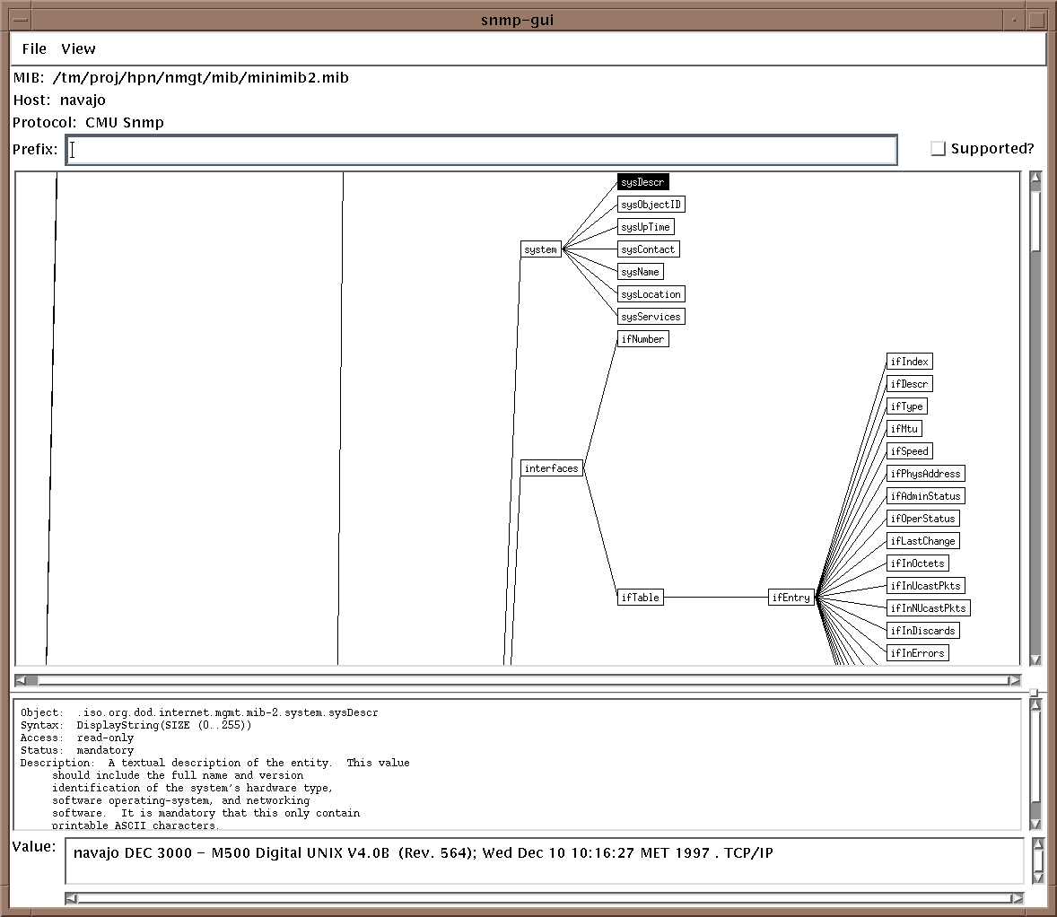
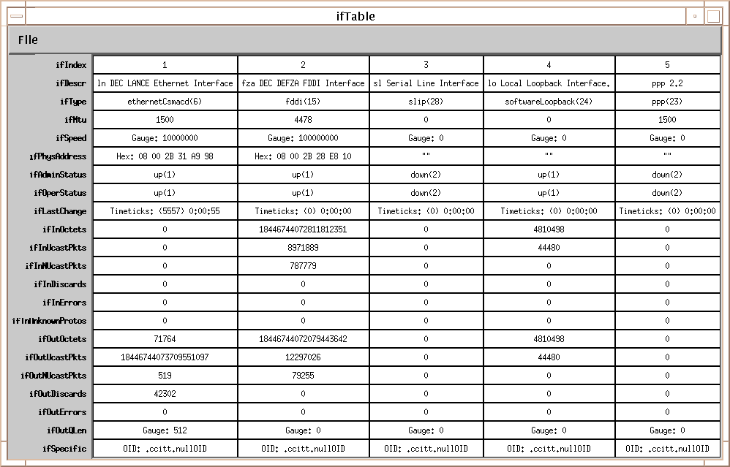

Management Applications: A MIB Browser
(Vintage) MIB browsers: visualizing the Managed Information Tree
Notes:
Some vintage MIB browser (snapshot from a long time ago)
To look at the managed object tree.

Slide 29
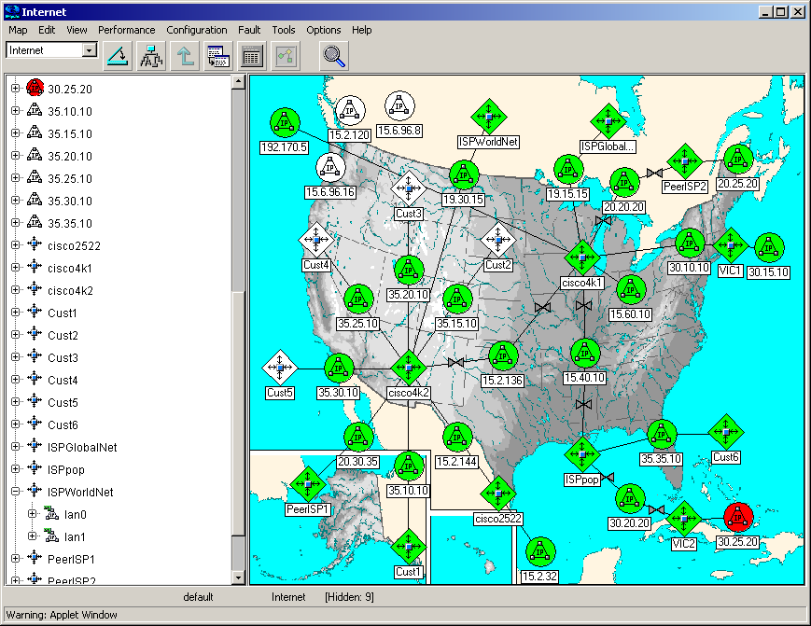
Management Platforms
There are many products since 20 years available which use SNMP
  CiscoWorks2000, IBM Tivoli Netview, HP Network Management Center (was OpenView), Oracle Enterprise Manager…
Very often the platforms provide more functionality than only component management
  Administration
  Business and management processes
  Network planning
  Software distribution
(Vintage) Network Management GUI: is there a problem in Cuba?
Notes:
There are commercial products based on SNMP, sold by Cisco, Oracle etc.
Usually provide more functionalities that only component management
Again: old snapshot (looks better now ;)
Nice colors (show red dot in the GUI: apparently there is a problem here near Cuba)

Slide 30
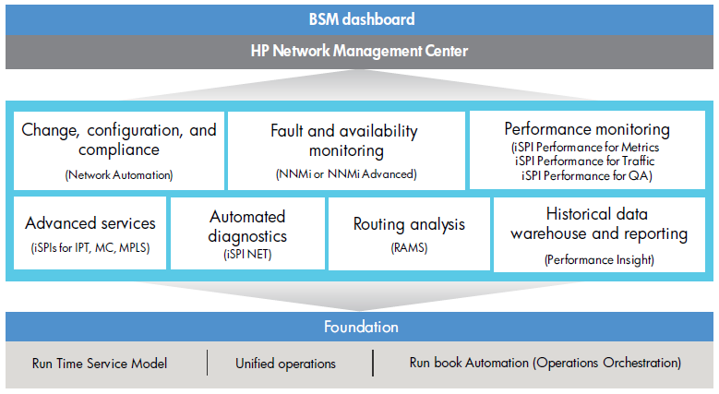

Example: HP Network Management Center
(More modern) tool with modules for:
  Diagnostic
  Load history
  Fault management
  Config. Automation
  …
Notes:
More modern example of tool including different modules for:
Diagnostic
Routing analysis
Load history
Performance monitoring
Fault management
Configuration automation
Etc.
To manage a large network today, you need a tool like this (or other equivalent tools from competitors).
Can‘t consider logging in manually in each and every box!

Slide 31
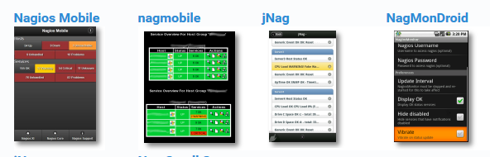
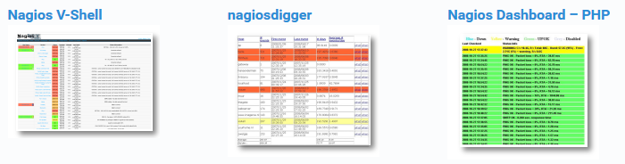

Example of today - Nagios
www.nagios.org – Open Source core system with many, many plug-ins, front-ends etc.
“Marketing arguments“:
  Plan for infrastructure upgrades before outdated systems cause failures
  Respond to issues at the first sign of a problem
  Automatically fix problems when they are detected
  Coordinate technical team responses
  Ensure your organization’s SLAs are being met
  Ensure IT infrastructure outages have a minimal effect on your organization’s bottom line
  Monitor your entire infrastructure and business processes

Slide 32
Summary: Application Layer Protocols
receive(port)
Internet: data delivery service with API send(IP, port, data), receive(port)
What runs on top of this API:
  Mapping names to IP addresses with DNS
  Communicating with Web server with HTTP
  Transferring/accessing Emails with SMTP and POP3/IMAP/HTTP
  Remote management of network elements with SNMP
  And much more…
Virtual Pipe
(Internet)
send(IP address, port, data)
Prof. Dr.-Ing. Jochen H. Schiller www.jochenschiller.de Telematics - 2015/16

Slide 33

Summary: Trends for Application Layer Protocols
From serving fixed users to accommodating mobile prosumers
  More wireless connectivity
  More user-generated content
Evolution driven by conflicting trends
  More P2P vs more client-server
    {WebRTC, BitTorrent…} vs {data centers, the cloud…}
  Personalization vs Privacy
    {cookies, tracking, data = 21st century oil…} vs {encryption, the “right to forget”…}
Centralized approaches have become distributed
  Problem: no single machine can take the full load
  Solution: geographically compact distribution (data centers)

Slide 34

Summary: Some Concepts We Learned
Decrease delay and traffic? Use caching!
  Name resolution
  Proxy Web
Too much load? Spread it on many machines!
  DNS name servers recursive delegation
  Web server 3-tier architecture
  Data center parallel computing
Increase availability or reliability? Replicate!
  DNS name server replication
  Content delivery networks
Notes:
Increase availability or reliability? Replicate!

Slide 35

Summary: Below Application Layer Protocols
receive(port)
OK, we know how we can use the data delivery API
But behind this API, how does it work? What’s inside the blackbox?
  How are bits transmitted over cables or radio?
  What do actual data packets look like in reality?
  How do data packets find their way through the network?
  What mechanisms control packet input and output rate?
Internet
Virtual Pipe
(Internet)
send(IP address, port, data)

Slide 36

Course Organization
The Internet as a Blackbox: Applications
  Basic terminology & concepts (protocols, API…)
  Dive into DNS, Email, HTTP, SNMP & their interface to the blackbox
Opening the Blackbox: The IP Protocol Stack
  Basic terminology & concepts (layers, standard stack…)
  Dive into each layers
New trends in the domain of computer networks
Notes:
Blackbox = virtual pipe connecting computers

Slide 37
Course Organization
The Internet as a Blackbox: Applications
  Basic terminology & concepts (protocols, API…)
  Dive into DNS, Email, HTTP, SNMP & their interface to the blackbox
Opening the Blackbox: The IP Protocol Stack
  Basic terminology & concepts (layers, standard stack…)
  Dive into each layers
New trends in the domain of computer networks
Notes:
Blackbox = virtual pipe connecting computers

