Slide 1

Telematics
Chapter 0
Organizational
Univ.-Prof. Dr.-Ing. Jochen H. Schiller
Freie Universität Berlin
Institute of Computer Science
Computer Systems and Telematics (CST)

Slide 2
Why “Telematics”?
Etymology
Telematics = telecommunications + informatics
= Information and Communication Technologies (ICT)
Similar courses also known as “Computer Networks”
Focus of this course
Interconnecting devices (and people)
Communication aspects
Applications on top
Notes:
Tele= greek root,
means remote or ‚over a distance‘

Slide 3
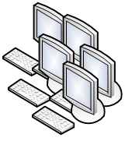




High-level Motivation
More complex than you think
How do you transmit data?
How do you access remotely multiple services from a single host?
How do you achieve scalability?
Notes:
By service we mean: email, or video streaming, or storage etc.
Very Google centric: how do you access something else than Google ;)

Slide 4
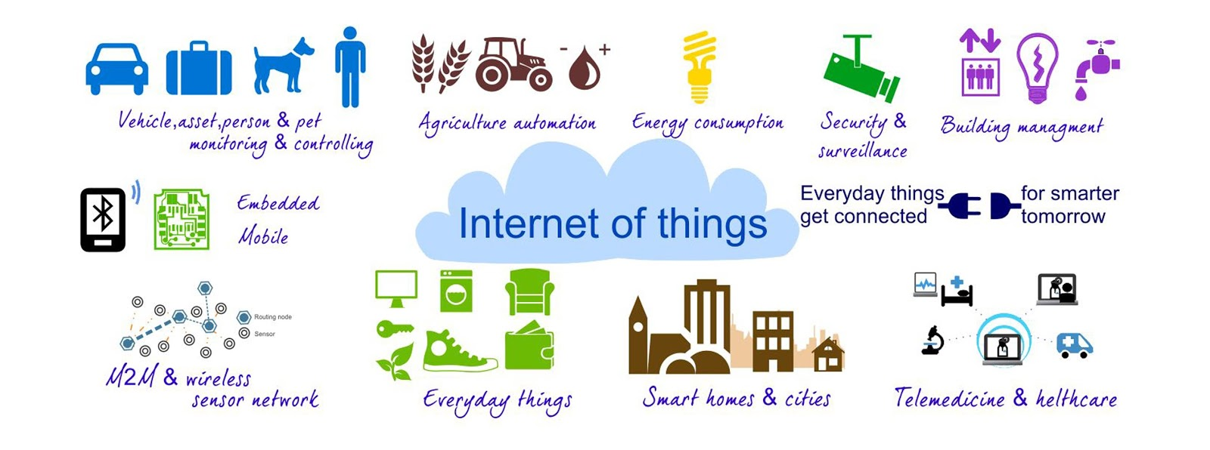

The IoT world
Source: The Telecare Blog, thetelecareblog.blogspot.de, 24.10.14

Slide 5
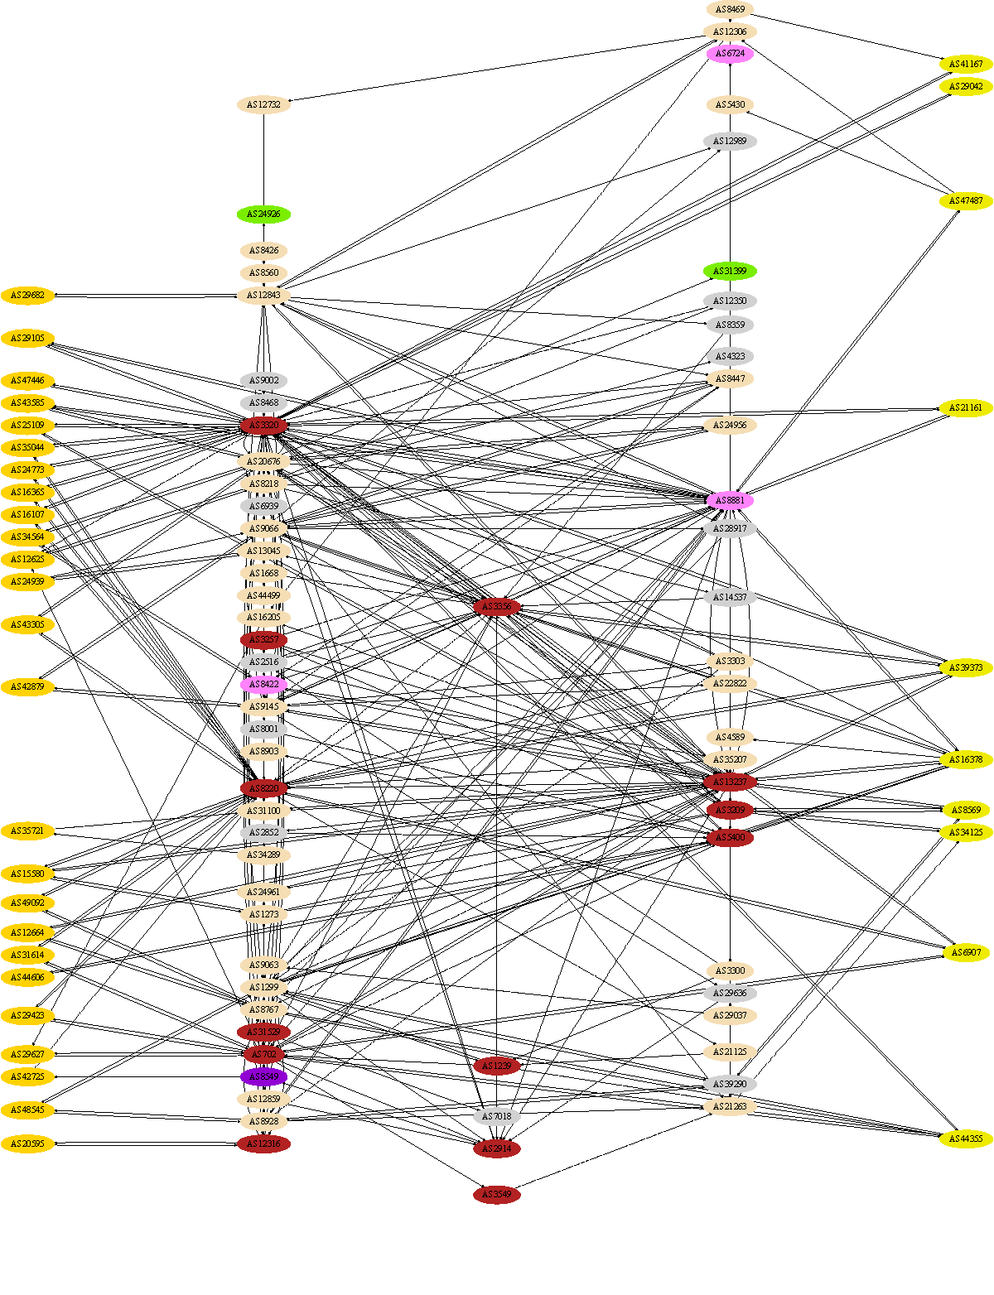
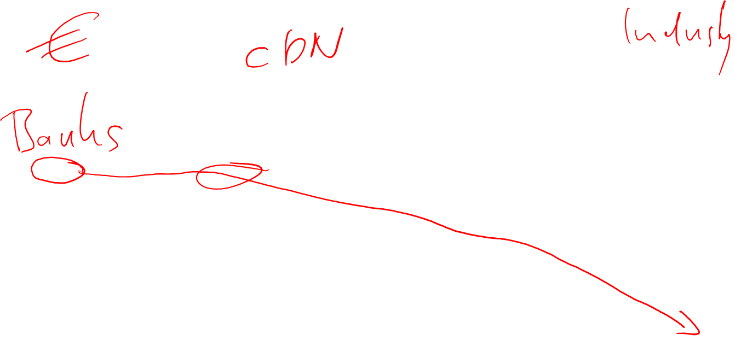
Example for complexity
Information flow between banks (left) and industry (right) “in Germany” as seen by looking at the autonomous systems

Slide 6
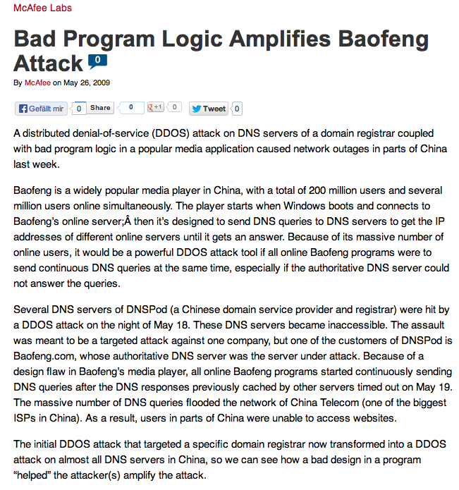
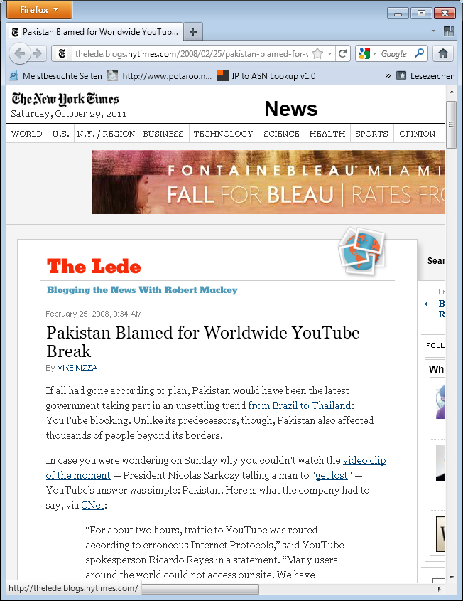

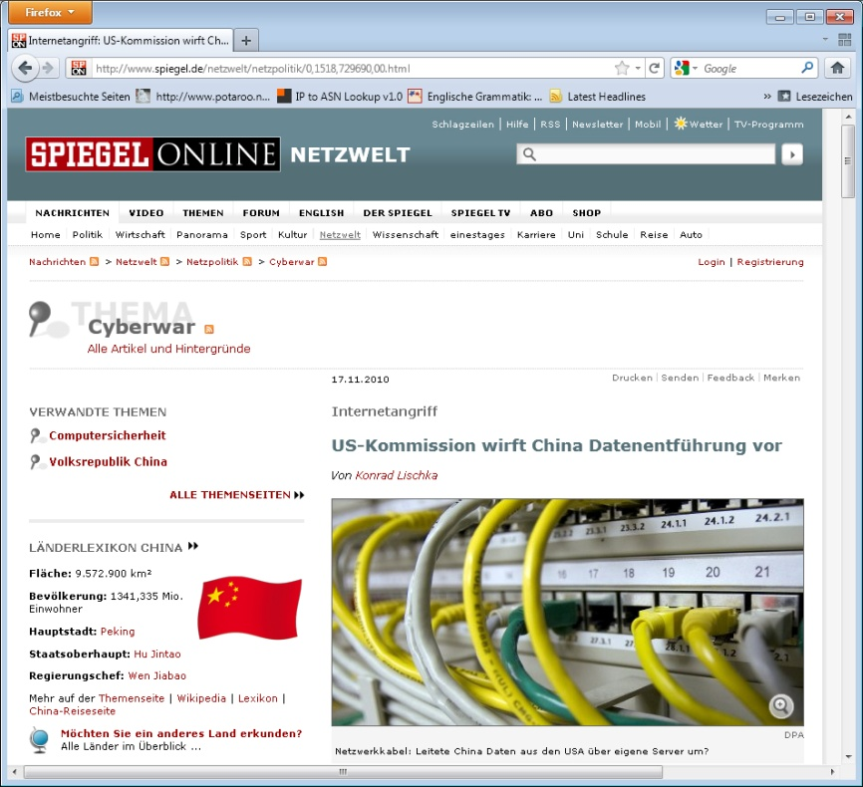
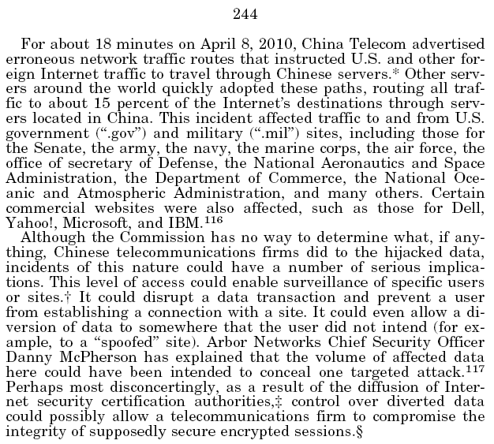
Incidents
Baofeng attack:
475 million users for
9 hours detached
from the Internet

Slide 7

Attacks in mobile phone networks
# Attacks / h
Date

Slide 8
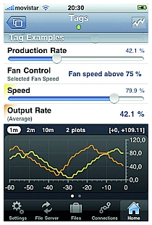
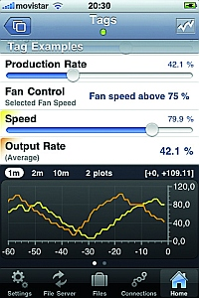

Industrial control systems
Vulnerability of the ICT infrastructure
  analog to the “normal” Internet, same technology
  > 95% of al computers today are embedded control systems
  Vulnerability of control systems
    Smart meter at home, SCADA (supervisory control and data acquisition) in power plants
    Many control systems are open - Never designed for Internet connectivity!
      en.wikipedia.org/wiki/SCADA#Security_issues
    Very simple “access” already available, e.g. Shodan,
  Controllability of complexity
    E.g. estimated 14 million nodes in Bangkok’s energy grid to control and to monitor
Main problem: Without power no ICT – how should ICT then control energy supply?
Source: pacetoday.com.au

Slide 9
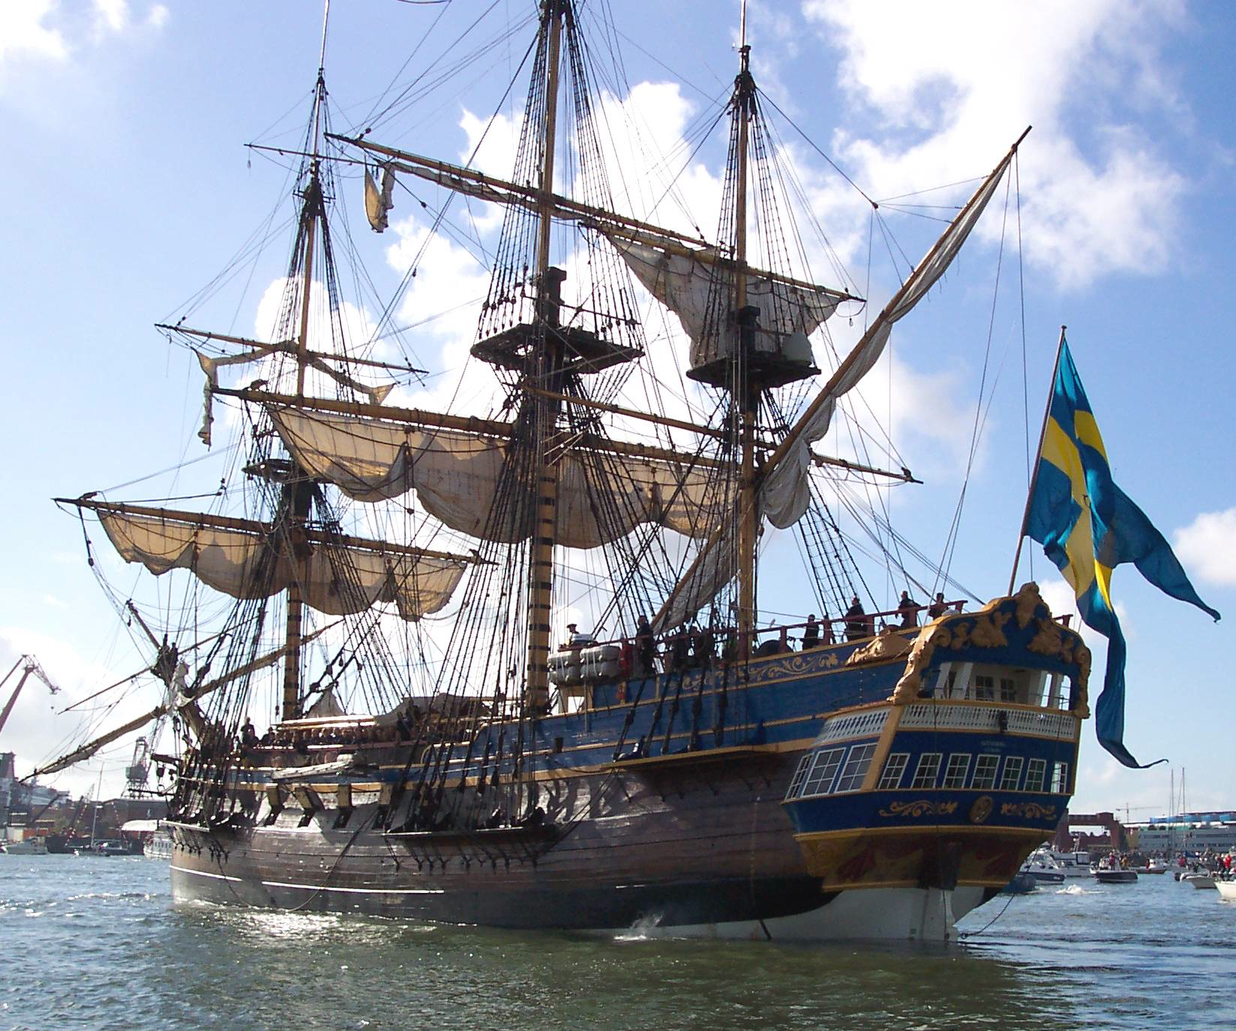
... and only very few know the ropes in case of an emergency!
„The Internet is not Enterprise
in Star Treck, but rather an
18th century sailing ship with
a small crew pulling the ropes.“
  Insider statement of a security consultant
  It is estimated that there are only about a thousand people world
  wide that can really bootstrap the Internet in case of a serious
  situation (e.g. breakdown of DNS, BGP under attack)
  Unfortunately, many can cause malfunctions (although there are also only a few high professionals)
Bild: www.soic.se

Slide 10
Major Topics of this Course
Application Layer
Physical Layer
Data Link & MAC Layer
Network Layer
Transport Layer
New Trends
User watching video clip
Server with video clips
Application Layer
Application Layer
Transport Layer
Transport Layer
Network Layer
Network Layer
Network Layer
Link Layer
Link Layer
Link Layer
Physical Layer
Physical Layer
Physical Layer
Notes:
Aiming more for breadth than for depth.
„More work needed“ to use the content of this course for R or D.

Slide 11
It’s More Than Some Technical Background
Internet is a prominent example of networking
  You know how to cross a street. You should know how data flows!
  Internet has a huge impact already, huge changes still to come
Two goals
Make you „informed citizens“ about what powers these changes.
Hint at areas which you are interested to dig into.
Notes:
VERY informed citizens

Slide 12
At the End of this Course, You Should …
know how networks in general are organized
know what the Internet could be or is
understand how wired/wireless (see Mobile Communications) networks work
understand why/how protocols and layers are used
understand how e-mails, videos get to where you are
understand how operators operate real, big networks
understand the cooperation of web browsers with web servers
Be aware of security issues when you use the network
be familiar with acronyms like: ALOHA, ARP, ATM, BGP, CDMA, CDN, CIDR, CSMA, DHCP, ETSI, FDM, FDMA, FTP, HDLC, HTTP, ICMP, ICN, IEEE, IETF, IP, IMAP, ISP, ITU, ISO/OSI, LAN, LTE, MAC, MAN, MPLS, MTU, NAT, NTP, PCM, POTS, PPP, PSTN, P2P, RARP, SCTP, SMTP, SNMP, TCP, TDM, TDMA, UDP, UMTS, VPN, WAN, ...

Slide 13

Courses of the CST group
Research Seminar
Mobile Communications
Reliable Systems
Software Project Computer Systems
Seminar Computer Systems
Distributed Systems
Microprocessor Lab
⑤
Telematics
Protocols, Services, Standards, LAN, Internet, TCP/IP, WWW, Security, QoS, Multimedia, IPv6, MPLS, ICN, …
English
④ Semester
Bachelor
Master
④
Praktikum Technische Informatik (TI IV)
Eingebettete Systeme, Schnittstellen, Treiber, Betriebssystem – programmieren, vernetzen, interagieren
Deutsch
③
Modul
Rechnerarchitektur,
Betriebs- und
Kommunikationssysteme
Betriebs- und Kommunikationssysteme (TI III)
Ein-/Ausgabe, DMA/PIO, Unterbrechungen, Puffer, Prozesse/Threads, UNIX/Windows, Netze, Medienzugriff, Protokolle, TCP/IP, Internet
Proseminar
Technische
Informatik
②
Rechnerarchitektur (TI II)
Harvard/v. Neumann, Mikroarchitektur, RISC/CISC, VLIW, Pipelining, Cache, Speicherhierarchie, Assembler, Multiprozessorsysteme
①
Grundlagen der Technischen Informatik (TI I)
Schaltnetze, Schaltwerke, Logikminimierung, Gatter, Speicher, Halbleiter, Transistoren, CMOS, AD/DA-Umsetzer

Slide 14
BE AWARE!!!
This course REQUIRES TI III or any other basic lecture covering Networking!
You know:
  Reference model, TCP/IP, basic networking, layers, sockets…
If not:
  Attend TI III FIRST!
The lecture will briefly touch all basic networking topics and will then go into advanced aspects!

Slide 15
Related Fields
Operating
Systems
Databases
Algorithms
Software-
Engineering
Distributed
Operating
Systems
Telematics
(Data Communication and Computer Networks)
Distributed
Databases
for
Distributed
Systems
Distributed
Algorithms
Communications Engineering
Notes:
Telematics has ties with the following domains
Algorithms: run locally vs distributed
Operating systems: native interaction : don't hang if you don't get answer from a remote service
Databases: synchronization of mobile devices, with intermittent connectivity, multiple users?
Software engineering: for distributed systems, but also distributed coding!
Not so much into the hardware design
But strong ties with engineering: software engineering, and communications engineering (cable design, boxes…)

Slide 16
Time Schedule and Grading
Lecture
  Monday, 14:00 – 16:00, HS001/A3, Start of class at 14:15
  Thursday, 12:00 – 14:00, HS/T9, Start of class at 12:15
Exercise
  Meetings TBA – on demand, answers open questions, more interactive
  BUT: regular handouts with questions to be answered by YOU (solutions available…)
Fail/Pass grading based on final written exam (Klausur)
  Will take place during the last lecture (Feb. 11th, 2016, HS/T9)
You HAVE to register online in Campus Management (legally binding)
You HAVE to register online in the KVV system (organization)
Notes:
Exercises: bi-weekly + voluntary + open questions
Random student presents
Exam right after the end of the course
(so that people can finish this before moving on to other things like internships etc.)

Slide 17

Office Hours, Communication, and Web Resources
Prof. Dr.-Ing. Jochen H. Schiller
  Consulting hours: Tuesday, 14-15
  Takustr. 9, Room 156
  jochen.schiller@fu-berlin.de
Course homepage with slides, announcements, links, mailing list, Q&A, … in the KVV
  https://kvv.imp.fu-berlin.de/portal/site/8300df3e-37c8-4dda-b534-45b753771989
The whole lecture will be recorded – slides plus annotations plus audio
  Available typically after finishing a chapter as pptx and mp4
Notes:
Matthias Wählisch help + German.
Any questions so far about these organizational details?

Slide 18
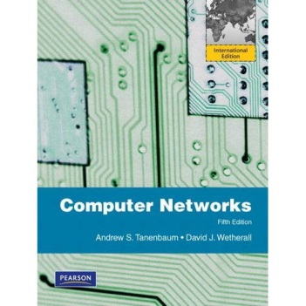
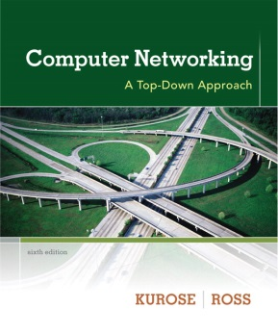
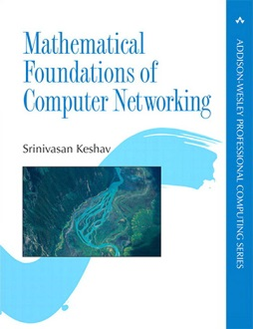

Literature
No textbook specific to this course
Recommendable literature:
  A. Tanenbaum & D. Wetherall: Computer Networks (5th edition)
  J. Kurose & K. Ross: Computer Networking (6th edition)
  S. Keshav: Mathematical Foundations of Computer Networking (2012)
  (there is more literature: W. Stallings book, W. Goralski book…)
  IETF drafts and RFCs
  IEEE 802 LAN/MAN standards
Notes:
Tanenbaum & D. Wetherall: a bottom up approach to computer networks
J. Kurose & K. Ross: a top down approach to computer networks
S. Keshav: mathematical foundations for computer networks

Slide 19
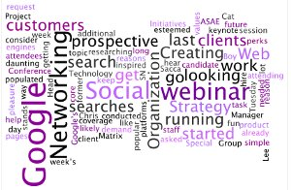

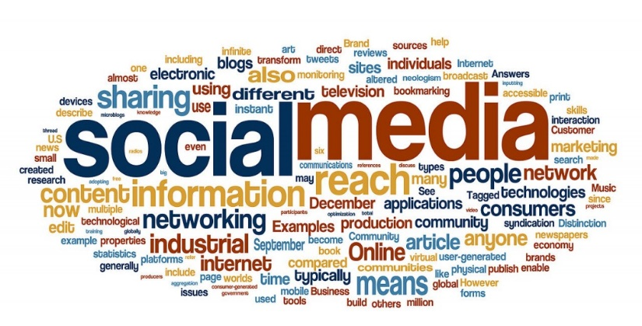
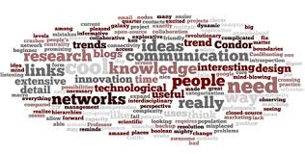
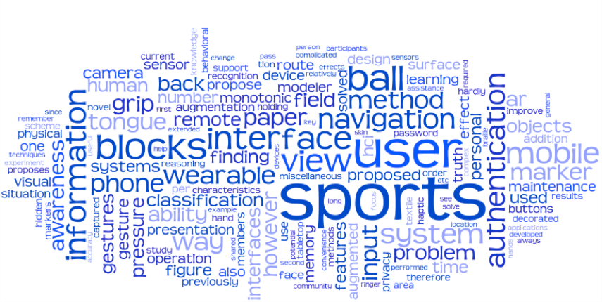
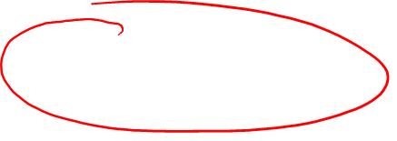
Details Specific to this Course
Attention span: Exponential decay!
Cognitive breaks:
  Whenever you think there is something interesting we should discuss
  We rather take some breaks, discuss, than rush through all slides
Take the time to:
  Submit interesting links or info to the KVV Forum
  Let us participate in whatever moves you
Notes:
Long lectures are ineffective. Critical survey:
Wilson, K. and Korn, J. H. (2007). « Attention during lectures: Beyond ten minutes ». Teaching of Psychology, 34 (2), 85–89.

Slide 20
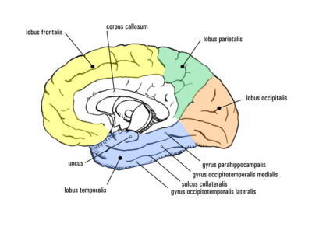

Some Simple Rules …
No laptops/phones
  Unless you really, really have to look-up something – but then share it with us!
Deployment of an anti-sleeping student strategy
Most important: You are the only one responsible for your own brain
Don’t stop thinking!
Notes:
Stare at the student until everyone stares at the student
elbowed by neighbor
SHOW TRIANGLE + ZOOM
Triangle: why is it a triangle?
3 vertices?
Straight lines?
Concept of triangle?
Can you ever have a real triangle? No. Why not?
Can you have a straight line in real life? No. Even a with a laser.
Yet everybody says it’s a triangle, even though no one has ever seen a triangle in real life.
How did that happen? Abstraction/imagination
Comes from the brain and from examples that have a common concept
Triangles are in our brain, they exist nowhere else

Slide 21

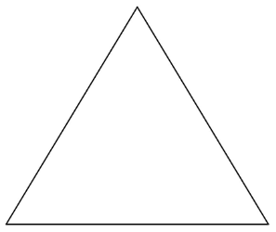
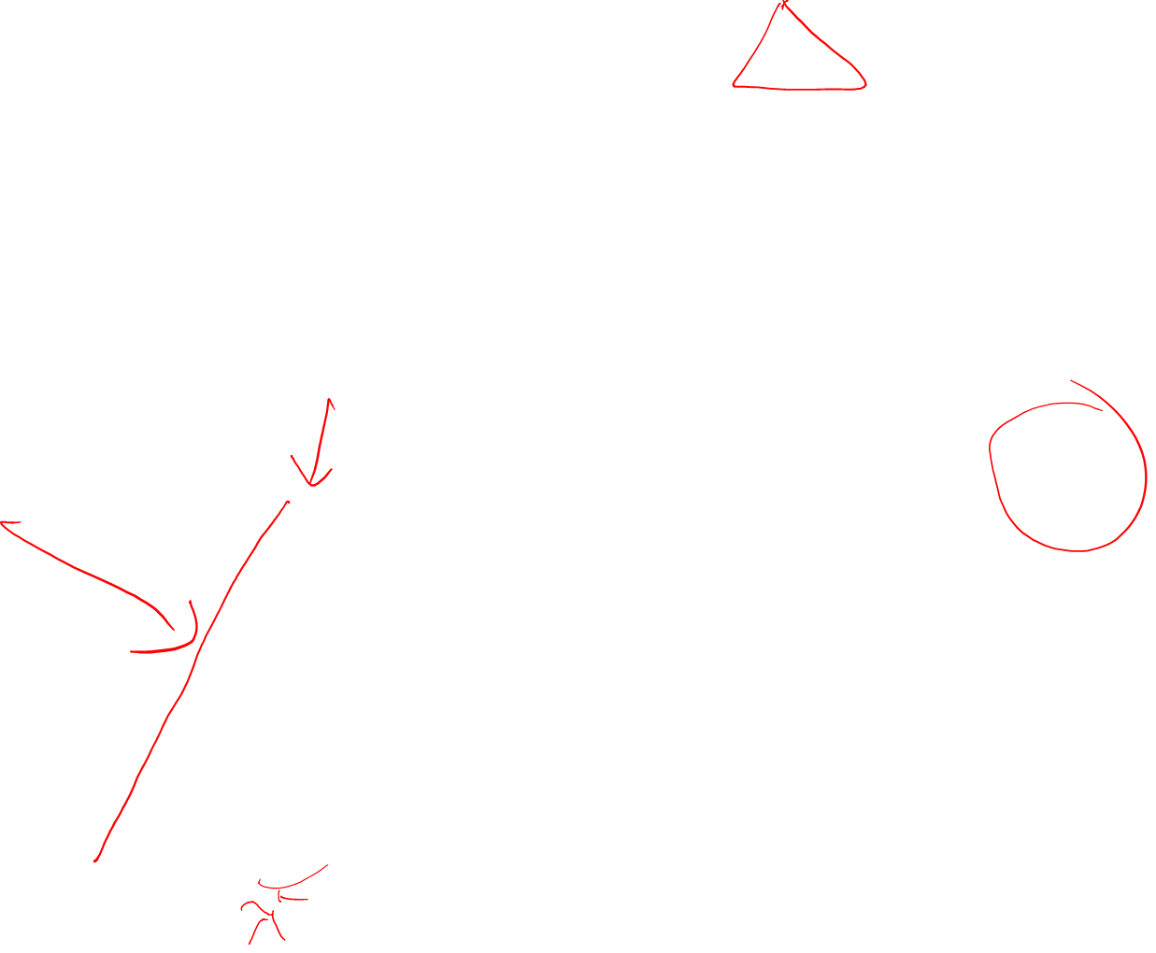
Digitizing an Ancient Greek Lesson
Three sides of that story:
  YOU have to make the effort to understand the concepts
  From atoms to bits
  Copy of a copy of a …
=?
Notes:
Important message:
I can show you examples of a concept, but the abstraction must happen on your side, so you have to make the effort to reprogram your brain to see a triangle.
So instructors can show you examples, but until you work at it, it’s not going to go inside your brain. So you need to make an effort on your side to internalize it.
Your goal is that your brain is different after the class compared to before you got in.
Just like you reformated your brain compared to when you were born, to grasp the concept of triangle.
From atoms to bits (Nickolas Negroponte from MIT, late 1990s)
before the Internet, all information were sent as atoms (books, letters, EXPENSIVE physical objects)
after the internet, most of the information is sent as bits, through the NETWORK, much cheaper
exemple books/newspapers/music/video even in consulting (outsourcing jobs like medical scan interpretation, hotlines etc.)
Copy of Keshav, who copied Socrates (related by Plato 3000 years ago) who drew a triangle in the sand and was asking what that is to a student, and just had the same dialog.
Digital world copy/paste paradoxes.
Anybody can take these slides and copy them for free: biens non-concurrents!
What does this change in society?

