Slide 1
Computational Proteomics and Metabolomics
Oliver Kohlbacher, Sven Nahnsen, Knut Reinert
9. Protein Inference

Slide 2
Overview
The protein inference problem
  Isoforms and protein groups
  Problem definition
Protein inference algorithms
  ProteinProphet
Protein false discovery rates
  Difference between PSM FDR and protein FDR
  Computing protein FDRs
  MAYU

Slide 3
LEARNING UNIT 9A
Protein Inference Problem
Problem definition
Protein families
Protein ambiguity groups
Inference through quantification
Significance of inferred hits
One hit wonders
Notes:
Problem definition
Protein families
Protein ambiguity groups
Inference through quantification
Significance of inferred hits
One hit wonders

Slide 4
Identifying Proteins
Identification methods so far only identify peptide-spectrum matches (PSMs)
  Search a database
  Return a ranked list of PSMs with associates scores
PSM false discovery rates (FDRs) can be computed through a target-decoy approach
An FDR of 1% would mean that 1% of the PSMs with a score above the threshold are expected to be incorrect
Note that this is a statement on the individual PSM, not per peptide or protein!

Slide 5
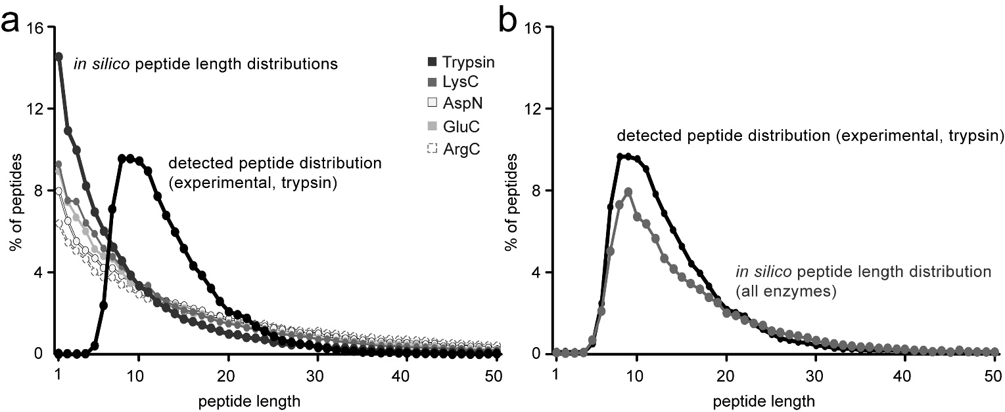
Identifying Proteins
Each PSM above the threshold contributes
  a match of a spectrum to a peptide
  a match of a peptide to a protein
Peptides are not necessarily unique!
Length distribution of observed peptides deviates from theoretical distribution: short peptides (length 6 and shorter) are usually not observed
Danielle L. Swaney; Craig D. Wenger; Joshua J. Coon; J. Proteome Res. 2010, 9, 1323-1329.

Slide 6
Uniqueness
If we are interested in proteomics (in contrast to peptide identification in metabolomics, MHC ligandomics etc.), we want to quantify proteins
Non-unique peptide sequences can stem from different proteins
Obviously, uniqueness depends on the chosen database
Uniqueness becomes more likely for longer peptide sequences
Reasons for non-uniqueness
  Chance hits
  Different isoforms
  Conserved regions shared within a protein family

Slide 7
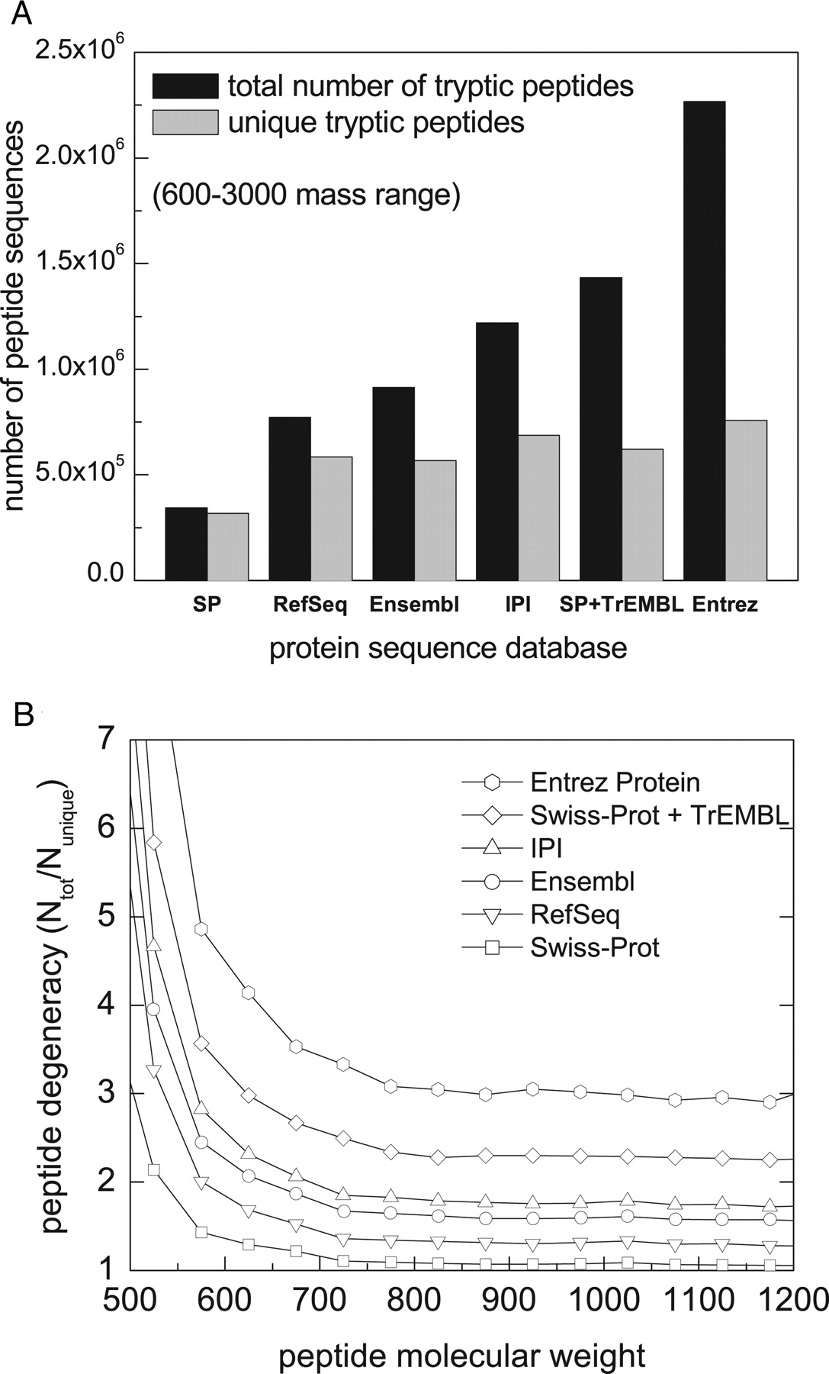
Uniqueness
Uniqueness depends on the size of the database
Searching an appropriate (non-redundant) database is thus preferable
Reference databases (SwissProt) usually contain few degenerate (non-unique) tryptic peptides above a mass of 750 Da
Problem: isoforms of proteins/splice variants!
Nesvizhskii A I , Aebersold R Mol Cell Proteomics 2005;4:1419-1440.

Slide 8
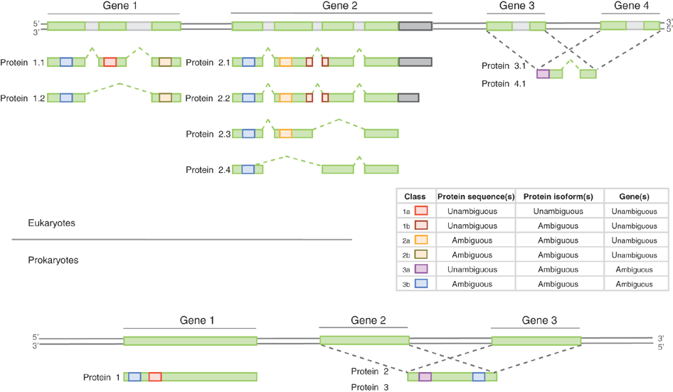
Uniqueness
Qeli & Ahrens, Nature Biotechnology 28, 647–650 (2010)

Slide 9
Protein Isoforms
www.nextprot.org/db/statistics/release?viewas=numbers
NextProt Release 3.0.20
  20,140 human proteins
  39,565 sequences resulting from alternative isoforms
On average 2.96 different splice variants for each protein sequence
Some proteins have a much larger number of variants
Resolving the different isoforms is only possible, if peptides crossing the right exon boundaries are observed
NextProt Release 3.0.20, 2013-11-01, http://www.nextprot.org/db/statistics/release?viewas=numbers

Slide 10
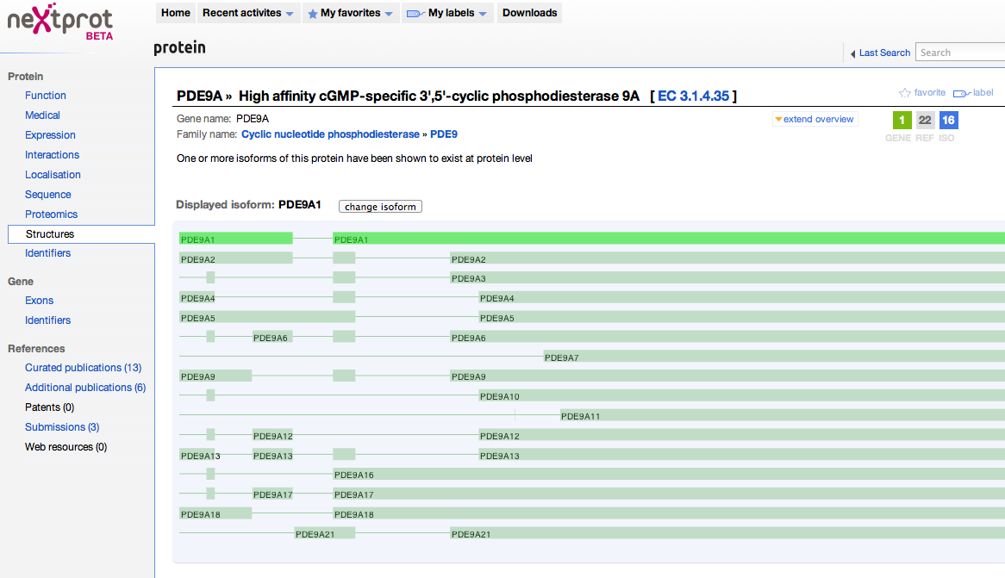
Protein Isoforms
phosphodiesterase 9A has 16 documented isoforms
Peptides stemming from the second half of the sequence are entirely indistinguishable between isoforms
http://www.nextprot.org/db/entry/NX_O76083/structures

Slide 11
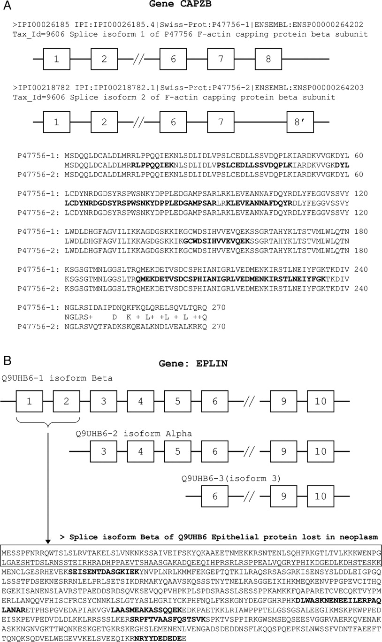
Protein Isoforms
Nesvizhskii A I , Aebersold R Mol Cell Proteomics 2005;4:1419-1440.

Slide 12
Protein Isoforms
Nesvizhskii A I , Aebersold R Mol Cell Proteomics 2005;4:1419-1440.

Slide 13
Protein Families
Sequence coverage is often poor in large scale studies: many proteins are identified through very few peptides only
In prokaryotes, typically over 90% of the identified peptides are unique in the whole proteome
In particular in eukaryotes the large number of orthologs leads to significant sequence identity between different proteins that are not isoforms
In eukaryotes, the number of unique identified peptides can thus easily drop below 50% (Gupta & Pevzner, 2009)

Slide 14
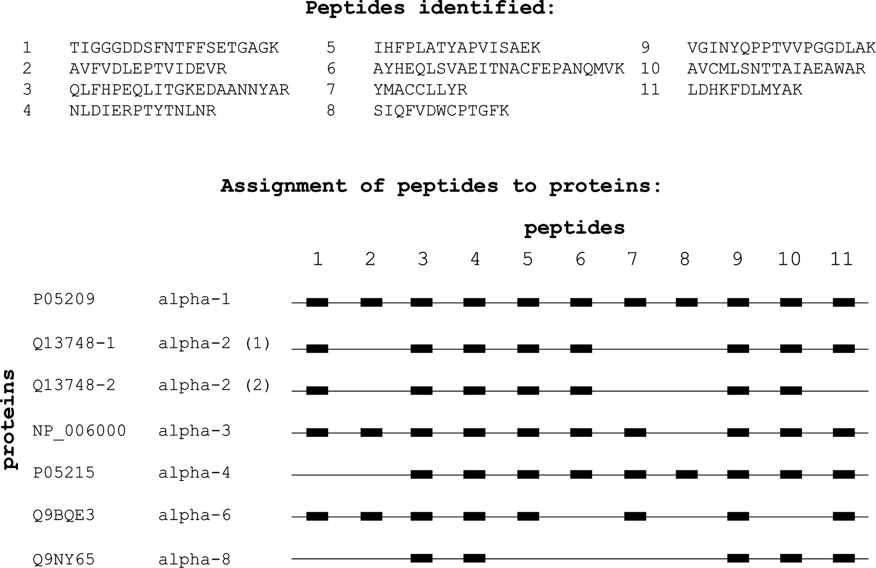
Protein Families

Slide 15

Parsimony-Based Inference
Idea
  Find the smallest set of proteins explaining all observed peptides
If all peptides mapping to one protein family can be explained by a single protein, then it is quite likely, that only this protein is present (but this must not necessarily be the case)
Basically: applying Occam’s razor to the dataset – find the simplest explanation possible (maximum parsimony)

Slide 16
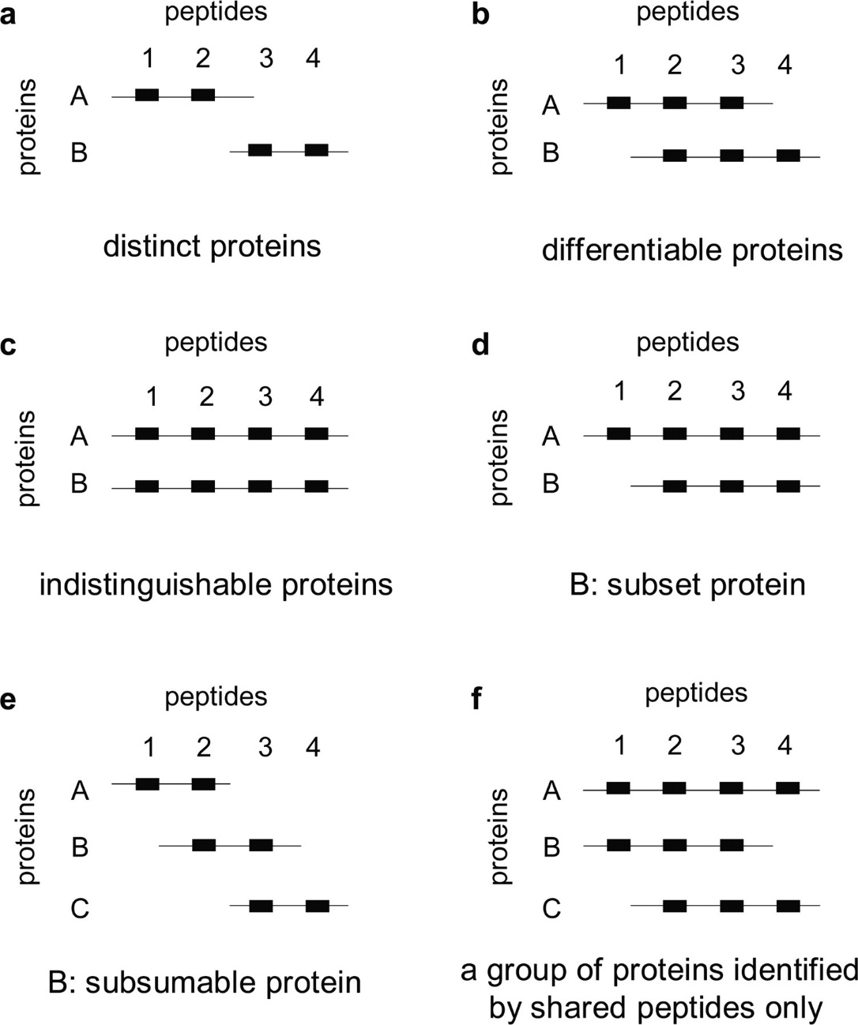
Parsimony-Based Inference
Scenarios for different proteins given a set of observed peptides
  Distinct proteins do not share peptides
  Differentiable proteins can be distinguished by at least one distinct peptide
  Indistinguishable proteins share all peptides
  Subset proteins contain only peptides also contained in another protein
  Subsumable proteins contain only peptides that are also contained in other proteins
Nesvizhskii A I , Aebersold R Mol Cell Proteomics 2005;4:1419-1440.

Slide 17
Protein Ambiguity Groups
Example:
Note that even though the presence of A is sufficient to explain all observed peptides, this does not automatically imply the absence of B and C
The data is explained equally well by the presence of A, the presence of A + B, A + C, B + C, or A + B + C
The set of proteins sharing one or multiple peptides is often referred to as a protein ambiguity group
A
B
C

Slide 18
Parsimony-Based Inference
Maximum parsimony inference results in a minimal list of proteins
It thus removes all distinct and differentiable proteins of a protein ambiguity group
It does not contain any subsumable or subset proteins
In the previous example, A would be sufficient to explain the observed peptides, B and C would not be reported
A
B
C

Slide 19
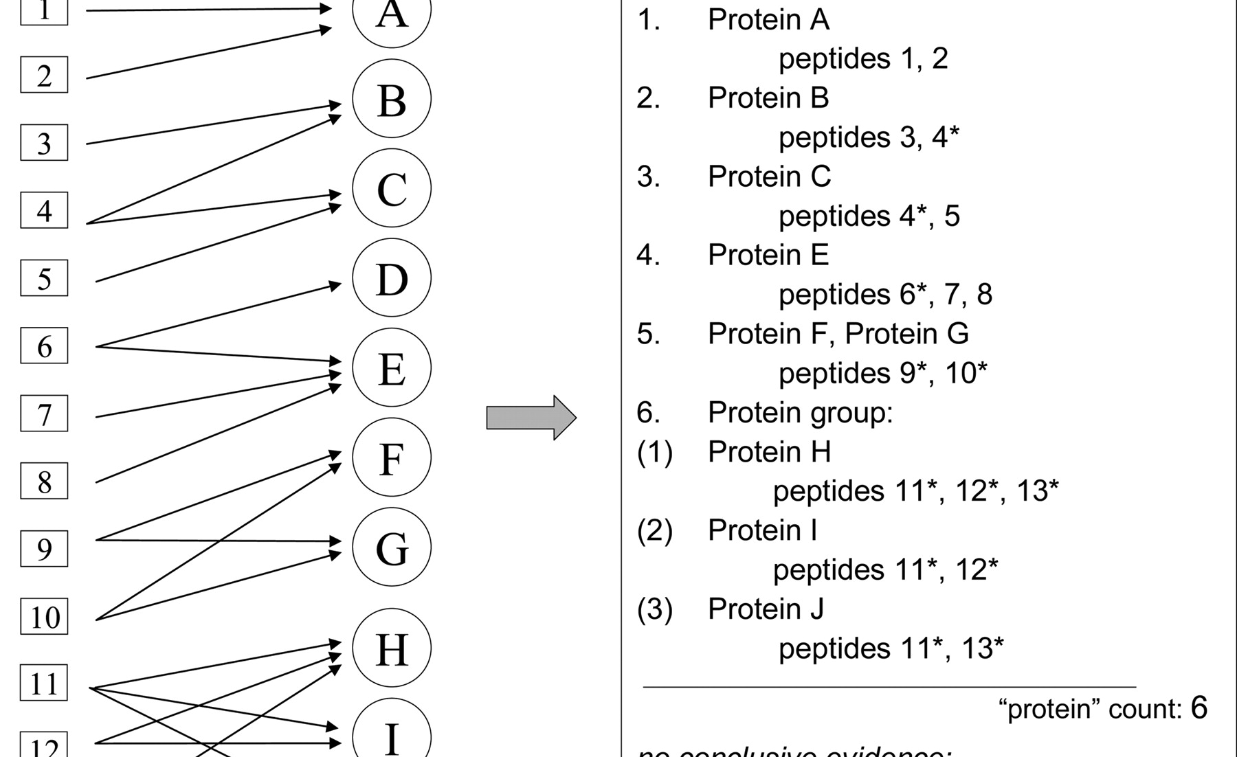
Reporting of PAGs
Nesvizhskii A I , Aebersold R Mol Cell Proteomics 2005;4:1419-1440.

Slide 20
Inference through Quantification
Quantitative data can be used for inference as well (similar to transcript data)
This is, however, non-trivial and usually done manually and on a case-by-case basis
Distinct peptides can be used to quantify their source proteins
Shared peptides result in an averaging of the quantitative information
This results in (often underdetermined) systems that can be used to quantify isoforms
Quantitative information can also be used to prove the presence of a specific isoform (through deviating ratios of shared peptides)

Slide 21
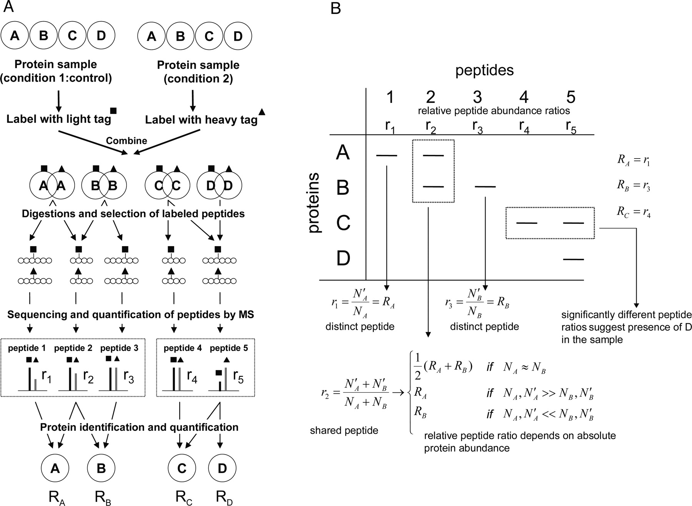
Inference through Quantification

Slide 22
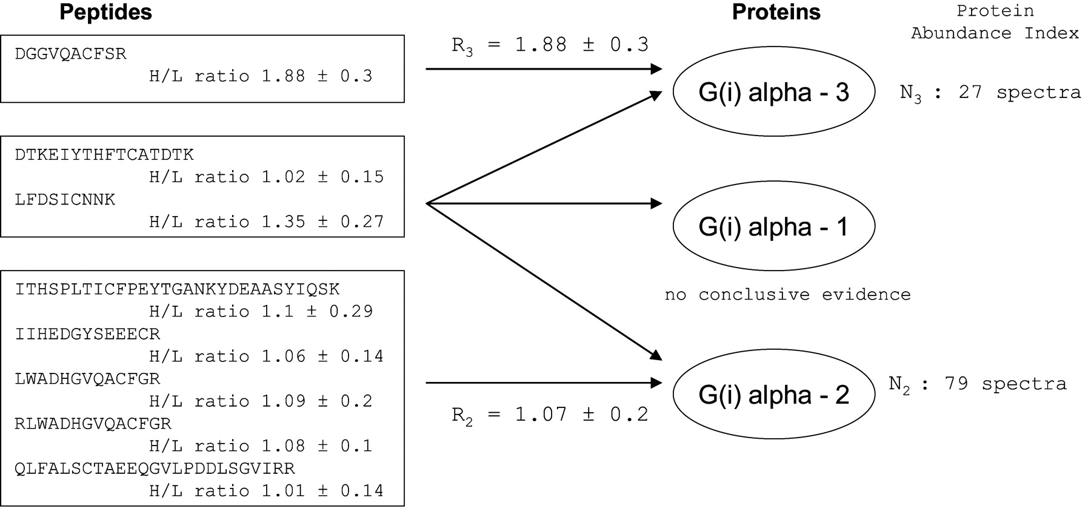
Inference through Quantification
Based on six unique and two shared peptides from a protein ambiguity group (three G proteins) one cannot decide whether G(i) alpha 1 is actually present in the sample
Often the quantification accuracy is not sufficient to provide a conclusive result
Nesvizhskii A I , Aebersold R Mol Cell Proteomics 2005;4:1419-1440.

Slide 23
Significance of Inferred Hits
What is the meaning of a PSM for a protein identification?
  FDR is calculated on the PSM level
  1% FDR means that one in 100 identifications yields a an incorrect protein identification
This does not mean that there is also an FDR rate of 1% on the protein level!
In particular in large-scale studies (tens of thousands of spectra), protein FDRs are much higher than peptide FDRs
PSMs for a large number of (mostly) identical samples
  Number of correctly identified proteins does not increase significantly with the number of spectra (it is always the same proteins being identified, additional (correct) PSMs do not increase the number of proteins)
  Number of false positives increases with the number of PSMs (yields hits to random proteins, so initially mostly novel false positives!)

Slide 24
One Hit Wonders
In many cases, proteins are identified through a single PSM only
These ‘single hit wonders’ have long been considered problematic: a single false PSM can lead to a wrongly identified protein
In fact, the so-called ‘Paris guidelines’ for data deposition in proteomics recommend only reporting identifications for which at least two peptides have been identified
This also became known as the ‘two peptide rule’
Obviously, just dropping a large part of PSMs is inadequate to address this problem
Bradshaw RA, Burlingame AL, Carr S, Aebersold R. Mol Cell Prot 2006, 5:787-8
http://www.mcponline.org/site/misc/ParisReport_Final.xhtml

Slide 25
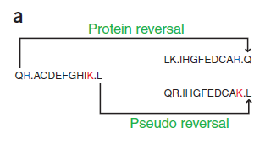
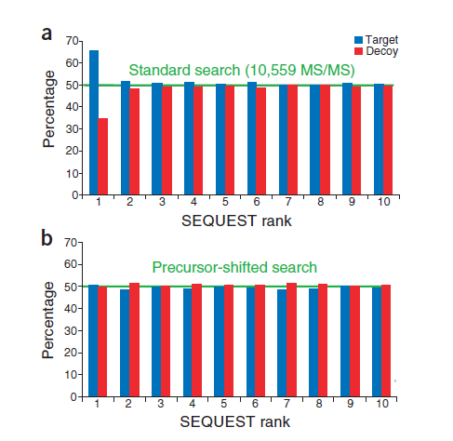
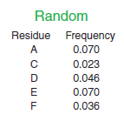
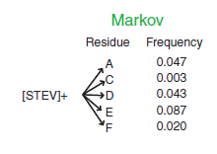
Recap: Target-decoy databases
Design decoy sequences
Separation of target and decoy results

Slide 26



Recap: FDR Calculation
General equation for FDR calculation (see statistics lecture)
There are two ways how FDRs are calculated based on target-decoy search results:
Käll et al. suggest
Zhang et al. suggest
OpenMS::TOPP::FalseDiscoveryRate uses the Käll metrics
(Käll et al., Proteome Res. 2008, 7, 29– 34)
(Zhang et al., J Proteome Res 2007;6(9):3549–3557)

Slide 27
One Hit Wonders
Gupta & Pevzner argued in 2009 that the application of the two peptide rule actually results in increased false discovery rates
Removing one-hit wonders should improve the FDR of peptide identifications – this is indeed the case
For a given number of decoy hits, the number of target peptides increases compared to keeping all PSMs (‘single peptide rule’)
Gupta & Pevzner, J. Proteome Res. 2009, 8, 4173-4181.

Slide 28
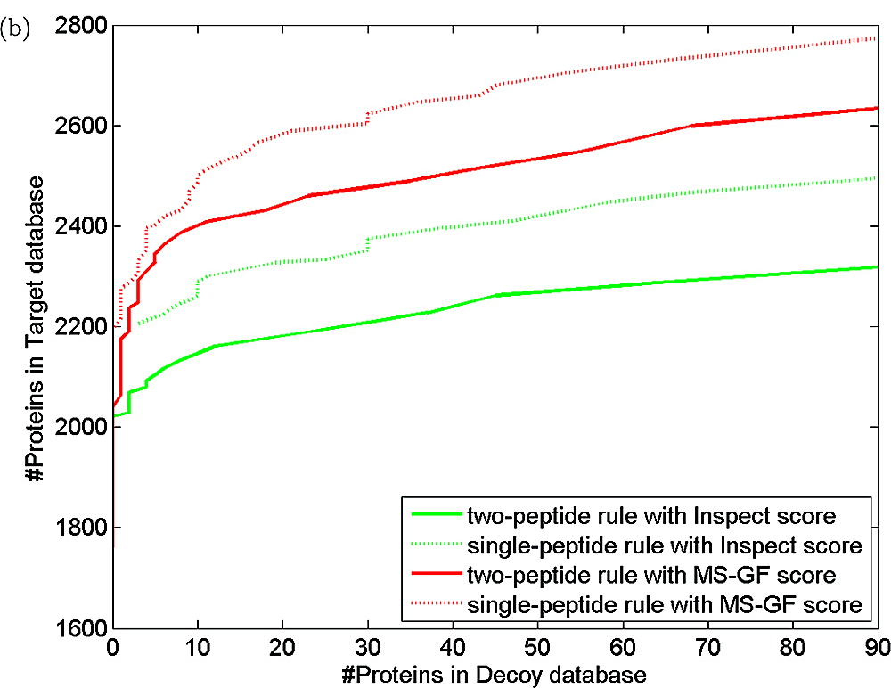
One Hit Wonders
On the protein level things are different, however
For the same dataset, the number of identified proteins is higher using the single peptide rule than using the two peptide rule at the same FDR!
More peptide identifications thus do not necessarily imply a higher protein discovery rate
Gupta & Pevzner, J. Proteome Res. 2009, 8, 4173-4181.

Slide 29
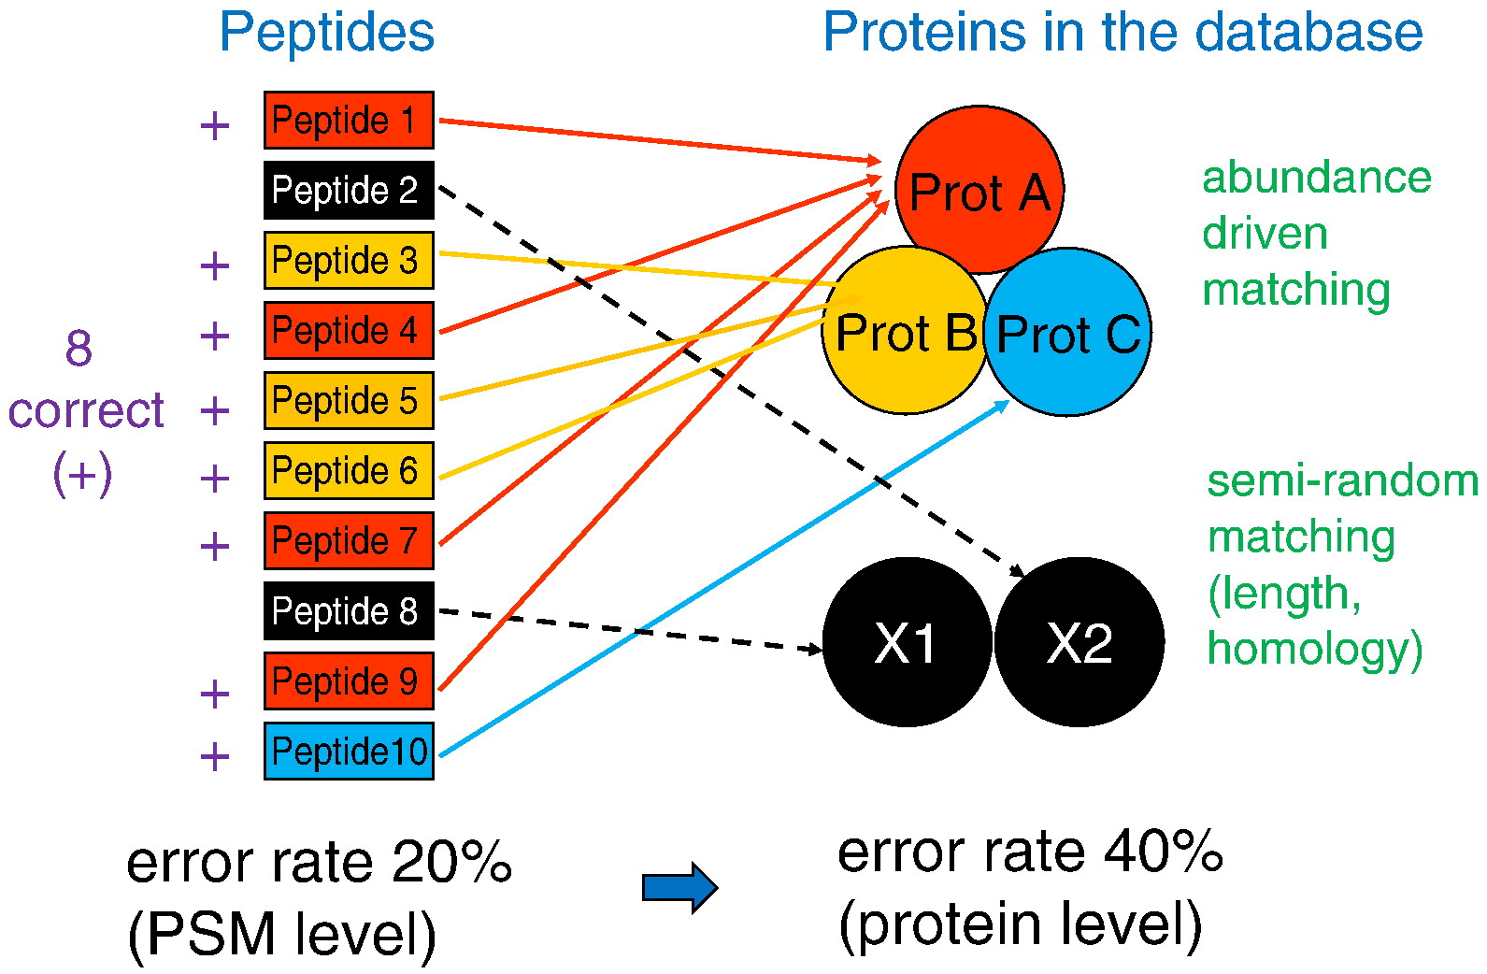
Protein FDRs
Error rates increase when going from peptides to proteins
  Correct peptide IDs tend to group into a small set of correct proteins
  Incorrect IDs are semi-random and scatter over the whole protein database
A. Nesvizhskii, J. Proteomics (2010), 73:2092-2123

Slide 30
LEARNING UNIT 9B
Protein Prophet
Peptide probability estimates
Protein probability estimates
Sibling peptides correction
Degenerate peptides
Notes:
Peptide probability estimates
Protein probability estimates
Sibling peptides correction
Degenerate peptides

Slide 31
ProteinProphet
ProteinProphet is an open-source software tool for protein inference and currently one of the standard tools in the area
Key ideas
  Maximum parsimony approaches to compile protein lists
  Reporting of protein ambiguity groups
  Protein probability estimation: estimate the probability that a given protein is correctly identified given all evidence for it
Nesvizhskii, et al., Anal. Chem. (2003), 75, 4646-4658

Slide 32
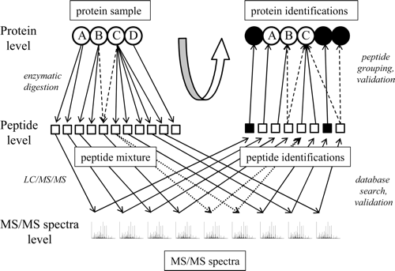
ProteinProphet - Overview
Nesvizhskii, et al., Anal. Chem. (2003), 75, 4646-4658

Slide 33
PeptideProphet
Peptide Probability Estimates (PPE)
  Computed by PeptideProphet
  Converts search engine scores into a probabilities
  Similar ideas have been discussed in the context of consensus identification
  PeptideProphet uses expectation maximization to compute a mixture model of the score distributions of correct and incorrect PSMs
  Given a PSM and a search engine score, we can thus compute a probability that the PSM is correct
In contrast to a (raw) score, PPEs are a simple way to determine the trust in each individual PSM
Nesvizhskii, et al., Anal. Chem. (2002), 74, 5383-5392

Slide 34
Protein Probability Estimates
Given the PPEs, we can easily compute the probability for each of the induced protein IDs
Assuming all peptides are unique, we can compute the probability P for an protein identification as 1 minus the probability of all peptide identifications inducing this peptide being wrong
We could do this on the peptide level quite simply as follows:
with probabilities p_{i} for the peptide identification of peptide I being correct
However, we also need to consider multiple evidence for different spectra giving evidence for the same peptide
Notes:
\begin{equation*}
P = 1 - \prod\limits_i\ ( 1 – p_i)
\end{equation*}

Slide 35
Protein Probability Estimates
We thus need to consider probabilities for each PSM independently
Each PSM is assigned a PPE by PeptideProphet
Probability that a protein is not present in a sample despite its PSMs depends on the probabilities p(+|D_{i}^{j}) for the peptide ID of peptide i based on the observed data (spectrum) j being correct
We can thus compute P based on PPEs of all PSMs:
Nesvizhskii, et al., Anal. Chem. (2003), 75, 4646-4658
Notes:
\begin{equation*}
P = 1 - \prod\limits_i\prod\limits_j ( 1 – p(+|D_i^j))
\end{equation*}

Slide 36
Protein Probability Estimates
There are a few problems with this:
  PSMs are not independent
  There is a high probability for multiple spectra of the same peptide to hit the same incorrect ID if the spectra are of high quality, but do not match the database (e.g., due to post-translational modification)
  Ambiguous peptide-protein matches
  If a peptide matches multiple proteins, its evidence cannot simply be shared across these proteins

Slide 37
Protein Probability Estimates
A simple way to deal with multiple PSMs is to
  Include each peptide just once
  Consider only the PSM with the best PPE of all PSMs to the same peptide:
  p_{i} = max_{j} p(+|D_{i}^{j})
P would then be computed as follows:
This procedure yields a more conservative estimate of protein probabilities
Notes:
\begin{equation*}
P = 1 - \prod\limits_i( 1 – \max_j p_i^j) = 1- \prod\limits_i (1-p_i)
\end{equation*}

Slide 38
ProteinProphet
Example:
>gi|125910|sp|P02754.3|LACB_BOVIN
MKCLLLALALTCGAQALIVTQTMKGLDIQKVAGTWYSLAMAASDISLLDAQSAPLRVYVEELKPTPEGDL
EILLQKWENGECAQKKIIAEKTKIPAVFKIDALNENKVLVLDTDYKKYLLFCMENSAEPEQSLACQCLVR
TPEVDDEALEKFDKALKALPMHIRLSFNPTQLEEQCHI
LSFNPTQLEEQCHI : p = 0.48
LSFNPTQLEEQCHI : p = 0.65
max = 0.65
TPEVDDEALEK : p = 0.91
VYVEELKPTPEGDLEILLQK : p = 0.81
P(LACB_BOVIN) = 1 – (1 – 0.81) (1 – 0.91) (1 - 0.65) = 0.99
After: Nesvizhskii, et al., Anal. Chem. (2003), 75, 4646-4658
After: Nesvizhskii, et al., Anal. Chem. (2003), 75, 4646-4658

Slide 39
Sibling Peptides
Correct assignments tend to cluster to the same proteins
Incorrect assignments tend to be hits to proteins with no other assigned peptides
As a result, the computed PPEs, while correct in the context of the whole dataset, need to be corrected for an accurate estimate in the context of their source protein
ProteinProphet introduces the notion of sibling peptides
Sibling peptides are peptides hitting the same protein
Rather than counting them, ProteinProphet defines the number of sibling peptides NSP_{i} for a peptide i as the sum of the PPEs:
where the sum runs over all peptides m hitting the same protein as i and PPEs p_{i} are the maximum values for a given peptide reached in the dataset
Notes:
\begin{equation*}
\mathrm{NSP}_i = \sum\limits_{\{m|m \neq i\}} p(+|D_m)
\end{equation*}

Slide 40
Sibling Peptides
Example:
>gi|125910|sp|P02754.3|LACB_BOVIN
MKCLLLALALTCGAQALIVTQTMKGLDIQKVAGTWYSLAMAASDISLLDAQSAPLRVYVEELKPTPEGDL
EILLQKWENGECAQKKIIAEKTKIPAVFKIDALNENKVLVLDTDYKKYLLFCMENSAEPEQSLACQCLVR
TPEVDDEALEKFDKALKALPMHIRLSFNPTQLEEQCHI
LSFNPTQLEEQCHI : p = 0.48
LSFNPTQLEEQCHI : p = 0.65
max = 0.65
TPEVDDEALEK : p = 0.91
VYVEELKPTPEGDLEILLQK : p = 0.81
NSP(VYV…) = 0.91 + 0.65 = 1.56
NSP(TPE…) = 0.65 + 0.81 = 1.46
NSP(LSF…) = 0.91 + 0.81 = 1.72
After: Nesvizhskii, et al., Anal. Chem. (2003), 75, 4646-4658

Slide 41
Sibling Peptides
Intuitively, one would trust identifications with a high NSP more than those with a low NSP (more evidence per protein)
We can thus refine PPEs in the context of the source protein as follows:
with
p(NSP|+) and p(NSP|-) being the probabilities of having a particular NSP value for correct/incorrect assignments
p(+|D) and p(-|D) are the uncorrected probabilities for the peptide assignment being correct/incorrect
Notes:
\begin{equation*}
p(+|D, NSP) =
\frac{p(+|D)p(NSP|+)}
{p(+|D)p(NSP|+) + p(-|D)p(NSP|-)}
\end{equation*}

Slide 42
Sibling Peptides
Values for p(NSP|+) and p(NSP|-) can be computed for the whole dataset
NSP values are binned and counted for correct and incorrect assignments
where N is the total number of peptides assignments and p(+) is the prior probability of a peptide identification being correct
p(+) can be computed by summation over all peptide identifications of the dataset:
Notes:
\begin{equation*}
p(NSP|+) = \frac{1}{N\,p(+)} = \sum\limits_{\{i|NSP_i \in k\}} p(+|D_i, NSP_i)
\end{equation*}
\begin{equation*}
p(+) = \frac{1}{N} \sum\limits_i p(+|D_i, NSP_i)
\end{equation*}

Slide 43
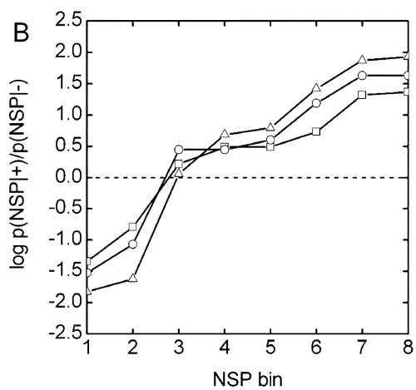
NSP Distributions
NSP distributions can be determined using expectation maximization
As a first guess, unadjusted p(+|D) values are used to compute an estimated NSP value for each assignment
Applying EM then yields adjusted probabilities, this is repeated until convergence has been reached
NSP distributions depend on the dataset and the dataset size
NSP distribution for datasets of varying size:
squares: single run of a low-complexity sample
circles: four runs of the same sample
triangles: 22 runs
Nesvizhskii, et al., Anal. Chem. (2003), 75, 4646-4658

Slide 44
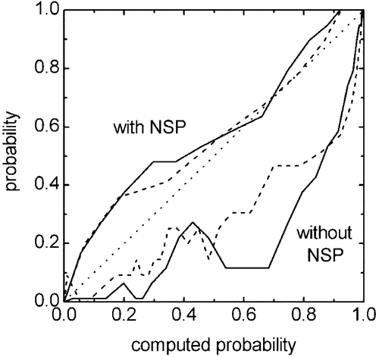
Influence of NSP Correction
NSP correction yields better predictions of protein probabilities
Figure on the right shows the predicted vs. true protein probabilities with and without NSP
Different lines correspond to different datasets
Dotted line: perfect prediction
Nesvizhskii, et al., Anal. Chem. (2003), 75, 4646-4658

Slide 45
Protein Ambiguity
Shared peptides within a PAG cause issues as well
Their probabilities can be distributed over their potential source proteins through a weighting scheme based on the protein probabilities:
Weights w_{i}^{n} are again estimated iteratively using an EM-like algorithm
w₁^{A}
protA
p₁
peptide 1
P_{A}
w₁^{B}
protB
p₂
peptide 2
P_{B}
w₂^{B}
Nesvizhskii, et al., Anal. Chem. (2003), 75, 4646-4658
Notes:
\begin{equation*}
w_i^n = \frac{P_n}{\sum\limits_{s=1...N_s}P_s}
\end{equation*}
\begin{equation*}
P_n = 1 - \prod\limits_i (1- w_i^n\,p(+|D_i))
\end{equation*}

Slide 46
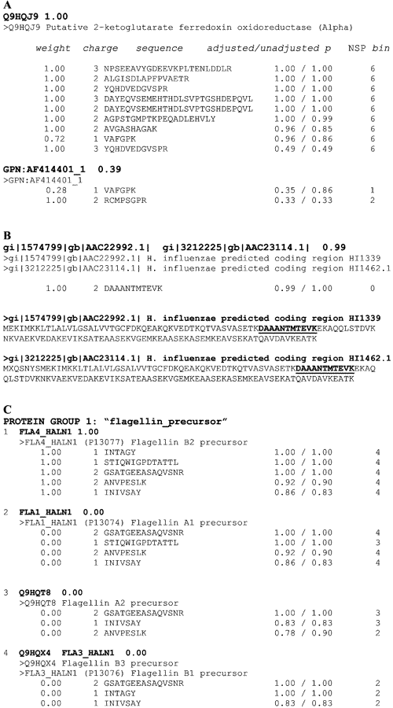
Protein Ambiguity Group
Nesvizhskii, et al., Anal. Chem. (2003), 75, 4646-4658

Slide 47
LEARNING UNIT 9C
Protein FDR calculation
Protein FDR calculation
MAYU
Notes:
Protein FDR calculation
MAYU

Slide 48
Estimating Protein FDRs
Peptides FDRs do not correspond to protein FDRs
Currently, large-scale studies often have dozens or hundreds of LC-MS runs that are being accumulated
Repeated measurements lead to an accumulation of false positive identifications
As a rule of thumb, protein FDR increases linearly with the number of repeat measurements
FDRs can be estimated in the same fashion as PSM FDRs through a naïve target-decoy approach

Slide 49
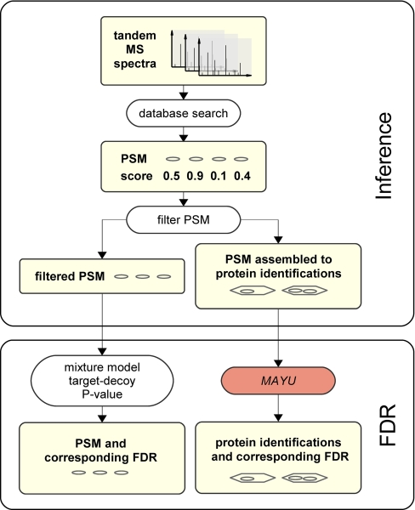
MAYU
MAYU estimates protein FDRs for large-scale datasets
The approach is similar to the PSM FDR determination done in PeptideProphet, but on the level of proteins
MAYU fits a hypergeometric distribution to determine the expected number of false positives
Reiter et al., Mol. Cell. Proteomics, 2009, 8, 2405-2417

Slide 50
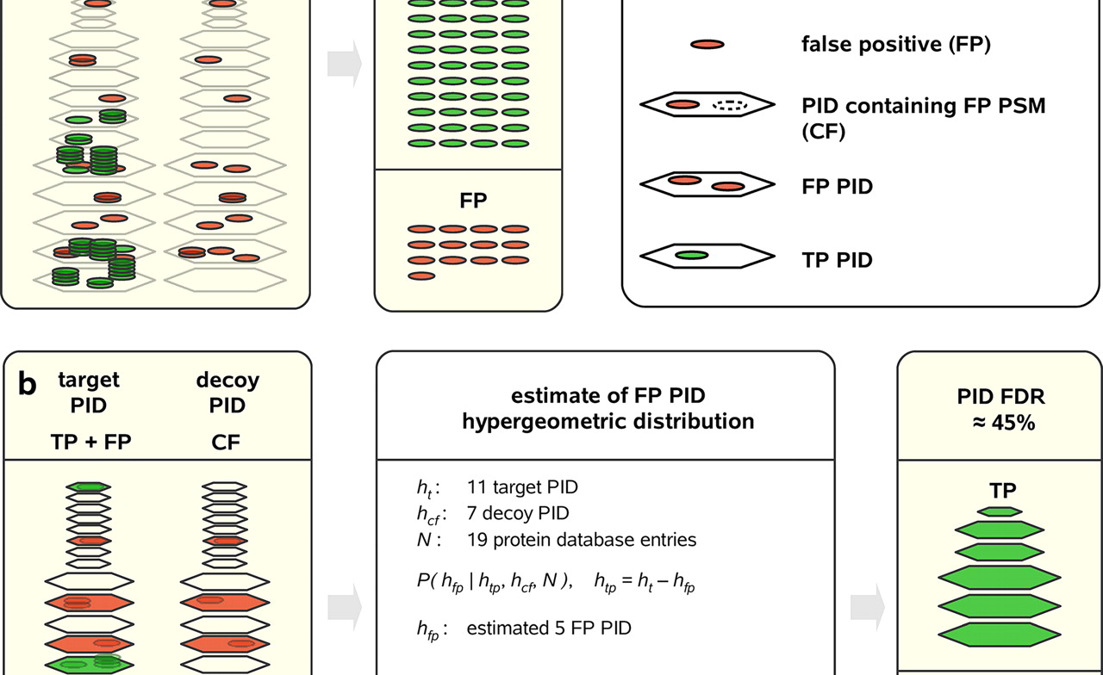
MAYU
Reiter et al., Mol. Cell. Proteomics, 2009, 8, 2405-2417

Slide 51
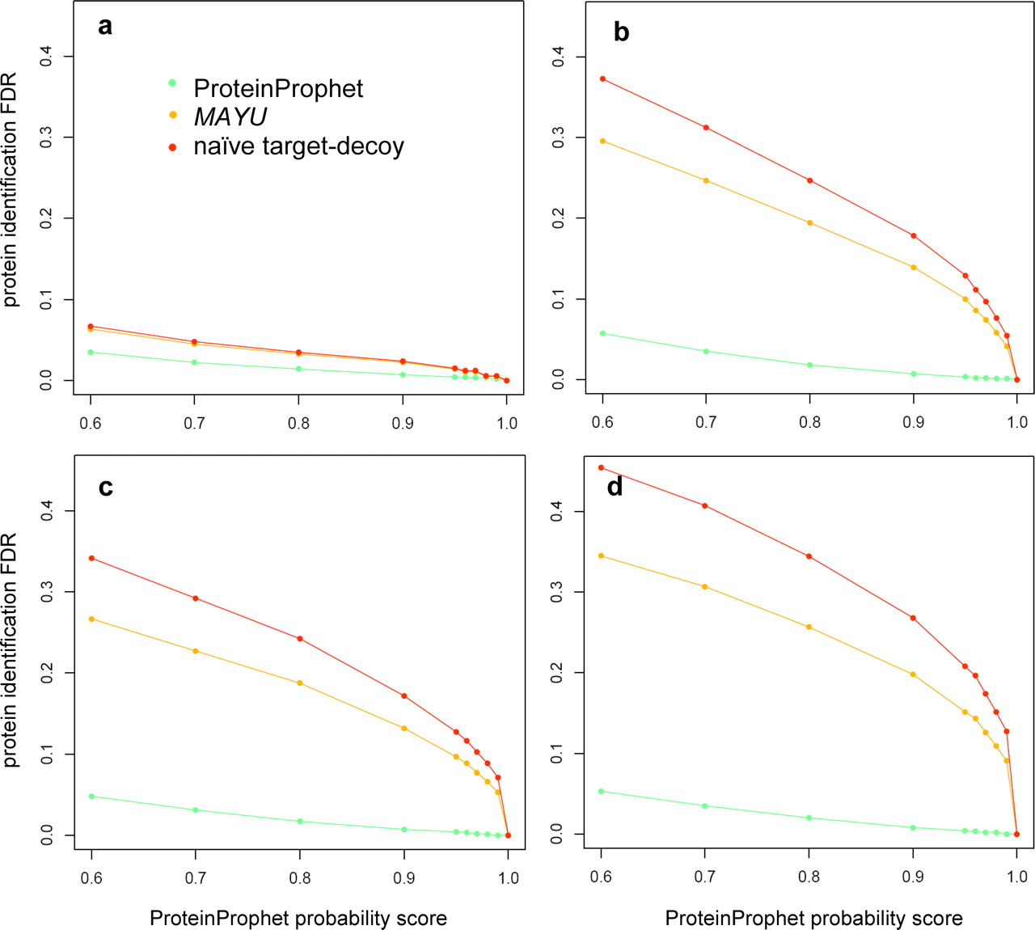
MAYU vs. ProteinProphet
1 run
5 runs
10 runs
20 runs
Reiter et al., Mol. Cell. Proteomics, 2009, 8, 2405-2417

Slide 52
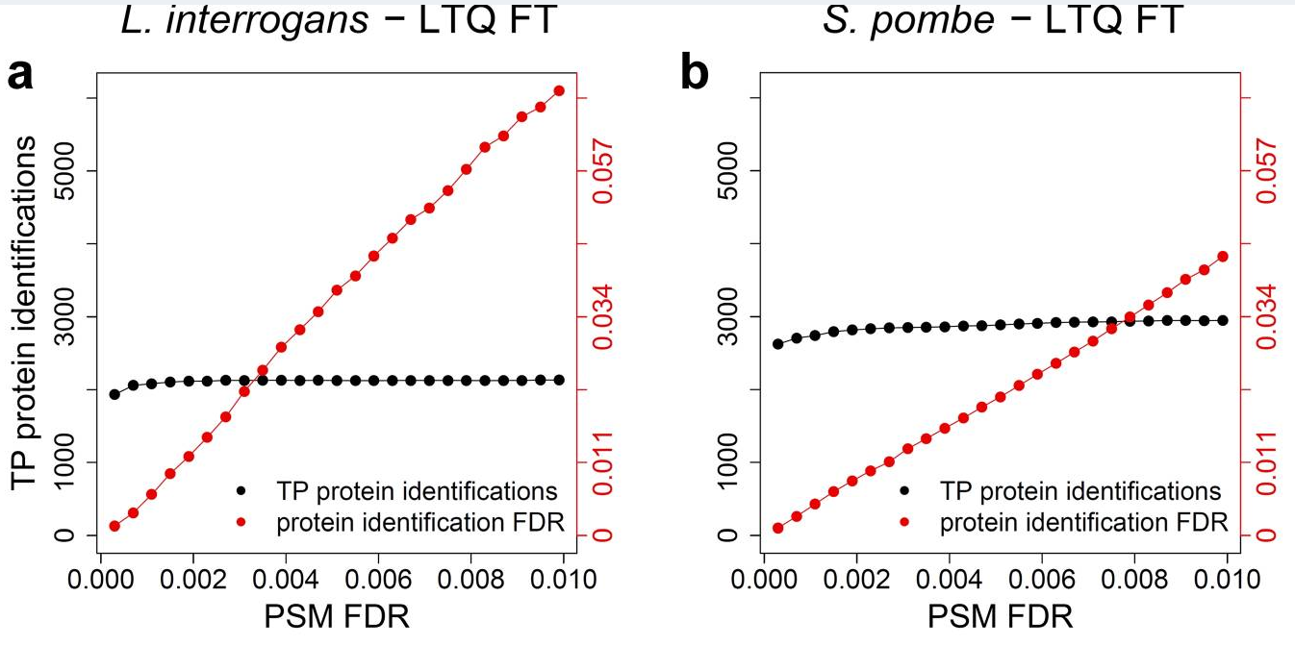
MAYU
Interestingly, increasing the PSM FDR does not yield an increased rate of true protein identification
Currently popular values of 1-5% PSM FDR seem to be much to high and yield very large protein FDRs (>10%)
Reiter et al., Mol. Cell. Proteomics, 2009, 8, 2405-2417

Slide 53
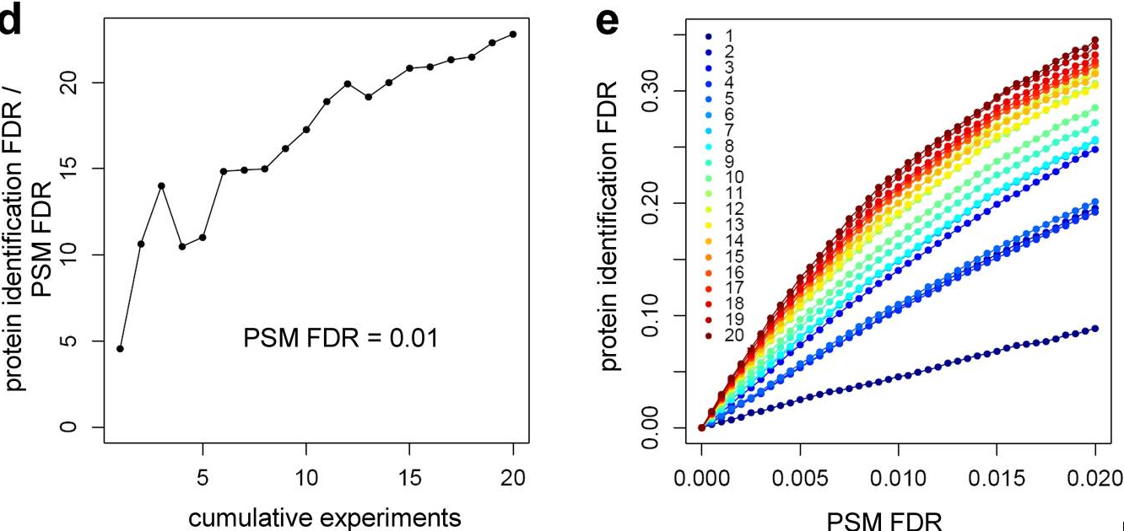
MAYU
These figures show the increase of protein FDR with the number of repeat measurements (right: color = number of runs)
As can be seen from these plots, large-scale studies are particularly prone to FP accumulation
Protein FDRs can thus easily reach values of over 50%, i.e. half of reported protein identifications can be incorrect!
Reiter et al., Mol. Cell. Proteomics, 2009, 8, 2405-2417

Slide 54
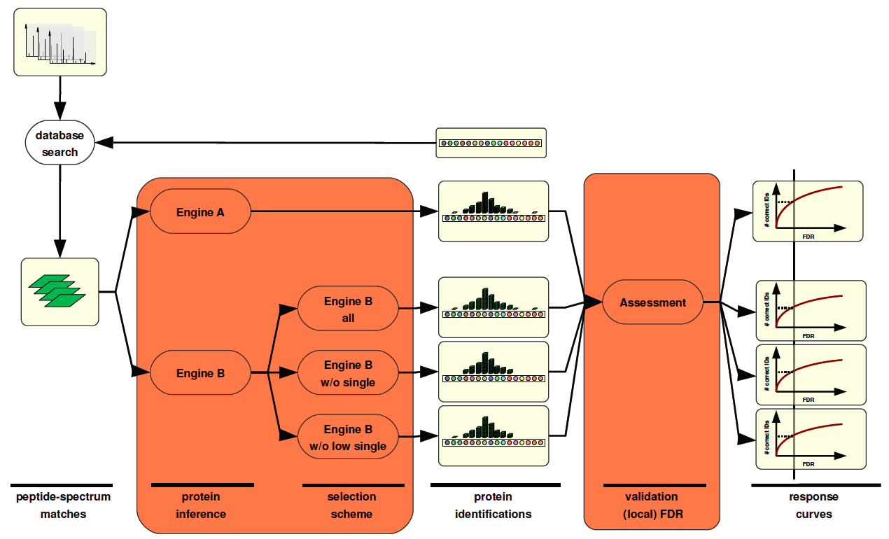
Benchmarking Inference Engines
With MAYU it is possible to benchmark different protein inference engines and PSM selection strategies (e.g., two-peptide vs. single-peptide rule)
Claassen et al., Mol Cell Proteomics (in press)

Slide 55
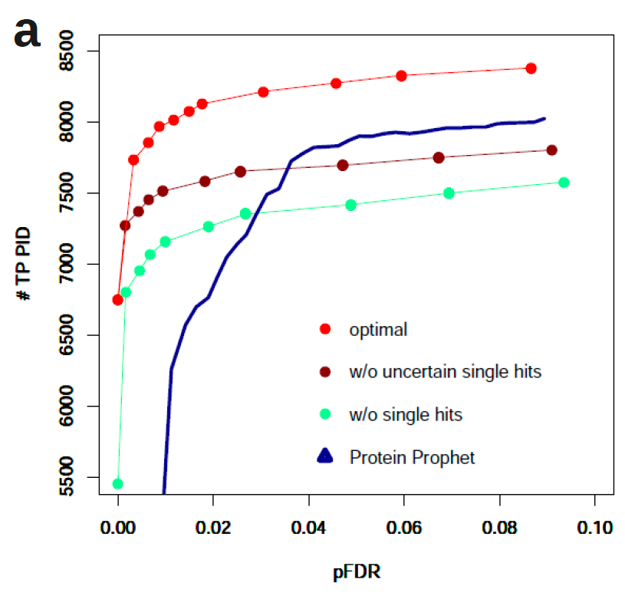
Benchmarking Inference Engines
Conclusions
  Keep all high quality hits, independent of whether they are single-hit wonders or not
  Stringent FDR filtering on the PSM level is required to get a good protein FDR
  Optimal strategy might depend on the dataset and on the organism (database size!)
Claassen et al., Mol Cell Proteomics (in press)

Slide 56
References
One-hit wonders, two peptide rule
  http://www.mcponline.org/site/misc/ParisReport_Final.xhtml
  Gupta, Pevzner, False Discover Rates of Protein Identifications: A Strike against the Two-Peptide Rule, J. Proteome Res. 2009, 8, 4173-4181.
Protein inference methods
  Nesvizhskii A I , Aebersold R, Interpretation of Shotgun Proteomics Data, Mol Cell Proteomics 2005;4:1419-1440
  Nesvizhskii, Keller, Kolker, Aebersold, A Statistical Model for Identifying Protein by Tandem Mass Spectrometry, Anal. Chem. 2003, 75, 4646-4658.
  Keller, Nesvizhskii, Kolker, Aebersold, Empirical Statistical Model to Estimate the Accuracy of Peptide Identifications Made by MS/MS and Database Search, Anal. Chem. 2002, 74, 5383-5392
  ProteinProphet and PeptideProphet:
  http://proteinprophet.sourceforge.net
Protein FDR Estimation (MAYU) and inference engine benchmarking
  Reiter L, Claassen M, Schrimpf SP, Jovanovic M, Schmidt A, Buhmann JM, Hengartner MO, Aebersold R, Protein identification false discovery rates for very large proteomics data sets generated by tandem mass spectrometry, Mol Cell Proteomics. 2009, 8:2405-17
  Claassen, Reiter, Hengartner, Buhmann, Aebersold, Generic Comparison of Protein Inference Engines, Mol. Cell. Proteomics (in press, PMID: 22057310)

