Slide 1
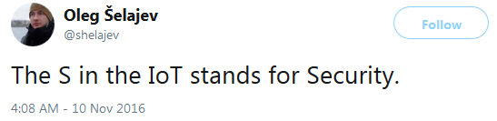
Security aspects in the Internet of Things – think of risks and side-effects in advance!
HEIBRiDS / Colloquium
June 8th, 2022
(lead developer, Oracle Labs)
Notes:
Security aspects in the Internet of Things – think of risks and side-effects in advance!
The Internet is everywhere and thus also in the tiniest devices forming the Internet of Things. But what happens when it comes to security issues? Why do we face new challenges and expose even life-critical systems to security threats? This presentation will not only introduce the technology, benefits, and challenges, but will also highlight very specific, fundamental issues causing a lot of pain when deploying billions of “things” without thinking of security from the very beginning. Just compare the many update cycles of today’s computers with an embedded device offering very limited or no updating capabilities but with an expected life-time of more than 20 years. How to envisage security issues 20 years from now? The situation is not hopeless, we can do something, but there is a long way to go.

Slide 2
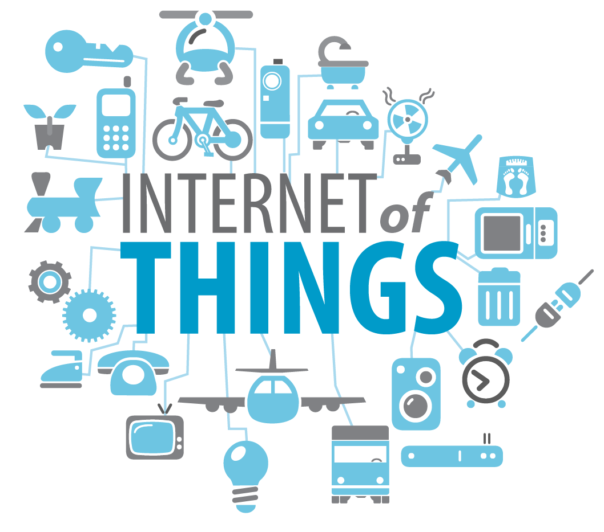
Outline
What is the Internet of Things?
  Do we need that?
What is so special about it?
  Isn’t that just a small PC?
Why are there problems?
  Oh, there are so many reasons …
Can we do something?
  Countermeasures – proactive or reactive?
Conclusion
  All too late or is there still some hope?
© www.webspotting.de

Slide 3
Outline
What is the Internet of Things?
  Do we need that?
What is so special about it?
  Isn’t that just a small PC?
Why are there problems?
  Oh, there are so many reasons …
Can we do something?
  Countermeasures – proactive or reactive?
Conclusion
  All too late or is there still some hope?
© www.webspotting.de

Slide 4
Since more than 30 years: Convergence
Mobile networks
„Classical“
Internet
Fixed networks
GSM
FTP
Cable networks
GPRS
WWW
UMTS
Web2
PSTN
LTE
P2P
Broadcast
Company networks
ISDN
VoD
Home networks
DSL
iTV
UMS
Content
Sharing
3/4/5G
VoIP
IPTV
WiFi
WiMax
Common technology
(everything over IP)
Communities

Slide 5
New: Convergence with new applications
Mobile networks
„Classical“
Internet
Internet of things
Fixed networks
Industrial control systems
Cable networks
Power grid
Company networks
Home networks
Medical devices
Autonomous vehicles
Common technology
(everything over IP)
…

Slide 6
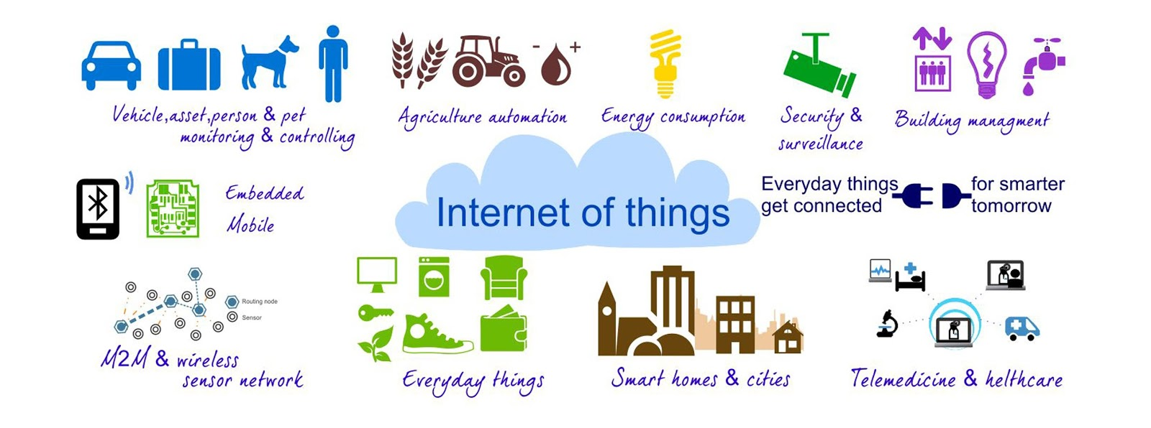
Hype since several years: The Internet of Things
Cars, animals, people,
monitoring
Agriculture
Energy
Security,
surveillance
Building automation
Embedded
systems
Machine-to-machine com.,
Sensor networks
Everyday things
Smart Home / City
Health care
Source: The Telecare Blog, thetelecareblog.blogspot.de, 24.10.14
One common technology for everything!

Slide 7
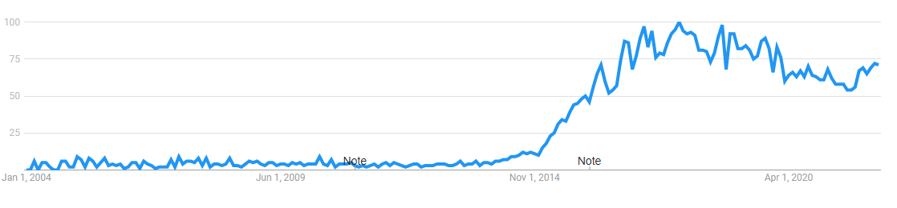
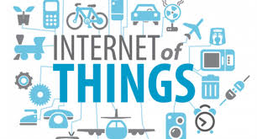

Hype: The Internet of Things
© Business World, 2018

Slide 8
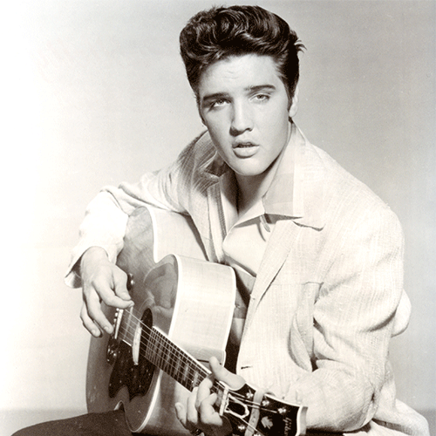
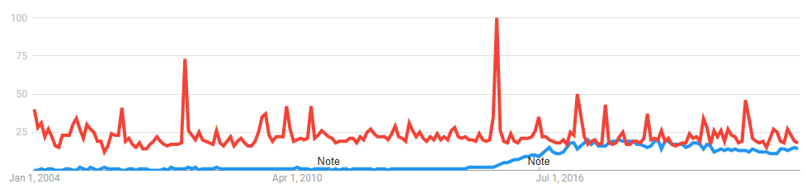

Hype is relative: The Internet of Things … well…
© Amazon, 2018
© Business World, 2018

Slide 9
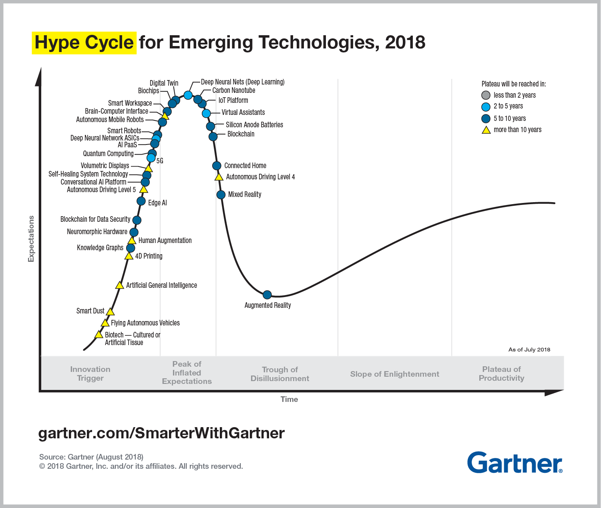
Hype cycles
IoT - Platform
2020: IoT in the trough of disillusionment

Slide 10
Internet of Things – is it really new?
1991: Mark Weiser
  The Computer for the 21st Century, ubiquitous use of IT, disappearing computer
1999: Kevin Ashton
  Coined the term Internet of Things in the context of logistics/supply chains, enhanced radio tags
Network of inter-connected, embedded mini computers
  Collecting and distributing data, Internet technologies as common platform, comprises enhanced RFIDs, wireless sensor networks, actors, mobile communications, “smart” objects, cyber physical systems, …
  Next generation embedded systems + wireless sensor networks + actors + Internet protocols + …
Already today, there are many more communicating systems compared to people – more than 10 billion
In the future:
  Some estimate > 25 billion in 2020, others estimate > 50 billion – ok, there will be MANY…
  As always great expectations: 202x - 1 trillion $ revenue p.a. estimated by GSMA

Slide 11
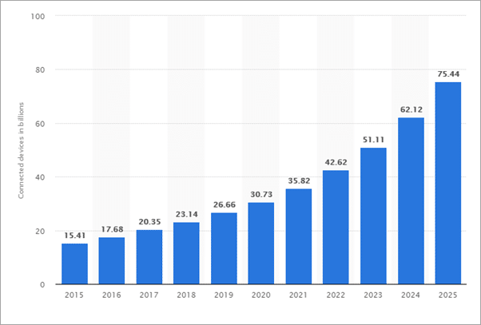
Estimated number of IoT devices
Be aware: there is no precise definition of a device / “thing”
Connected devices [billions]
© statista 2021

Slide 12














The Internet of Things: Drivers
€
=
Data +
Pre-processing
Transmission
Knowledge
Action
Value
© K. Dolfus, SBB 2017

Slide 13
Outline
What is the Internet of Things?
  Do we need that?
What is so special about it?
  Isn’t that just a small PC?
Why are there problems?
  Oh, there are so many reasons …
Can we do something?
  Countermeasures – proactive or reactive?
Conclusion
  All too late or is there still some hope?
© www.webspotting.de

Slide 14

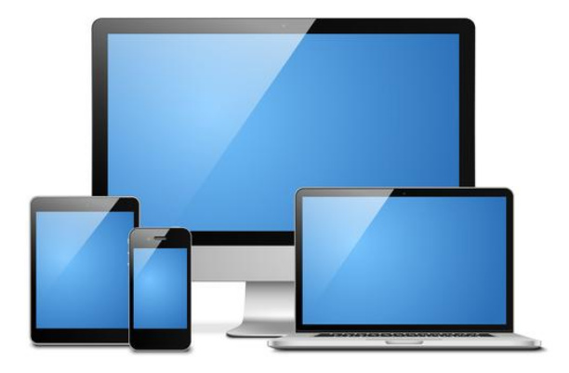
„Normal“ Computer
Memory
  1–32 GiB RAM, 1–4 TB SSD/HD
Processor
  Intel/AMD x86-64, ARM
Operating System
  Windows, MacOS, Linux, iPadOS, iOS, Android
Usage
  Diverse, no fixed/special purpose
Updating
  Automatic by manufacturer
Anti virus/firewall
  Quite common, automatic updating
Life-time
  2–8 years
© Vecteezy
High performance, little heterogeneity, (more or less) up-to-date

Slide 15

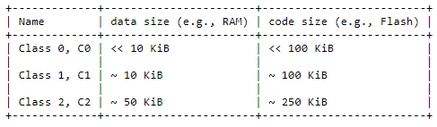
„Thing“ in the Internet of Things
Memory
  1 KiB–1 MiB RAM, 1 KiB–1 MiB ROM/Flash
Processor
  Great variety with different capabilities
Operating System
  Nothing, loop, RIOT-OS, Contiki NG, …
Usage
  Often fixed purpose
Updating
  ??? – often not feasible
Anti-virus/firewall
  ???
Life-time
  1–30 years
RFC 7228
ARM Cortex-M, Atmel Atmega, Atmel SAM,
CC26xx, ESP, NXP LPC, Nordic nRF, PIC32,
MSP430 …
Low performance, high heterogeneity, up-to-date???

Slide 16
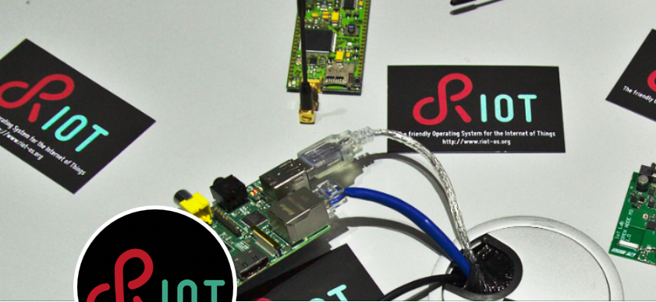
Security risks in the Internet of Things
Examples for the variety– RIOT OS (www.riot-os.org)
Facts
  Variety of platforms and manufacturers
  Very long life-cycles/short product cycles
  Low interest in security
  Low-performance devices
  Unclear liability
Higher risks
  Things are directly connected to values
    Cameras → privacy, situation monitoring
    Doors → admission control
    Cars, medical devices → personal safety
    Valves → industrial production
    …
Compromised things can cause much higher damage compared to the majority of classical systems (e.g., PC on the desktop)
Architectures
AVR
ARM7
Cortex-M0
Cortex-M0+
Cortex-M3
Cortex-M4
Cortex-M7
ESP8266
MIPS32
MSP430
PIC32
X86
…
Boards
Airfy Beacon
Arduino Due, Mega 2560, Zero
Atmel samr21-Xplained Pro
f4vi
mbed NXP LPC1768
Micro::bit
Nordic nrf51822, nrf52840 (DevKit)
Nucleo boards
senseBox
STM32F4DISCOVERY
TelosB
Texas Instruments cc2538 Developer Kit, EZ430-Chronos,UDOO Board
Waspmote-pro
Zolertia Z1
…
Right now RIOT supports more than 220
different hardware platforms

Slide 17

Terra incognita – even for IT professionals
Many still think computer = PC
Classical thinking of the 80ies/last century
Quite often buzzwords only:
  Smartphone, Phablet, Tablet, Cloud, Fog, smart grid,
  smart city, smart xy, Internet of Things,
  BYOD (Bring Your Own Device) etc.
  Without knowing what is really behind it!
BUT IoT means
Full-featured computer (with operating system, memory, processor, I/O, …) embedded in many “things”
  Printer, BIOS, USB stick, lighting, batteries, keyboard, headset, glasses etc.
„Always on“ – there is no switch to take it off-line
  Permanent connection to the Internet and the environment possible
Many (unknown) interfaces!!

Slide 18
Outline
What is the Internet of Things?
  Do we need that?
What is so special about it?
  Isn’t that just a small PC?
Why are there problems?
  Oh, there are so many reasons …
Can we do something?
  Countermeasures – proactive or reactive?
Conclusion
  All too late or is there still some hope?
© www.webspotting.de

Slide 19
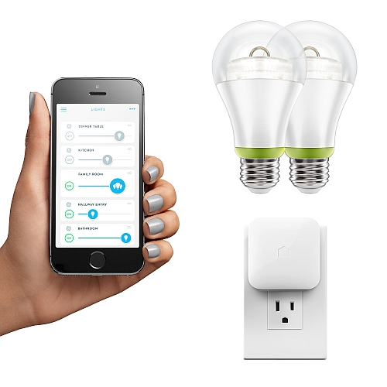
Security risks in the Internet of Things
Even the simplest things are complex – although their function may be trivial
  The networked light switch includes operating system,
  communication software, web server etc.
  A simple valve uses (secured) connections,
  security algorithms, memory management etc.
Security is difficult for an application developer to understand and to achieve
  Focus is on the functionality of a product
  Use of (hopefully available) security functions of the underlying platform
  Platform developer do not know the application, cannot really prove security
Many more tests/evaluations are needed
  In reality way too many combinations of platforms, applications, products
  Additionally, life-cycle vs. product cycle plus scalability of all approaches
© GE Lighting 2017

Slide 20
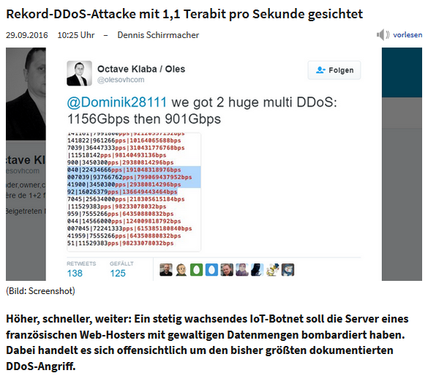
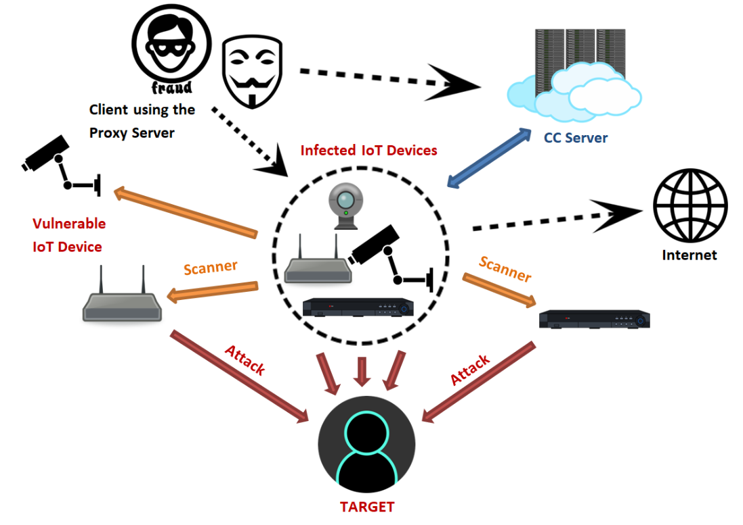
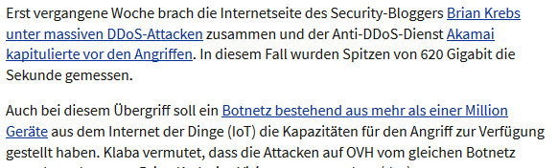
Typical attack scenarios with things
28.2.2018: OMG-Botnet uses IoT devices as proxys
https://www.heise.de/security/meldung/
OMG-Botnet-macht-aus-IoT-Geraeten-Proxys-3982037.html
„There are more than 5.3 million vulnerable IoT devices in Spain. More than 493.000 in Barcelona, which currently hosts the MWC.“ (heise, 03/2017)
https://www.fortinet.com/blog/threat-research/omg--mirai-based-bot-turns-iot-devices-into-proxy-servers.html

Slide 21

Example: Photovoltaics
Headline: Cyber-attack on solar panels could shut down power grids via domino effect
  The Horus Scenario (https://horusscenario.com/) – see also the 50.2 Hz problem, Blackout, …
  30-50% solar power in Germany – switching this on and off repeatedly most likely brings down the power grid
  Many vulnerabilities found in the inverters – and reported to the manufacturer before disclosure at SHA2017
Interesting answers of the manufacturer (https://www.sma.de/fileadmin/content/global/specials/
documents/cyber-security/Whitepaper-Cyber-Security-AEN1732_07.pdf)
  Only some models are affected, all the others use “the latest security standards”
  Any device not connected to the Internet is not affected.
BUT:
  DC/AC inverters have to be remotely controllable by the power grid operator – it’s the law
  Additionally, the webservice some manufacturers use operates on unencrypted data, exchanges usr/pwd for Internet connectivity including the PIN for the SIM to the portal operator for the PV portal – it’s the reality …
  Why? Don’t know …

Slide 22
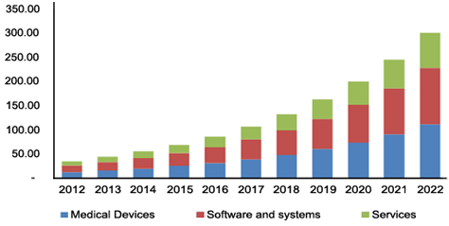
IoT and Healthcare
“Global Internet of Things (IoT) in Healthcare Market is expected to reach nearly $410 billion by 2022” (GrandView Research).
Collateral damage possible
But also direct attacks ➔ MEDJACK (medical device hijack)
Unsecure systems „inside“: HW, SW, building automation/IoT, door locks, WLAN, etc. but also the patients
Updating/patching devices difficult or simply not allowed
Firewalls often cannot detect “old” attack schemes
US IoT/Healthcare Market
The devices vulnerable to MEDJACK … include “diagnostic equipment (PET scanners, CT scanners, MRI machines, etc.), therapeutic equipment (infusion pumps, medical lasers, surgical machines), life support equipment (heart/lung machines, medical ventilators, extracorporeal membrane oxygenation machines and dialysis machines) and more.”

Slide 23
Is the Internet of Things secure?
OWASP Internet of Things Top 10 2018 :
  Weak Guessable, or Hardcoded Passwords
  Insecure Network Services
  Insecure Ecosystem Interfaces
  Lack of Secure Update Mechanism
  Use of Insecure or Outdated Components
  Insufficient Privacy Protection
  Insecure Data Transfer and Storage
  Lack of Device Management
  Insecure Default Settings
  Lack of Physical Hardening
Open Web Application Security Project (OWASP), www.owasp.org
What is the difference wrt. “classical” mobile or fixed networked devices?

Slide 24
A bit more precise: What are the IoT specific problems?
Oh, there are so many…
  Resistance wrt. DoS attacks, draining of batteries
  Limited resources for security protocols or algorithms
  Life-cycle vs. versions and updating
  Does the thing really do what I thinks it should do and the thing claims to do? ( -> remote attestation)
  Reverse engineering, manipulation, quantum proof
  …
Musa G. Samaila, Miguel Neto, Diogo A. B. Fernandes, Mário M. Freire, and Pedro
R. M. Inácio. „Challenges of securing Internet of Things devices: A survey“. In: Security
and Privacy 1.2 (2018)
Mahmoud Ammar, Giovanni Russello, and Bruno Crispo. „Internet of Things: A survey
on the security of IoT frameworks“. In: Journal of Information Security and Applications
38 (2018), pp. 8–27
O. Garcia-Morchon, S. Kumar, and M. Sethi. Internet of Things (IoT) Security: State of
the Art and Challenges. RFC 8576. Internet Engineering Task Force, Apr. 2019

Slide 25
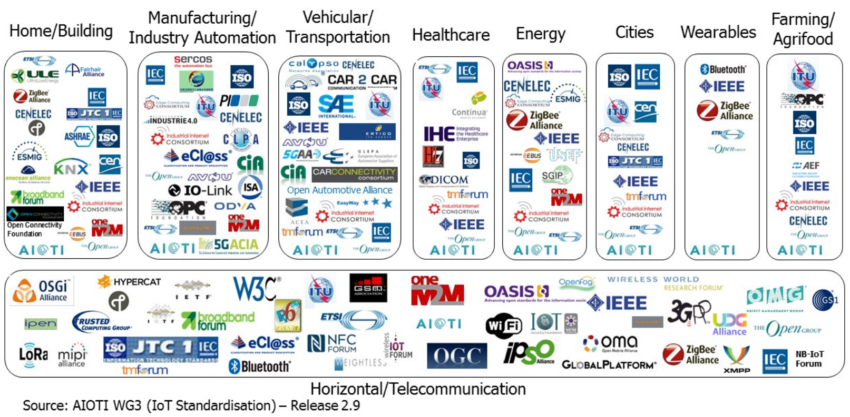
Heterogeneity – Standardization – Interoperability
Yes, many people work on this …
© aioti.eu

Slide 26
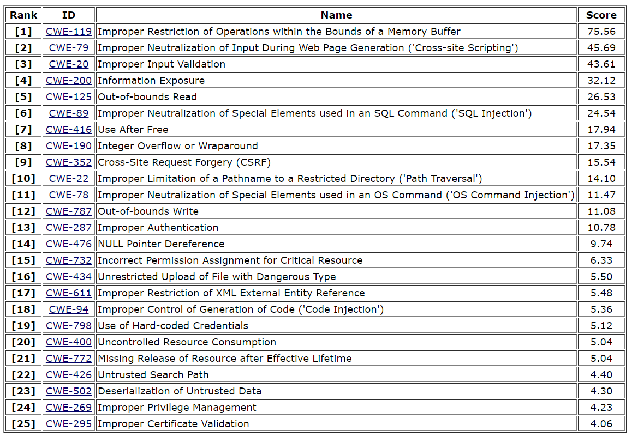
Even more specific: What is one of the technical problems?
2019 CWE Top 25
Most Dangerous Software Errors
Improper or non-existing memory protection!
  1. Improper restriction of operations within bounds
  5. Out-of-bounds read
  7. Use after free
  12. Out-of-bounds write
➔ „arbitrary“ code can be executed!
https://cwe.mitre.org/top25/archive/2019/2019_cwe_top25.html

Slide 27
Memory protection
Memory
Operating system
  Partitioning of the memory
  Separation of processes
MMU (Memory Management Unit)
  Hardware support for memory protection
  simpler: MPU (Memory Protection Unit)
access
attempt
✓
Process
A
Process
B
MMU
access
attempt
Process
C
Operating system
programs

Slide 28
Memory protection
Memory
Operating system
  Partitioning of the memory
  Separation of processes
MMU (Memory Management Unit)
  Hardware support for memory protection
  simpler: MPU (Memory Protection Unit)
Within one address space
  Protection of different memory regions
  E.g. read-only, read/write, data, code
➔ Memory protection mechanisms interpret content
access
attempt
✓
Program code
read/write
Data
read/write
MPU
Data
read-only
access
attempt
Program code
read-only
Privileged
program code
programs

Slide 29
Without memory protection
No interpretation of the content, no knowledge about the meaning of data
  Program code, data, read-only, belongs to process x, privileged…
Memory
Data A (code)
read/write
Data B (variables)
read/write
Data C (stack)
read/write
Data D (data)
read-only (ROM)
Data E (code)
read-only (ROM)

Slide 30
Without memory protection
No interpretation of the content, no knowledge about the meaning of data
  Program code, data, read-only, belongs to process x, privileged…
EVERYTHING is just data
  Interpretation depends on the current state (program counter)
  Operands can be interpreted as commands
  Very flexible – but also very vulnerable wrt. errors or attacks
  that’s the classical von Neumann principle!
Hardware-based separation (“interpretation”) possible
  Harvard architecture (separated commands from operands)
  ROM (read only) / RAM (read/write)
Memory
Daten A (Code)
schreib-/lesbar
RAM
read/write
Daten B (Variablen)
schreib-/lesbar
Daten C (Stack)
schreib-/lesbar
ROM
read-only
Daten D (Daten)
nur lesbar (ROM)
Daten E (Code)
nur lesbar (ROM)

Slide 31
Without memory protection
No interpretation of the content, no knowledge about the meaning of data
  Program code, data, read-only, belongs to process x, privileged…
EVERYTHING is just data
  Interpretation depends on the current state (program counter)
  Operands can be interpreted as commands
  Very flexible – but also very vulnerable wrt. errors or attacks
  that’s the classical von Neumann principle!
Hardware-based separation (“interpretation”) possible
  Harvard architecture (separated commands from operands)
  ROM (read only) / RAM (read/write)
  ➔ Wide range of manipulations and execution of erroneous code is possible
Memory
Data A (code)
read/write
Data B (variables)
read/write
Data C (stack)
read/write
Data D (daten)
read-only (ROM)
✓
Data E (code)
read-only (ROM)

Slide 32
Without memory protection
Heise 5/21: 54 years undiscoverd – mother of all security issues
Basic design decision (mistake?) also affects fundamental
(even purely theoretical) computer architectures
Example: Marvin Minskis universal Turing machine from 1967
Johnson: Intrinsic Propensity for Vulnerability in Computers? Arbitrary Code Execution in the Universal Turing Machine, arXiv:2105.02124
No interpretation of the content, no knowledge about the meaning of data
  Program code, data, read-only, belongs to process x, privileged…
EVERYTHING is just data
  Interpretation depends on the current state (program counter)
  Operands can be interpreted as commands
  Very flexible – but also very vulnerable wrt. errors or attacks
  that’s the classical von Neumann principle!
Hardware-based separation (“interpretation”) possible
  Harvard architecture (separated commands from operands)
  ROM (read only) / RAM (read/write)
  ➔ Wide range of manipulations and execution of erroneous code is possible
CVE-2021-32471

Slide 33
IoT specific security problems
Hardware
  No or insufficient memory protection
Operating system
  Knows only basic security mechanisms
Intrusion detection
  Too weak, typically not on device but edge/cloud
Manufacturer
  Many and often out of reach
Interoperability
  Huge number of players, few common standards, device incompatibility
Complexity
  Many more interfaces, more devices, many software versions, plethora of hardware components and configurations…
Updating
  Feasible in theory – but in real systems? How to access a device after 10, 20 years?

Slide 34
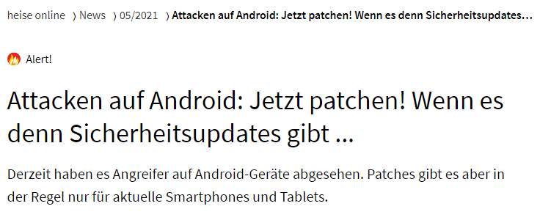
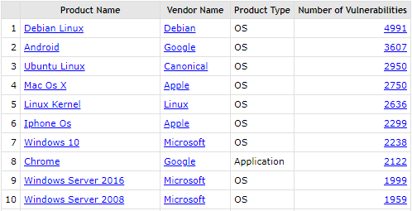
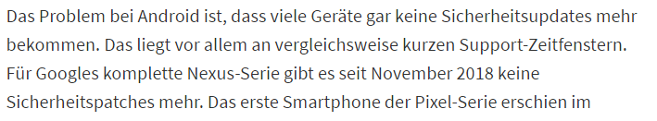
Updating vs. life-time – a really big problem!
?
Attacks against Android phones – patch now (if there are patches available …)
© www.cvedetails.com
No more updates for “older” devices – e.g. no updates for Nexus devices since November 2018
manufactured until 2016!

Slide 35
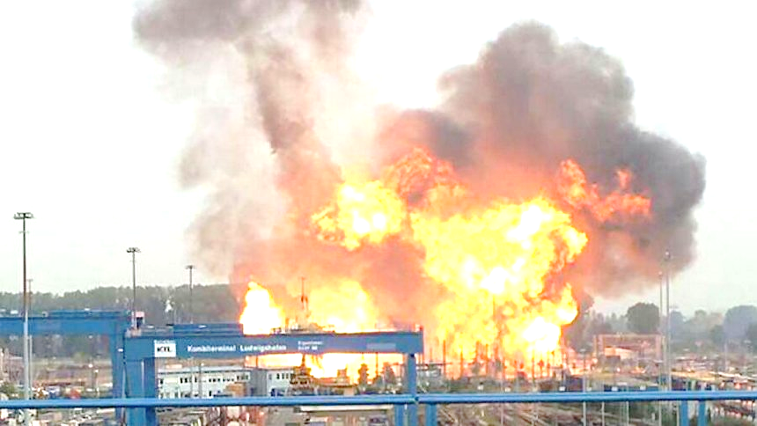





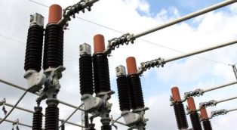


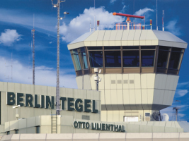



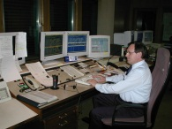

Networked systems – Things communicate with things (and humans)
Source: Spiegel Online
Somehow inter-connected…

Slide 36
Mind the gap between data and the real world!
Data-based
situation
Real situation
How large is the gap?

Slide 37
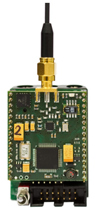
IoT Challenges - what is really new
  „The Internet of Things (IoT) will present new attack surfaces as most of the IoT devices do not offer integrated security and, furthermore, it is often not possible to update security mechanisms later on. If compromised, these devices may serve as a backdoor for hackers to enter clinical IT systems – undiscovered for months.“ (DarkReading, www.informationweek.com, 22.12.16)
  Large variety of systems (hardware, interfaces, operating systems), typically “weak”
  Real interaction with the environment (CPS)
  Longer (but also much shorter!) life cycles, deeply embedded
  Complete unclear patching/updating strategy, responsibility
  SME problem: do they know what they do?
  How to integrate today the security needed in 30 years?
  First steps in the right direction: certified IoT devices and liability

Slide 38
Outline
What is the Internet of Things?
  Do we need that?
What is so special about it?
  Isn’t that just a small PC?
Why are there problems?
  Oh, there are so many reasons …
Can we do something?
  Countermeasures – proactive or reactive?
Conclusion
  All too late or is there still some hope?
© www.webspotting.de

Slide 39
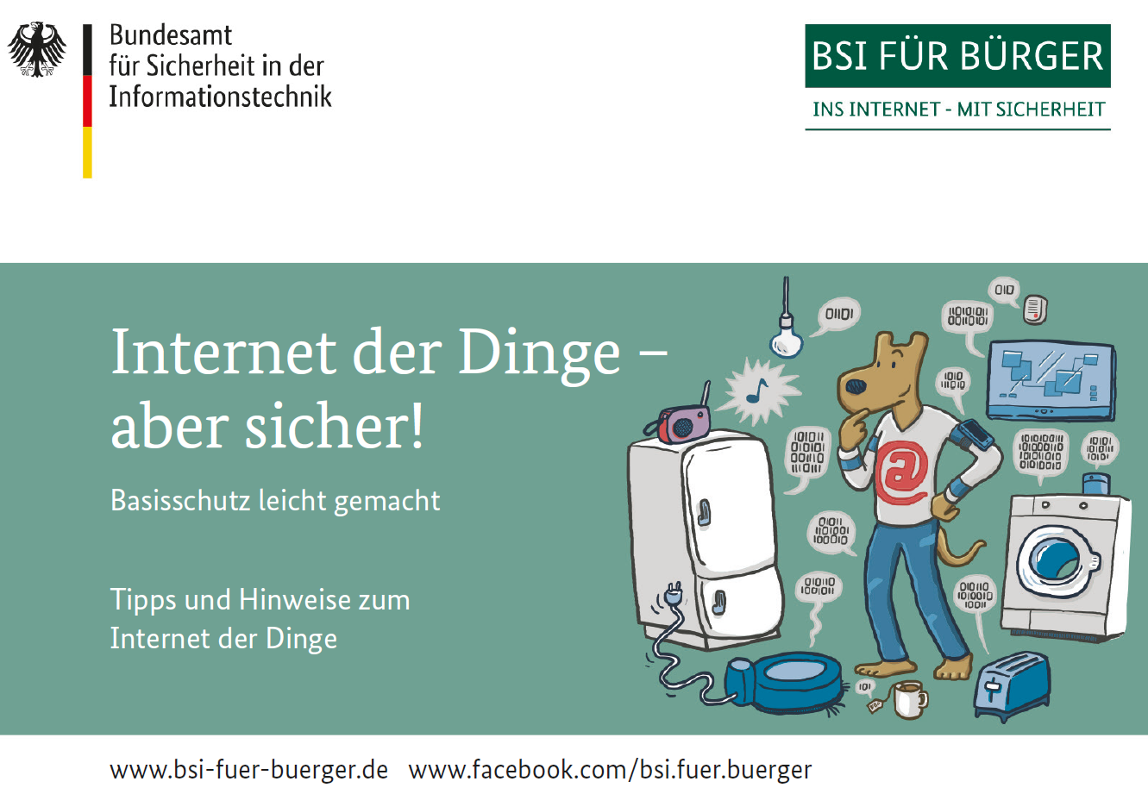
First steps – by far not enough!
European Union Agency For Network And Information Security.
Baseline Security Recommendations
for IoT, 2017 www.enisa.europa.eu/
publications/
baseline-security-recommendations-for-iot
Good Practices for Security of IoT - Secure Software Development Lifecycle, 2019
www.enisa.europa.eu/publications/good-practices-for-security-of-iot-1
IoT Security Standards Gap Analysis, 2019
www.enisa.europa.eu/publications/iot-security-standards-gap-analysis
ETSI EN 303 645: CYBER; Cyber Security for Consumer Internet of Things: Baseline Requirements
ETSI TS 103 701: CYBER; Cyber Security for Consumer Internet of Things: Conformance Assessment of Baseline Requirements
Optional for vendors –
pure plausibility check!

Slide 40
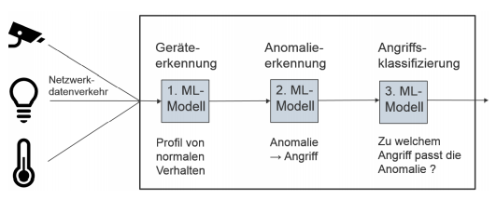
Many activities regarding IoT security
Hardware
  Integrated encryption, memory protection, protection against reverse engineering and tampering, cryptographic bootloader…
Operating system
  Zephyr, mbedOS, RT-Thread, NuttX, RIOT …
Intrusion detection
  Passban, IDSA-IoT, HADIoT…
Updating
  SUIT (Software Updates for IoT), Brendan Moran, Hannes Tschofenig, David Brown, and Milosch Meriac. A Firmware Update Architecture for Internet of Things. Internet-Draft. Internet Engineering Task Force, Nov. 2019.
  H. Birkholz, D. Thaler, M. Richardson, N. Smith, and W. Pan. Remote Attestation Procedures Architecture. Internet-Draft. Internet Engineering Task Force, Feb. 2021.
Communication protocols
  Hannes Tschofenig and Emmanuel Baccelli. Cyberphysical Security for the Masses: A Survey of the Internet Protocol Suite for Internet of Things Security. In: IEEE Security & Privacy 17.5 (2019), pp. 47–57.
device
detection
anomaly
detection
attack
classification
network
traffic
1st ML
model
2nd ML
model
3rd ML
model
profile of
normal
behavior
anomaly
-> attack
which type of attack causes anomaly?

Slide 41
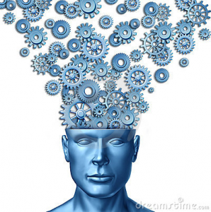
Non-technical challenges
Many new processes required that fit to the technological change
Training, education
  Complete different level compared to network security technologies in classical distributed, networked devices
IoT ecosystem
  Different types of interactions and threats
Testing, simulation, resilience, cooperation
  Technological, but also legal – up to the management
Do salaries, carrier paths, legislation, … fit to these challenges?

Slide 42
Outline
What is the Internet of Things?
  Do we need that?
What is so special about it?
  Isn’t that just a small PC?
Why are there problems?
  Oh, there are so many reasons …
Can we do something?
  Countermeasures – proactive or reactive?
Conclusion
  All too late or is there still some hope?
© www.webspotting.de

Slide 43

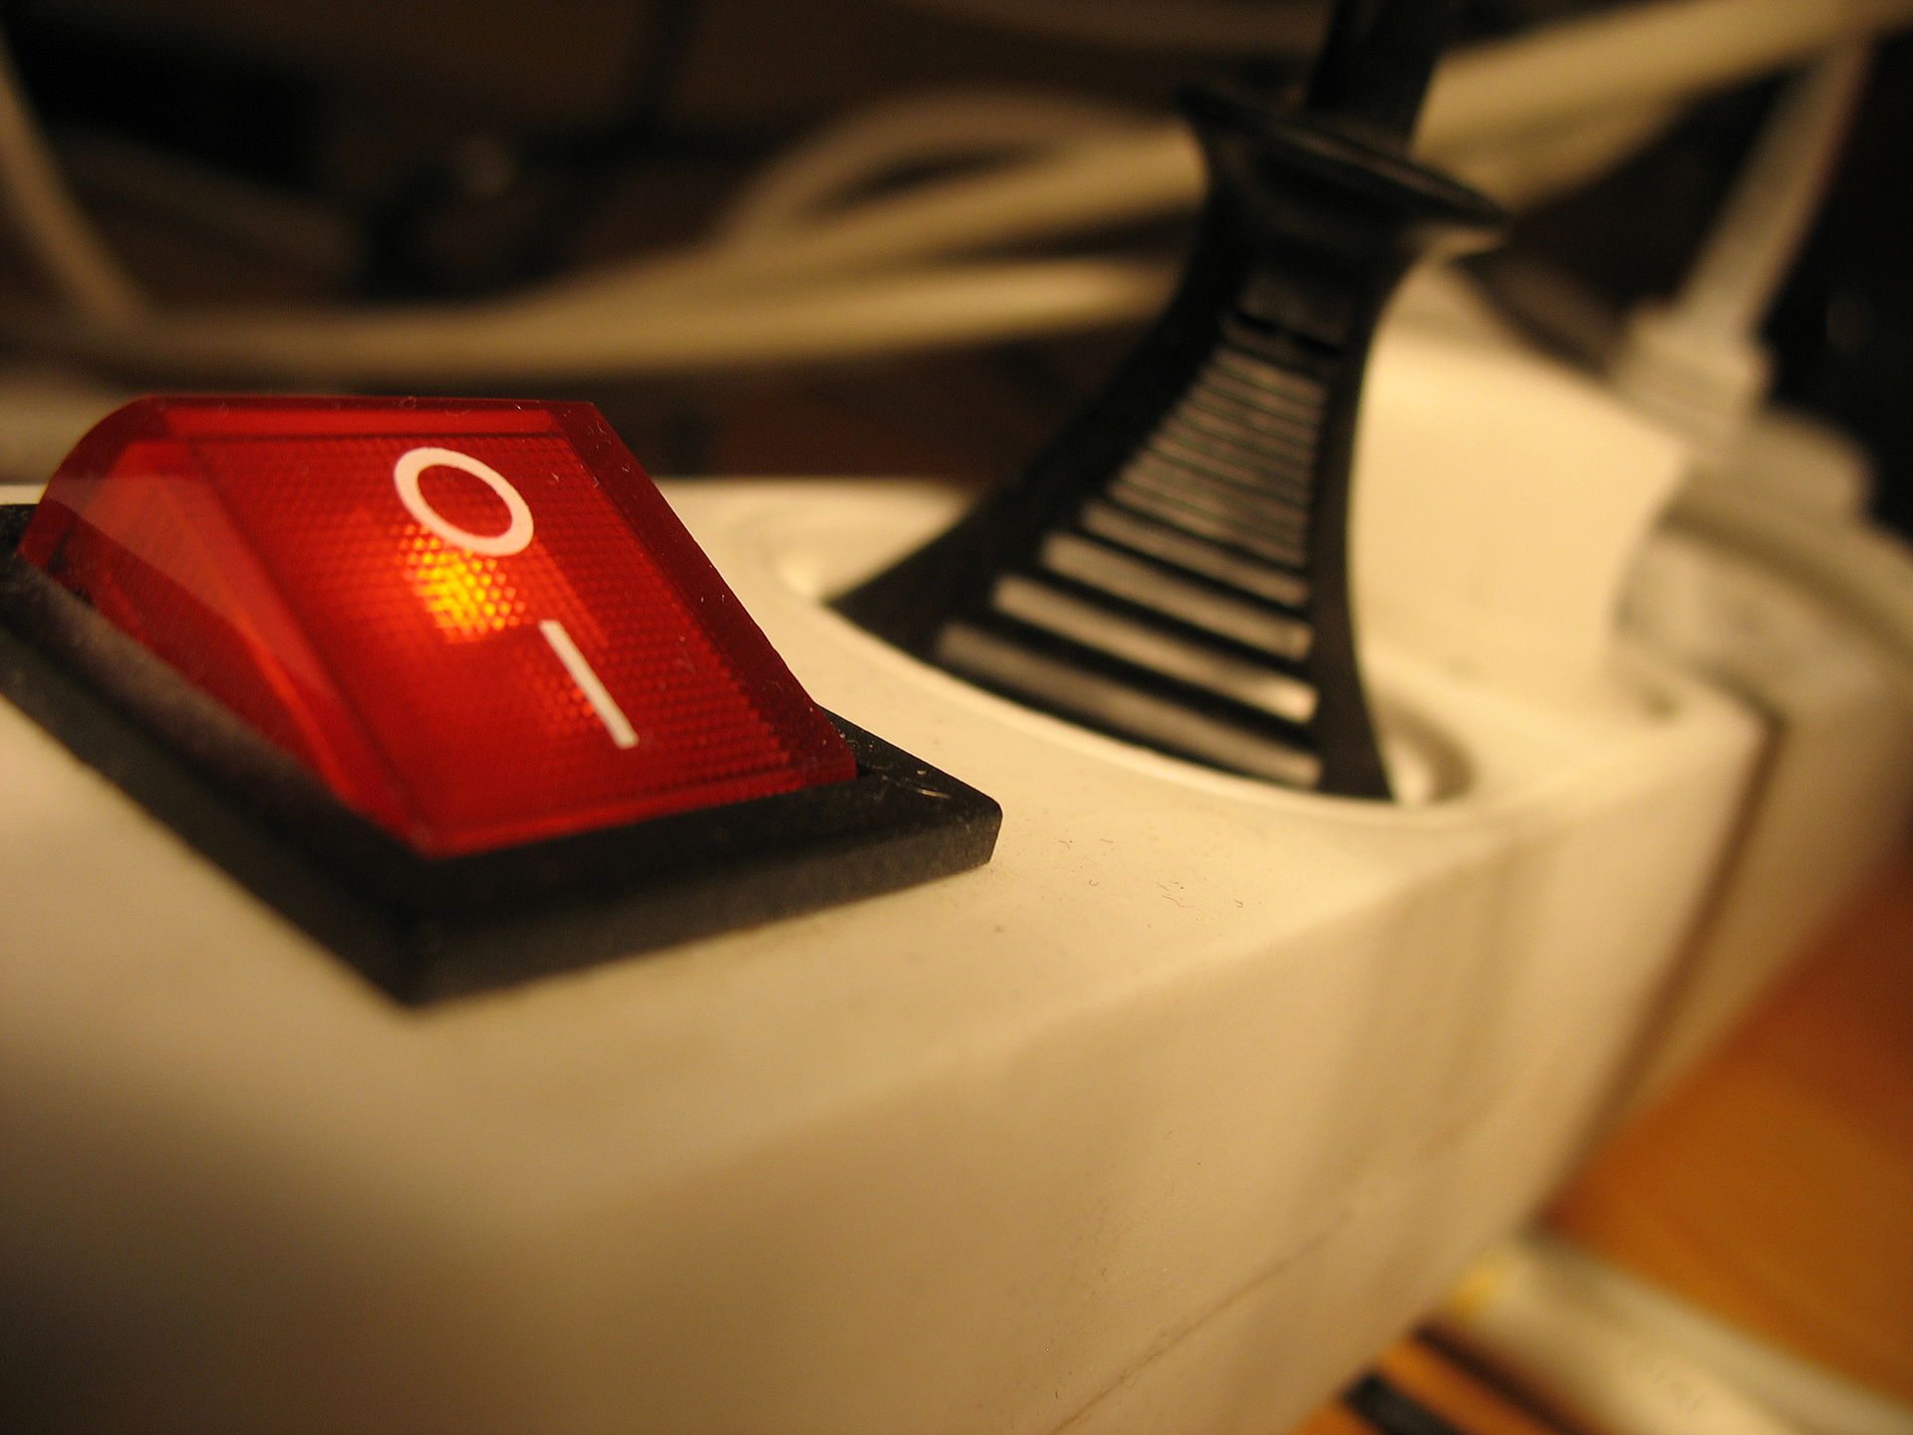
Can we control the complexity of our (IoT) networks?
NO
  If we continue to connect “just because the interface fits somehow”
  Yes, many new applications, but we do not know all side-effects?
By ​English Wikipedia user Firstfreddy, CC BY-SA 3.0

Slide 44
Can we regain control of our (IoT) networks?
NO
  If we continue to connect “just because the interface fits somehow”
  Yes, many new applications, but we do not know all side-effects?
YES
  If we go back to the classical engineering
  principles used in many disciplines
  Unfortunately, network “engineering” today
  quite often ignores basic rules
  Unfortunately, often there is no strong
  business case for solid engineering
By ​English Wikipedia user Firstfreddy, CC BY-SA 3.0

Slide 45
IoT and security – a permanent process
Approach: Try to avoid the loss of control, but be prepared for a complete failure
Pure technical approaches are limited
  Helps only with simple attackers, not useful to protect against the professionaly
  Complete system often not understood, e.g., mobile phone/BYOD/company networks/new and unknown interfaces
Do only things you understand
  Better less functionality, but secure (e.g., own cloud/edge/…)
  Fewer, simpler and understandable interfaces (e.g. VPN box instead of software client)
Use well-known practices
  Encrypted file systems, smart cards instead of passwords, multi-way authentication, …
  Many best practices do exist – but have to be used!
  See certification, ISO, BSI, …

Slide 46
Conclusion
The biggest challenges today are not so much technical problems as they are matters of awareness
  We have a lot of security architectures, protocols, algorithms … at hand
  But we do not really use them in a proper way! (and sometimes we don’t know how to do it…)
Know what you do before you introduce IoT in safety and security critical systems!
  Otherwise history is repeating and we will (again) enter the permanent fight of patches and updates vs. abuse and attacks.
Unfortunately, right now there is no strong business case for manufacturers to add a ubiquitous security element into the development process
  It is up to the professional consumers in safety critical environments to call for sound standards and guaranteed common security settings.
  Plus legislation, certification, liability…

