Slide 1
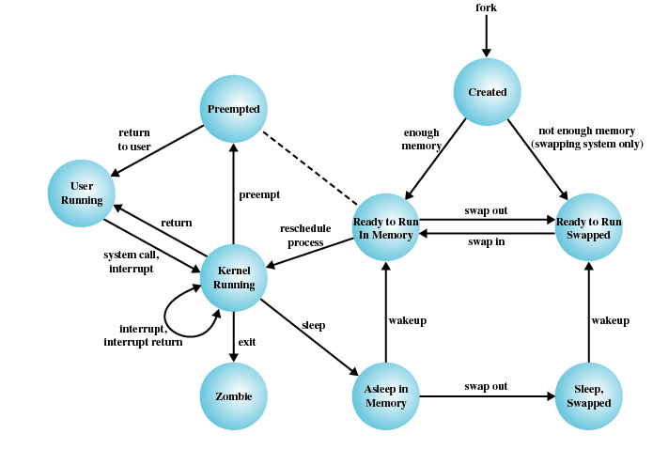
TI III: Operating Systems & Computer Networks
I/O and File System
Prof. Dr.-Ing. Jochen Schiller
Computer Systems & Telematics
Freie Universität Berlin, Germany

Slide 2
Content
Introduction and Motivation
Subsystems, Interrupts and System Calls
Processes
Memory
Scheduling
I/O and File System
Booting, Services, and Security

Slide 3
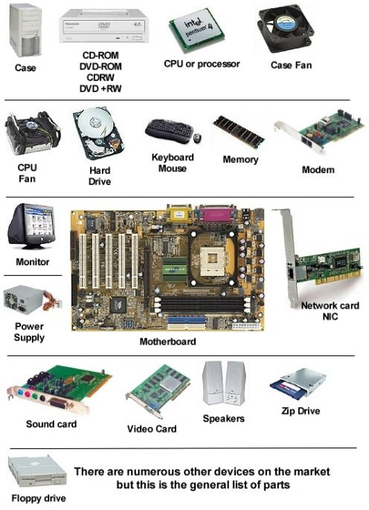
Operating System Design and I/O

Slide 4
Operating System Design and I/O
Efficiency Problems
  I/O (usually) cannot keep up with processor speed
  Use of multiprogramming allows for some processes to be waiting on I/O while another process executes
  Most I/O devices extremely slow compared to main memory
  Swapping is used to bring in additional Ready processes (requires I/O operations)
Generality
  Desirable to handle all I/O devices in a uniform manner, i.e., provide good abstraction to application programmer
  Hide most of details of device I/O in lower-level routines
    Processes and upper levels see devices in general terms, e.g., read, write, open, close, lock, unlock
Conflicting goals motivate focus on API design

Slide 5
Types of I/O Devices
Wide variety of I/O devices
  Human readable, e.g., display, keyboard, mouse
  Machine readable, e.g., disk and tape drives, sensors, controllers, actuators
  Communication, e.g., digital line drivers, modems
Data rate
  Application
  (software support, priority)
  Complexity of control
  Unit of transfer
  (stream, blocks, characters)
  Data representation
  Encoding schemes
  Error conditions

Slide 6
Alternatives for I/O Organization
Device abstraction
  Character-based I/O
    E.g. input devices like keyboard or mouse
  Block-based I/O
    E.g. data storage
  Not necessarily related to implementation, e.g. USB
Communication endpoint (socket) abstraction
  Used for networking
  Second part of this lecture
File abstraction
  Structured, persistent storage
  Sometimes with additional semantics, e.g., locking, transaction support, etc.

Slide 7
Evolution of the I/O Function
1
Processor directly controls a peripheral device
2
A controller or I/O module is added
3
Same configuration as step 2, but now interrupts are employed
4
5
6
The I/O module is given direct control of memory via DMA
The I/O module is enhanced to become a separate processor, with a specialized instruction set tailored for I/O
The I/O module has a local memory of its own and is, in fact, a computer in its own right
Notes:
As computer systems have evolved, there has been a pattern of increasing
complexity and sophistication of individual components. Nowhere is this more
evident than in the I/O function. The evolutionary steps can be summarized as
Follows:
1. The processor directly controls a peripheral device. This is seen in simple
microprocessor-controlled devices.
2. A controller or I/O module is added. The processor uses programmed I/O
without interrupts. With this step, the processor becomes somewhat divorced
from the specific details of external device interfaces.
3. The same configuration as step 2 is used, but now interrupts are employed. The
processor need not spend time waiting for an I/O operation to be performed,
thus increasing efficiency.
4. The I/O module is given direct control of memory via DMA. It can now move
a block of data to or from memory without involving the processor, except at
the beginning and end of the transfer.
5. The I/O module is enhanced to become a separate processor, with a
specialized instruction set tailored for I/O. The central processing unit
(CPU) directs the I/O processor to execute an I/O program in main
memory. The I/O processor fetches and executes these instructions without
processor intervention. This allows the processor to specify a sequence of
I/O activities and to be interrupted only when the entire sequence has been
performed.
6. The I/O module has a local memory of its own and is, in fact, a computer
in its own right. With this architecture, a large set of I/O devices can be
controlled, with minimal processor involvement. A common use for such an
architecture has been to control communications with interactive terminals.
The I/O processor takes care of most of the tasks involved in controlling the
terminals.
As one proceeds along this evolutionary path, more and more of the I/O
function is performed without processor involvement. The central processor is
increasingly relieved of I/O-related tasks, improving performance. With the last
two steps (5 and 6), a major change occurs with the introduction of the concept of
an I/O module capable of executing a program.
A note about terminology: For all of the modules described in steps 4
through 6, the term direct memory access is appropriate, because all of these
types involve direct control of main memory by the I/O module. Also, the I/O
module in step 5 is often referred to as an I/O channel , and that in step 6 as an
I/O processor ; however, each term is, on occasion, applied to both situations. In
the latter part of this section, we will use the term I/O channel to refer to both
types of I/O modules.

Slide 8
I/O Related Programming Techniques
Programmed I/O
  Process is busy-waiting for the operation to complete
Interrupt-driven I/O
  I/O command is issued
  Processor continues executing instructions
  I/O module sends an interrupt when done
Direct Memory Access (DMA)
  DMA module controls exchange of data between main memory and the I/O device
  Processor interrupted only after entire block has been transferred
while (*IO_STATUS_ADDR != IO_DONE){}

Slide 9
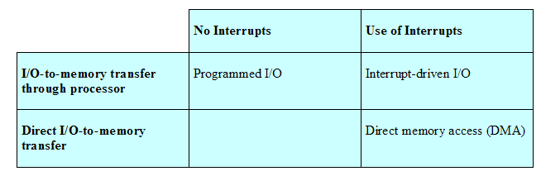
Comparison of I/O Techniques
Programmed I/O
  Only when there’s no alternative, e.g., timing with very high accuracy
Interrupt-driven I/O
  Event-based programming, e.g., user input
Direct memory access
  Data transfer, e.g. disk I/O, graphics operations, network packet processing

Slide 10
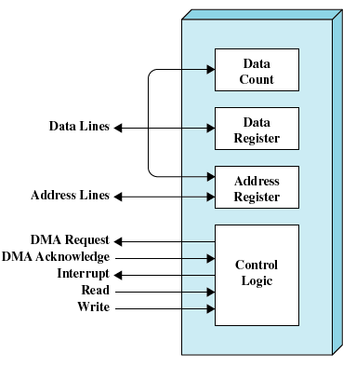
Direct Memory Access
Moving data between main memory and peripherals is a simple operation, but keeps CPU busy
Delegate I/O operation to extra hardware: DMA module
DMA module transfers data directly to or from memory
  “For-loop in hardware”
  Continuous memory regions
When complete, DMA module sends interrupt signal to CPU

Slide 11
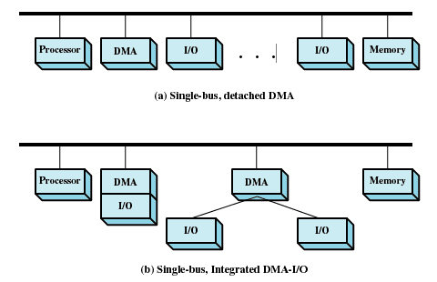
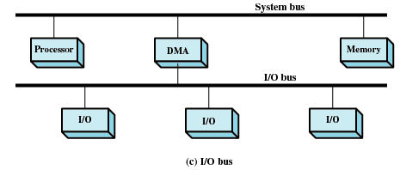
DMA Configurations
Single-bus, detached DMA
  Simple, but inefficient
  Requires multiple I/O requests to device
Single-bus, integrated DMA-I/O
  Efficient, but expensive
  One controller per device (group)
I/O bus
  Efficient and less expensive
  Separate bus, one controller

Slide 12
I/O Buffering
Main memory used to temporarily store data
  Mitigates differences in data processing speeds
    Processes must wait for I/O to complete before proceeding
  Manage pages that must remain in main memory during I/O
    Buffer must be accessible to low-level drivers and hardware
Approaches (with different buffering strategies)
  Block-oriented
    Information is stored in fixed sized blocks
    Transfers are made one block at a time
    Used for disks and tapes
  Stream-oriented (stream of characters)
    Transfer information as a stream of bytes
    Used for terminals, printers, communication ports, mouse and other pointing devices, and most other devices that are not secondary storage

Slide 13
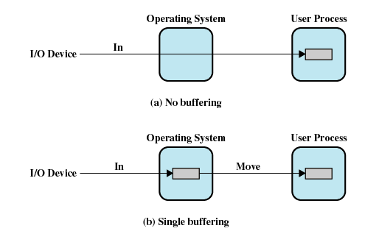
I/O Buffering Implementations
No buffering

Slide 14
I/O Buffering Implementations
Single buffering
  Block-oriented: User process can process one fixed-sized block of data while next block is read in
  Stream-oriented: Process one variable-sized and delimited line at time

Slide 15
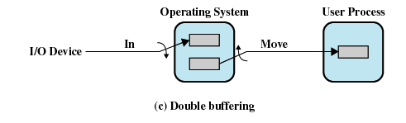
I/O Buffering Implementations
Double buffering
  Process can transfer data to or from one buffer while OS empties or fills other buffer

Slide 16
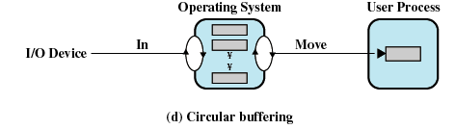
I/O Buffering Implementations
Circular/ring buffering
  Each individual buffer is one unit in circular buffer
  Used when I/O operation must keep up with process

Slide 17
Questions & Tasks
  If you want to learn more, please check the hidden slides (i.e. slides not covered in the video/lecture but available via the PDF)!
  Programmed I/O (PIO) looks pretty inefficient – but are there also situations where PIO has advantages over DMA?
  Point out bottlenecks in the DMA configurations! Are you aware of more efficient solutions? (Hint: check current PC architectures, PCIe etc.)

Slide 18
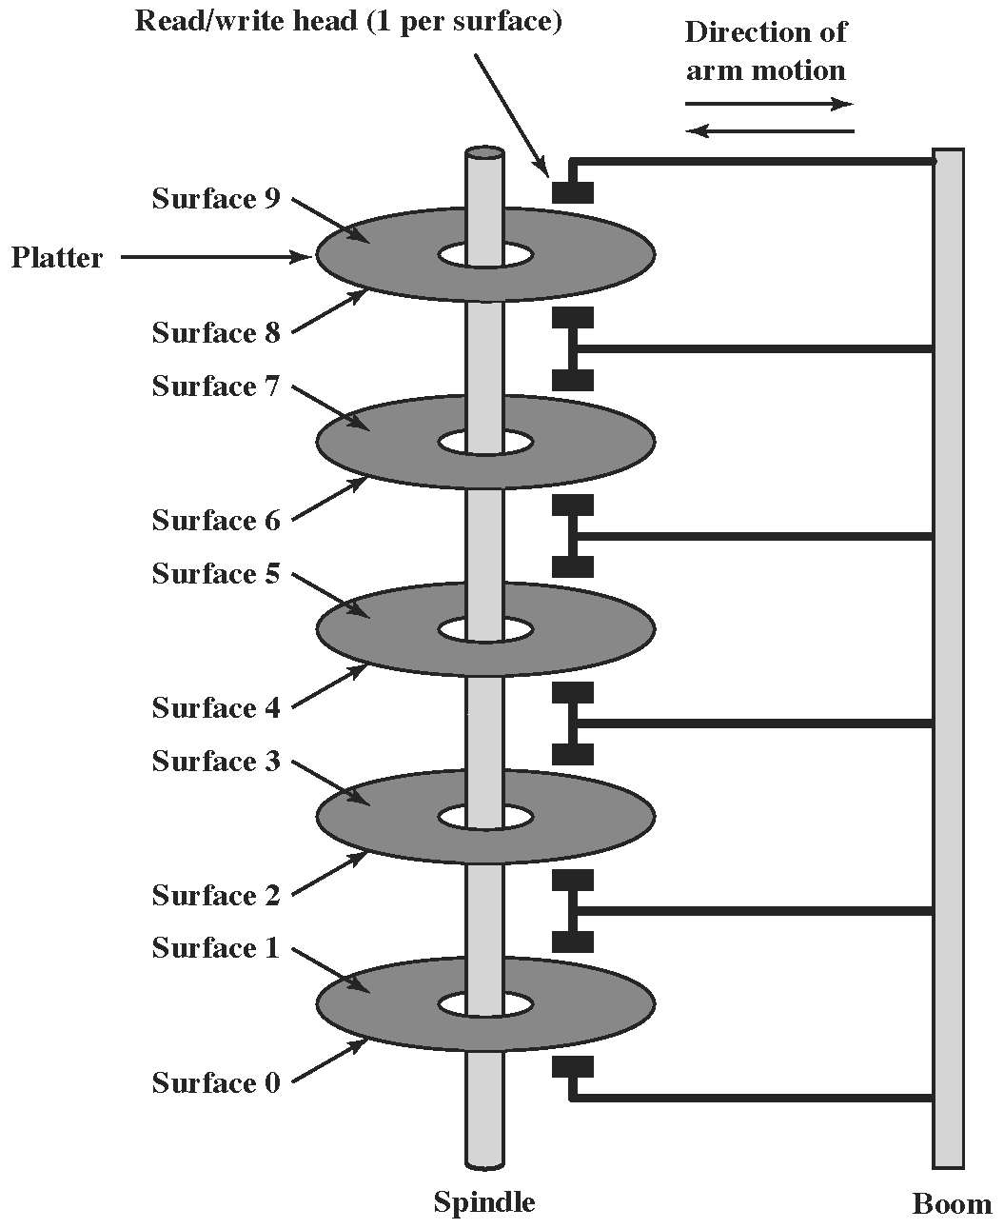

Disk Drive as Mass Storage

Slide 19
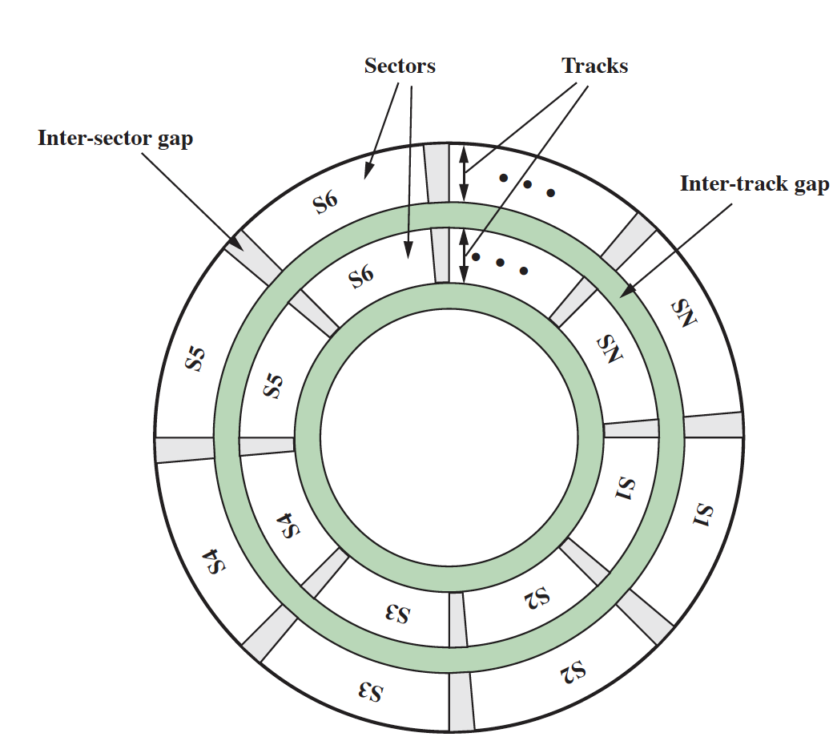
Disk Drive as Mass Storage

Slide 20
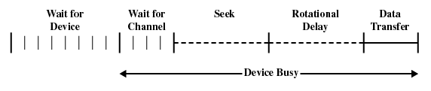
I/O Scheduling
For a single resource there will be a number of I/O requests
  From one or several processes
  Some devices keep internal state, so ordering of I/O requests matters
Example: Disk access
  Access time
    Sum of seek time and rotational delay
      Time it takes to get in position to read or write
    Seek time is the reason for differences in performance
  Data transfer occurs as the sector moves under the head
  Reorder I/O requests according to current state of disk

Slide 21
Positioning the Read/Write Heads
When the disk drive is operating, the disk is rotating at constant speed
To read or write the head must be positioned at the desired track and at the beginning of the desired sector on that track
Track selection involves moving the head in a movable-head system or electronically selecting one head on a fixed-head system
On a movable-head system the time it takes to position the head at the track is known as seek time
The time it takes for the beginning of the sector to reach the head is known as rotational delay
The sum of the seek time and the rotational delay equals the access time
Notes:
When the disk drive is operating, the disk is rotating at constant speed. To
read or write, the head must be positioned at the desired track and at the beginning
of the desired sector on that track. 1 Track selection involves moving the head in a
movable-head system or electronically selecting one head on a fixed-head system.
On a movable-head system, the time it takes to position the head at the track is
known as seek time . In either case, once the track is selected, the disk controller
waits until the appropriate sector rotates to line up with the head. The time it takes
for the beginning of the sector to reach the head is known as rotational delay , or
rotational latency. The sum of the seek time, if any, and the rotational delay equals
the access time , which is the time it takes to get into position to read or write. Once
the head is in position, the read or write operation is then performed as the sector
moves under the head; this is the data transfer portion of the operation; the time
required for the transfer is the transfer time .
In addition to the access time and transfer time, there are several queuing
delays normally associated with a disk I/O operation. When a process issues an
I/O request, it must first wait in a queue for the device to be available. At that
time, the device is assigned to the process. If the device shares a single I/O channel
or a set of I/O channels with other disk drives, then there may be an additional
wait for the channel to be available. At that point, the seek is performed to begin
disk access.
In some high-end systems for servers, a technique known as rotational
positional sensing (RPS) is used. This works as follows: When the seek command
has been issued, the channel is released to handle other I/O operations. When
the seek is completed, the device determines when the data will rotate under
the head. As that sector approaches the head, the device tries to reestablish the
communication path back to the host. If either the control unit or the channel is
busy with another I/O, then the reconnection attempt fails and the device must
rotate one whole revolution before it can attempt to reconnect, which is called
an RPS miss. This is an extra delay element that must be added.

Slide 22
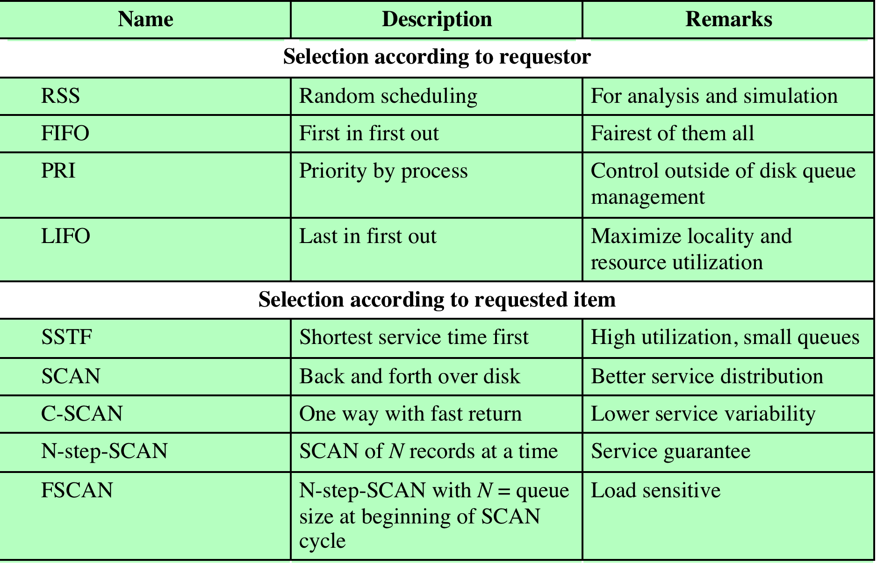
Disk Scheduling Algorithms

Slide 23
Disk I/O Scheduling Policies
Example
  Disk with 200 tracks
  Disk request queue has random requests
  Order of requests
  55, 58, 39, 18, 90, 160, 150, 38, 184

Slide 24
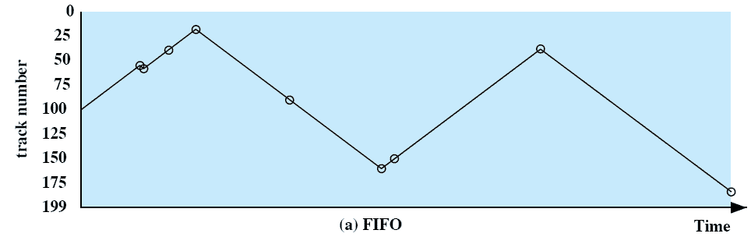
First-In, First-Out (FIFO)
Processes in sequential order
Fair to all processes
Approximates random scheduling in performance if there are many processes competing for the disk
  Requests: 55, 58, 39, 18, 90, 160, 150, 38, 184
Notes:
The simplest form of scheduling is first-in-first-out (FIFO)
scheduling, which processes items from the queue in sequential order. This strategy
has the advantage of being fair, because every request is honored and the requests are
honored in the order received. Figure 11.7a illustrates the disk arm movement with
FIFO. This graph is generated directly from the data in Table 11.2a . As can be seen,
the disk accesses are in the same order as the requests were originally received.
With FIFO, if there are only a few processes that require access and if many
of the requests are to clustered file sectors, then we can hope for good performance.
However, this technique will often approximate random scheduling in performance,
if there are many processes competing for the disk. Thus, it may be profitable to
consider a more sophisticated scheduling policy. A number of these are listed in
Table 11.3 and will now be considered.

Slide 25
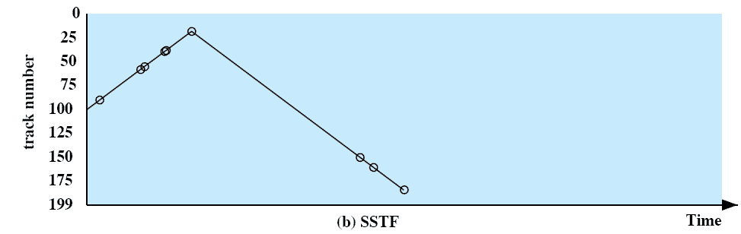
Shortest Service Time First (SSTF)
Select the disk I/O request that requires the least movement of the disk arm from its current position
Always choose the minimum seek time
  Requests: 55, 58, 39, 18, 90, 160, 150, 38, 184
  Service order: 90, 58, 55, 39, 38, 18, 150, 160, 184
Notes:
The shortest-service-time-first (SSTF) policy
is to select the disk I/O request that requires the least movement of the disk arm
from its current position. Thus, we always choose to incur the minimum seek time.
Of course, always choosing the minimum seek time does not guarantee that the
average seek time over a number of arm movements will be minimum. However,
this should provide better performance than FIFO. Because the arm can move in
two directions, a random tie-breaking algorithm may be used to resolve cases of
equal distances.
Figure 11.7b and Table 11.2b show the performance of SSTF on the same
example as was used for FIFO. The first track accessed is 90, because this is the
closest requested track to the starting position. The next track accessed is 58 because
this is the closest of the remaining requested tracks to the current position of 90.
Subsequent tracks are selected accordingly.

Slide 26
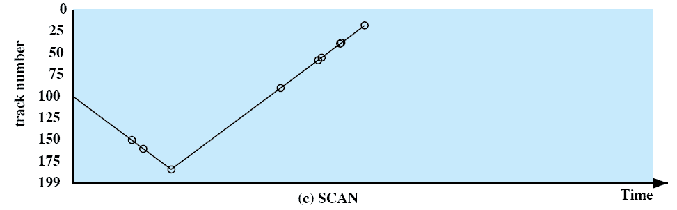
SCAN
Also known as the elevator algorithm
Arm moves in one direction only
  satisfies all outstanding requests until it reaches the last track in that direction then the direction is reversed
Favors jobs whose requests are for tracks nearest to both innermost and outermost tracks
  Requests: 55, 58, 39, 18, 90, 160, 150, 38, 184
  Service order: 150, 160, 184, 90, 58, 55, 39, 38, 18
Notes:
With the exception of FIFO, all of the policies described so far can leave
some request unfulfilled until the entire queue is emptied. That is, there may always
be new requests arriving that will be chosen before an existing request. A simple
alternative that prevents this sort of starvation is the SCAN algorithm, also known
as the elevator algorithm because it operates much the way an elevator does.
With SCAN, the arm is required to move in one direction only, satisfying all
outstanding requests en route, until it reaches the last track in that direction or until
there are no more requests in that direction. This latter refinement is sometimes
referred to as the LOOK policy. The service direction is then reversed and the scan
proceeds in the opposite direction, again picking up all requests in order.
Figure 11.7c and Table 11.2c illustrate the SCAN policy. Assuming that the
initial direction is of increasing track number, then the first track selected is 150,
since this is the closest track to the starting track of 100 in the increasing direction.
As can be seen, the SCAN policy behaves almost identically with the SSTF
policy. Indeed, if we had assumed that the arm was moving in the direction of lower
track numbers at the beginning of the example, then the scheduling pattern would
have been identical for SSTF and SCAN. However, this is a static example in which
no new items are added to the queue. Even when the queue is dynamically changing,
SCAN will be similar to SSTF unless the request pattern is unusual.
Note that the SCAN policy is biased against the area most recently traversed.
Thus it does not exploit locality as well as SSTF.
It is not difficult to see that the SCAN policy favors jobs whose requests are
for tracks nearest to both innermost and outermost tracks and favors the latest arriving
jobs. The first problem can be avoided via the C-SCAN policy, while the
second problem is addressed by the N-step-SCAN policy.

Slide 27
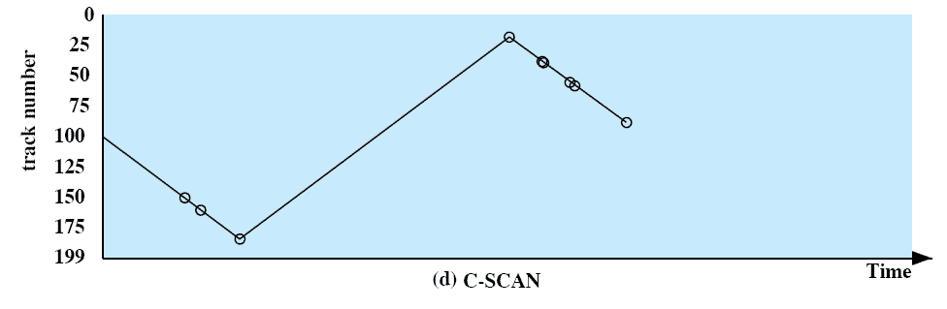
C-SCAN (Circular SCAN)
Restricts scanning to one direction only
When the last track has been visited in one direction, the arm is returned to the opposite end of the disk and the scan begins again
  Requests: 55, 58, 39, 18, 90, 160, 150, 38, 184
  Service order: 150, 160, 184, 18, 38, 39, 55, 58
Notes:
The C-SCAN (circular SCAN) policy restricts scanning to one direction
only. Thus, when the last track has been visited in one direction, the arm is returned
to the opposite end of the disk and the scan begins again. This reduces the maximum
delay experienced by new requests. With SCAN, if the expected time for a scan
from inner track to outer track is t , then the expected service interval for sectors at
the periphery is 2 t. With C-SCAN, the interval is on the order of t + s max , where
s max is the maximum seek time.
Figure 11.7d and Table 11.2d illustrate C-SCAN behavior. In this case the first
three requested tracks encountered are 150, 160, and 184. Then the scan begins
starting at the lowest track number, and the next requested track encountered is 18.

Slide 28
N-Step-SCAN
Segments the disk request queue into subqueues of length N
Subqueues are processed one at a time, using SCAN
While a queue is being processed new requests must be added to some other queue
If fewer than N requests are available at the end of a scan, all of them are processed with the next scan
Notes:
With SSTF, SCAN, and C-SCAN, it is possible that
the arm may not move for a considerable period of time. For example, if one or a
few processes have high access rates to one track, they can monopolize the entire
device by repeated requests to that track. High-density multisurface disks are more
likely to be affected by this characteristic than lower-density disks and/or disks with
only one or two surfaces. To avoid this “arm stickiness,” the disk request queue
can be segmented, with one segment at a time being processed completely. Two
examples of this approach are N -step-SCAN and FSCAN.
The N -step-SCAN policy segments the disk request queue into subqueues of
length N. Subqueues are processed one at a time, using SCAN. While a queue is
being processed, new requests must be added to some other queue. If fewer than N
requests are available at the end of a scan, then all of them are processed with the
next scan. With large values of N , the performance of N -step-SCAN approaches
that of SCAN; with a value of N = 1 , the FIFO policy is adopted.
FSCAN is a policy that uses two subqueues. When a scan begins, all of the
requests are in one of the queues, with the other empty. During the scan, all new
requests are put into the other queue. Thus, service of new requests is deferred until
all of the old requests have been processed.

Slide 29
FSCAN
Uses two subqueues
When a scan begins, all of the requests are in one of the queues, with the other empty
During scan, all new requests are put into the other queue
Service of new requests is deferred until all of the old requests have been processed
Notes:
FSCAN is a policy that uses two subqueues. When a scan begins, all of the
requests are in one of the queues, with the other empty. During the scan, all new
requests are put into the other queue. Thus, service of new requests is deferred until
all of the old requests have been processed.

Slide 30
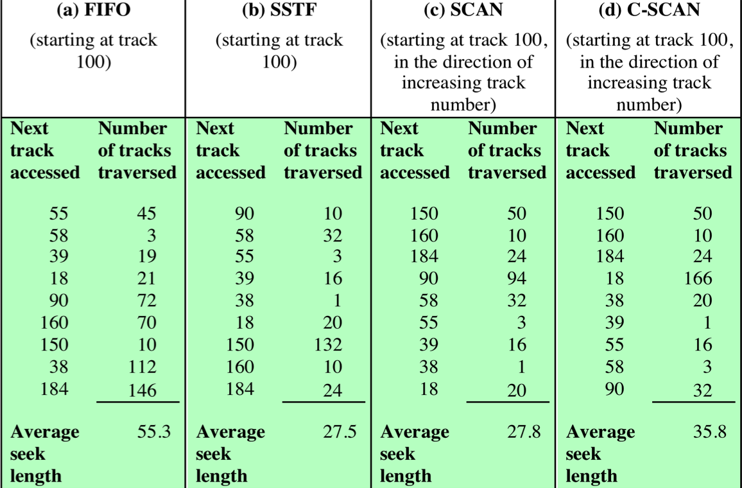
Comparison of Disk Scheduling Algorithms

Slide 31
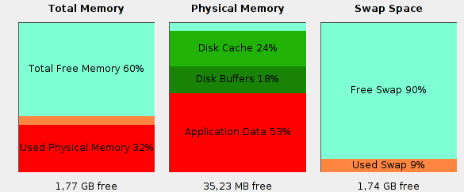
Disk Cache
Main memory buffer for disk sectors
  Contains copy of subset of sectors on disk
  Speeds up I/O requests to these sectors
Policies:
  Least Recently Used
    Block longest in cache with no reference to it is replaced
  Least Frequently Used
    Block with fewest references is replaced
    Reference count is misleading for bursty access patterns

Slide 32
RAID
Redundant Array of Independent Disks
Set of physical disk drives viewed by the operating system as a single logical drive
Data are distributed across the physical drives of an array
Redundant disk capacity is used to store parity information

Slide 33
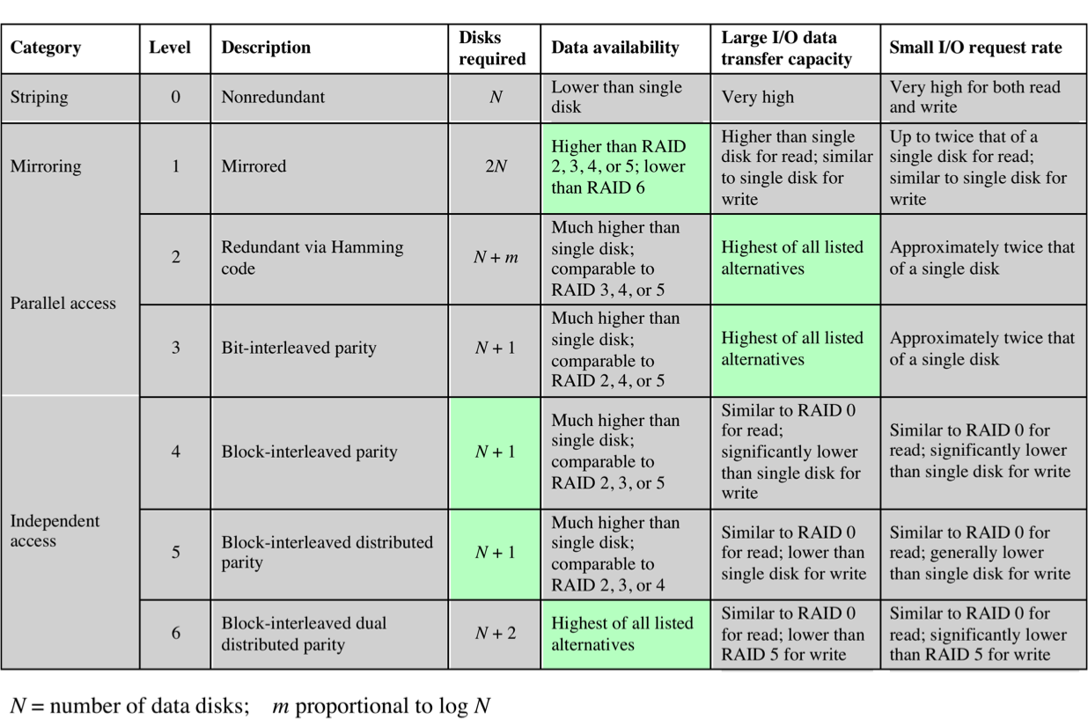
RAID Levels
Notes:
We now examine each of the RAID levels. Table 11.4 provides a rough
guide to the seven levels. In the table, I/O performance is shown both in terms of
data transfer capacity, or ability to move data, and I/O request rate, or ability to
satisfy I/O requests, since these RAID levels inherently perform differently relative
to these two metrics. Each RAID level’s strong point is highlighted in color.
Of the seven RAID levels described, only four are commonly used: RAID
levels 0, 1, 5, and 6.

Slide 34
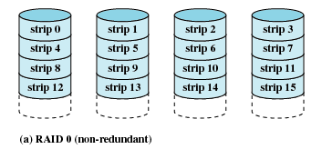
RAID Level 0
Not a true RAID because it does not include redundancy to improve performance or provide data protection
User and system data are distributed across all of the disks in the array
Logical disk is divided into strips
Notes:
RAID level 0 is not a true member of the RAID family, because it does not include
redundancy to improve performance or provide data protection. However, there
are a few applications, such as some on supercomputers in which performance
and capacity are primary concerns and low cost is more important than improved
reliability.
For RAID 0, the user and system data are distributed across all of the disks
in the array. This has a notable advantage over the use of a single large disk: If two
different I/O requests are pending for two different blocks of data, then there is a
good chance that the requested blocks are on different disks. Thus, the two requests
can be issued in parallel, reducing the I/O queuing time.
But RAID 0, as with all of the RAID levels, goes further than simply distributing
the data across a disk array: The data are striped across the available disks.
This is best understood by considering Figure 11.8 . All user and system data are
viewed as being stored on a logical disk. The logical disk is divided into strips; these
strips may be physical blocks, sectors, or some other unit. The strips are mapped
round robin to consecutive physical disks in the RAID array. A set of logically
consecutive strips that maps exactly one strip to each array member is referred
to as a stripe . In an n -disk array, the first n logical strips are physically stored as
the first strip on each of the n disks, forming the first stripe; the second n strips
are distributed as the second strips on each disk; and so on. The advantage of this
layout is that if a single I/O request consists of multiple logically contiguous strips,
then up to n strips for that request can be handled in parallel, greatly reducing the
I/O transfer time.

Slide 35
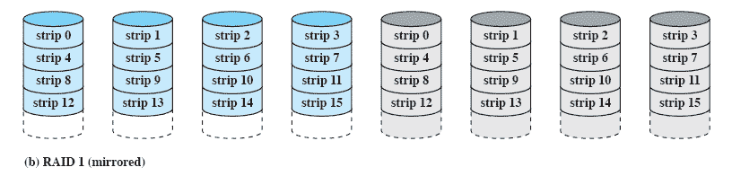
RAID Level 1
Redundancy is achieved by the simple expedient of duplicating all the data
There is no “write penalty”
When a drive fails the data may still be accessed from the second drive
Principal disadvantage is the cost
Notes:
RAID 1 differs from RAID levels 2 through 6 in the way in which redundancy is
achieved. In these other RAID schemes, some form of parity calculation is used
to introduce redundancy, whereas in RAID 1, redundancy is achieved by the simple
expedient of duplicating all the data. Figure 11.8b shows data striping being
used, as in RAID 0. But in this case, each logical strip is mapped to two separate
physical disks so that every disk in the array has a mirror disk that contains the
same data. RAID 1 can also be implemented without data striping, though this is
less common.
There are a number of positive aspects to the RAID 1 organization:
1. A read request can be serviced by either of the two disks that contains the
requested data, whichever one involves the minimum seek time plus rotational
latency.
2. A write request requires that both corresponding strips be updated, but this
can be done in parallel. Thus, the write performance is dictated by the slower
of the two writes (i.e., the one that involves the larger seek time plus rotational
latency). However, there is no “write penalty” with RAID 1. RAID levels
2 through 6 involve the use of parity bits. Therefore, when a single strip is
updated, the array management software must first compute and update the
parity bits as well as updating the actual strip in question.
3. Recovery from a failure is simple. When a drive fails, the data may still be
accessed from the second drive.
The principal disadvantage of RAID 1 is the cost; it requires twice the disk
space of the logical disk that it supports. Because of that, a RAID 1 configuration
is likely to be limited to drives that store system software and data and other highly
critical files. In these cases, RAID 1 provides real-time backup of all data so that in
the event of a disk failure, all of the critical data is still immediately available.
In a transaction-oriented environment, RAID 1 can achieve high I/O request
rates if the bulk of the requests are reads. In this situation, the performance of RAID
1 can approach double of that of RAID 0. However, if a substantial fraction of the I/O
requests are write requests, then there may be no significant performance gain over
RAID 0. RAID 1 may also provide improved performance over RAID 0 for data
transfer intensive applications with a high percentage of reads. Improvement occurs
if the application can split each read request so that both disk members participate.

Slide 36
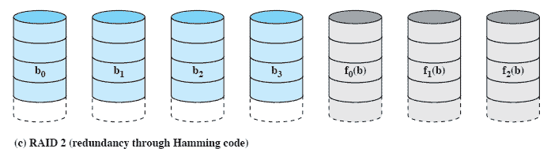
RAID Level 2
Makes use of a parallel access technique
Data striping is used
Typically a Hamming code is used
Effective choice in an environment in which many disk errors occur
Notes:
RAID levels 2 and 3 make use of a parallel access technique. In a parallel access
array, all member disks participate in the execution of every I/O request. Typically,
the spindles of the individual drives are synchronized so that each disk head is in the
same position on each disk at any given time.
As in the other RAID schemes, data striping is used. In the case of RAID 2
and 3, the strips are very small, often as small as a single byte or word. With RAID 2,
an error-correcting code is calculated across corresponding bits on each data disk,
and the bits of the code are stored in the corresponding bit positions on multiple
parity disks. Typically, a Hamming code is used, which is able to correct single-bit
errors and detect double-bit errors.
Although RAID 2 requires fewer disks than RAID 1, it is still rather costly.
The number of redundant disks is proportional to the log of the number of data
disks. On a single read, all disks are simultaneously accessed. The requested data
and the associated error-correcting code are delivered to the array controller. If
there is a single-bit error, the controller can recognize and correct the error instantly,
so that the read access time is not slowed. On a single write, all data disks and parity
disks must be accessed for the write operation.
RAID 2 would only be an effective choice in an environment in which many
disk errors occur. Given the high reliability of individual disks and disk drives,
RAID 2 is overkill and is not implemented.

Slide 37
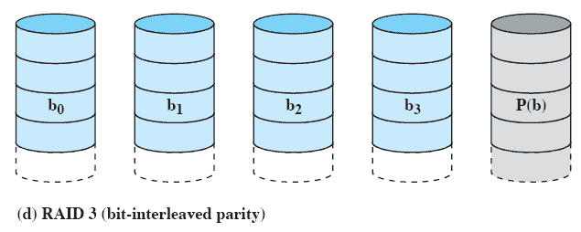
RAID Level 3
Requires only a single redundant disk, no matter how large the disk array
Employs parallel access, with data distributed in small strips
Can achieve very high data transfer rates
Notes:
RAID 3 is organized in a similar fashion to RAID 2. The difference is that RAID 3
requires only a single redundant disk, no matter how large the disk array. RAID 3
employs parallel access, with data distributed in small strips. Instead of an error correcting
code, a simple parity bit is computed for the set of individual bits in the
same position on all of the data disks.
REDUNDANCY In the event of a drive failure, the parity drive is accessed and data
is reconstructed from the remaining devices. Once the failed drive is replaced, the
missing data can be restored on the new drive and operation resumed.
Data reconstruction is simple. Consider an array of five drives in which X0
through X3 contain data and X4 is the parity disk. The parity for the i th bit is
calculated as follows:
X4(i) = X3(i) X2(i) X1(i) X0(i)
where is exclusive-OR function.
Suppose that drive X1 has failed. If we add X4(i) X1(i) to both sides of the
preceding equation, we get
X1(i) = X4(i) X3(i) X2(i) X0(i)
Thus, the contents of each strip of data on X1 can be regenerated from the contents
of the corresponding strips on the remaining disks in the array. This principle is true
for RAID levels 3 through 6.
In the event of a disk failure, all of the data are still available in what is referred
to as reduced mode. In this mode, for reads, the missing data are regenerated on the
fly using the exclusive-OR calculation. When data are written to a reduced RAID 3
array, consistency of the parity must be maintained for later regeneration. Return to
full operation requires that the failed disk be replaced and the entire contents of the
failed disk be regenerated on the new disk.
PERFORMANCE Because data are striped in very small strips, RAID 3 can achieve
very high data transfer rates. Any I/O request will involve the parallel transfer of
data from all of the data disks. For large transfers, the performance improvement is
especially noticeable. On the other hand, only one I/O request can be executed at a
time. Thus, in a transaction-oriented environment, performance suffers.

Slide 38
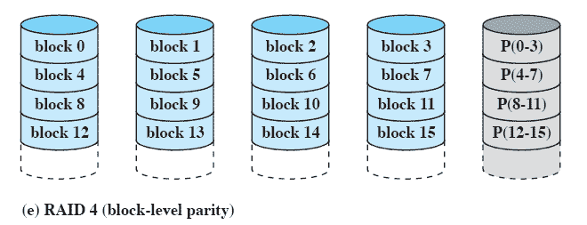
RAID Level 4
Makes use of an independent access technique
A bit-by-bit parity strip is calculated across corresponding strips on each data disk, and the parity bits are stored in the corresponding strip on the parity disk
Involves a write penalty when an I/O write request of small size is performed
Notes:
RAID levels 4 through 6 make use of an independent access technique. In an independent
access array, each member disk operates independently, so that separate
I/O requests can be satisfied in parallel. Because of this, independent access arrays
are more suitable for applications that require high I/O request rates and are relatively
less suited for applications that require high data transfer rates.
As in the other RAID schemes, data striping is used. In the case of RAID
4 through 6, the strips are relatively large. With RAID 4, a bit-by-bit parity strip
is calculated across corresponding strips on each data disk, and the parity bits are
stored in the corresponding strip on the parity disk.
RAID 4 involves a write penalty when an I/O write request of small size is performed.
Each time that a write occurs, the array management software must update
not only the user data but also the corresponding parity bits. Consider an array of
five drives in which X0 through X3 contain data and X4 is the parity disk. Suppose
that a write is performed that only involves a strip on disk X1. Initially, for each bit
i , we have the following relationship:
X4(i) = X3(i) X2(i) X1(i) X0(i) (11.1)
After the update, with potentially altered bits indicated by a prime symbol:
X4=(i) = X3(i) X2(i) X1=(i) X0(i)
= X3(i) X2(i) X1=(i) X0(i) X1(i) X1(i)
= X3(i) X2(i) X1 (i) X0(i) X1(i) X1=(i)
= X4(i) X1(i) X1=(i)
The preceding set of equations is derived as follows. The first line shows that
a change in X1 will also affect the parity disk X4. In the second line, we add the
terms [ X1(i) X1(i)] . Because the exclusive-OR of any quantity with itself
is 0, this does not affect the equation. However, it is a convenience that is used to
create the third line, by reordering. Finally, Equation ( 11.1 ) is used to replace the
first four terms by X4( i ).
To calculate the new parity, the array management software must read the old
user strip and the old parity strip. Then it can update these two strips with the new
data and the newly calculated parity. Thus, each strip write involves two reads and
two writes.
In the case of a larger size I/O write that involves strips on all disk drives, parity
is easily computed by calculation using only the new data bits. Thus, the parity drive
can be updated in parallel with the data drives and there are no extra reads or writes.
In any case, every write operation must involve the parity disk, which therefore
can become a bottleneck.

Slide 39
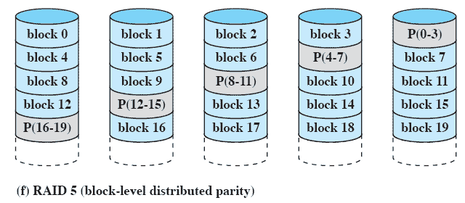
RAID Level 5
Similar to RAID-4 but distributes the parity bits across all disks
Typical allocation is a round-robin scheme
Has the characteristic that the loss of any one disk does not result in data loss
Notes:
RAID 5 is organized in a similar fashion to RAID 4. The difference is that RAID
5 distributes the parity strips across all disks. A typical allocation is a round-robin
scheme, as illustrated in Figure 11.8f . For an n -disk array, the parity strip is on a
different disk for the first n stripes, and the pattern then repeats.
The distribution of parity strips across all drives avoids the potential I/O
bottleneck of the single parity disk found in RAID 4. Further, RAID 5 has the
characteristic that the loss of any one disk does not result in data loss.

Slide 40
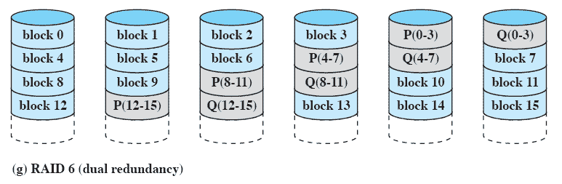
RAID Level 6
Two different parity calculations are carried out and stored in separate blocks on different disks
Provides extremely high data availability
Incurs a substantial write penalty because each write affects two parity blocks
Notes:
RAID 6 was introduced in a subsequent paper by the Berkeley researchers
[KATZ89]. In the RAID 6 scheme, two different parity calculations are carried out
and stored in separate blocks on different disks. Thus, a RAID 6 array whose user
data require N disks consists of N + 2 disks.
Figure 11.8g illustrates the scheme. P and Q are two different data check algorithms.
One of the two is the exclusive-OR calculation used in RAID 4 and 5. But
the other is an independent data check algorithm. This makes it possible to regenerate
data even if two disks containing user data fail.
The advantage of RAID 6 is that it provides extremely high data availability.
Three disks would have to fail within the MTTR (mean time to repair) interval to
cause data to be lost. On the other hand, RAID 6 incurs a substantial write penalty,
because each write affects two parity blocks. Performance benchmarks [EISC07]
show a RAID 6 controller can suffer more than a 30% drop in overall write performance
compared with a RAID 5 implementation. RAID 5 and RAID 6 read
performance is comparable.

Slide 41
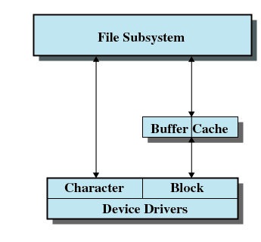
UNIX SVR4 I/O
Each individual device is associated with a special file:
  /dev/dsp0: First sound card
  /dev/hda: IDE, primary master
  /dev/hda1: First partition on
  /dev/hda
  /dev/tty: Controlling terminal
  ...
Two types of I/O:
  Buffered (default)
  Unbuffered (raw)
I/O

Slide 42
Questions & Tasks
  Compare an SSD with an HD when it comes to I/O scheduling. What are the differences?
  What determines the performance of the different disk scheduling algorithms?
  What are disadvantages of RAID-systems? Where do they have their single point of failure?

Slide 43
Content
Introduction and Motivation
Subsystems, Interrupts and System Calls
Processes
Memory
Scheduling
I/O and File System
Booting, Services, and Security

Slide 44
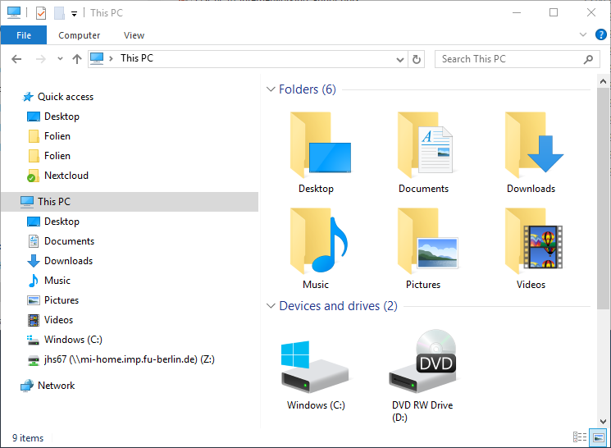
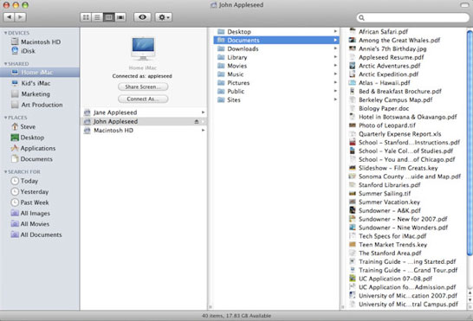
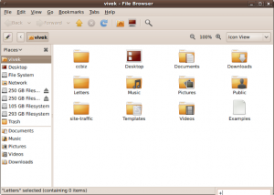
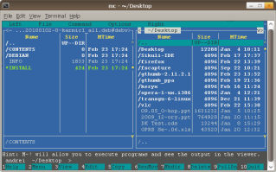
File System Overview

Slide 45
File System Overview
Goals
  Meet data management needs and requirements of user
  Guarantee that data in file is valid (over time)
  Optimize performance
  Provide I/O support for variety of storage device types
  Minimize or eliminate the potential for lost or destroyed data (redundancy)
  Provide a standardized set of I/O interface routines
  Provide I/O support for multiple users
    Concurrency, access control, etc.

Slide 46
File System Overview
Types of File Systems
Disk File Systems
  Windows: FAT, FAT16, FAT32, NTFS
  Linux: ext, ext2, ext3
  UNIX: UFS, …
  MAC OS X: HFS, HFS+
Distributed File Systems
  NFS, AFS, SMB
Special Purpose File Systems

Slide 47
File System Overview
Properties
  Long-term existence
  Sharable between processes
  Structure (internal /organizational)
Typical File Operations
  Create Create new file
  Delete Delete existing file
  Open Open new/existing file
  Close Close open file
  Read Read data from open file
  Write Write data to open file

Slide 48
Minimal User Requirements
Each user ...
1
should be able to create, delete, read, write and modify files
2
may have controlled access to other users’ files
3
may control what type of accesses are allowed to the files
4
5
6
7
should be able to restructure the files in a form appropriate to the problem
should be able to move data between files
should be able to back up and recover files in case of damage
should be able to access his or her files by name rather than by numeric identifier
Notes:
With respect to the first point, meeting user requirements, the extent of such
requirements depends on the variety of applications and the environment in which
the computer system will be used. For an interactive, general-purpose system, the
following constitute a minimal set of requirements:
1. Each user should be able to create, delete, read, write, and modify files.
2. Each user may have controlled access to other users’ files.
3. Each user may control what types of accesses are allowed to the user’s files.
4. Each user should be able to restructure the user’s files in a form appropriate to
the problem.
5. Each user should be able to move data between files.
6. Each user should be able to back up and recover the user’s files in case of
damage.
7. Each user should be able to access his or her files by name rather than by
numeric identifier.
These objectives and requirements should be kept in mind throughout our discussion
of file management systems.

Slide 49
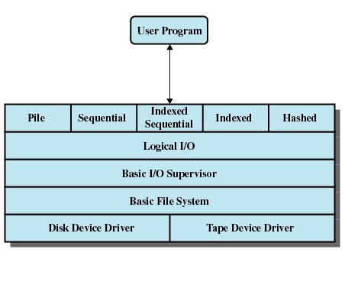
File System Architecture
Access Method (API)
  Reflect different file structures
  Different ways to access data
Logical I/O
  Enables users to access records
  General-purpose record I/O capability
  Maintains basic data about file
Basic I/O Supervisor
  I/O initiation and termination
  Selection of the I/O device
  Scheduling to optimize performance
Basic File System
  Physical I/O
  Placement of blocks
  Buffers blocks in main memory
Device Drivers
  Communicate with peripheral devices
  Responsible for starting I/O operations on a device
  Processes completion of I/O request

Slide 50
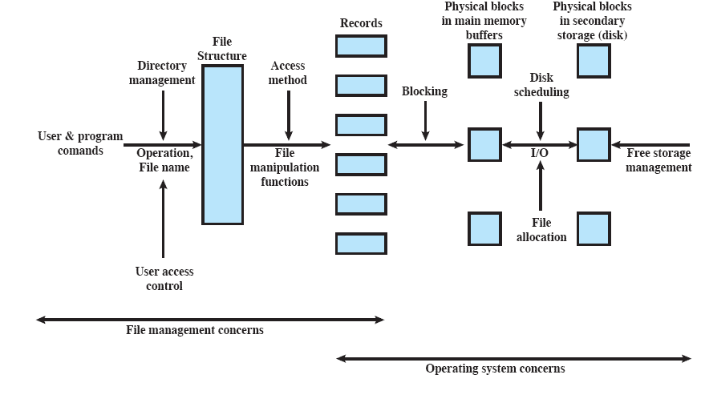
Elements of File Management
Notes:
Another way of viewing the functions of a file
system is shown in Figure 12.2 . Let us follow this diagram from left to right. Users
and application programs interact with the file system by means of commands for
creating and deleting files and for performing operations on files. Before performing
any operation, the file system must identify and locate the selected file. This requires
the use of some sort of directory that serves to describe the location of all files, plus
their attributes. In addition, most shared systems enforce user access control: Only
authorized users are allowed to access particular files in particular ways. The basic
operations that a user or application may perform on a file are performed at the
record level. The user or application views the file as having some structure that
organizes the records, such as a sequential structure (e.g., personnel records are
stored alphabetically by last name). Thus, to translate user commands into specific
file manipulation commands, the access method appropriate to this file structure
must be employed.
Whereas users and applications are concerned with records or fields, I/O is
done on a block basis. Thus, the records or fields of a file must be organized as a
sequence of blocks for output and unblocked after input. To support block I/O of
files, several functions are needed. The secondary storage must be managed. This
involves allocating files to free blocks on secondary storage and managing free storage
so as to know what blocks are available for new files and growth in existing files.
In addition, individual block I/O requests must be scheduled; this issue was dealt with
in Chapter 11 . Both disk scheduling and file allocation are concerned with optimizing
performance. As might be expected, these functions therefore need to be considered
together. Furthermore, the optimization will depend on the structure of the files and
the access patterns. Accordingly, developing an optimum file management system
from the point of view of performance is an exceedingly complicated task.
Figure 12.2 suggests a division between what might be considered the concerns
of the file management system as a separate system utility and the concerns
of the operating system, with the point of intersection being record processing. This
division is arbitrary; various approaches are taken in various systems.
In the remainder of this chapter, we look at some of the design issues suggested
in Figure 12.2 . We begin with a discussion of file organizations and access
methods. Although this topic is beyond the scope of what is usually considered the
concerns of the operating system, it is impossible to assess the other file-related
design issues without an appreciation of file organization and access. Next, we look
at the concept of file directories. These are often managed by the operating system
on behalf of the file management system. The remaining topics deal with the physical
I/O aspects of file management and are properly treated as aspects of OS design.
One such issue is the way in which logical records are organized into physical blocks.
Finally, there are the related issues of file allocation on secondary storage and the
management of free secondary storage.

Slide 51
File Organization Types
Five of the common file organizations are:
The pile
The sequential file
The indexed sequential file
The indexed file
The direct, or hashed, file
Notes:
The number of alternative file organizations that have been implemented or
just proposed is unmanageably large, even for a book devoted to file systems. In this
brief survey, we will outline five fundamental organizations. Most structures used in
actual systems either fall into one of these categories or can be implemented with a
combination of these organizations. The five organizations, the first four of which
are depicted in Figure 12.3 , are as follows:
The pile
• The sequential file
• The indexed sequential file
• The indexed file
• The direct, or hashed, file

Slide 52
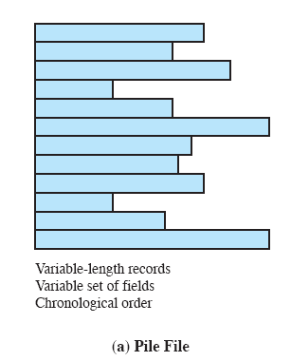
The Pile
Least complicated form of file organization
Data are collected in the order they arrive
Each record consists of one burst of data
Purpose is simply to accumulate the mass of data and save it
Record access is by exhaustive search
Notes:
The least-complicated form of file organization may be termed the pile . Data are
collected in the order in which they arrive. Each record consists of one burst of
data. The purpose of the pile is simply to accumulate the mass of data and save it.
Records may have different fields, or similar fields in different orders. Thus, each
field should be self-describing, including a field name as well as a value. The length
of each field must be implicitly indicated by delimiters, explicitly included as a subfield,
or known as default for that field type.
Because there is no structure to the pile file, record access is by exhaustive
search. That is, if we wish to find a record that contains a particular field with a
particular value, it is necessary to examine each record in the pile until the desired
record is found or the entire file has been searched. If we wish to find all records
that contain a particular field or contain that field with a particular value, then the
entire file must be searched.
Pile files are encountered when data are collected and stored prior to processing
or when data are not easy to organize. This type of file uses space well when the
stored data vary in size and structure, is perfectly adequate for exhaustive searches,
and is easy to update. However, beyond these limited uses, this type of file is unsuitable
for most applications.

Slide 53
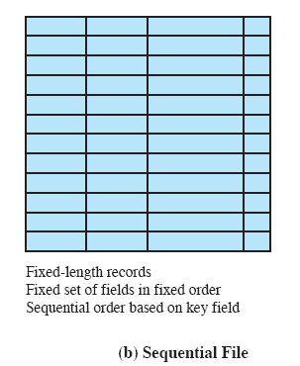
The Sequential File
Most common form of file structure
A fixed format is used for records
Key field uniquely identifies the record
Typically used in batch applications
Only organization that is easily stored on tape as well as disk
Notes:
The most common form of file structure is the sequential file. In this type of file,
a fixed format is used for records. All records are of the same length, consisting of
the same number of fixed-length fields in a particular order. Because the length and
position of each field are known, only the values of fields need to be stored; the field
name and length for each field are attributes of the file structure.
One particular field, usually the first field in each record, is referred to as the
key field. The key field uniquely identifies the record; thus key values for different
records are always different. Further, the records are stored in key sequence: alphabetical
order for a text key, and numerical order for a numerical key.
Sequential files are typically used in batch applications and are generally
optimum for such applications if they involve the processing of all the records (e.g.,
a billing or payroll application). The sequential file organization is the only one that
is easily stored on tape as well as disk.
For interactive applications that involve queries and/or updates of individual
records, the sequential file provides poor performance. Access requires the sequential
search of the file for a key match. If the entire file, or a large portion of the
file, can be brought into main memory at one time, more efficient search techniques
are possible. Nevertheless, considerable processing and delay are encountered to
access a record in a large sequential file. Additions to the file also present problems.
Typically, a sequential file is stored in simple sequential ordering of the records within
blocks. That is, the physical organization of the file on tape or disk directly matches
the logical organization of the file. In this case, the usual procedure is to place new
records in a separate pile file, called a log file or transaction file. Periodically, a batch
update is performed that merges the log file with the master file to produce a new file
in correct key sequence.
An alternative is to organize the sequential file physically as a linked list. One
or more records are stored in each physical block. Each block on disk contains a
pointer to the next block. The insertion of new records involves pointer manipulation
but does not require that the new records occupy a particular physical block
position. Thus, some added convenience is obtained at the cost of additional
processing and overhead.

Slide 54
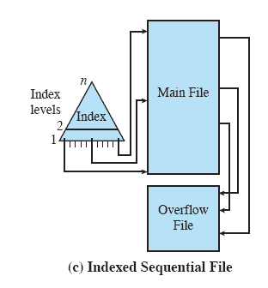
Indexed Sequential File
Adds an index to the file to support random access
Adds an overflow file
Greatly reduces the time required to access a single record
Multiple levels of indexing can be used to provide greater efficiency in access
Notes:
A popular approach to overcoming the disadvantages of the sequential file is the
indexed sequential file. The indexed sequential file maintains the key characteristic
of the sequential file: Records are organized in sequence based on a key field. Two
features are added:
i) an index to the file to support random access, and ii) an overflow file.
The index provides a lookup capability to reach quickly the vicinity of a desired
record. The overflow file is similar to the log file used with a sequential file but is
integrated so that a record in the overflow file is located by following a pointer from
its predecessor record.
In the simplest indexed sequential structure, a single level of indexing is
used. The index in this case is a simple sequential file. Each record in the index file
consists of two fields: a key field, which is the same as the key field in the main file,
and a pointer into the main file. To find a specific field, the index is searched to find
the highest key value that is equal to or precedes the desired key value. The search
continues in the main file at the location indicated by the pointer.
To see the effectiveness of this approach, consider a sequential file with
1 million records. To search for a particular key value will require on average one-half
million record accesses. Now suppose that an index containing 1,000 entries
is constructed, with the keys in the index more or less evenly distributed over
the main file. Now it will take on average 500 accesses to the index file followed
by 500 accesses to the main file to find the record. The average search length is
reduced from 500,000 to 1,000.
Additions to the file are handled in the following manner: Each record in
the main file contains an additional field not visible to the application, which is a
pointer to the overflow file. When a new record is to be inserted into the file, it is
added to the overflow file. The record in the main file that immediately precedes
the new record in logical sequence is updated to contain a pointer to the new record
in the overflow file. If the immediately preceding record is itself in the overflow file,
then the pointer in that record is updated. As with the sequential file, the indexed
sequential file is occasionally merged with the overflow file in batch mode.
The indexed sequential file greatly reduces the time required to access a single
record, without sacrificing the sequential nature of the file. To process the entire file
sequentially, the records of the main file are processed in sequence until a pointer
to the overflow file is found, then accessing continues in the overflow file until a null
pointer is encountered, at which time accessing of the main file is resumed where it
left off.
To provide even greater efficiency in access, multiple levels of indexing can be
used. Thus the lowest level of index file is treated as a sequential file and a higher level
index file is created for that file. Consider again a file with 1 million records.
A lower-level index with 10,000 entries is constructed. A higher-level index into
the lower-level index of 100 entries can then be constructed. The search begins at
the higher-level index (average length = 50 accesses) to find an entry point into the
lower-level index. This index is then searched (average length = 50) to find an entry
point into the main file, which is then searched (average length = 50). Thus the average
length of search has been reduced from 500,000 to 1,000 to 150.

Slide 55
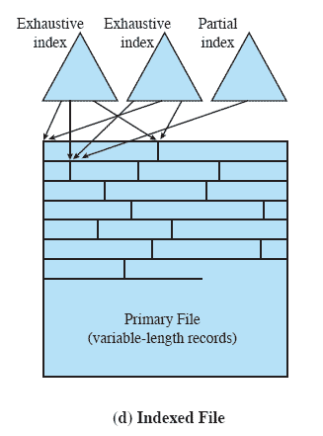
Indexed File
Records are accessed only through their indexes
Variable-length records can be employed
Exhaustive index contains one entry for every record in the main file
Partial index contains entries to records where the field of interest exists
Used mostly in applications where timeliness of information is critical
Examples would be airline reservation systems and inventory control systems
Notes:
The indexed sequential file retains one limitation of the sequential file: Effective
processing is limited to that which is based on a single field of the file. For example,
when it is necessary to search for a record on the basis of some other attribute than
the key field, both forms of sequential file are inadequate. In some applications, the
flexibility of efficiently searching by various attributes is desirable.
To achieve this flexibility, a structure is needed that employs multiple indexes,
one for each type of field that may be the subject of a search. In the general indexed
file, the concept of sequentially and a single key are abandoned. Records are
accessed only through their indexes. The result is that there is now no restriction
on the placement of records as long as a pointer in at least one index refers to that
record. Furthermore, variable-length records can be employed.
Two types of indexes are used. An exhaustive index contains one entry for
every record in the main file. The index itself is organized as a sequential file for
ease of searching. A partial index contains entries to records where the field of
interest exists. With variable-length records, some records will not contain all fields.
When a new record is added to the main file, all of the index files must be updated.
Indexed files are used mostly in applications where timeliness of information
is critical and where data are rarely processed exhaustively. Examples are airline
reservation systems and inventory control systems.

Slide 56
Direct or Hashed File
Access directly any block of a known address
Makes use of hashing on the key value
Often used where:
  very rapid access is required
  fixed-length records are used
  records are always accessed one at a time
Examples are:
directories
pricing tables
schedules
name lists
Notes:
The direct, or hashed, file exploits the capability found on disks to access directly any
block of a known address. As with sequential and indexed sequential files, a key field
is required in each record. However, there is no concept of sequential ordering here.
The direct file makes use of hashing on the key value. This function is explained
in Appendix F . Figure F.1b shows the type of hashing organization with an overflow
file that is typically used in a hash file.
Direct files are often used where very rapid access is required, where fixed length
records are used, and where records are always accessed one at a time.
Examples are directories, pricing tables, schedules, and name lists.

Slide 57
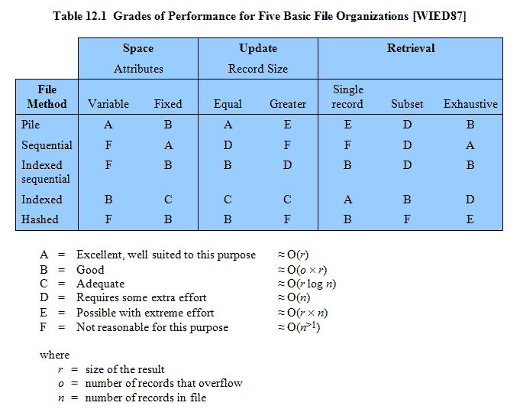
Grades of Performance
Notes:
Table 12.1 summarizes relative performance aspects of these five organizations.

Slide 58
Operations Performed on a Directory
To understand the requirements for a file structure, it is helpful to consider the types of operations that may be performed on the directory:
Search
Create files
Delete files
List directory
Update directory
Notes:
To understand the requirements for a file structure, it is helpful to consider
the types of operations that may be performed on the directory:
• Search: When a user or application references a file, the directory must be
searched to find the entry corresponding to that file.
• Create file: When a new file is created, an entry must be added to the directory.
• Delete file: When a file is deleted, an entry must be removed from the directory.
• List directory: All or a portion of the directory may be requested. Generally,
this request is made by a user and results in a listing of all files owned by that
user, plus some of the attributes of each file (e.g., type, access control information,
usage information).
• Update directory: Because some file attributes are stored in the directory, a
change in one of these attributes requires a change in the corresponding directory
entry.
The simple list is not suited to supporting these operations. Consider the needs
of a single user. The user may have many types of files, including word-processing
text files, graphic files, spreadsheets, and so on. The user may like to have these
organized by project, by type, or in some other convenient way. If the directory is a
simple sequential list, it provides no help in organizing the files and forces the user
to be careful not to use the same name for two different types of files. The problem
is much worse in a shared system. Unique naming becomes a serious problem.
Furthermore, it is difficult to conceal portions of the overall directory from users
when there is no inherent structure in the directory.

Slide 59
File Directories
Contains information about files
  Attributes, e.g., read/write/executable bits, access time
  Ownership, e.g., user/group or Access Control List (ACL)
  Location with regard to logical structure of medium
Directory itself may be implemented as file owned by operating system
Provides mapping between file names and files themselves
  “inodes” in Unix
  One file can have multiple names (“hard links”)
Structure
  List of entries, one for each file
  Sequential file with name of file serving as key
  Initially no support for organizing files (except for naming)
    Forces user to be careful not to use the same name for two different files

Slide 60
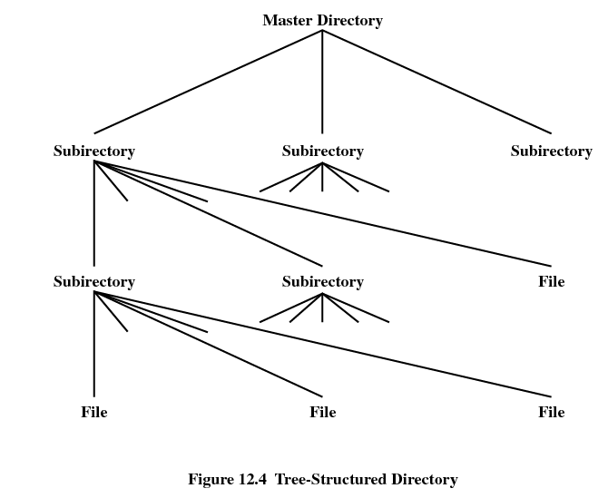
Multi-Level Directories
Two-level Scheme (historical)
  One directory for each user and a master directory
  Master directory contains entry for each user
  Each user directory is a simple list of files for that user
  Provides no help in structuring collections of files

Slide 61
Multi-Level Directories
Hierarchical / Tree-Structure
  Master directory with user directories underneath it
  Each user directory may have subdirectories and files as entries
  Some operating systems use multiple trees with own identifiers, e.g., drive letters (A:, C:)

Slide 62
Hierarchical/Tree-Structured Directory
Files are located by following path from root (master) directory down various branches
  Pathname of file
Supports several files with same file name as long as path names differ
Per-process current directory is working directory
Files are referenced relative to current working directory (CWD)

Slide 63
File Sharing
Two issues arise when allowing files to be shared among a number of users
Access rights
Management of simultaneous access
Notes:
In a multiuser system, there is almost always a requirement for allowing files to be
shared among a number of users. Two issues arise:
access rights and
the management of simultaneous access.

Slide 64
Access Rights
None
  User may not know of existence of file
  User is not allowed to read user directory that includes file
Knowledge
  User can only determine that file exists and who its owner is
Execution
  User can load and execute program but cannot copy it
Reading
  User can read file for any purpose, including copying and execution
Appending
  User can add data to file but cannot modify or delete any of its contents
Updating
  User can modify, delete and add to file’s data
  Includes creating file, rewriting it and removing all or part of its data
Changing protection
  User can change access rights granted to other users
Deletion
  User can delete a file
Owner
  All rights previously listed
  Grant rights to others using classes of users:
    Specific user
    User groups
    Everybody
Complex access policies implemented with Access Control Lists (ACLs)
Watch out for semantic differences between files and directories!

Slide 65
User Access Rights
Owner
usually the initial creator of the file
has full rights
may grant rights to others
Specific Users
individual users who are designated by user ID
User Groups
a set of users who are not individually defined
All
all users who have access to this system
these are public files
Notes:
One user is designated as owner of a given file, usually the person who initially
created a file. The owner has all of the access rights listed previously and may grant
rights to others. Access can be provided to different classes of users:
• Specific user: Individual users who are designated by user ID
• User groups: A set of users who are not individually defined. The system must
have some way of keeping track of the membership of user groups.
• All: All users who have access to this system. These are public files.

Slide 66
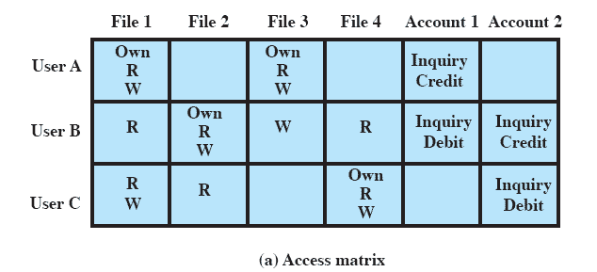
Access Matrix
The basic elements are
  subject: an entity capable of accessing objects
  object: anything to which access is controlled
  access right: the way in which an object is accessed by a subject
Notes:
Following successful logon, the user has been granted access to one or a set of hosts
and applications. This is generally not sufficient for a system that includes sensitive
data in its database. Through the user–access control procedure, a user can be
identified to the system. Associated with each user, there can be a profile that specifies
permissible operations and file accesses. The operating system can then enforce
rules based on the user profile. The database management system, however, must
control access to specific records or even portions of records. For example, it may
be permissible for anyone in administration to obtain a list of company personnel,
but only selected individuals may have access to salary information. The issue is
more than just a matter of level of detail. Whereas the operating system may grant
a user permission to access a file or use an application, following which there are
no further security checks, the database management system must make a decision
on each individual access attempt. That decision will depend not only on the user’s
identity but also on the specific parts of the data being accessed and even on the
information already divulged to the user.
A general model of access control as exercised by a file or database management
system is that of an access matrix (Figure 12.15a, based on a figure in
[SAND94]). The basic elements of the model are as follows:
• Subject: An entity capable of accessing objects. Generally, the concept of subject
equates with that of process. Any user or application actually gains access
to an object by means of a process that represents that user or application.
• Object: Anything to which access is controlled. Examples include files, portions
of files, programs, segments of memory, and software objects (e.g., Java objects).
• Access right: The way in which an object is accessed by a subject. Examples
are read, write, execute, and functions in software objects.
One dimension of the matrix consists of identified subjects that may attempt
data access. Typically, this list will consist of individual users or user groups, although
access could be controlled for terminals, hosts, or applications instead of or in addition
to users. The other dimension lists the objects that may be accessed. At the greatest
level of detail, objects may be individual data fields. More aggregate groupings,
such as records, files, or even the entire database, may also be objects in the matrix.
Each entry in the matrix indicates the access rights of that subject for that object.

Slide 67
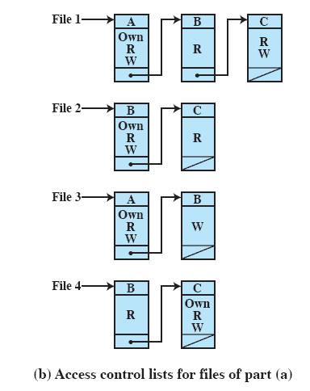
Access Control Lists
A matrix may be decomposed by columns, yielding access control lists
The access control list lists users and their permitted access rights
Notes:
In practice, an access matrix is usually sparse and is implemented by decomposition
in one of two ways. The matrix may be decomposed by columns, yielding
access control lists (Figure 12.15b). Thus for each object, an access control list lists
users and their permitted access rights. The access control list may contain a default,
or public, entry. This allows users that are not explicitly listed as having special rights
to have a default set of rights. Elements of the list may include individual users as
well as groups of users.

Slide 68
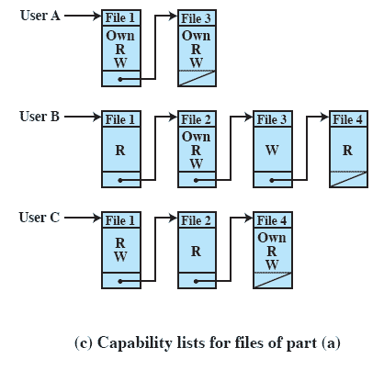
Capability Lists
Decomposition by rows yields capability tickets
A capability ticket specifies authorized objects and operations for a user
Notes:
Decomposition by rows yields capability tickets (Figure 12.15c). A capability
ticket specifies authorized objects and operations for a user. Each user has a
number of tickets and may be authorized to loan or give them to others. Because
tickets may be dispersed around the system, they present a greater security problem
than access control lists. In particular, the ticket must be unforgeable. One way to
accomplish this is to have the operating system hold all tickets on behalf of users.
These tickets would have to be held in a region of memory inaccessible to users.

Slide 69
Questions & Tasks
  Check out the file system on your computer – on the command line and using a window-based UI! How do you set certain access rights? Encryption?
  Can a computer use different file systems at the same time for different storage devices?
  We are typically very much used to tree-structures for file systems. Are there alternatives? What are advantages/disadvantages?
  What is a link/shortcut?

Slide 70

Secondary Storage Management
Secondary storage space must be allocated to files
Must keep track of space available for allocation

Slide 71
File Allocation
On secondary storage, a file consists of a collection of blocks
The operating system or file management system is responsible for allocating blocks to files
The approach taken for file allocation may influence the approach taken for free space management
Space is allocated to a file as one or more portions (contiguous set of allocated blocks)
File allocation table (FAT)
  data structure used to keep track of the portions assigned to a file
Notes:
On secondary storage, a file consists of a collection of blocks. The operating system
or file management system is responsible for allocating blocks to files. This raises
two management issues. First, space on secondary storage must be allocated to files,
and second, it is necessary to keep track of the space available for allocation. We
will see that these two tasks are related; that is, the approach taken for file allocation
may influence the approach taken for free space management. Further, we will
see that there is an interaction between file structure and allocation policy.
We begin this section by looking at alternatives for file allocation on a single
disk. Then we look at the issue of free space management, and finally we discuss
reliability.
File Allocation
Several issues are involved in file allocation:
1. When a new file is created, is the maximum space required for the file allocated
at once?
2. Space is allocated to a file as one or more contiguous units, which we shall
refer to as portions. That is, a portion is a contiguous set of allocated blocks.
The size of a portion can range from a single block to the entire file. What size
of portion should be used for file allocation?
3. What sort of data structure or table is used to keep track of the portions
assigned to a file? An example of such a structure is a file allocation table
(FAT) , found on DOS and some other systems.

Slide 72
Preallocation vs Dynamic Allocation
A preallocation policy requires that the maximum size of a file be declared at the time of the file creation request
For many applications it is difficult to estimate reliably the maximum potential size of the file
  Tends to be wasteful because users and application programmers tend to overestimate size
Dynamic allocation allocates space to a file in portions as needed
Notes:
A preallocation policy requires
that the maximum size of a file be declared at the time of the file creation request.
In a number of cases, such as program compilations, the production of summary
data files, or the transfer of a file from another system over a communications
network, this value can be reliably estimated. However, for many applications, it
is difficult if not impossible to estimate reliably the maximum potential size of the
file. In those cases, users and application programmers would tend to overestimate
file size so as not to run out of space. This clearly is wasteful from the point of view
of secondary storage allocation. Thus, there are advantages to the use of dynamic
allocation, which allocates space to a file in portions as needed.

Slide 73
Secondary Storage Management
File Allocation Methods
Contiguous allocation
  Single set of blocks is allocated to a file at time of creation
  Single entry in file allocation table (starting block, length of file)
  Incurs fragmentation; changing size of a file is expensive
Chained allocation
  Allocation on basis of individual block
  Each block contains a pointer to next block in chain
  Single entry in file allocation table (starting block, length of file)
  Seeking within file (random access) is expensive
Indexed allocation
  File allocation table contains a separate one-level index for each file
  The index has one entry for each portion allocated to file
  The file allocation table contains block number for index
  Avoids problems mentioned above, incurs some storage overhead

Slide 74
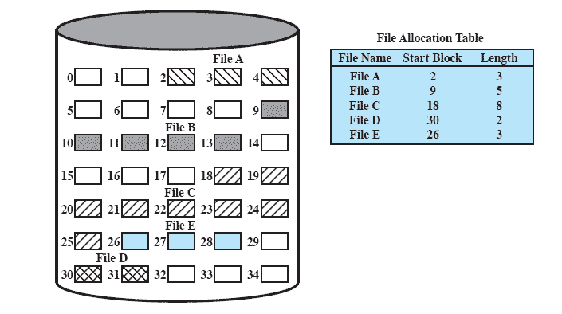
Methods of File Allocation
Contiguous File Allocation
  A single contiguous set of blocks is allocated to a file at the time of file creation
  Preallocation strategy using variable-size portions
  Is the best from the point of view of the individual sequential file
External fragmentation on disk

Slide 75
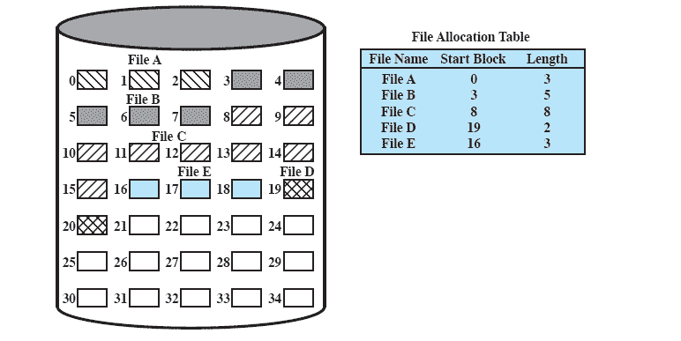
Methods of File Allocation
Contiguous File Allocation (After Compaction)
Notes:
From time to time, it will be necessary to perform a compaction algorithm to free up additional
space on the disk (Figure 12.10). Also, with preallocation, it is necessary to declare
the size of the file at the time of creation, with the problems mentioned earlier.

Slide 76
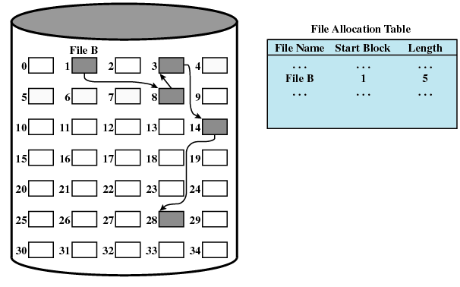
Methods of File Allocation
Chained Allocation
  Allocation is on an individual block basis
  Each block contains a pointer to the next block in the chain
  The file allocation table needs just a single entry for each file
  No external fragmentation to worry about
  Best for sequential files
Low random access performance

Slide 77
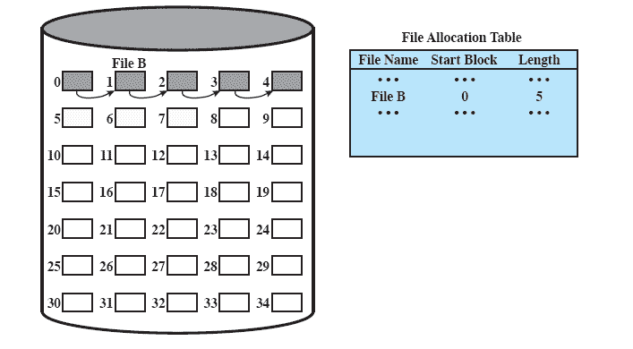
Methods of File Allocation
Chained Allocation After Consolidation
Notes:
One consequence of chaining, as described so far, is that there is no accommodation
of the principle of locality. Thus, if it is necessary to bring in several blocks of
a file at a time, as in sequential processing, then a series of accesses to different parts
of the disk are required. This is perhaps a more significant effect on a single-user
system but may also be of concern on a shared system. To overcome this problem,
some systems periodically consolidate files ( Figure 12.12 ).

Slide 78
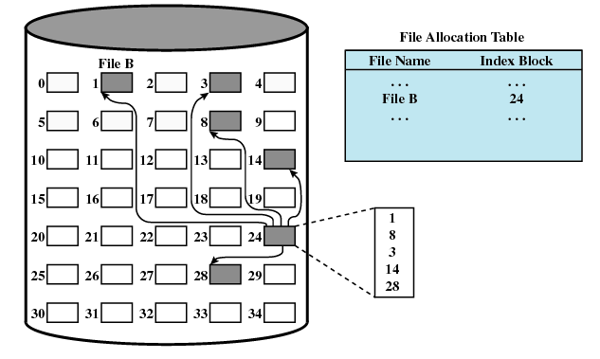
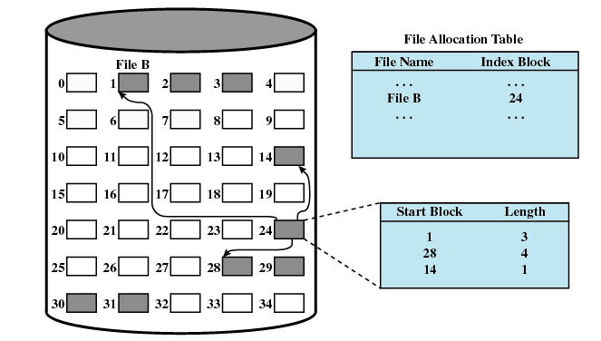
Methods of File Allocation
Indexed Allocation with Block Portions
Indexing overhead
Index Allocation with Variable-Length Portions
Good compromise

Slide 79
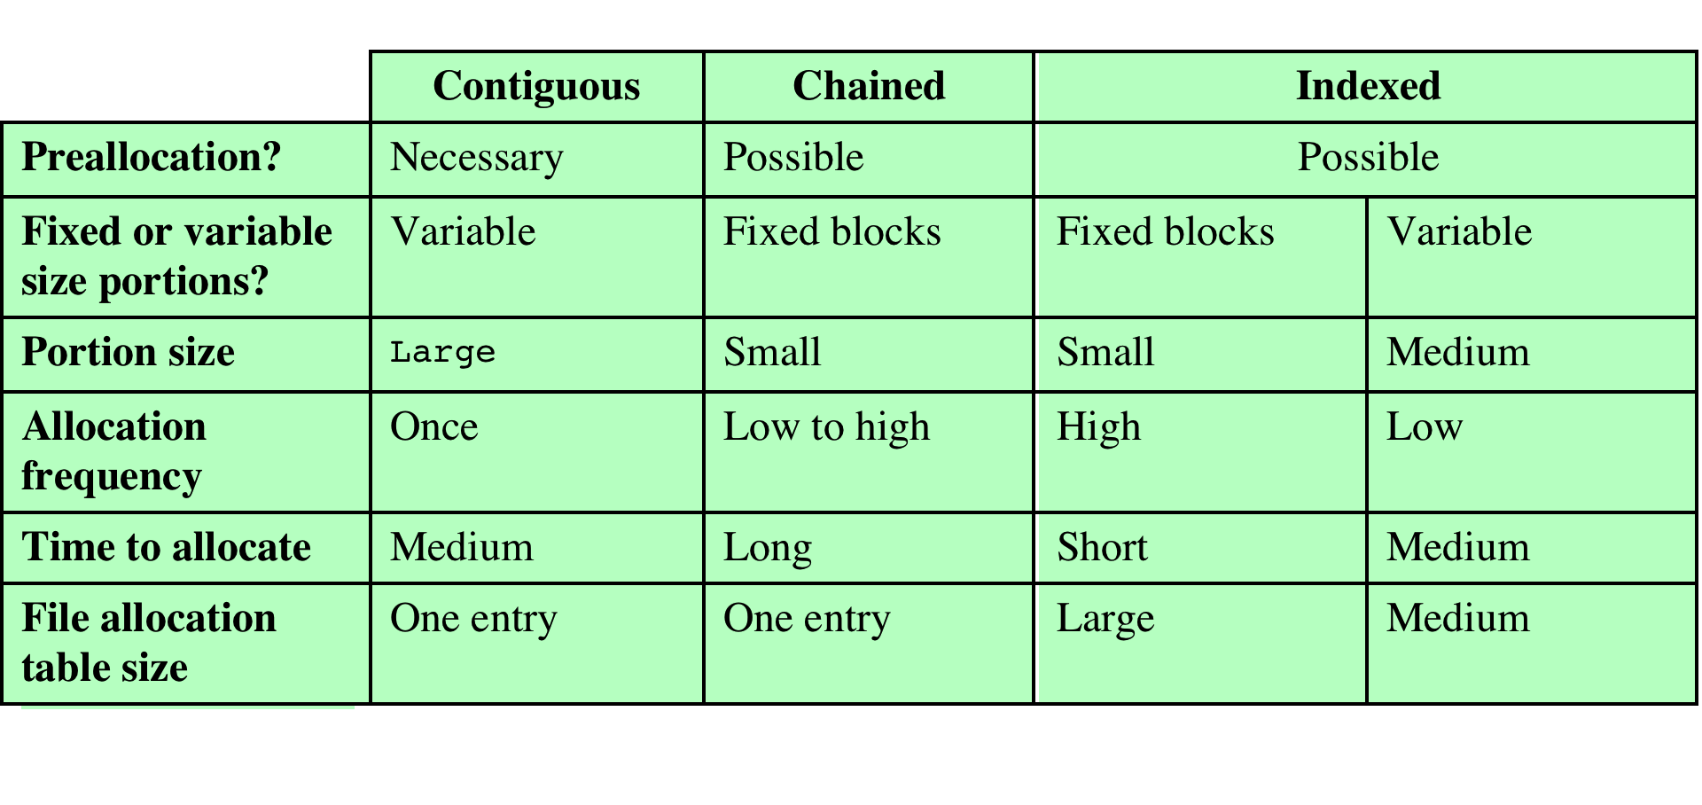
File Allocation Methods
Notes:
Table 12.3 File Allocation Methods
Having looked at the issues of preallocation versus
dynamic allocation and portion size, we are in a position to consider specific file
allocation methods. Three methods are in common use: contiguous, chained, and
indexed. Table 12.3 summarizes some of the characteristics of each method.

Slide 80
Free Space Management
Just as allocated space must be managed, so must the unallocated space
To perform file allocation, it is necessary to know which blocks are available
A disk allocation table is needed in addition to a file allocation table
Notes:
Just as the space that is allocated to files must be managed, so the space that is not
currently allocated to any file must be managed. To perform any of the file allocation
techniques described previously, it is necessary to know what blocks on the disk
are available. Thus we need a disk allocation table in addition to a file allocation
table. We discuss here a number of techniques that have been implemented.

Slide 81
Bit Tables
This method uses a vector containing one bit for each block on the disk
Each entry of a 0 corresponds to a free block, and each 1 corresponds to a block in use
Advantages
  works well with any file allocation method
  it is as small as possible
Notes:
This method uses a vector containing one bit for each block on the
disk. Each entry of a 0 corresponds to a free block, and each 1 corresponds to a
block in use. For example, for the disk layout of Figure 12.9 , a vector of length 35 is
needed and would have the following value:
00111000011111000011111111111011000
A bit table has the advantage that it is relatively easy to find one or a contiguous
group of free blocks. Thus, a bit table works well with any of the file
allocation methods outlined. Another advantage is that it is as small as possible.
However, it can still be sizable. The amount of memory (in bytes) required for a
block bitmap is
disk size in bytes/
8 * file system block size
Thus, for a 16-Gbyte disk with 512-byte blocks, the bit table occupies about
4 Mbytes. Can we spare 4 Mbytes of main memory for the bit table? If so, then the
bit table can be searched without the need for disk access. But even with today’s
memory sizes, 4 Mbytes is a hefty chunk of main memory to devote to a single function.
The alternative is to put the bit table on disk. But a 4-Mbyte bit table would
require about 8,000 disk blocks. We can’t afford to search that amount of disk space
every time a block is needed, so a bit table resident in memory is indicated.
Even when the bit table is in main memory, an exhaustive search of the table
can slow file system performance to an unacceptable degree. This is especially true
when the disk is nearly full and there are few free blocks remaining. Accordingly,
most file systems that use bit tables maintain auxiliary data structures that summarize
the contents of subranges of the bit table. For example, the table could be
divided logically into a number of equal-size subranges. A summary table could
include, for each subrange, the number of free blocks and the maximum-sized contiguous
number of free blocks. When the file system needs a number of contiguous
blocks, it can scan the summary table to find an appropriate subrange and then
search that subrange.

Slide 82
Chained Free Portions
The free portions may be chained together by using a pointer and length value in each free portion
Negligible space overhead because there is no need for a disk allocation table
Suited to all file allocation methods
Disadvantages
  leads to fragmentation
  every time you allocate a block you need to read the block first to recover the pointer to the new first free block before writing data to that block
Notes:
The free portions may be chained together by using
a pointer and length value in each free portion. This method has negligible space
overhead because there is no need for a disk allocation table, merely for a pointer to
the beginning of the chain and the length of the first portion. This method is suited
to all of the file allocation methods. If allocation is a block at a time, simply choose
the free block at the head of the chain and adjust the first pointer or length value.
If allocation is by variable-length portion, a first-fit algorithm may be used: The
headers from the portions are fetched one at a time to determine the next suitable
free portion in the chain. Again, pointer and length values are adjusted.
This method has its own problems. After some use, the disk will become quite
fragmented and many portions will be a single block long. Also note that every
time you allocate a block, you need to read the block first to recover the pointer to
the new first free block before writing data to that block. If many individual blocks
need to be allocated at one time for a file operation, this greatly slows file creation.
Similarly, deleting highly fragmented files is very time consuming.

Slide 83
Indexing
Treats free space as a file and uses an index table as it would for file allocation
For efficiency, the index should be on the basis of variable-size portions rather than blocks
This approach provides efficient support for all of the file allocation methods
Notes:
The indexing approach treats free space as a file and uses an index table
as described under file allocation. For efficiency, the index should be on the basis
of variable-size portions rather than blocks. Thus, there is one entry in the table for
every free portion on the disk. This approach provides efficient support for all of
the file allocation methods.

Slide 84
Free Block List
Each block is assigned a number sequentially
the list of the numbers of all free blocks is maintained in a reserved portion of the disk
Depending on the size of the disk, either 24 or 32 bits will be needed to store a single block number
the size of the free block list is 24 or 32 times the size of the corresponding bit table and must be stored on disk
There are two effective techniques for storing a small part of the free block list in main memory:
the list can be treated as a push-down stack with the first few thousand elements of the stack kept in main memory
the list can be treated as a FIFO queue, with a few thousand entries from both the head and the tail of the queue in main memory
Notes:
In this method, each block is assigned a number sequentially
and the list of the numbers of all free blocks is maintained in a reserved portion of
the disk. Depending on the size of the disk, either 24 or 32 bits will be needed to
store a single block number, so the size of the free block list is 24 or 32 times the size
of the corresponding bit table and thus must be stored on disk rather than in main
memory. However, this is a satisfactory method.
Consider the following points:
1. The space on disk devoted to the free block list is less than 1% of the total disk
space. If a 32-bit block number is used, then the space penalty is 4 bytes for
every 512-byte block.
2. Although the free block list is too large to store in main memory, there are
two effective techniques for storing a small part of the list in main memory.
a. The list can be treated as a push-down stack (Appendix 1B) with the first
few thousand elements of the stack kept in main memory. When a new
block is allocated, it is popped from the top of the stack, which is in main
memory. Similarly, when a block is deallocated, it is pushed onto the stack.
There only has to be a transfer between disk and main memory when the
in-memory portion of the stack becomes either full or empty. Thus, this
technique gives almost zero-time access most of the time.
b. The list can be treated as a FIFO queue, with a few thousand entries from
both the head and the tail of the queue in main memory. A block is allocated
by taking the first entry from the head of the queue and deallocated
by adding it to the end of the tail of the queue. There only has to be a transfer
between disk and main memory when either the in-memory portion of
the head of the queue becomes empty or the in-memory portion of the tail
of the queue becomes full.
In either of the strategies listed in the preceding point (stack or FIFO queue),
a background thread can slowly sort the in-memory list or lists to facilitate contiguous
allocation.

Slide 85
Questions & Tasks
  Is secondary storage management only needed for hard disks? What about an SSD?
  What are advantages and disadvantages of contiguous allocation? When/where can it be used?
  What happens with indexed allocation when the index does not fit into a block?

Slide 86
UNIX File Management
In the UNIX file system, six types of files are distinguished:
Regular, or ordinary
contains arbitrary data in zero or more data blocks
Directory
contains a list of file names plus pointers to associated inodes
Special
contains no data but provides a mechanism to map physical devices to file names
Named pipes
Links
an alternative file name for an existing file
Symbolic links
a data file that contains the name of the file it is linked to
an interprocess communications facility
Notes:
Regular, or ordinary: Contains arbitrary data in zero or more data blocks.
Regular files contain information entered in them by a user, an application program, or a system utility program.
The file system does not impose any internal structure to a regular file but treats it as a stream of bytes.
Directory: Contains a list of file names plus pointers to associated inodes (index nodes)
Directories are hierarchically organized
Directory files are actually ordinary files with special write protection privileges so that only the file system can write into them, while read access is available to user programs.
Special: Contains no data, but provides a mechanism to map physical devices to file names.
The file names are used to access peripheral devices, such as terminals and printers.
Each I/O device is associated with a special file.
Named pipes: A pipe is an interprocess communications facility.
A pipe file buffers data received in its input so that a process that reads from the pipe’s output receives the data on a first-in-first-out basis.
Links: A link is an alternative file name for an existing file.
Symbolic links: This is a data file that contains the name of the file it is linked to.

Slide 87

Inodes
All types of UNIX files are administered by the OS by means of inodes
An inode (index node) is a control structure that contains the key information needed by the operating system for a particular file
Several file names may be associated with a single inode
  an active inode is associated with exactly one file
  each file is controlled by exactly one inode
Notes:
Modern UNIX operating systems support multiple file systems but map all of these
into a uniform underlying system for supporting file systems and allocating disk
space to files. All types of UNIX files are administered by the OS by means of
inodes. An inode (index node) is a control structure that contains the key information
needed by the operating system for a particular file. Several file names may be
associated with a single inode, but an active inode is associated with exactly one file,
and each file is controlled by exactly one inode.

Slide 88
FreeBSD Inode and File Structure
Notes:
The attributes of the file as well as its permissions and other control information
are stored in the inode. The exact inode structure varies from one UNIX
implementation to another. The FreeBSD inode structure, shown in Figure 12.16 ,
includes the following data elements:
• The type and access mode of the file
• The file’s owner and group-access identifiers
• The time that the file was created, when it was most recently read and written, and when its inode was most recently updated by the system
• The size of the file in bytes
• A sequence of block pointers, explained in the next subsection
• The number of physical blocks used by the file, including blocks used to hold indirect pointers and attributes
• The number of directory entries that reference the file
• The kernel and user-settable flags that describe the characteristics of the file
• The generation number of the file (a randomly selected number assigned to the inode each time that the latter is allocated to a new file; the generation number is used to detect references to deleted files)
• The blocksize of the data blocks referenced by the inode (typically the same as, but sometimes larger than, the file system blocksize)
The size of the extended attribute information
• Zero or more extended attribute entries
The blocksize value is typically the same as, but sometimes larger than, the file
system blocksize. On traditional UNIX systems, a fixed blocksize of 512 bytes was
used. FreeBSD has a minimum blocksize of 4,096 bytes (4 Kbytes); the blocksize
can be any power of 2 greater than or equal to 4,096. For typical file systems, the
blocksize is 8 Kbytes or 16 Kbytes. The default FreeBSD blocksize is 16 Kbytes.
Extended attribute entries are variable-length entries used to store auxiliary
data that are separate from the contents of the file. The first two extended attributes
defined for FreeBSD deal with security. The first of these support access control
lists; this is described in Chapter 15 . The second defined extended attribute supports
the use of security labels, which are part of what is known as a mandatory
access control scheme, also defined in Chapter 15 .
On the disk, there is an inode table, or inode list, that contains the inodes of
all the files in the file system. When a file is opened, its inode is brought into main
memory and stored in a memory-resident inode table.

Slide 89
File Allocation
File allocation is done on a block basis
Allocation is dynamic, as needed, rather than using preallocation
An indexed method is used to keep track of each file, with part of the index stored in the inode for the file
In all UNIX implementations the inode includes a number of direct pointers and three indirect pointers (single, double, triple)
Notes:
File allocation is done on a block basis. Allocation is dynamic, as needed, rather
than using preallocation. Hence, the blocks of a file on disk are not necessarily contiguous.
An indexed method is used to keep track of each file, with part of the index
stored in the inode for the file. In all UNIX implementations, the inode includes a
number of direct pointers and three indirect pointers (single, double, triple).
The FreeBSD inode includes 120 bytes of address information that is organized
as fifteen 64-bit addresses, or pointers. The first 12 addresses point to the first
12 data blocks of the file. If the file requires more than 12 data blocks, one or more
levels of indirection is used as follows:
• The thirteenth address in the inode points to a block on disk that contains the
next portion of the index. This is referred to as the single indirect block. This
block contains the pointers to succeeding blocks in the file.
• If the file contains more blocks, the fourteenth address in the inode points to
a double indirect block. This block contains a list of addresses of additional
single indirect blocks. Each of single indirect blocks, in turn, contains pointers
to file blocks.
• If the file contains still more blocks, the fifteenth address in the inode points
to a triple indirect block that is a third level of indexing. This block points to
additional double indirect blocks.
All of this is illustrated in Figure 12.16 .

Slide 90

UNIX Directories and Inodes
Directories are structured in a hierarchical tree
Each directory can contain files and/or other directories
A directory that is inside another directory is referred to as a subdirectory
Notes:
Directories are structured in a hierarchical tree. Each directory can contain files
and/or other directories. A directory that is inside another directory is referred to
as a subdirectory. As was mentioned, a directory is simply a file that contains a
list of file names plus pointers to associated inodes. Figure 12.17 shows the overall
structure. Each directory entry (dentry) contains a name for the associated file or
subdirectory plus an integer called the i-number (index number). When the file or
directory is accessed, its i-number is used as an index into the inode table.

Slide 91
Volume Structure
A UNIX file system resides on a single logical disk or disk partition and is laid out with the following elements:
Boot block
contains code required to boot the operating system
Superblock
contains attributes and information about the file system
Inode table
collection of inodes for each file
Data blocks
storage space available for data files and subdirectories
Notes:
A UNIX file system resides on a single logical disk or disk partition and is laid out
with the following elements:
• Boot block: Contains code required to boot the operating system
• Superblock: Contains attributes and information about the file system, such as
partition size, and inode table size
• Inode table: The collection of inodes for each file
• Data blocks: Storage space available for data files and subdirectories

Slide 92




UNIX File Access Control
Notes:
Most UNIX systems depend on, or at least are based on, the file access control
scheme introduced with the early versions of UNIX. Each UNIX user is assigned a
unique user identification number (user ID). A user is also a member of a primary
group, and possibly a number of other groups, each identified by a group ID. When
a file is created, it is designated as owned by a particular user and marked with that
user’s ID. It also belongs to a specific group, which initially is either its creator’s
primary group, or the group of its parent directory if that directory has SetGID
permission set. Associated with each file is a set of 12 protection bits. The owner ID,
group ID, and protection bits are part of the file’s inode.
Nine of the protection bits specify read, write, and execute permission for the
owner of the file, other members of the group to which this file belongs, and all
other users. These form a hierarchy of owner, group, and all others, with the highest
relevant set of permissions being used. Figure 12.18a shows an example in which the
file owner has read and write access; all other members of the file’s group have read
access, and users outside the group have no access rights to the file. When applied to
a directory, the read and write bits grant the right to list and to create/rename/delete
files in the directory. The execute bit grants the right to search the directory for a
component of a filename.
The remaining three bits define special additional behavior for files or directories.
Two of these are the “set user ID” (SetUID) and “set group ID” (SetGID)
permissions. If these are set on an executable file, the operating system functions as
follows. When a user (with execute privileges for this file) executes the file, the system
temporarily allocates the rights of the user’s ID of the file creator, or the file’s
group, respectively, to those of the user executing the file. These are known as the
“effective user ID” and “effective group ID” and are used in addition to the “real
user ID” and “real group ID” of the executing user when making access control
decisions for this program. This change is only effective while the program is being
executed. This feature enables the creation and use of privileged programs that may
use files normally inaccessible to other users. It enables users to access certain files
in a controlled fashion. Alternatively, when applied to a directory, the SetGID permission
indicates that newly created files will inherit the group of this directory. The
SetUID permission is ignored.
The final permission bit is the “Sticky” bit. When set on a file, this originally
indicated that the system should retain the file contents in memory following execution.
This is no longer used. When applied to a directory, though, it specifies that
only the owner of any file in the directory can rename, move, or delete that file. This
is useful for managing files in shared temporary directories.
One particular user ID is designated as “superuser.” The superuser is exempt
from the usual file access control constraints and has systemwide access. Any
program that is owned by, and SetUID to, the “superuser” potentially grants unrestricted
access to the system to any user executing that program. Hence, great care
is needed when writing such programs.
This access scheme is adequate when file access requirements align with users
and a modest number of groups of users. For example, suppose a user wants to give
read access for file X to users A and B and read access for file Y to users B and C.
We would need at least two user groups, and user B would need to belong to both
groups in order to access the two files. However, if there are a large number of
different groupings of users requiring a range of access rights to different files, then
a very large number of groups may be needed to provide this. This rapidly becomes
unwieldy and difficult to manage, even if possible at all. 6 One way to overcome this
problem is to use access control lists, which are provided in most modern UNIX
systems.
A final point to note is that the traditional UNIX file access control scheme
implements a simple protection domain structure. A domain is associated with the
user, and switching the domain corresponds to changing the user ID temporarily.

Slide 93

UNIX File Access Control

Slide 94
Access Control Lists in UNIX
FreeBSD allows the administrator to assign a list of UNIX user IDs and groups to a file
Any number of users and groups can be associated with a file, each with three protection bits (read, write, execute)
A file may be protected solely by the traditional UNIX file access mechanism
FreeBSD files include an additional protection bit that indicates whether the file has an extended ACL
Notes:
Many modern UNIX and UNIX-based operating systems support access control
lists, including FreeBSD, OpenBSD, Linux, and Solaris. In this section, we describe
the FreeBSD approach, but other implementations have essentially the same features
and interface. The feature is referred to as extended access control list, while
the traditional UNIX approach is referred to as minimal access control list.
FreeBSD allows the administrator to assign a list of UNIX user IDs and
groups to a file by using the setfacl command. Any number of users and groups
can be associated with a file, each with three protection bits (read, write, execute),
offering a flexible mechanism for assigning access rights. A file need not have an
ACL but may be protected solely by the traditional UNIX file access mechanism.
FreeBSD files include an additional protection bit that indicates whether the file
has an extended ACL.
FreeBSD and most UNIX implementations that support extended ACLs use
the following strategy (e.g., Figure 12.18b ):
1. The owner class and other class entries in the nine-bit permission field have
the same meaning as in the minimal ACL case.
2. The group class entry specifies the permissions for the owner group for this
file. These permissions represent the maximum permissions that can be
assigned to named users or named groups, other than the owning user. In this
latter role, the group class entry functions as a mask.
3. Additional named users and named groups may be associated with the file,
each with a three-bit permission field. The permissions listed for a named
user or named group are compared to the mask field. Any permission
for the named user or named group that is not present in the mask field is
disallowed.
When a process requests access to a file system object, two steps are performed.
Step 1 selects the ACL entry that most closely matches the requesting process. The
ACL entries are looked at in the following order: owner, named users, (owning or
named) groups, and others. Only a single entry determines access. Step 2 checks
if the matching entry contains sufficient permissions. A process can be a member
in more than one group; so more than one group entry can match. If any of these
matching group entries contain the requested permissions, one that contains the
requested permissions is picked (the result is the same no matter which entry is
picked). If none of the matching group entries contains the requested permissions,
access will be denied no matter which entry is picked.

Slide 95

Linux Virtual File System (VFS)
Presents a single, uniform file system interface to user processes
Defines a common file model that is capable of representing any conceivable file system’s general feature and behavior
Assumes files are objects that share basic properties regardless of the target file system or the underlying processor hardware
Notes:
Linux includes a versatile and powerful file-handling facility, designed to support a
wide variety of file management systems and file structures. The approach taken in
Linux is to make use of a virtual file system (VFS) , which presents a single, uniform
file system interface to user processes. The VFS defines a common file model that is
capable of representing any conceivable file system’s general feature and behavior.
The VFS assumes that files are objects in a computer’s mass storage memory that
share basic properties regardless of the target file system or the underlying processor
hardware. Files have symbolic names that allow them to be uniquely identified
within a specific directory within the file system. A file has an owner, protection
against unauthorized access or modification, and a variety of other properties. A
file may be created, read from, written to, or deleted. For any specific file system, a
mapping module is needed to transform the characteristics of the real file system to
the characteristics expected by the virtual file system.
Figure 12.19 indicates the key ingredients of the Linux file system strategy. A
user process issues a file system call (e.g., read) using the VFS file scheme. The VFS
converts this into an internal (to the kernel) file system call that is passed to a mapping
function for a specific file system [e.g., IBM’s Journaling File System (JFS)]. In
most cases, the mapping function is simply a mapping of file system functional calls
from one scheme to another. In some cases, the mapping function is more complex.
For example, some file systems use a file allocation table (FAT), which stores the
position of each file in the directory tree. In these file systems, directories are not
files. For such file systems, the mapping function must be able to construct dynamically,
and when needed, the files corresponding to the directories. In any case, the
original user file system call is translated into a call that is native to the target file
system. The target file system software is then invoked to perform the requested
function on a file or directory under its control and secondary storage. The results
of the operation are then communicated back to the user in a similar fashion.

Slide 96

The Role of VFS within the Kernel
Notes:
Figure 12.20 indicates the role that VFS plays within the Linux kernel. When
a process initiates a file-oriented system call (e.g., read), the kernel calls a function
in the VFS. This function handles the file-system-independent manipulations and
initiates a call to a function in the target file system code. This call passes through
a mapping function that converts the call from the VFS into a call to the target file
system. The VFS is independent of any file system, so the implementation of a mapping
function must be part of the implementation of a file system on Linux. The
target file system converts the file system request into device-oriented instructions
that are passed to a device driver by means of page cache functions.
VFS is an object-oriented scheme. Because it is written in C, rather than a
language that supports object programming (such as C++ or Java), VFS objects are
implemented simply as C data structures. Each object contains both data and pointers
to file-system-implemented functions that operate on data.

Slide 97

Example: Linux VFS/Ext2
  The virtual file system is a layer between the kernel and the file system code
Manages all the different file systems that are mounted
The real file systems are either built into the kernel itself or are built as loadable modules

Slide 98

Ext2: Inodes
Basic concept of the Ext2 system (and of all Unix file systems) is the structure called inode (index node)
A file is represented by one inode
The length of files is variable but all inodes are of the same length (128 Byte)
Smaller files are more quickly accessed than larger files

Slide 99

Ext2: Directories
A directory is a file which is formatted with a special format - a list of directory entries
  Also a directory has an inode
Directory entries are of variable length
  File names of varying length are supported
An entry consists of
  Inode number
  Entry length
  Name length
  File name
The first two entries for every directory are always the standard “.” and “..” (“this directory” and “the parent directory”)
The inode number of the root directory is stored in the super block so the system can access it directly at any time

Slide 100

Ext2: Blocks and Block Groups
A block is the smallest unit that can be allocated on an Ext2 partition
The blocks are grouped into block groups of the same size
If possible, data blocks for a file are allocated in the same group as its inode
  Related data is kept physically close, seek time is reduced
Each group stores a copy of critical administrative information
  Data security is increased
All block groups have the same size and are stored sequentially
  The location of a block group can be derived from its index

Slide 101

Ext2: Block Groups
Super block
  Description of basic size and shape of the file system
    information that allows to use and maintain the system
Group descriptors
  Position of block bitmap, inode bitmap and inode table, number of free data blocks, inodes and directories
    information used when new data blocks are allocated
Copies in all block groups
  Only super block and group descriptors in block group 0 are actually used, the remaining copies are only used in case of file system corruption

Slide 102

Ext2: Block Groups
Block bitmap/ inode bitmap | One bit per block/inode, indicates whether the block/inode is used or free to keep track of allocated blocks and inodes
Inode table | A predefined number of inodes
Data blocks | Blocks storing the actual data

Slide 103
Related System Calls (Linux)
int open(const char *pathname, int flags)
  Open file at pathname with options flags and return file descriptor
int close(int fd)
  Close file desciptor fd
ssize_t read(int fd, void *buf, size_t count)
ssize_t write(int fd, const void *buf, size_t count)
  Read/write data at buf with count bytes from/to file descriptor fd
off_t lseek(int fd, off_t offset, int whence)
  Seek, i.e. change current “cursor position”, in file descriptor fd by offset bytes in relation to whence (SEEK_SET, SEEK_CUR, SEEK_END)
int fcntl(int fd, int cmd)
int fcntl(int fd, int cmd, long arg)
int fcntl(int fd, int cmd, struct flock *lock)
  Performs operation cmd on file descriptor fd, e.g. locking to protects against concurrent access, signaling on I/O, ...
    Is this a well-designed interface?

Slide 104
Content
Introduction and Motivation
Subsystems, Interrupts and System Calls
Processes
Memory
Scheduling
I/O and File System
Booting, Services, and Security

