Slide 1
Computational Proteomics and Metabolomics
Oliver Kohlbacher, Sven Nahnsen, Knut Reinert
6. Quantification III: SRM/MRM, SWATH

Slide 2
Overview
iTRAQ quantification
  Labeling
  Data analysis
Targeted proteomics: SRM/MRM
  Definition of targeted proteomics
  Data analysis
  Human Proteome Project
Other quantification methods
  Spectral counting
Comparison of quantification methods

Slide 3
LEARNING UNIT 6A
Isobaric LABELING

Slide 4
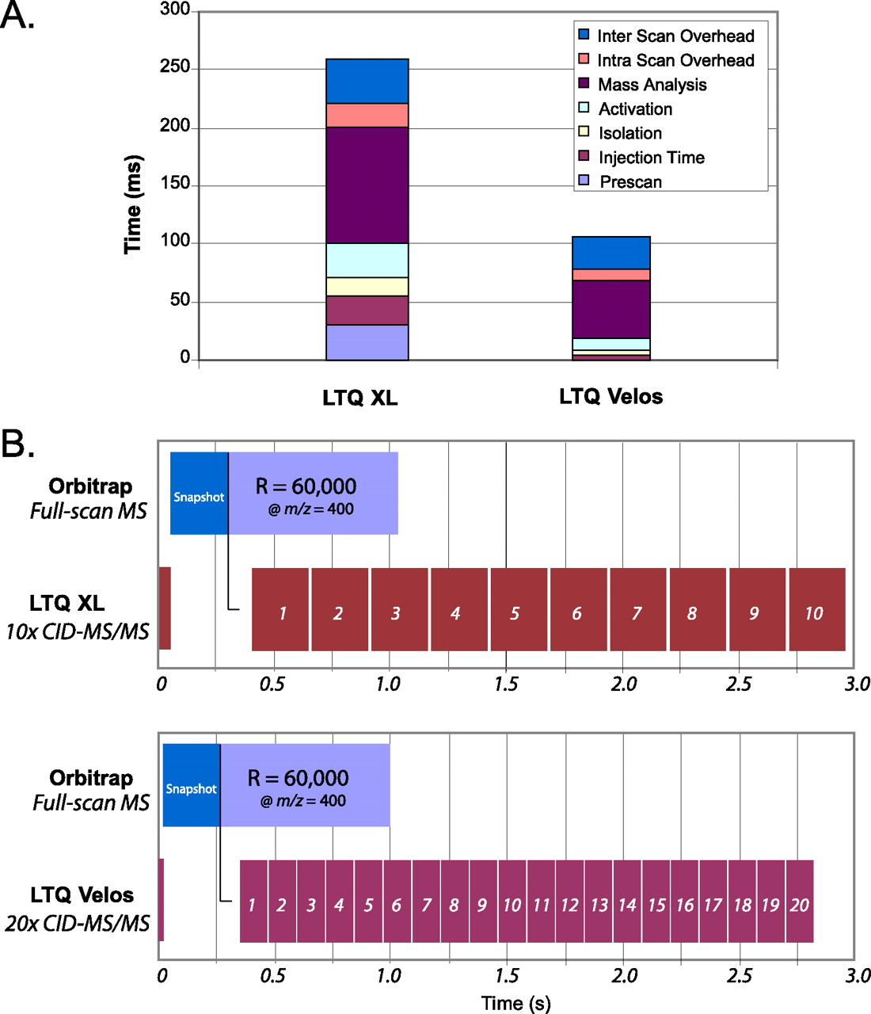
LC-MS/MS
Data-Driven Acquisition: MS spectrum (survey spectrum) controls the selection of peptide ions for CID fragmentation
Peptide ion intensity determines fragmentation order (most intense first)
‘TOP10’ means that the 10 most intense peptide peaks from each survey spectrum will be chosen for fragmentation before a new survey spectrum is acquired
Direct re-fragmentation of the same mass is prevented by (dynamic) exclusion lists
Olsen J V et al. Mol Cell Proteomics 2009;8:2759-2769
B Domon, R Aebersold Science 2006;312:212-217

Slide 5
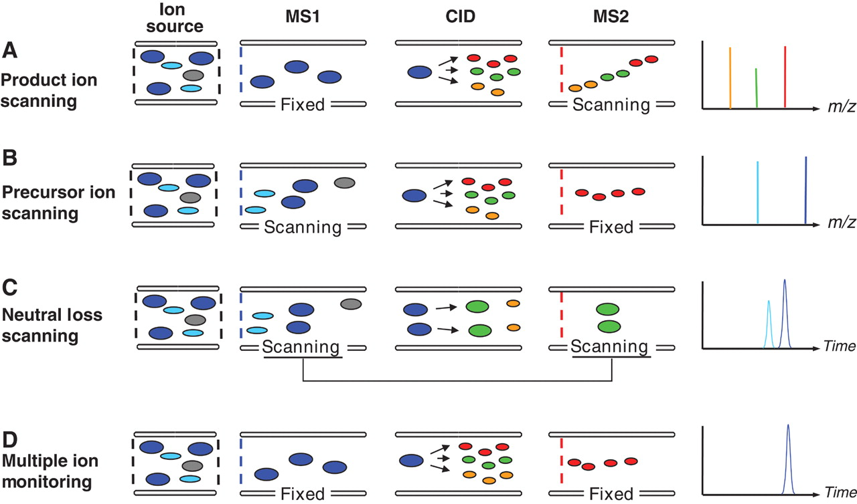
MS/MS Techniques
B Domon, R Aebersold Science 2006;312:212-217

Slide 6
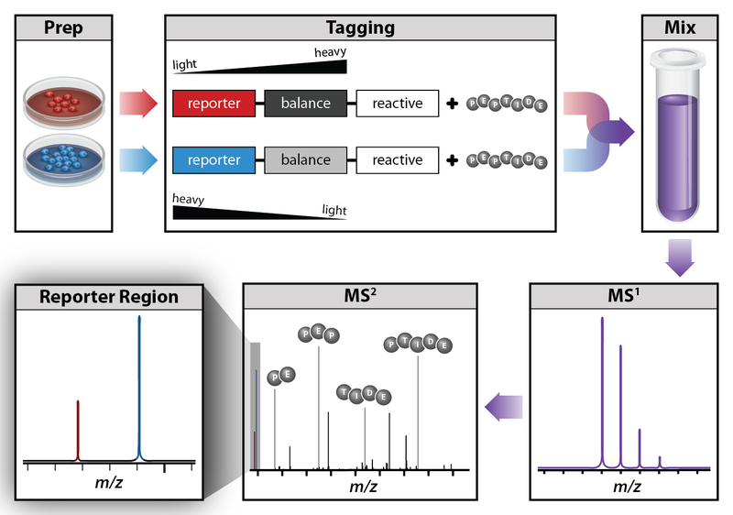
Isobaric Labeling
http://en.wikipedia.org/wiki/File:Isobaric_labeling.png [accessed 19.11.11, 19:48 CET]

Slide 7
Isobaric Labeling
Idea
  Label the different samples with labels of the same mass (isobaric)
  Design the label in a way the fragmentation pattern allows to distinguish them upon collision-induced dissociation
  MS² spectra will then contain reporter ions
  Quantification and identification are then both based on tandem spectra only
Key method: iTRAQ – isobaric tags for relative and absolute quantification
  Based on covalent modification of N-terminus of peptides
  Labeling performed after digestion (also applicable to clinical samples)
  Kits available for 4 or 8 distinct labels (‘quadruplex’, ‘octuplex’)

Slide 8
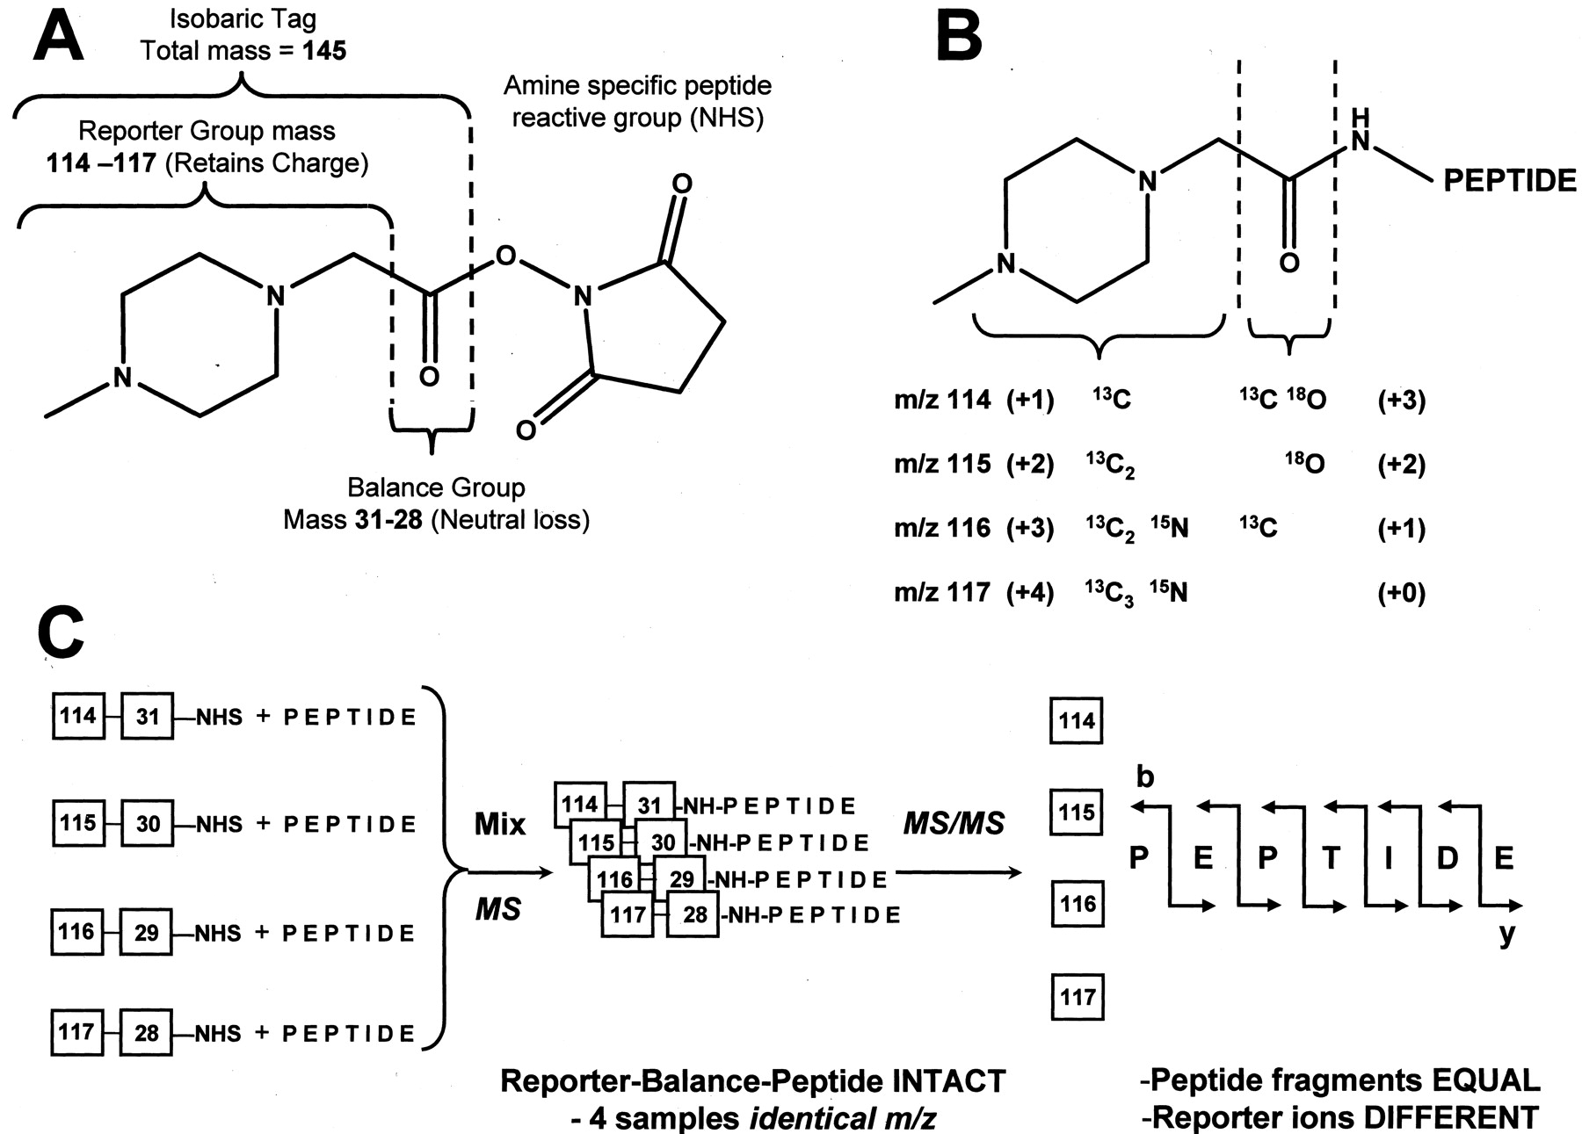
iTRAQ
Ross et al., Mol Cell Prot (2004), 3, 1154-1169.

Slide 9
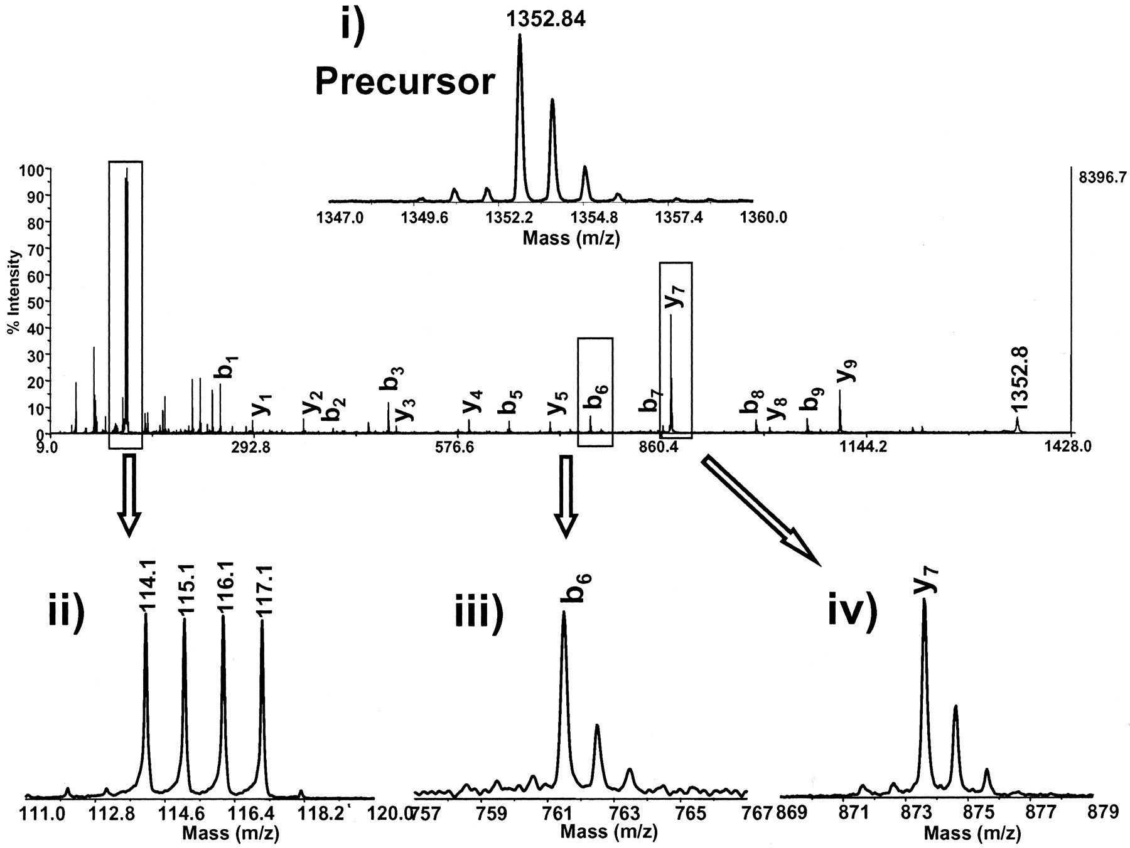
iTRAQ
Ross et al., Mol Cell Prot (2004), 3, 1154-1169.

Slide 10
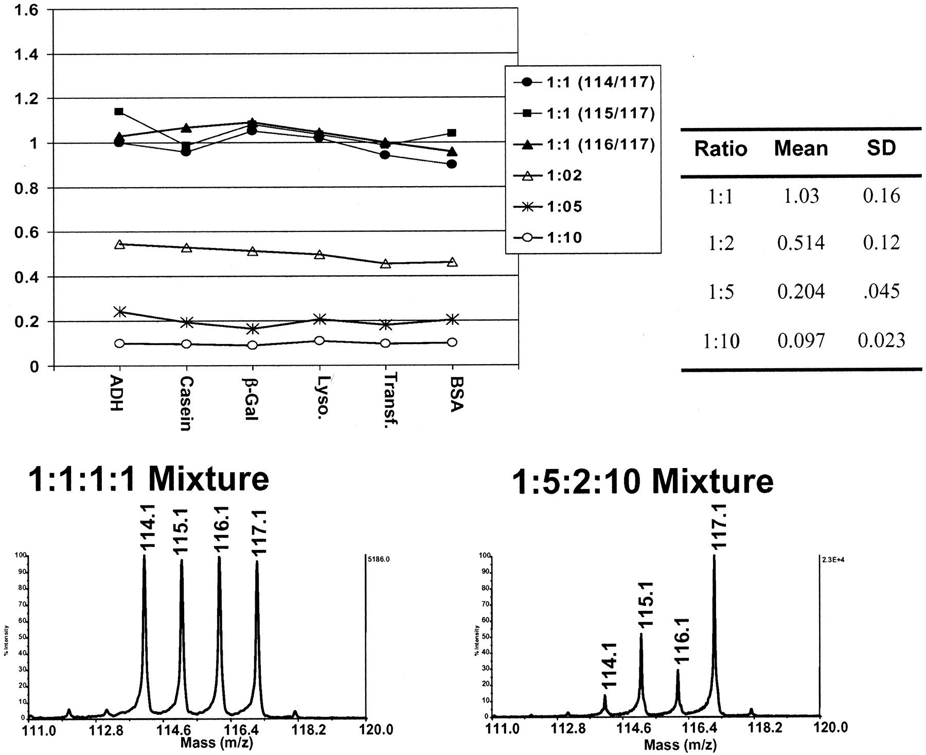
iTRAQ
Ross et al., Mol Cell Prot (2004), 3, 1154-1169.

Slide 11
iTRAQ
iTRAQ reagents contain isotopic impurities
The intensity of each reporter ion peak will thus influence the intensities (areas) of adjacent peaks (+/- 2 nominal masses)
Correction factors can be determined for each of the reporter ions (by mass spectrometry of the individual reagents)
Observed peak intensities and real (corrected) channel intensities can thus be related by a system of linear equations
This system of linear equations can be solved
D’Ascenzo et al., Brief Funct Genomic Proteomic. 2008 Mar; 7’(2):127-35

Slide 12
Correction and Normalization
Isotopic correction and normalization relative to a specific channel to improve quantification results
Example below:
  8-plex containing two time series (t=0 on channel 113 and 114 respectively)
  Left: unnormalized raw peak intensities
  Middle: log fold changes for both time series relative to their respective t=0
  Right: after isotopic correction and media normalization
D’Ascenzo et al., Brief Funct Genomic Proteomic. 2008 Mar; 7’(2):127-35

Slide 13
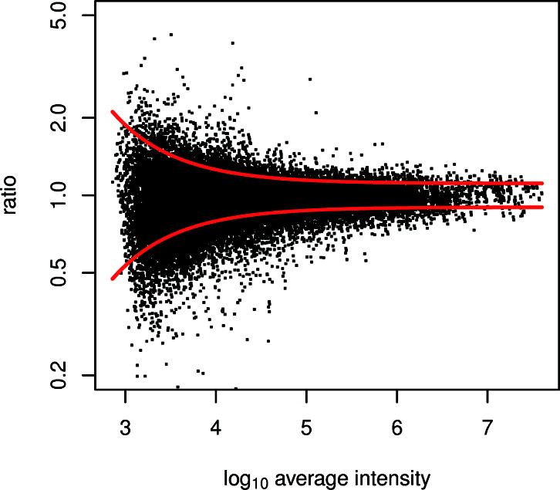
iTRAQ
Noise model
  Reliability of the signal intensity reduces with the intensity
  Low-intensity peaks thus have a higher error than high-intensity peaks
  This behavior is known in statistics as heteroscedasticity: different subpopulations of the samples have different variance
  The noise in iTRAQ (and most other quantification methods) is thus heteroscedastic noise
Noise from an iTRAQ experiment as determined from a 1:1:1:1 experiment. All iTRAQ channels should show the same intensities. For low intensities, ratios spread out further.
  Breitwieser et al., J. Proteome Res., 2011, 10 (6), pp 2758–2766

Slide 14
iTRAQ
Peptide quantification => protein quantification
Different isoforms make the translation from peptide to protein quantities non-trivial
Peptides can only be mapped to so-called protein groups, a set of proteins containing this peptide
For iTRAQ: some peptides can not be used to distinguish between protein isoforms
Regression methods are used to unravel some of this information
See protein inference problem
  Breitwieser et al., J. Proteome Res., 2011, 10 (6), pp 2758–2766

Slide 15
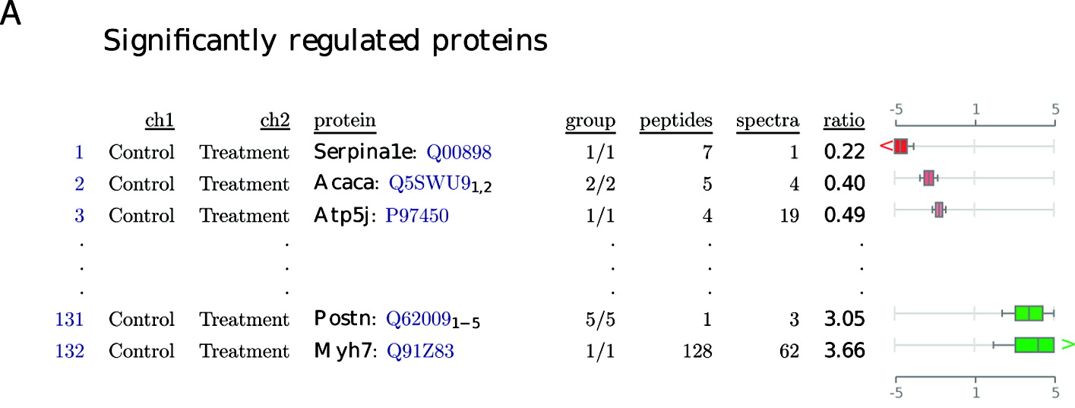
iTRAQ Analysis
isobar is an R package for iTRAQ analysis that
  Reads the MS data (spectra and identifications)
  Corrects for isotopic impurities
  Implements a heteroscedastic noise model
  Quantifies full proteins based on its peptides
Output: a full report on differentially quantified proteins
  Breitwieser et al., J. Proteome Res., 2011, 10 (6), pp 2758–2766

Slide 16
LEARNING UNIT 6B
SRM/MRM

Slide 17
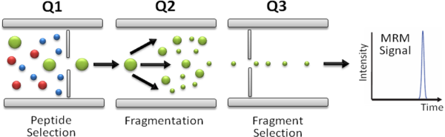
SRM/MRM
Selected Reaction Monitoring (SRM) and Multiple Reaction Monitoring (MRM) use the signal of selected MS² fragment ions for quantification
It is typically performed on triple-quadrupole instruments: Q₁ selects a peptide ion, Q₂ fragments the peptide, and Q₃ selects a specific fragment ion for the detector
Double mass selection reduces possible interferences between ions, quantification through MRM signal area
http://www.srmatlas.org/mrmassays.php

Slide 18
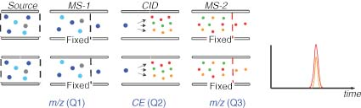
SRM vs. MRM
SRM: monitor a single fixed mass window only
MRM: scan rapidly over multiple (very narrow) mass windows and thus acquire traces of multiple fragment ion masses in parallel
Gallien et al., J. Mass Spectrom, 2011, 46(3), 298-312

Slide 19
Targeted Assays
Targeted proteomics/metabolomics is based on a list of known analytes (proteins, metabolites)
Targeted methods are in contrast to so-called discovery mode or shotgun proteomics, where proteins/metabolites are identified and quantified as comprehensively, as possible
MRM Assay:
  Consists of a transition list
  For each SRM transition, the expected retention time, precursor ion m/z, and fragment ion m/z need to be specified
  Transition list is uploaded to the instrument prior to the analysis and controls
Advantages of SRM/MRM
  Minimal fractionation only (second separation in the MS)
  Better sensitivity
  Better linear range (4-5 orders of magnitude)

Slide 20
Computational Challenges
Assay construction
  Given a list of proteins, determine a transition list
  Based on either experimentally determined tandem spectra (to identify the most intense fragment ions) or on predicted spectra
  Assays need to be optimized (avoid interferences, optimize instrument settings for each transition)
Automated assay analysis
  Given an assay, automatically quantify a sample

Slide 21
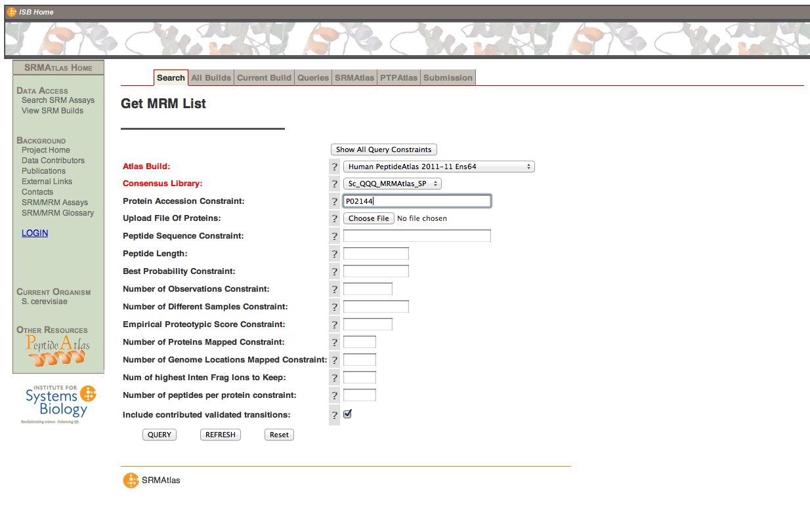
SRM Atlas

Slide 22
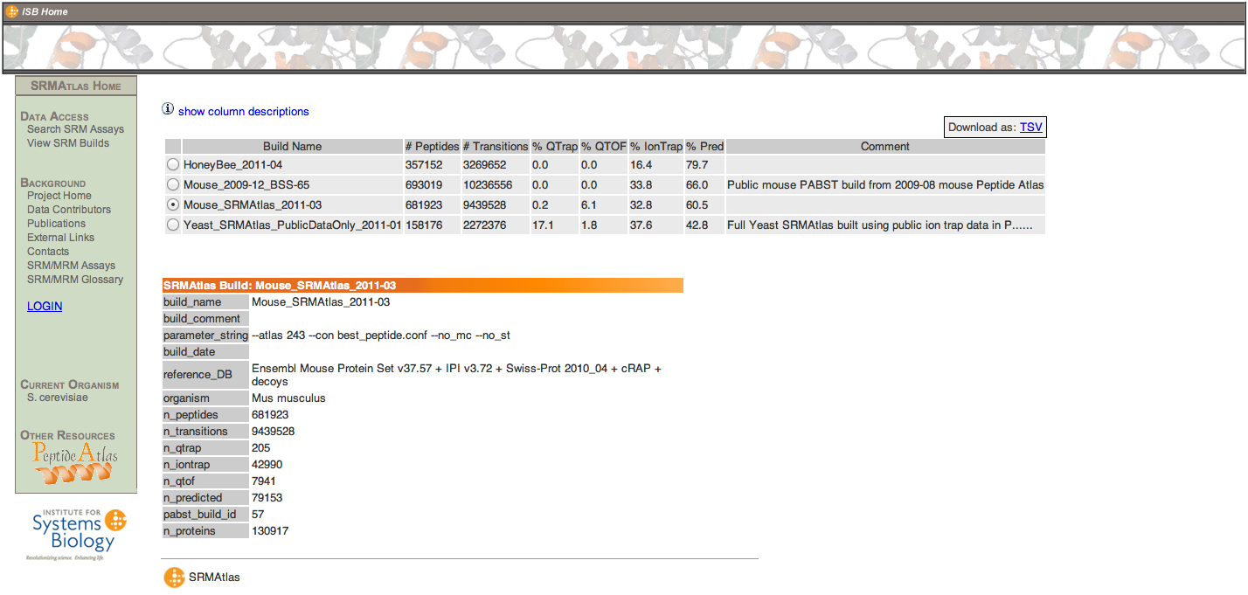
SRM Atlas
Apart from the search interface, SRM Atlas also offers downloadable transition lists for several organisms (based on experimentally validated and predicted transitions)

Slide 23
Skyline
Skyline is a software package (Windows only) for the construction and analysis of MRM assays
Skyline permits the construction and optimization of MRM assays based on experimental data
The graphical user interface also permits the analysis of the resulting datasets and (semi-)automatic processing of larger datasets

Slide 24
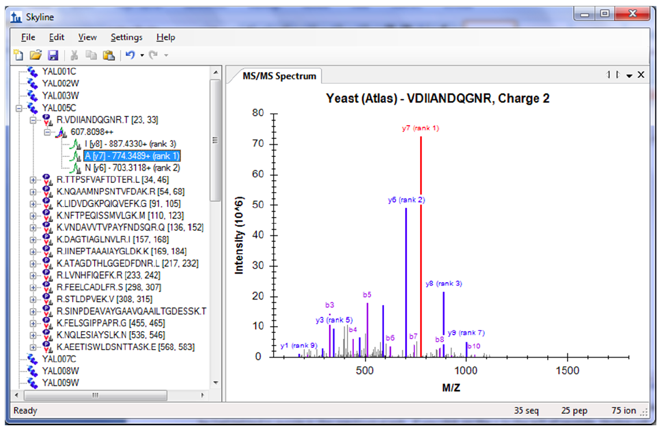
Skyline – Assay Construction
https://skyline.gs.washington.edu/tutorials/MethodEdit-1_1.pdf

Slide 25
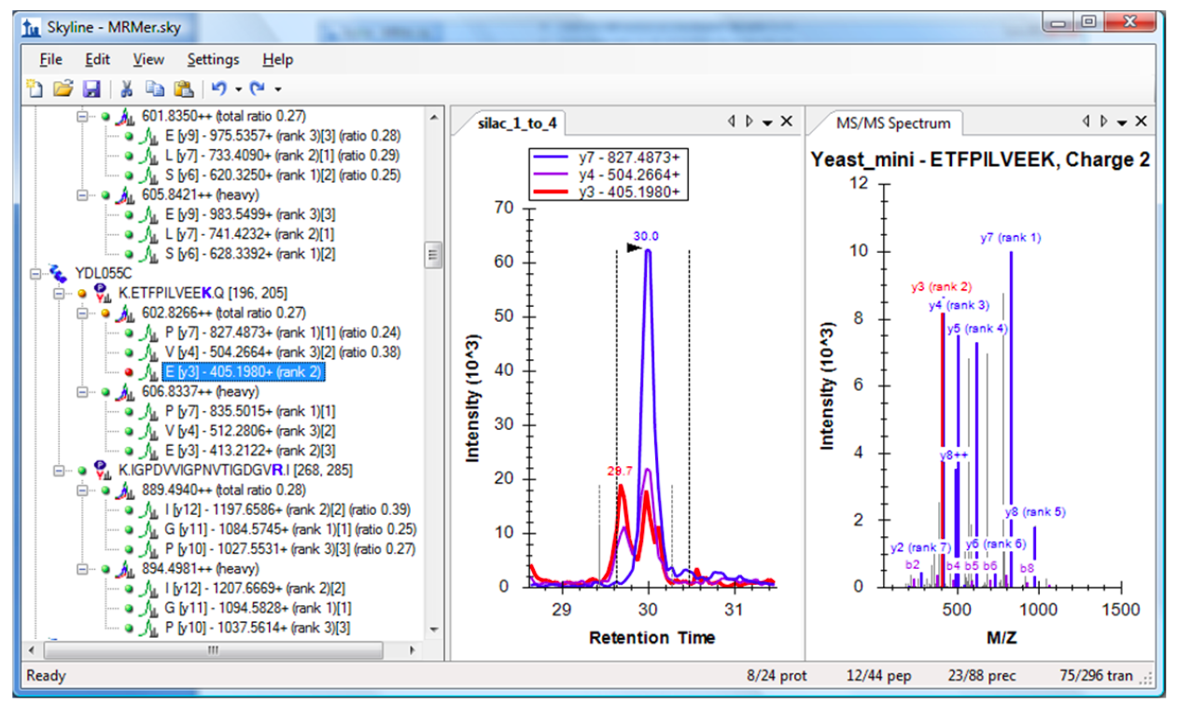
Skyline
https://skyline.gs.washington.edu/tutorials/ExistingQuant-1_1.pdf

Slide 26
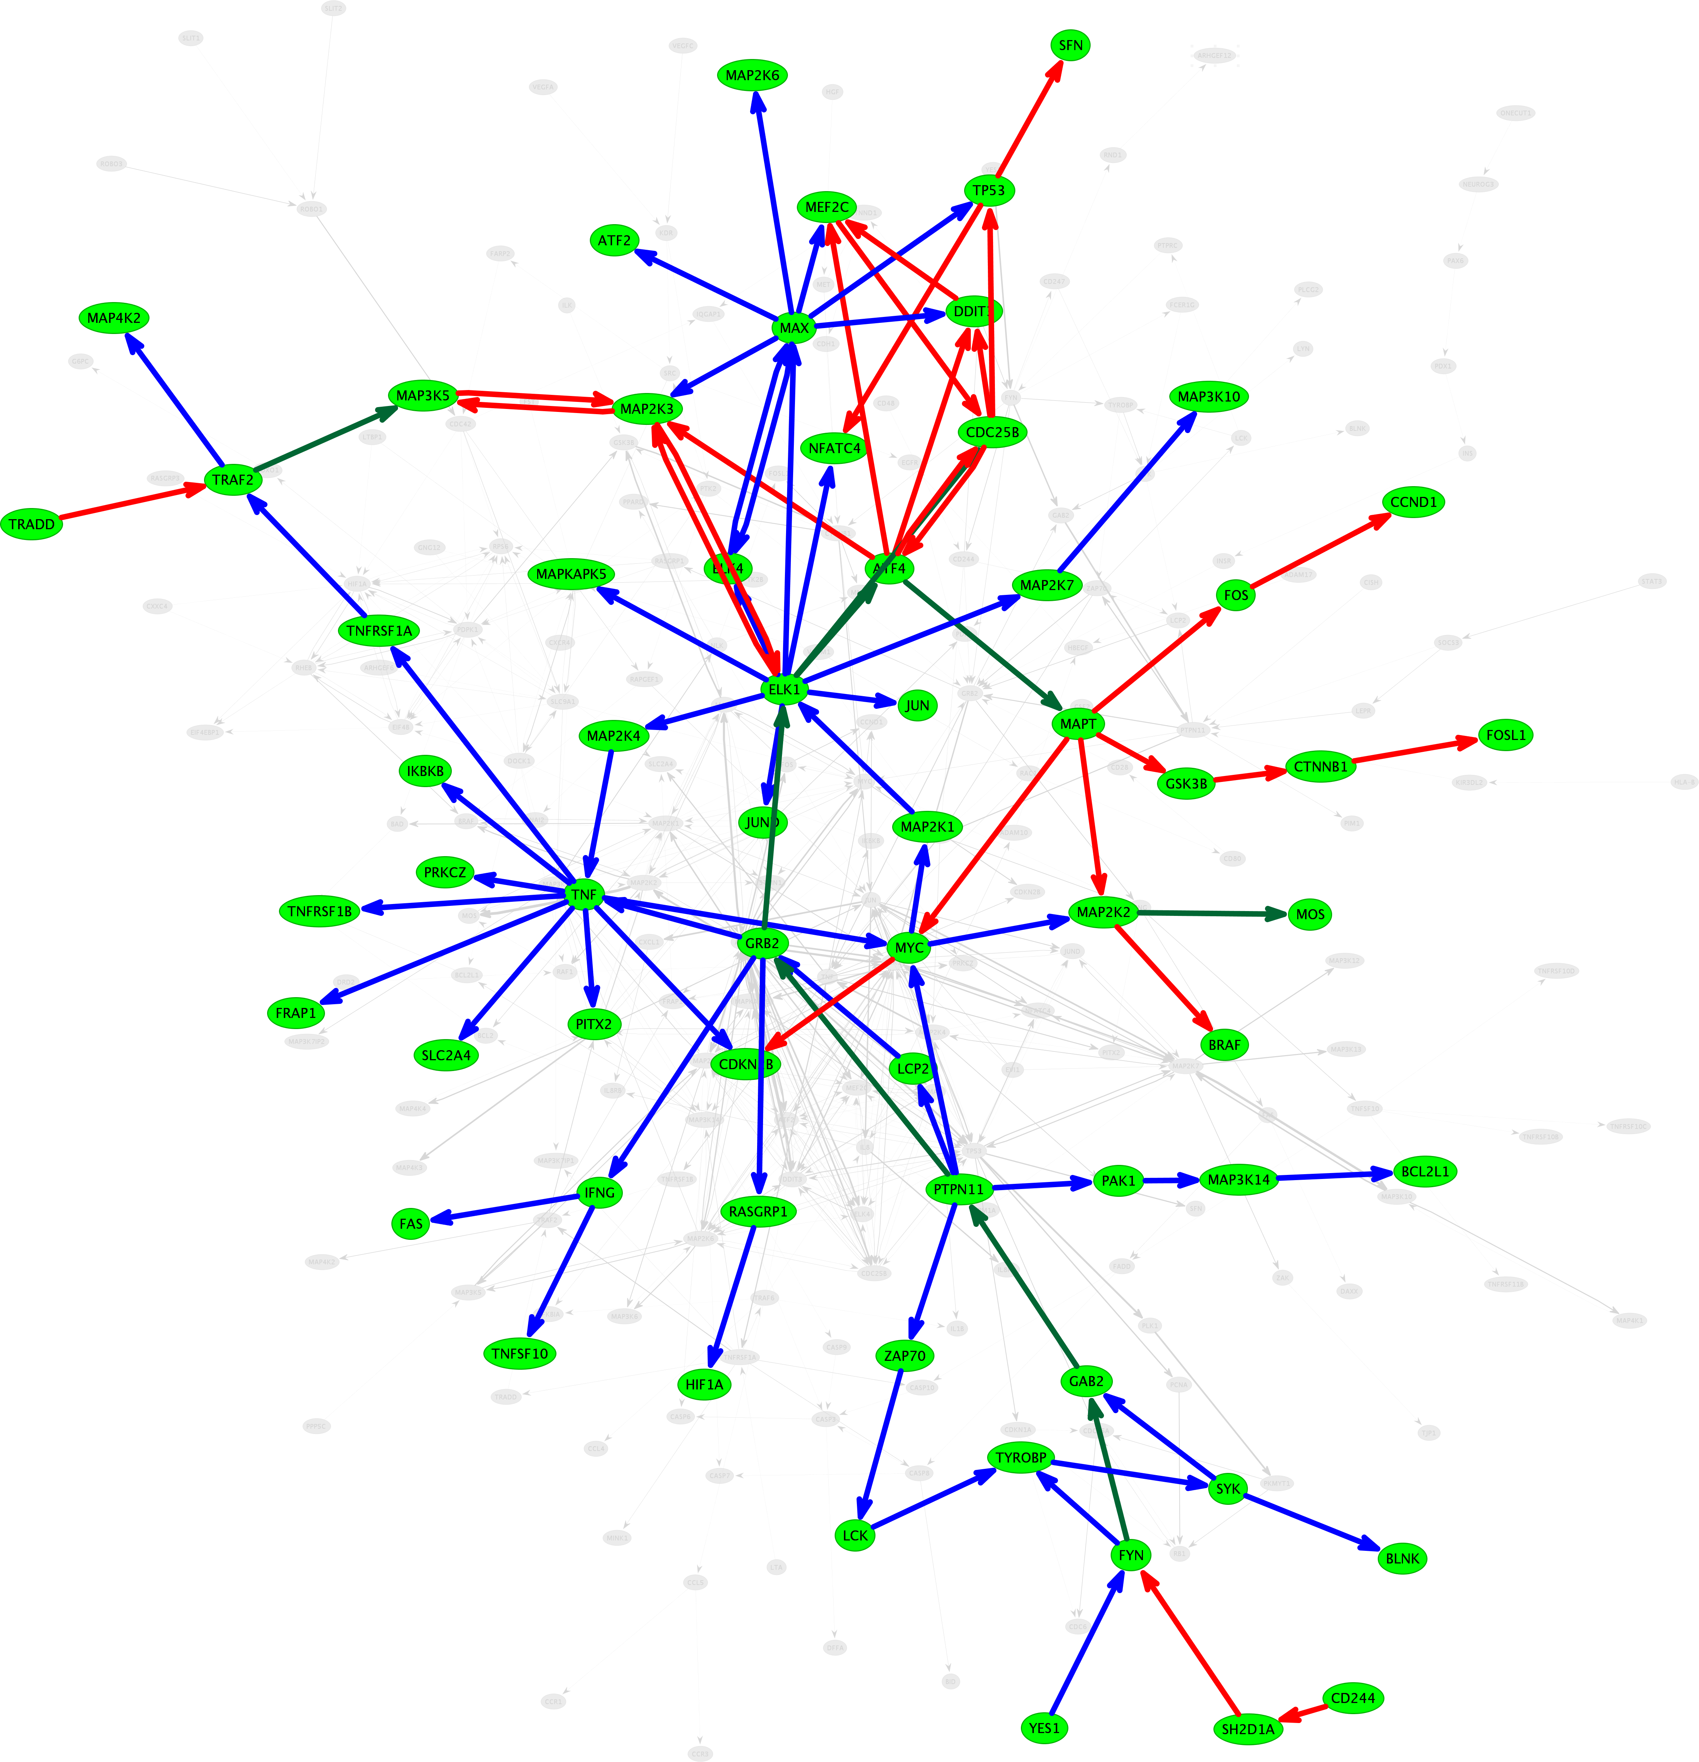
MRM Transition Scheduling
Idea
  Identify proteins of interest (e.g., from a pathway)
  Predict MRM transitions to cover all proteins
  Predict optimal scheduling of transitions
  Formulate as a combinatorial optimization problem (ILP)

Slide 27
Targeted MRM Scheduling
For a set of given protein sequences
  in silico digest
  Predict proteotypicity
  Predict retention time
  Predict tandem spectrum
  Select transitions from the predicted values
Protein Sequences
Digestion
Peptide List
PT Prediction
PT Peptide List
RT Prediction
RT Peptide List
Fragmentation
Spectra
Trans. Selection
Transition List
Notes:
Of course, any existing pre-knowledge can be used to improve the results in general. Examples are retention times and MS/MS spectra of known peptides.

Slide 28
Prediction Methods
Proteotypicity prediction
  Predict whether the peptide is a so-called proteotypic peptide
  Proteotypic peptides are peptides that are typically observed for a given peptide and allow unique protein mapping
  This corresponds to predicting the response factors: proteotypic peptides have high response factors, ionize well, yield strong signals and are thus observed whenever the protein is present
Retention time prediction
  Predict at what time the peptide will elute
  Depends on the separation system
  For a given separation system, the retention time will depend on the peptide
Both properties, proteotypicity and retention time, depend on the sequence of the peptide ) sequence-based machine learning can solve both problems

Slide 29
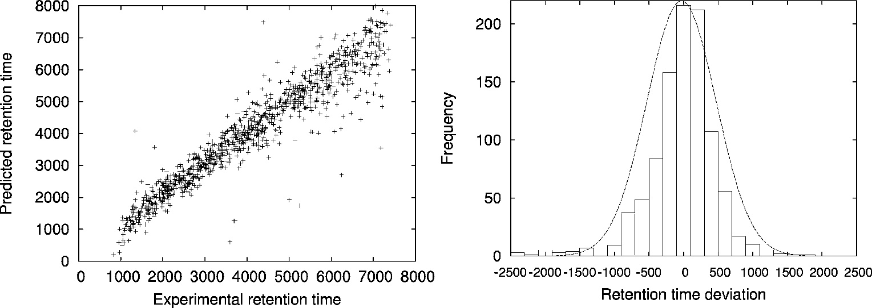
Retention Time Prediction
Retention time (as well as proteotypicity) can be predicted using support vector regression (SVR)
All that is needed is a sufficiently large training set (100+ peptides) and their retention time
The predictor can then predict retention times of arbitrary peptides given their sequence alone
Accuracy is excellent (r² = 0.94)
Bertsch et al., J. Proteome Res. (2010), 2010, 9(5):2696-704

Slide 30
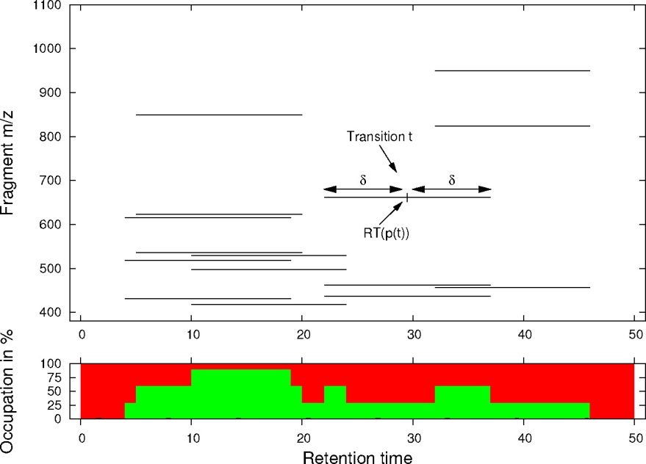
Optimization Problem
Given
  A set of possible transitions
Objective
  Pack as many of the transitions into a list as possible
  Maximize coverage of the proteins
Combinatorial optimization problem, can be solved using integer linear programming (ILP)
The number of transitions at any time is limited
Each transition has to be scheduled for a certain retention time window
Given the choice between multiple transitions, those should be preferred that stem from peptides/proteins not yet measured
Bertsch et al., J. Proteome Res. (2010), 2010, 9(5):2696-704

Slide 31
Optimization Problem
Definitions
  A set of protein sequences S = {s₁,…,s_{k}}
  S can be digested in silico into a set of tryptic peptides
  P={p₁,…,p_{n}}
  The sequence of a peptide is mapped to a predicted
    Retention time RT(p),
    Proteotypicity PT(p), and
    A set of predicted fragment ion intensities FI(p)
  A set of possible transitions T={t₁,…,t_{l}}, where each transition t is defined by its peptide parent mass p(t) and fragment ion m/z m(t)
  δ denotes the length in RT of a scheduled transition (based on the std. deviation of the retention time prediction)

Slide 32
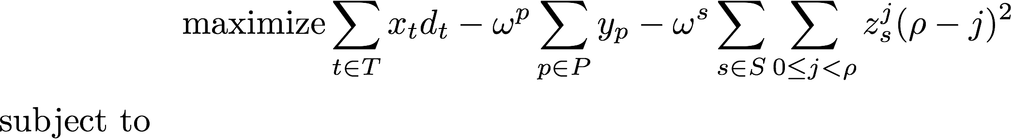




Optimization Problem
ILP Formulation
Binary decision variables x_{t}: x_{t}= 1 if the transition in T is choosen, 0 otherwise
Weight d_{t} describes the detectability (log value of combined proteotypicity and
fragment ion probability)
Binary decision variables y_{p}: y_{p}= 1 if peptide is NOT covered by at least transitions.
Binary decision variables z_{s}^{j}: z_{s}^{j}= 1 if protein sequence s is NOT represented by at least j peptides. Is the given minimum number of peptides.
are constants appropriately chosen
Bertsch et al., J. Proteome Res. (2010), 2010, 9(5):2696-704
Notes:
\begin{equation*}
\text{maximize}\sum_{t \in T}{x_{t}d_{t}} - \omega^{p} \sum_{p \in P}{y_p} - \omega^{s} \sum_{s \in S} \sum_{0 \leq j < \rho} {}z_{s}^{j}(\rho - j)^2
\end{equation*}
subject to
\begin{equation*}
\tau y_p + \sum_{i \in T_p}{x_i}\geq\tau \text{, }\forall ~p \in P
\end{equation*}
\begin{equation*}
(j+1)z_{s}^{j}+\sum_{p \in P_s}{tcov(p)} \geq j + 1 \text{, } \forall ~s \in S \text{, } \forall ~0 \leq j < \rho
\end{equation*}
with
\begin{equation*} tcov(p)=\begin{cases} 1, & \sum_{i}{x}\geq~\tau \\ 0, & \text{otherwise}\end{cases}
\end{equation*}
and
\begin{equation*}
\sum_{j \in TS_i}{x_j} \leq C, \forall ~1 \leq i \leq N
\end{equation*}

Slide 33
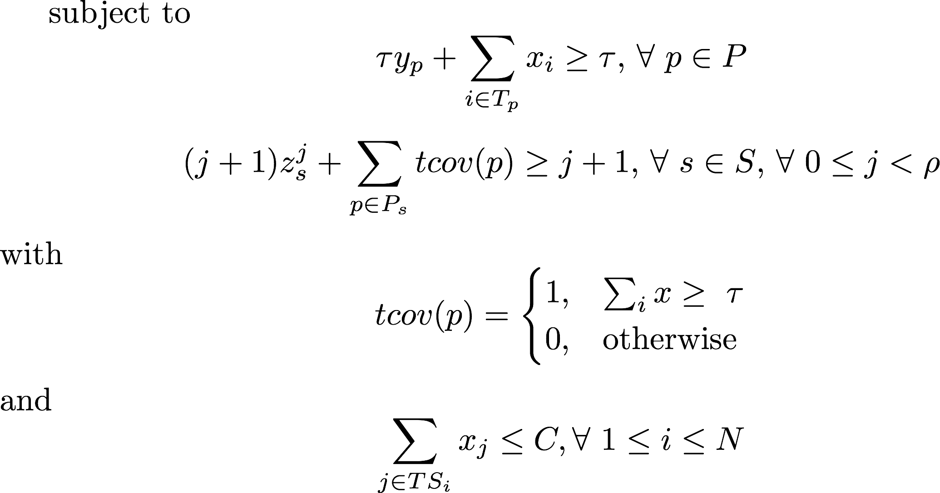
Optimization Problem
First equation ensures coverage by
The second equation ensures protein s is covered by at least j peptides
The last constraint given restricts the number of transitions in parallel to at most C, the maximal number of transitions that can be measured in parallel.
Bertsch et al., J. Proteome Res. (2010), 2010, 9(5):2696-704
Notes:
\begin{equation*}
\text{maximize}\sum_{t \in T}{x_{t}d_{t}} - \omega^{p} \sum_{p \in P}{y_p} - \omega^{s} \sum_{s \in S} \sum_{0 \leq j < \rho} {}z_{s}^{j}(\rho - j)^2
\end{equation*}
subject to
\begin{equation*}
\tau y_p + \sum_{i \in T_p}{x_i}\geq\tau \text{, }\forall ~p \in P
\end{equation*}
\begin{equation*}
(j+1)z_{s}^{j}+\sum_{p \in P_s}{tcov(p)} \geq j + 1 \text{, } \forall ~s \in S \text{, } \forall ~0 \leq j < \rho
\end{equation*}
with
\begin{equation*} tcov(p)=\begin{cases} 1, & \sum_{i}{x}\geq~\tau \\ 0, & \text{otherwise}\end{cases}
\end{equation*}
and
\begin{equation*}
\sum_{j \in TS_i}{x_j} \leq C, \forall ~1 \leq i \leq N
\end{equation*}

Slide 34
Optimization Problem
ILP Formulation (complete)
Bertsch et al., J. Proteome Res. (2010), 2010, 9(5):2696-704
Notes:
\begin{equation*}
\text{maximize}\sum_{t \in T}{x_{t}d_{t}} - \omega^{p} \sum_{p \in P}{y_p} - \omega^{s} \sum_{s \in S} \sum_{0 \leq j < \rho} {}z_{s}^{j}(\rho - j)^2
\end{equation*}
subject to
\begin{equation*}
\tau y_p + \sum_{i \in T_p}{x_i}\geq\tau \text{, }\forall ~p \in P
\end{equation*}
\begin{equation*}
(j+1)z_{s}^{j}+\sum_{p \in P_s}{tcov(p)} \geq j + 1 \text{, } \forall ~s \in S \text{, } \forall ~0 \leq j < \rho
\end{equation*}
with
\begin{equation*} tcov(p)=\begin{cases} 1, & \sum_{i}{x}\geq~\tau \\ 0, & \text{otherwise}\end{cases}
\end{equation*}
and
\begin{equation*}
\sum_{j \in TS_i}{x_j} \leq C, \forall ~1 \leq i \leq N
\end{equation*}

Slide 35
Training Performance
Predictions are between 80% and 86% correct
Expected accuracy of an individual predicted transition is thus
0.83 x 0.86 x 0.8 = 0.57
Expectation:
about 57% success rate
peptide list
PT Prediction
~83%
PT peptide list
RT Prediction
~86%
RT peptide list
Fragmentation
~80%
Spectra
Trans. Selection
Transition List
Notes:
If we now put the evaluations together we can estimate the number of successful transitions we expect. Proteotypicity works in about 83% of the cases. If we choose 1.5 times standard deviation of the Gaussian distribution we include about 86% of the peptides in the retention time window. High abundant fragment ions are predicted roughly with 80% sensitivity. Putting all these numbers together, and assuming that the numbers are independent of each other, we expect roughly 50% of the transitions to work.

Slide 36
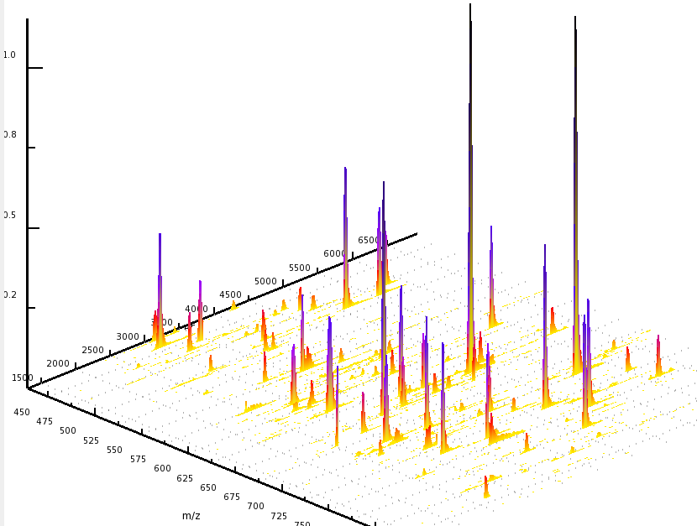
Proof of Principle
Test: 48 protein mix
154 out of the 306 generated transitions showed signals (50%)
As expected, about half of the transitions were successful
Most showed clean signals and good intensities
Bertsch et al., J. Proteome Res. (2010), 2010, 9(5):2696-704
Notes:
We expected that about 50% of the transitions will work. And indeed, about 50% of the transitions generated for the proteins showed a signal.

Slide 37
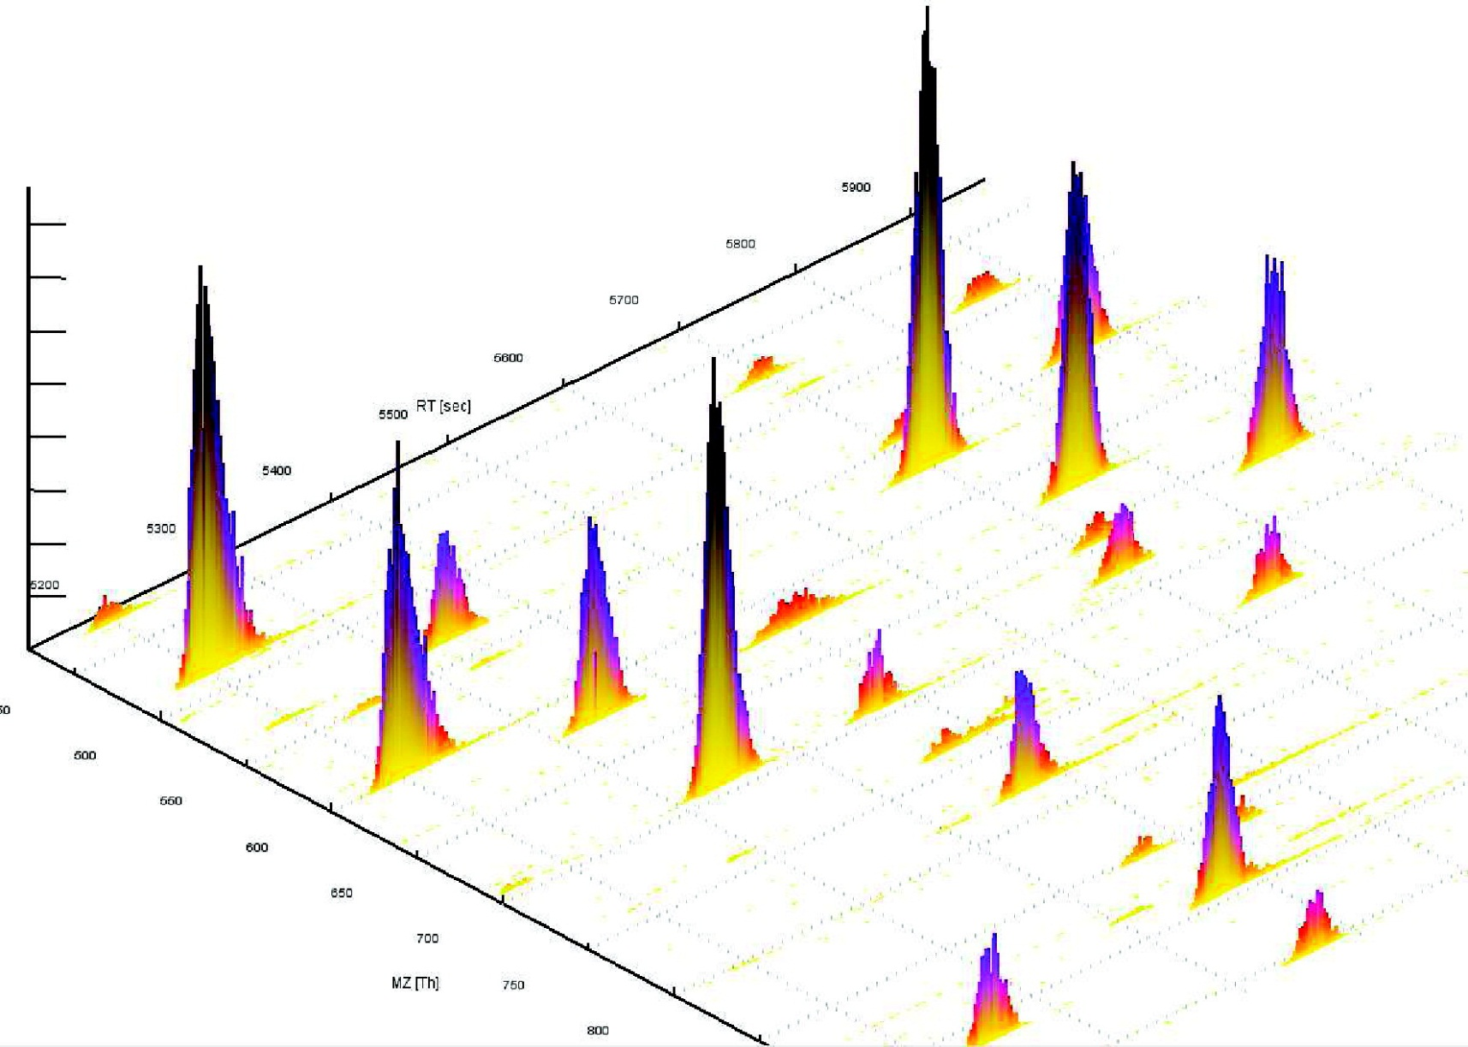
SRM Maps
Small region of the whole pseudo 2D HPLC−MS map of the UPS1 protein mixture sMRM experiment in 3D view. The m/z axis shows the product ion m/z values of the transitions.
Bertsch et al., J. Proteome Res. (2010), 2010, 9(5):2696-704

Slide 38
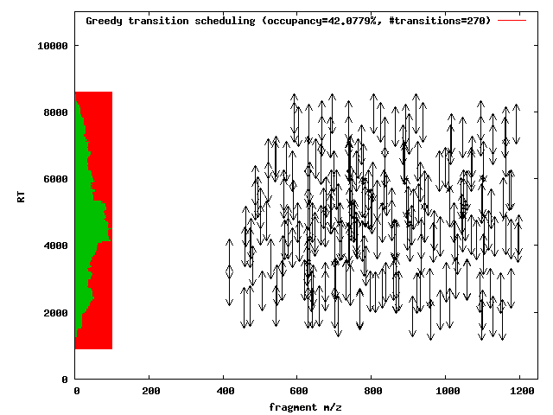
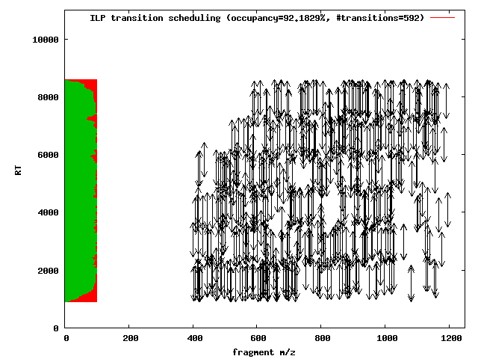
Optimal Scheduling
Combinatorial optimization problem
  Ensure minimum number of transitions per protein
  Maximize the number of transitions measured to increase accuracy and coverage
  Make optimal use of the instrument’s acquisition time
270 Transitions (42% of max)
592 Transitions (92% of max)
Bertsch et al., J. Proteome Res. (2010), 2010, 9(5):2696-704

Slide 39
SRM Analysis – mQuest/mProphet
mQuest/mProphet is a suite of (Perl and R) tools for the analysis of MRM data sets
Input
  Acquired SRM dataset (mzXML)
  Transition list (Excel spreadsheet)
Output
  Quantified proteins
mQuest maps the transition list onto the acquired data
mProphet performs the statistical analysis
  Reiter et al., . Nat Methods. 2011 May;8(5):430-5.

Slide 40
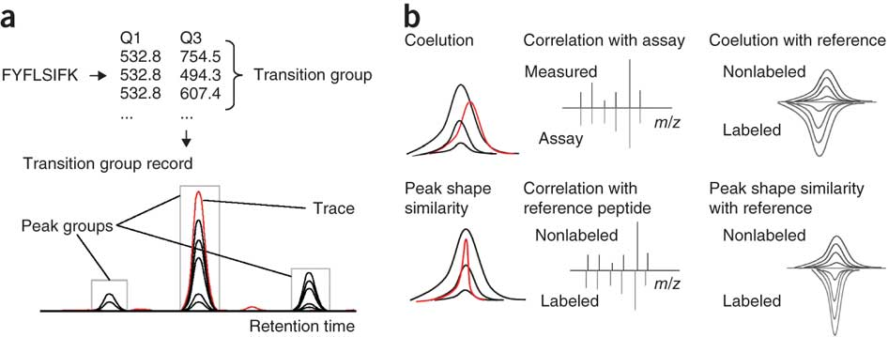
SRM Analysis – mQuest/mProphet
Peak shape scoring
  Transitions caused by the same peptide should have the same peak shape (“coelution”)
  Interferences would most likely show a different shape
  Coeluting peaks in different traces form a peak group
  Reiter et al., . Nat Methods. 2011 May;8(5):430-5.

Slide 41
Scoring
Scoring consists of various subscores
  Coelution – how well do the peaks elute at the same time (and at the same time as the assay reference)
  Peak shape – how well do the peak shapes agree within a peak group
  Peak intensities – how well do relative intensities of the different transitions agree with the reference (the tandem spectrum of the peptide)
Subscores are combined linearly into a complete score and then converted into p-values
Coefficients of the linear combination are adjusted automatically based on the analysis of artificial decoy transitions

Slide 42
Scoring
Coelution
  Compute cross-correlation of each peak of the peak group with each other peak
  Peak RT shift is determined as the maximum of the pair-wise cross-correlation (more robust than difference of peak maxima in noisy signals)
  Mean of these shifts is reported as a score
Peak shape
  Based on the maximum correlation of two peaks as well
Peak intensities
  Pearson correlation coefficient between peak intensities of the peak group and intensities of the corresponding intensities in the reference peptide

Slide 43
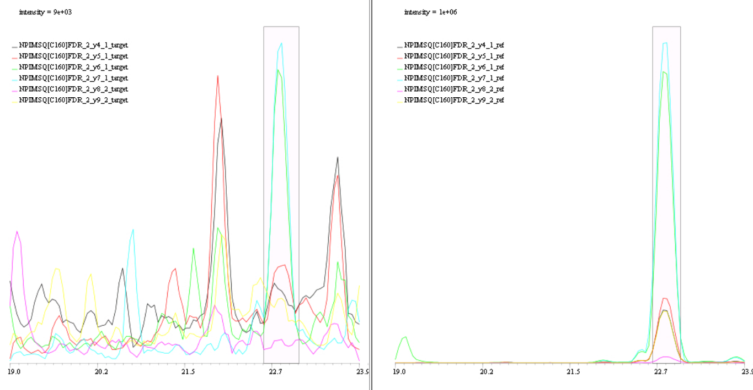
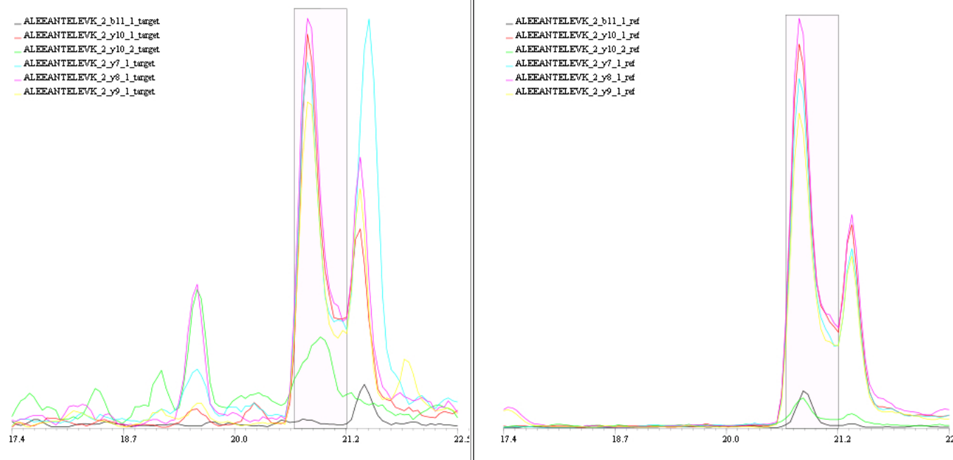
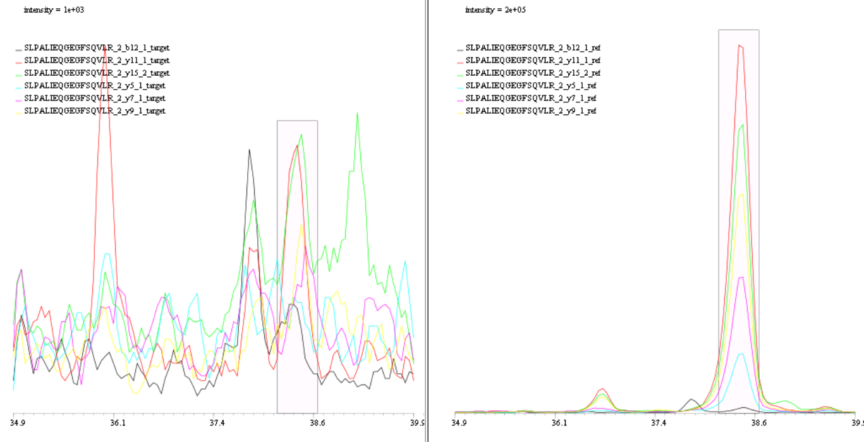
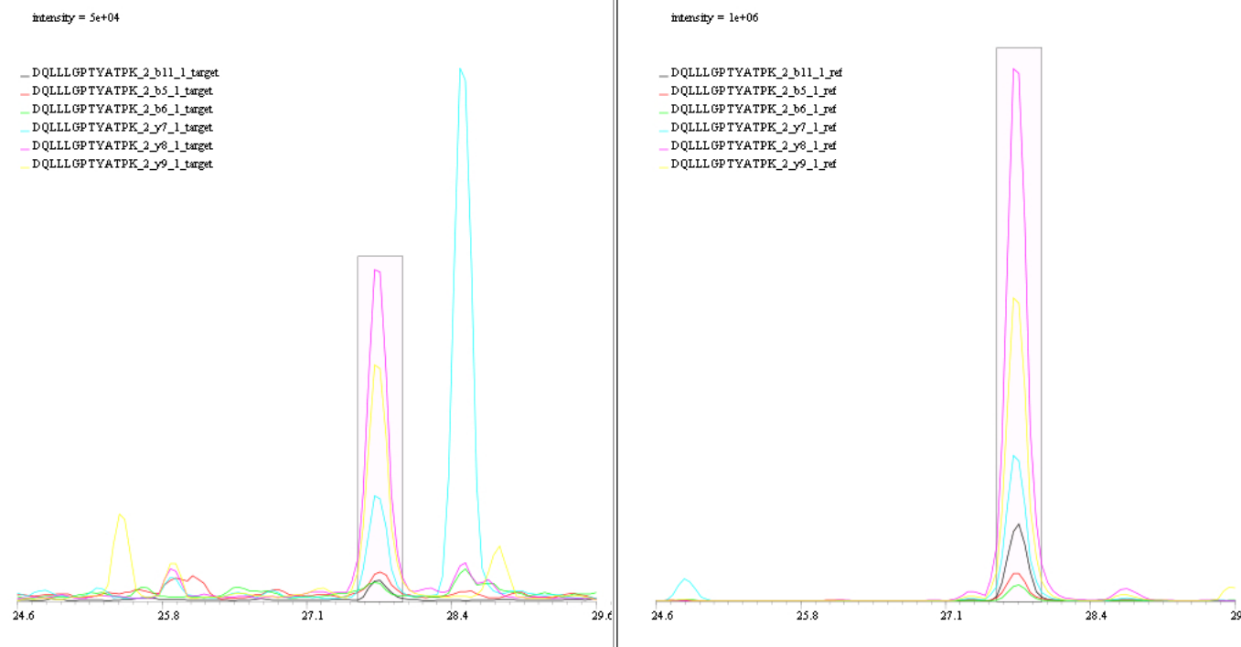
Reality
Real-world MRM traces. Left: measurement from a complex sample, right: reference transition.
  Reiter et al., . Nat Methods. 2011 May;8(5):430-5.

Slide 44
LEARNING UNIT 6C
Comparison of Methods

Slide 45
Spectral Counting
Spectral counting is a trivial quantitation method based on counting tandem MS spectra matching the same peptide
Idea
  If the peptide is more abundant, then it will trigger a tandem spectrum more often
Advantages
  Trivial to implement
Disadvantages
  Depends on instrument settings (dynamic exclusion time)
  No physical basis for the quantification
  Rather inaccurate

Slide 46
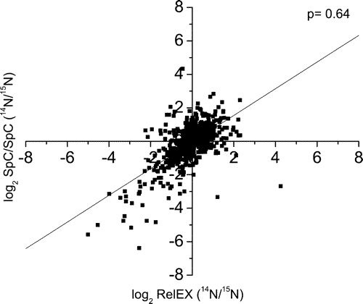
Spectral Counting vs. Labeling
Zybailov et al. compared spectral counting and metabolic labeling (¹⁴N/¹⁵N labeling) in yeast
Both methods – according to the authors – yield good quantification results
“We demonstrate that spectrum counting and mass spectrometry derived ion chromatograms strongly correlate for determining quantitative changes in protein expression. Spectrum counting proved more reproducible and has a wider dynamic range contributing to the deviation of the two quantitative approaches from a perfect positive correlation.”

Slide 47
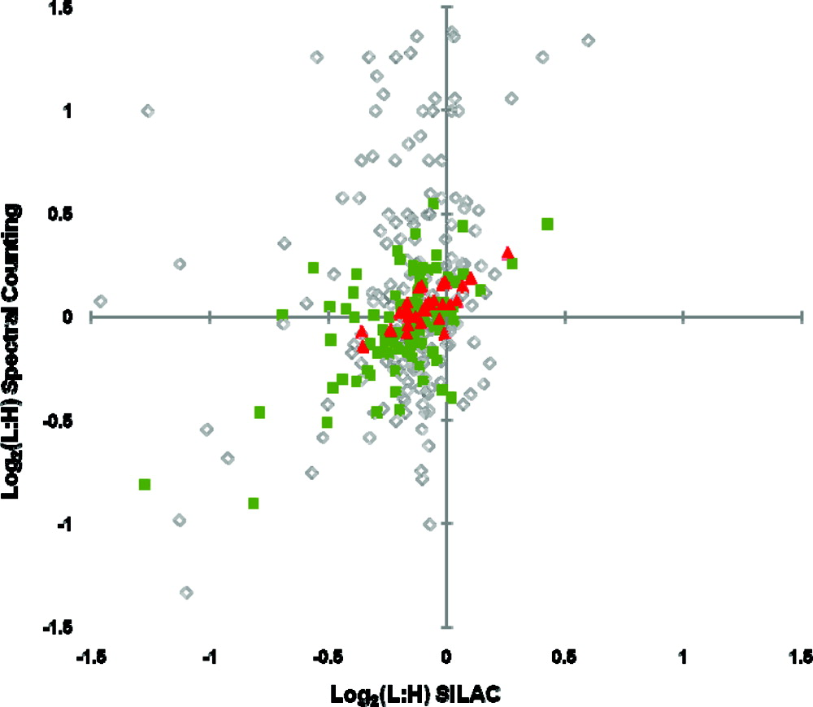
Spectral Counting vs. SILAC
Collier et al. compared SILAC to spectral counting on human embryonic stem cells
“With respect to protein quantification, spectral counting was inherently able to quantify more proteins (885) than SILAC (450), although less accurately unless a 5 spectral count limit was established for protein quantification, reducing the number of proteins quantified by spectral counting to 340. In a normal experimental setting, a label-free strategy allows for double the total protein amount to be analyzed using spectral counting compared to SILAC.”
  Collier et al., Anal Chem. 2010 Oct 15;82(20):8696-702.

Slide 48
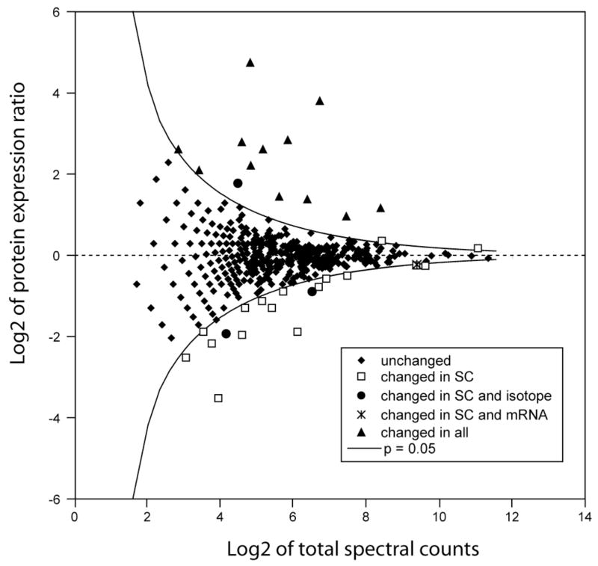
Spectral Counting vs. SILAC
Hendickson et al. compared metabolic labeling to spectral count on microbial proteomes (wt vs. mutant)
“Spectral counting showed lower overall sensitivity defined in terms of detecting a two-fold change in protein expression, and in order to achieve the same level of quantitative proteome coverage as the stable isotope method, it would have required approximately doubling the number of mass spectra collected.”
  Hendickson et al., Analyst. 2006 Dec;131(12):1335-41.

Slide 49
iTRAQ vs. Label-Free
Wang et al. compared iTRAQ labeling and label-free quantification
Chlamydomonas proteome samples were analyzed and four proteins added in various concentrations as internal standards
Samples were analyzed in technical and biological replicate on an Thermo Orbitrap Velos
iTRAQ quantification was performed using MASCOT distiller
Label-free quantification was performed using Progenesis LC-MS
Wang et al., J Proteome Res. 2011 Dec 1. [Epub ahead of print, PMID: 22059437]

Slide 50
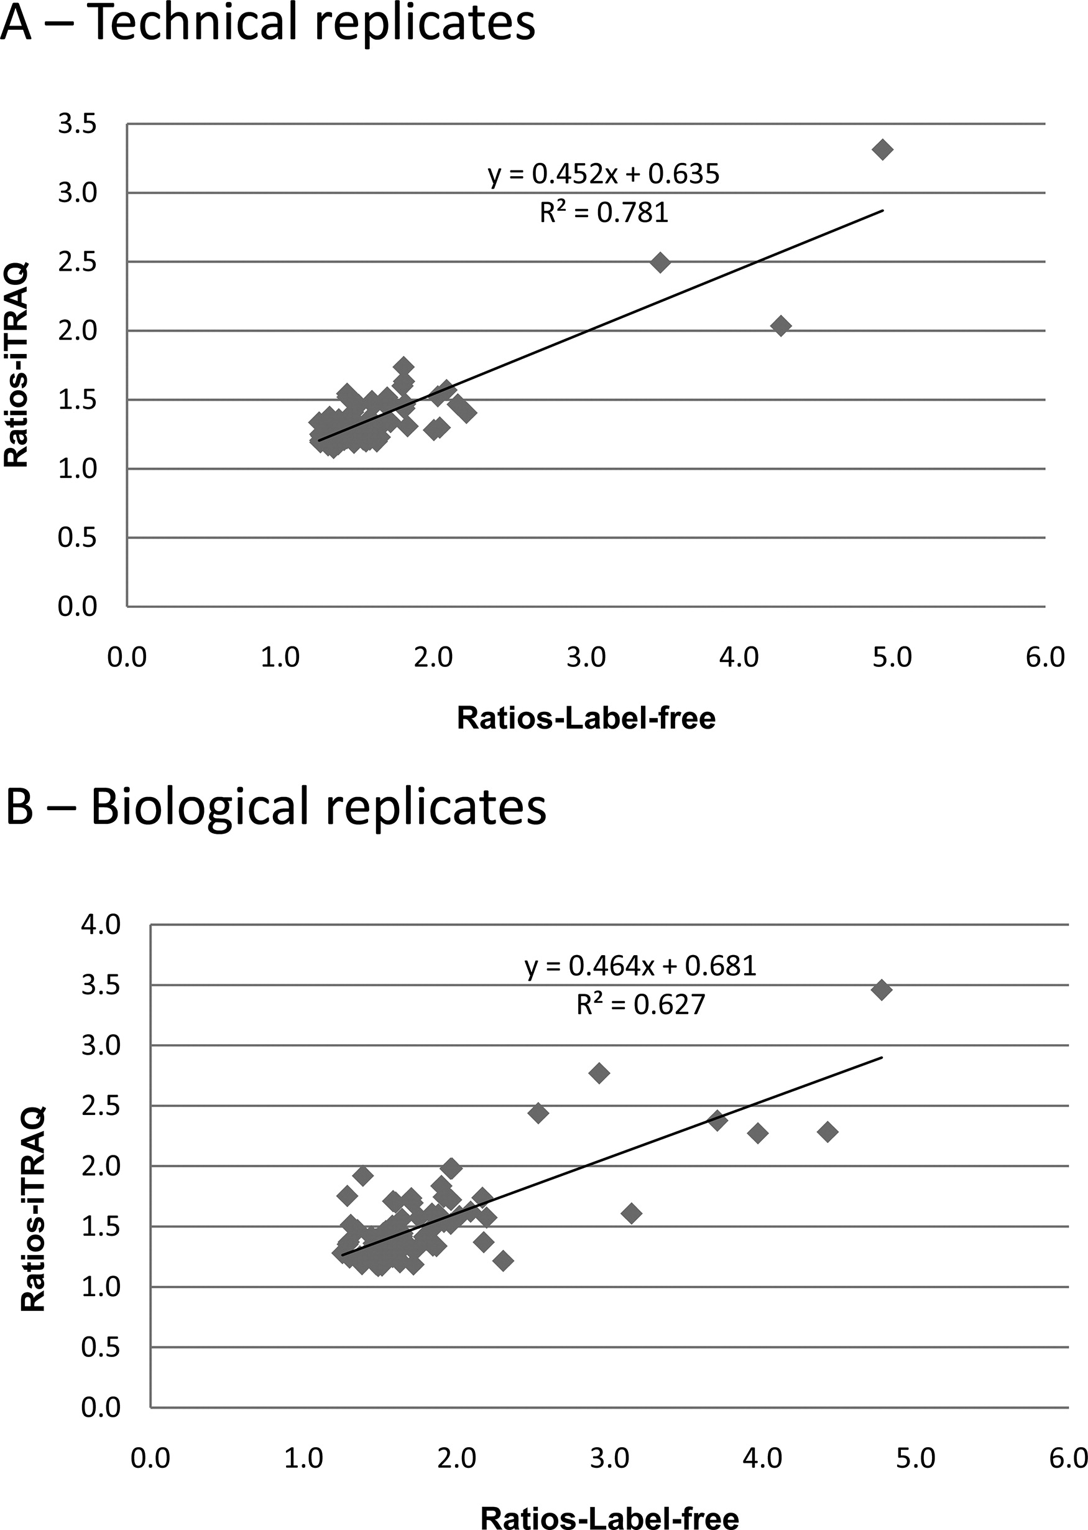
iTRAQ vs. Label-Free
“The comparison between both methods indicates that the label-free method provided better quantitation accuracy for high fold change ratios; however, quantitation precision is better when using iTRAQ. […] The results from both approaches have a good correlation of protein ratios for the commonly quantified proteins; […] iTRAQ, with its higher quantitation accuracy when ratios are close to 1, would allow the identification of smaller changes often times responsible for important biological changes ”
Wang et al., J Proteome Res. 2011 Dec 1. [Epub ahead of print, PMID: 22059437]

Slide 51
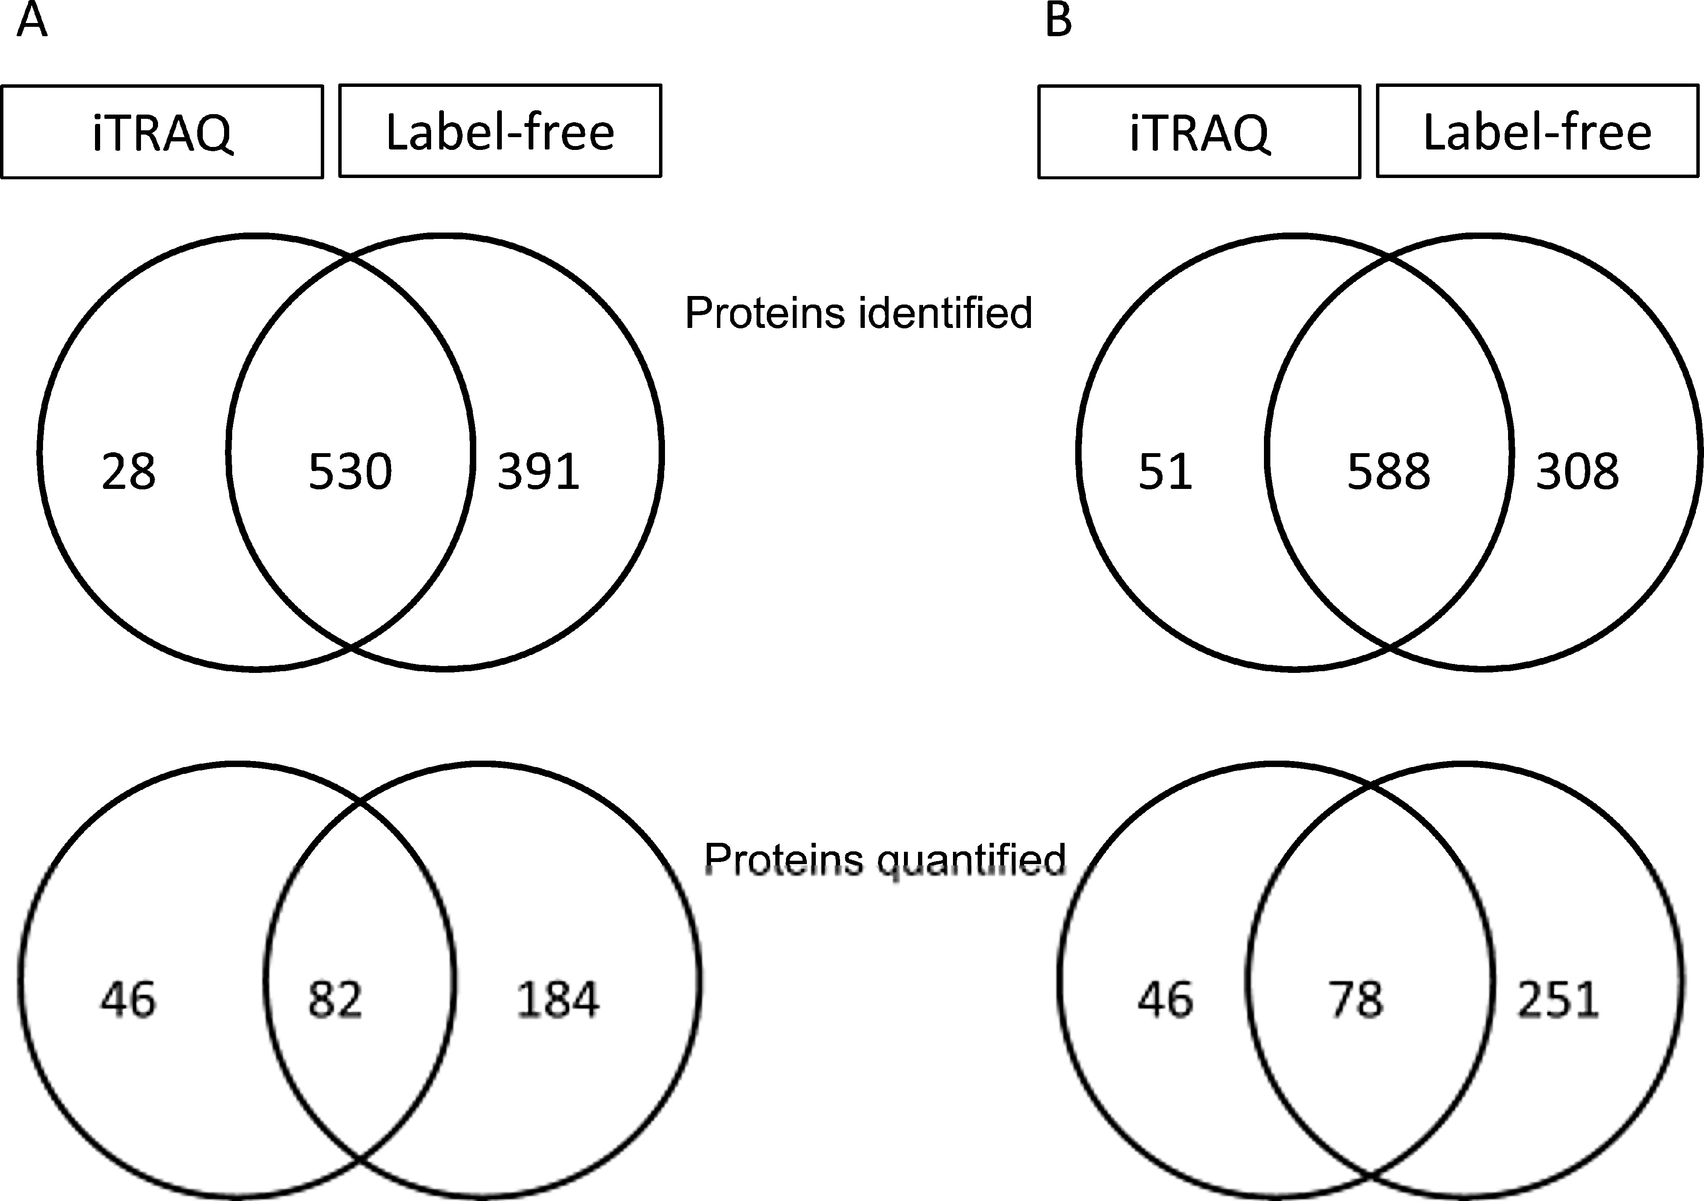
iTRAQ vs. Label-Free
Wang et al., J Proteome Res. 2011 Dec 1. [Epub ahead of print, PMID: 22059437]

Slide 52
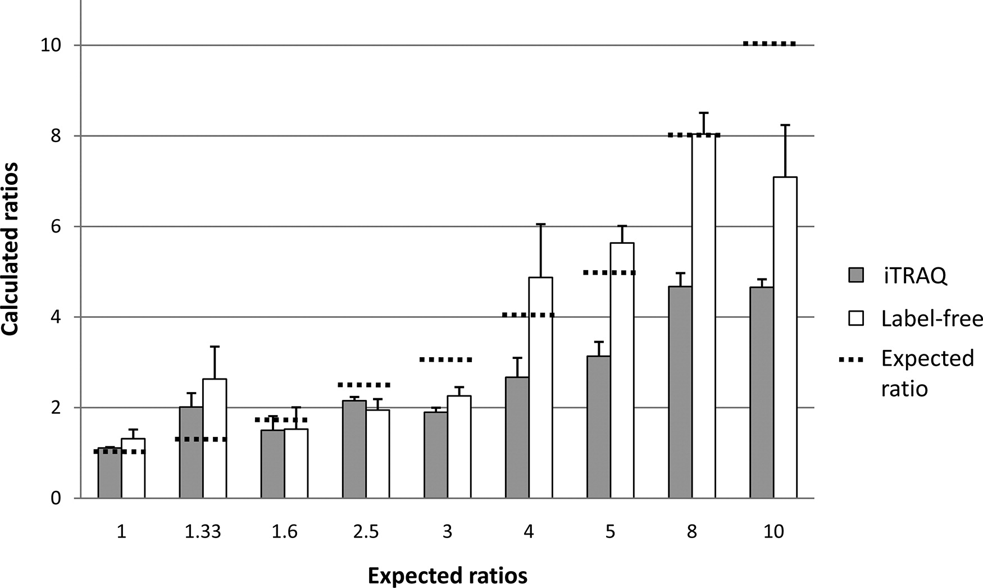
iTRAQ vs. Label-Free
Wang et al., J Proteome Res. 2011 Dec 1. [Epub ahead of print, PMID: 22059437]

Slide 53
Comparison of Methods
Comparison of quantification methods is difficult: few studies really benchmark multiple methods
Most experimental labs have established one or two methods at best
Quantitative proteomics is still pretty much an open field
No standard method has been firmly established yet
Currently, SILAC, and label-free are probably the most ‘popular’ methods, followed by MRM
Choice of the quantification method depends on the application, the available instrument and the available bioinformatics expertise

Slide 54
References
iTRAQ analysis
  Breitwieser FP, Müller A, Dayon L, Köcher T, Hainard A, Pichler P, Schmidt-Erfurth U, Superti-Furga G, Sanchez JC, Mechtler K, Bennett KL, Colinge J., J. Proteome Res., 2011, 10 (6), pp 2758–2766
MRM scheduling
  Bertsch A, Jung S, Zerck A, Pfeifer N, Nahnsen S, Henneges C, Nordheim A, Kohlbacher O. Optimal de novo design of MRM experiments for rapid assay development in targeted proteomics. J Proteome Res. 2010, 9(5):2696-704.
SRM Atlas
  http://www.srmatlas.org/
mProphet
  Reiter L, Rinner O, Picotti P, Hüttenhain R, Beck M, Brusniak MY, Hengartner MO, Aebersold R. mProphet: automated data processing and statistical validation for large-scale SRM experiments. Nat Methods. 2011 May;8(5):430-5.
Skyline package for SRM assay construction/analysis
  Darren Kessner; Matt Chambers; Robert Burke; David Agus; Parag Mallick. ProteoWizard: Open Source Software for Rapid Proteomics Tools Development. Bioinformatics 2008; doi: 10.1093/bioinformatics/btn323
  http://proteowizard.sourceforge.net/downloads.shtml
Comparison of quantification methods
  Zybailov B, Coleman MK, Florens L, Washburn MP. Correlation of relative abundance ratios derived from peptide ion chromatograms and spectrum counting for quantitative proteomic analysis using stable isotope labeling. Anal Chem. 2005 Oct 1;77(19):6218-24.
  Collier TS, Sarkar P, Franck WL, Rao BM, Dean RA, Muddiman DC. Direct comparison of stable isotope labeling by amino acids in cell culture and spectral counting for quantitative proteomics. Anal Chem. 2010 Oct 15;82(20):8696-702.
  Hendrickson EL, Xia Q, Wang T, Leigh JA, Hackett M. Comparison of spectral counting and metabolic stable isotope labeling for use with quantitative microbial proteomics. Analyst. 2006 Dec;131(12):1335-41.
  Wang H, Alvarez S, Hicks LM.Comprehensive Comparison of iTRAQ and Label-free LC-Based Quantitative Proteomics Approaches Using Two Chlamydomonas reinhardtii Strains of Interest for Biofuels Engineering. J Proteome Res. 2011 Dec 1. [Epub ahead of print, PMID: 22059437]
Quantification in general
  Bantscheff et al., Quantitative mass spectrometry in proteomics: a critical review, Anal Bioanal Chem (2005), 389, 1017-1031 [PMID: 17668192]

Slide 55
Materials
Online Materials
  Learning Unit 6A, B, C

