Slide 1
Seq(uence) An(alysis) in KNIME
Temesgen H. Dadi
Freie Universität Berlin
SeqAn Workshop - KNIME Spring Summit Berlin
March 17, 2017

Slide 2
What is SeqAn?
An open source C++ library
Efficient algorithms and
Data structures
For Sequence Analysis
Focuses on biological data.
A unique generic design
www.seqan.de
Notes:
SeqAn is an open source C++ library of efficient algorithms and data structures for the analysis of sequences with the focus on biological data. Our library applies a unique generic design that guarantees high performance, generality, extensibility, and integration with other libraries. SeqAn is easy to use and simplifies the development of new software tools with a minimal loss of performance.

Slide 3
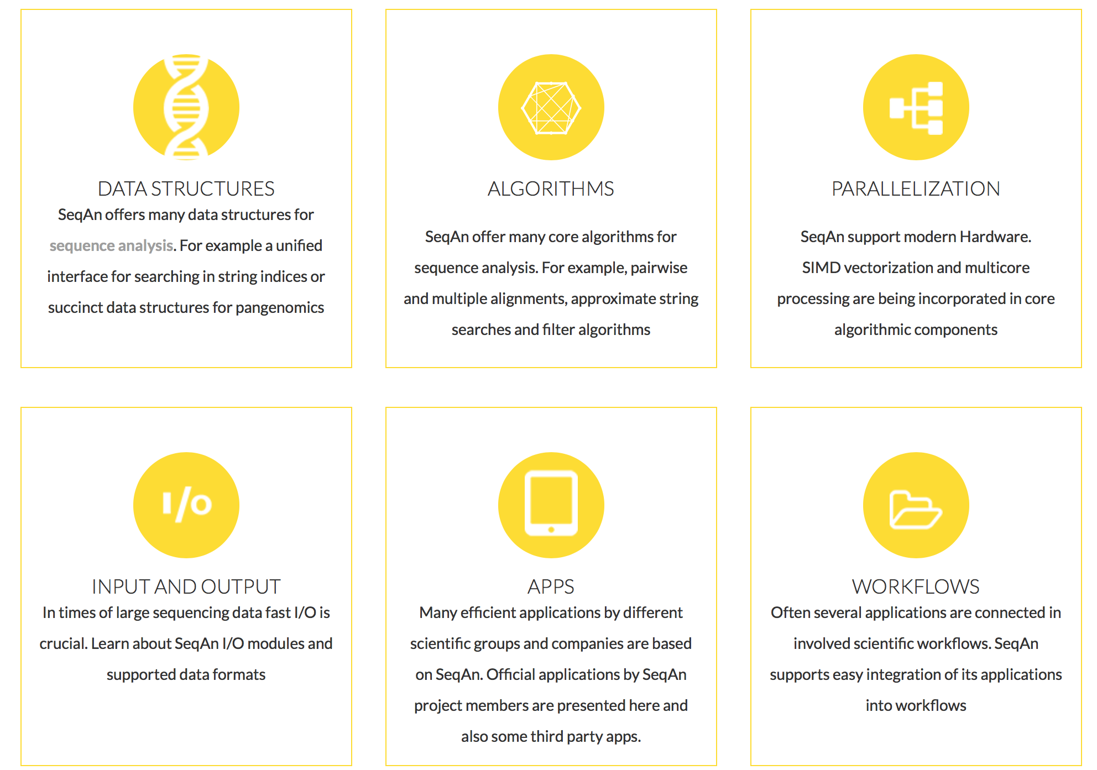
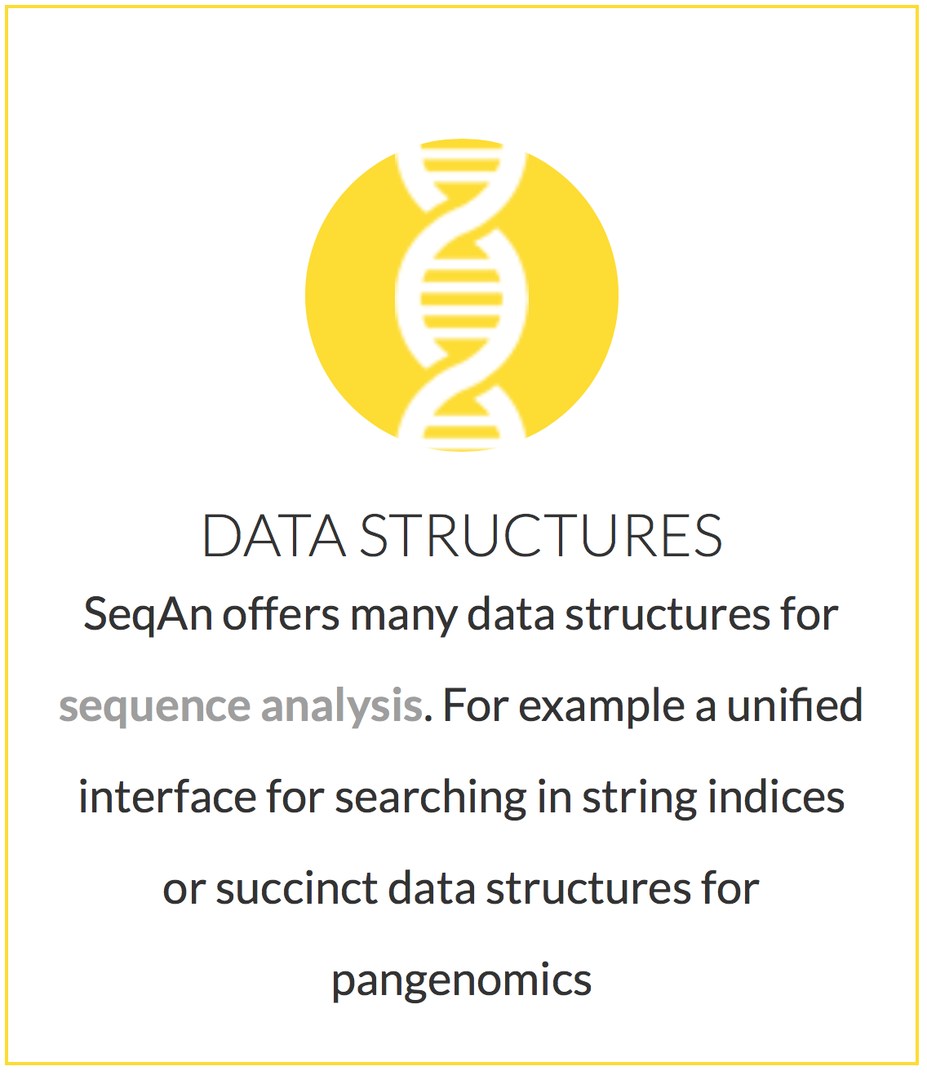
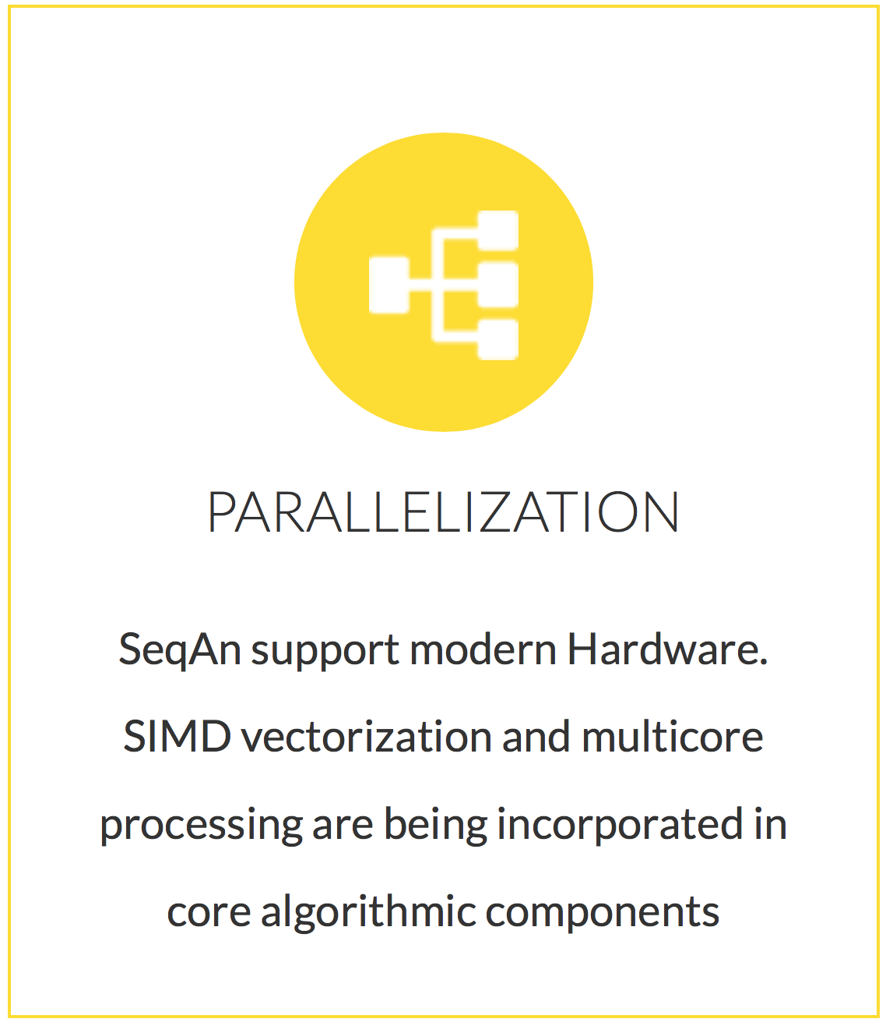
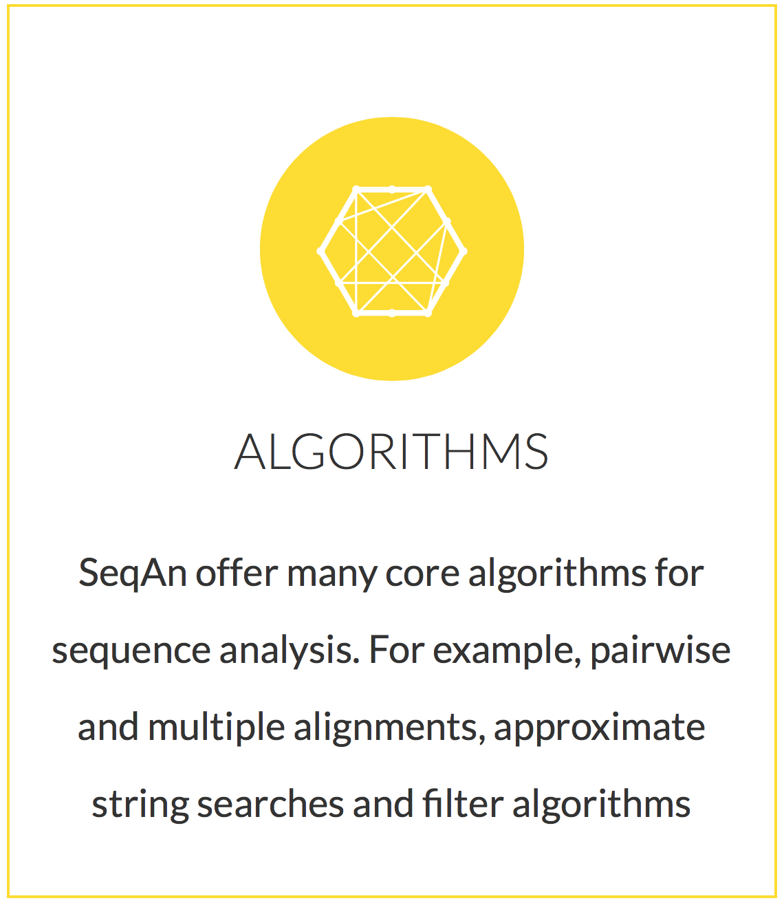
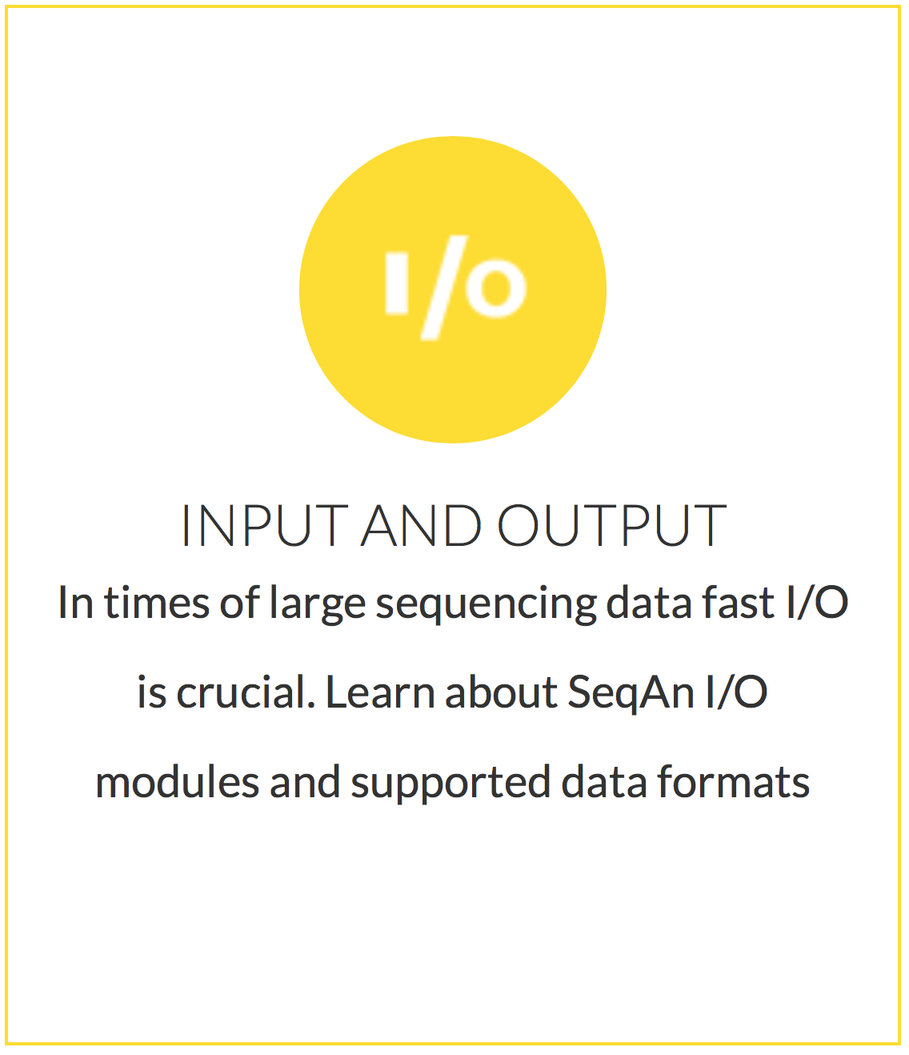
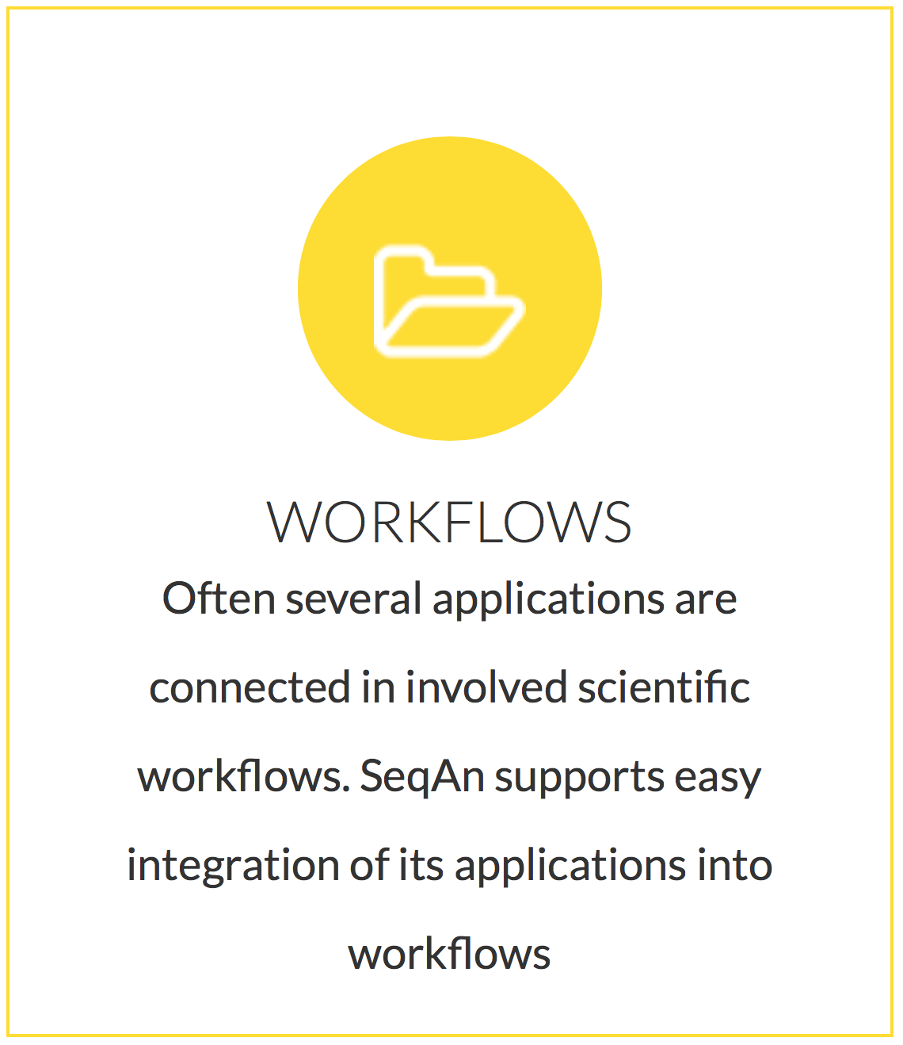
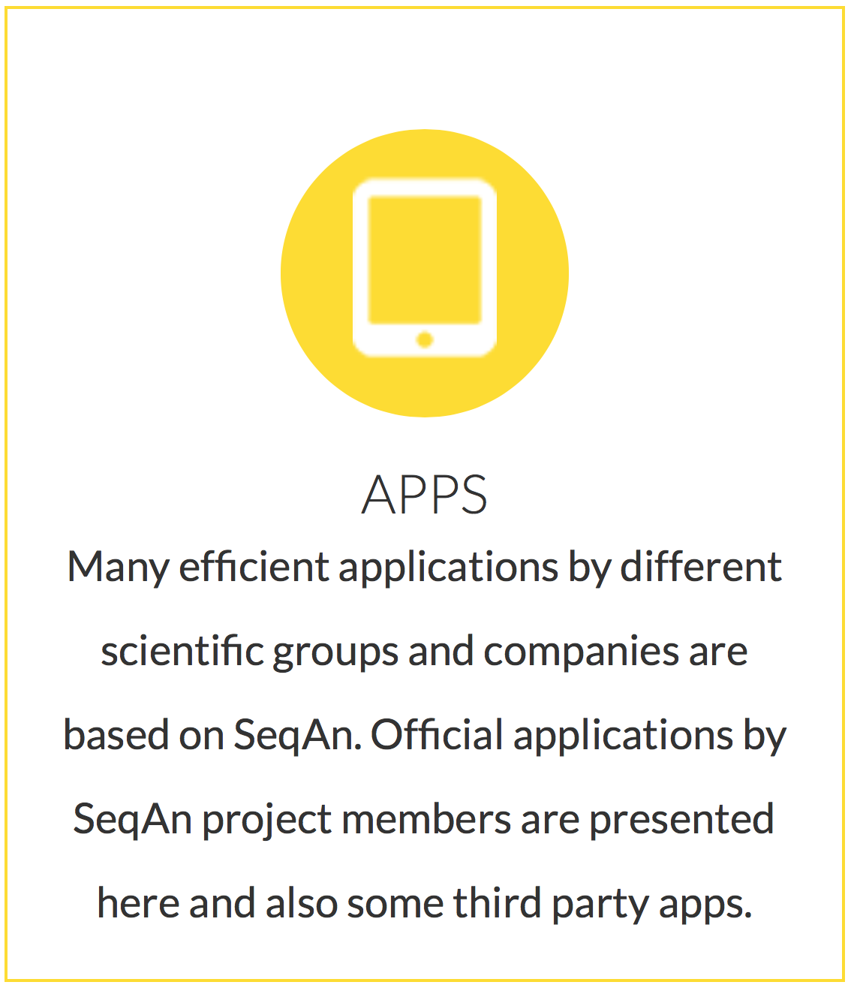
What does SeqAn offer?

Slide 4
How do I get SeqAn APPs in KNIME
As community-contribution nodes
Update site:
http://update.knime.org/community-contributions/trusted/3.3
Platforms Supported:
Linux, MacOS and Windows (Partially)

Slide 5
Demo

